Slide 1

RIWS: Resilience scenarios for integrated water systems
Ana Mijic and Leyang Liu
Department of Civil and Environmental Engineering
DAFNI Conference 2024

Slide 2

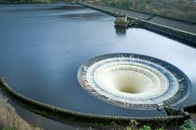
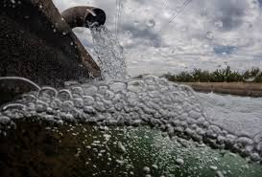

Integrated Water System and RIWS
People, land and water
Water supply system
Integrated
Water System
Wastewater system
River environment

Slide 3
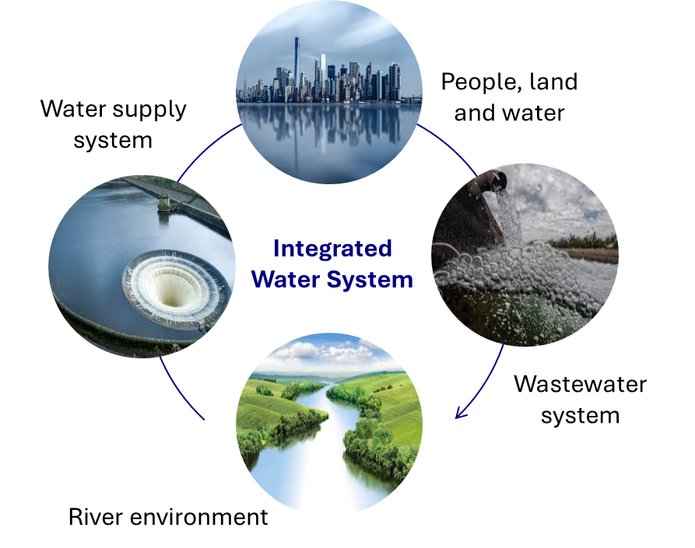
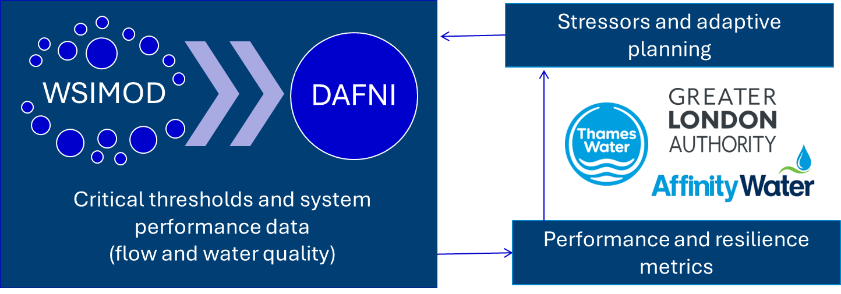
Integrated Water System and RIWS

Slide 4
RIWS timeline and progress
Oct
2023
Jan
2024
Apr
2024
Jul
2024
Oct
2024
Jan
2024
Apr
2024
Technical development
WSIMOD (Base) uploading
WSIMOD (Extensions and advanced customisation) uploading
Journal publication submitted
Resilience assessment
Manuscript to be submitted
Research
Adaptive planning and deep uncertainty
Engagement
Stakeholder workshop
Stakeholder workshop

Slide 5
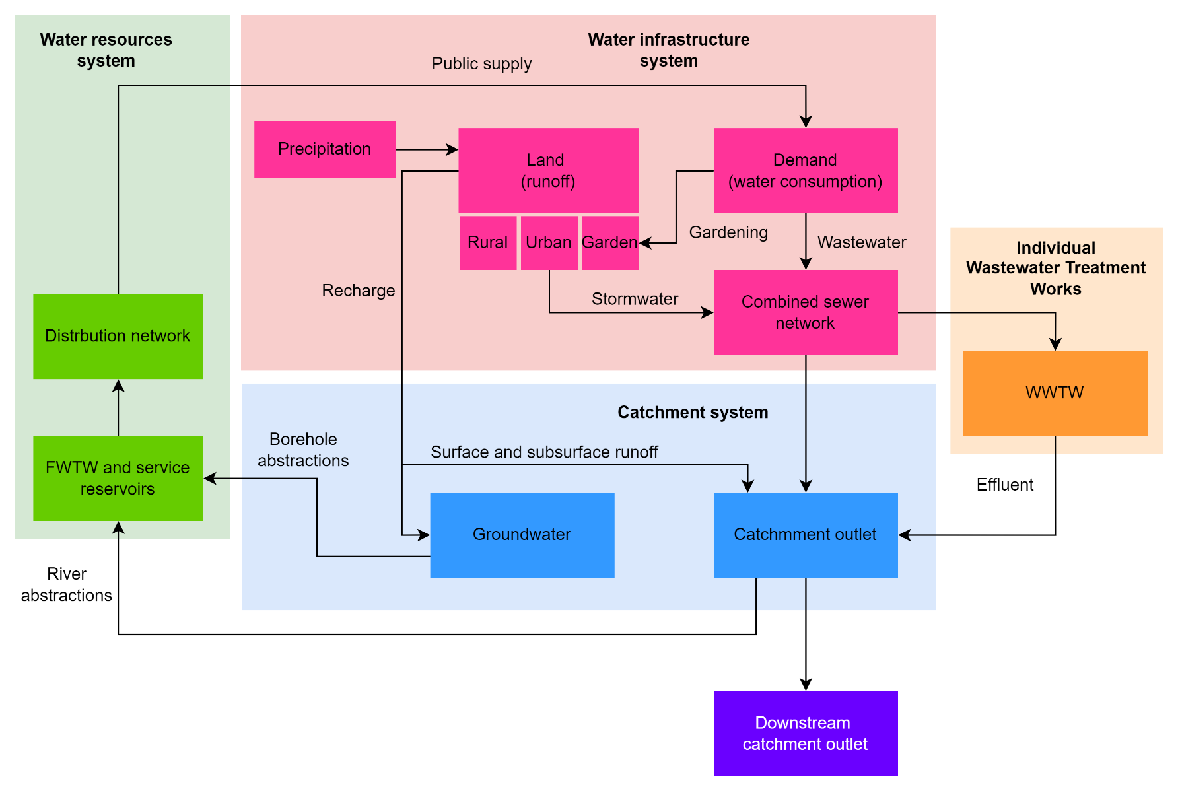

WSIMOD Framework
Highly flexible whole-water system modelling Python open-source software
WSIMOD generic configuration
Catchment outlet

Slide 6
Part 1: Resilience
Submitted for review

Slide 7
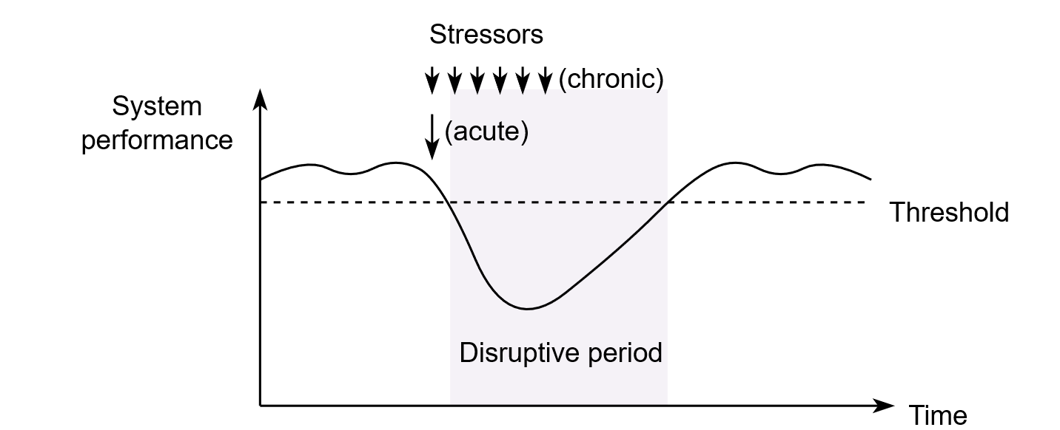
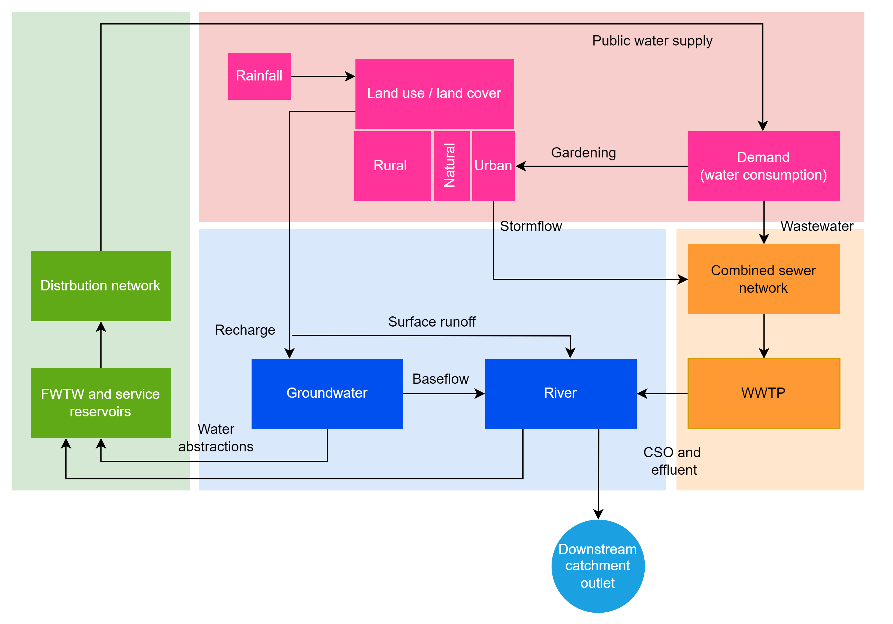
Water Systems Integration Resilience Assessment Framework
Integration across metrics, time and water system components
A. Unified definition of dynamic resilience with a two-level threshold
C. Unified evaluation for multiple water system components
Vulnerable threshold
Critical threshold
b
a
c
B. Unified definition of performance and resilience metrics
1) Abstractions/demand balance (Demand)
2) Groundwater availability (Groundwater)
3) CSO ammonia concentration (CSO)
4) Sewer flooding (Sewer)
5) High flows (Flood)
6) Low flows (Drought)
7) River water quality (Phosphate)
8) River water quality (Nitrate)
Event-level
3
Annual-level
System-level

Slide 8
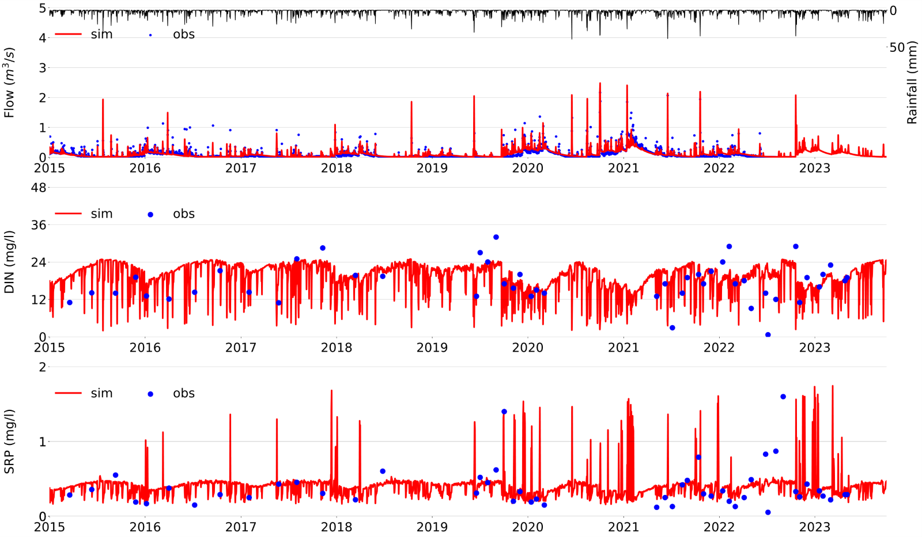
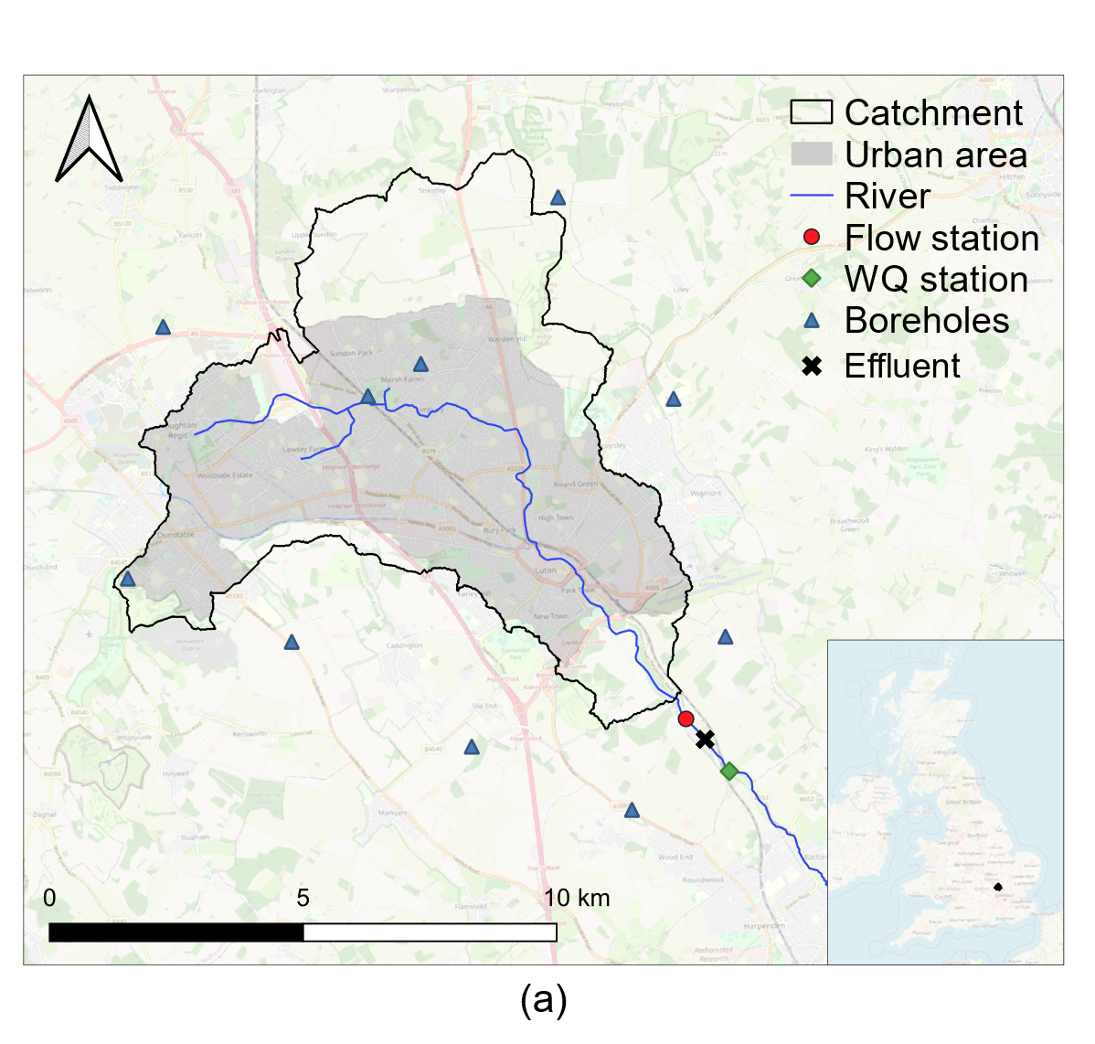
Case study – Luton catchment, UK
Simulations using WSIMOD
NSE = 0.6
PB = 9%
PB = -2%
8-year simulation period

Slide 9

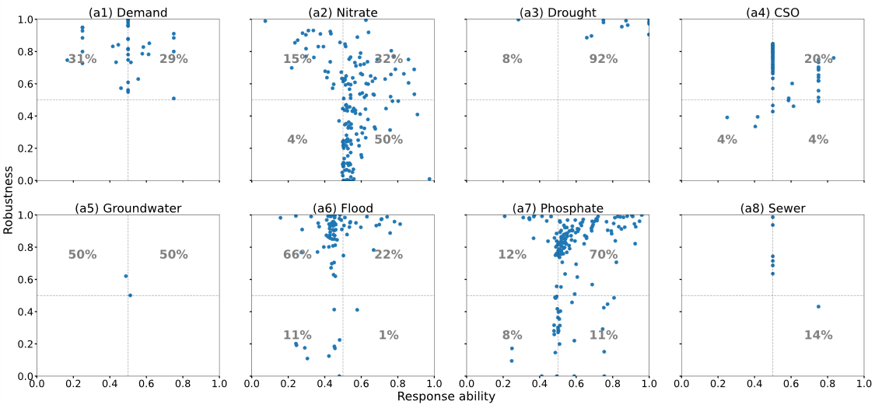

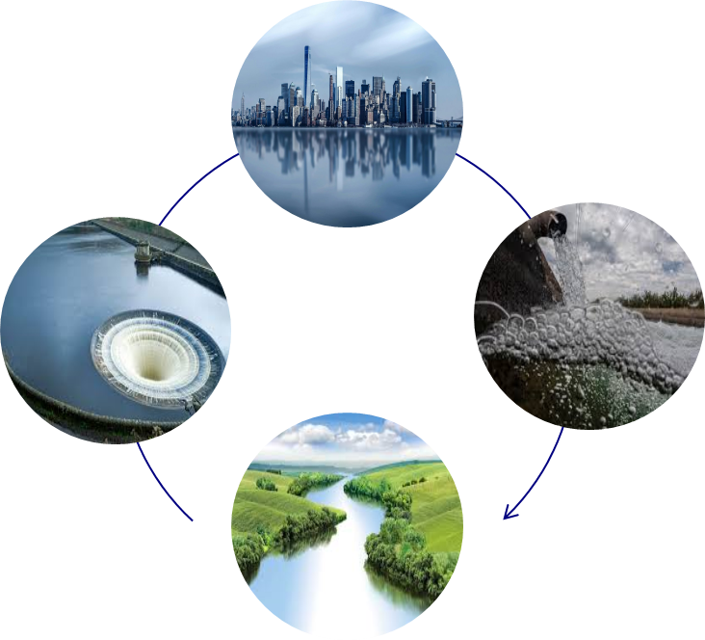
Resilience assessment per water system component
Event-level: response and robustness variability across the system
Robustness
Response

Slide 10
Resilience assessment per water system component
Event-level: response and robustness variability across the system
Robustness
92%
66%
Flood indicators show low loss of functionality but slower recovery, making the system highly vulnerable for extreme events
Response
Luton low flow and phosphate indicators show strong resistance and recovery
11%
70%
Significant losses of functionality for P and N that occur due to the high pollution peaks
11%
50%

Slide 11
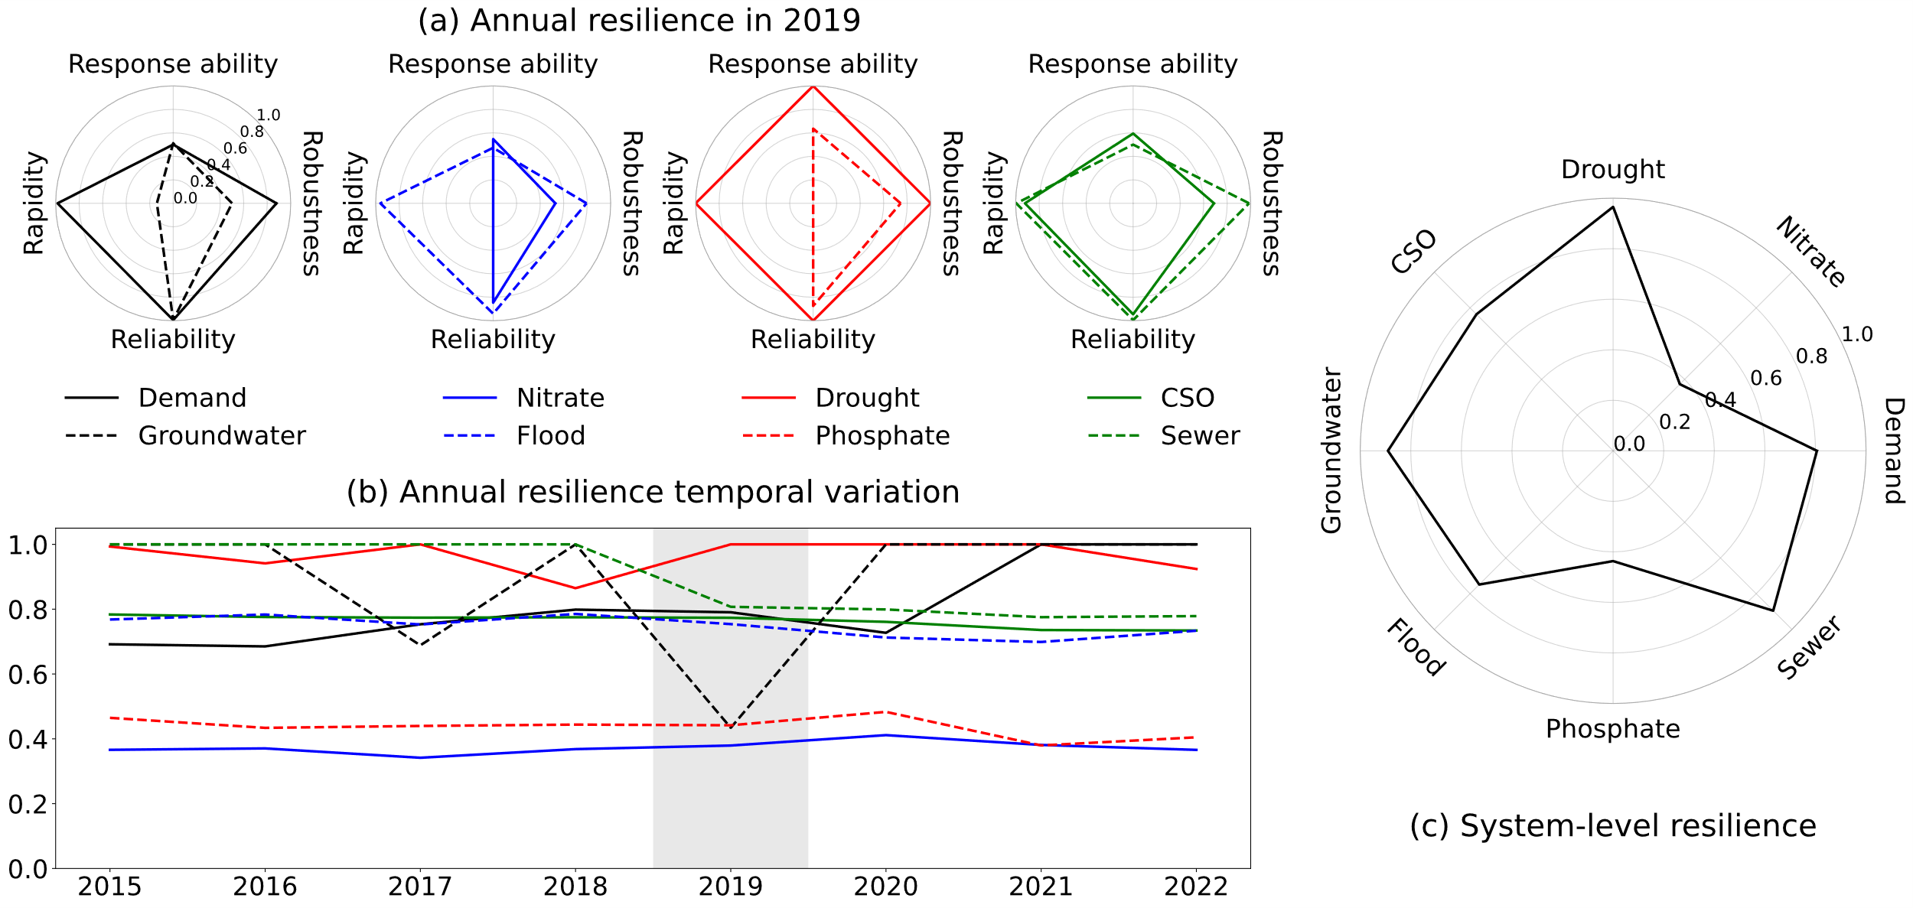
Resilience assessment – aggregation
Annual per component and the system level
In 2019, resilience was more affected for groundwater resources and water quality than surface water flow aspects of the IWS
When the resilience metric is aggregated as a system level, it is clear which components of an IWS have been designed with resilience in mind

Slide 12
Part 2: Adaptive planning
Work in progress

Slide 13
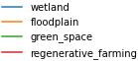
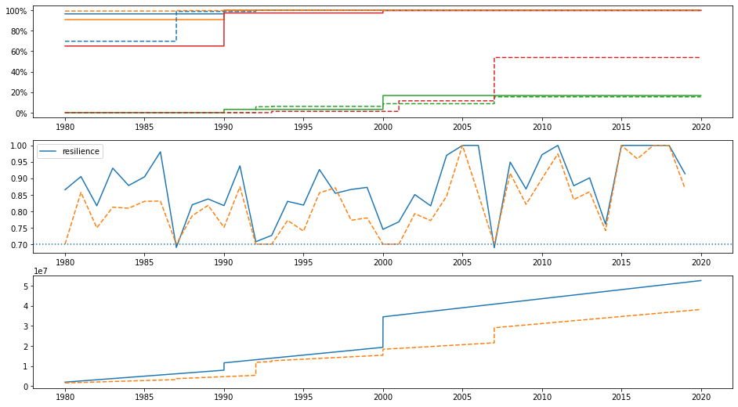

The novel multi-stage adaptive planning
Multi-stage
Most ideal
Flood resilience example
(Scaled) Size of interventions
Flood resilience
Within the predicted range of climate uncertainty:
How my system performs without portfolio of interventions?
Implement
and
monitor
Costs
Business-as-usual (BAU) resilience
How each designed portfolio performs?
Preferences
Portfolio resilience

Slide 14
Part 3: What next
Work in progress

Slide 15

Benefits and potential impact of RIWS approach
Stakeholder engagement through communications of resilience assessment findings
Environment Agency:
Implications for resilience of aquatic ecological systems
Affinity Water:
'Criticality' in water supply systems
Consider groundwater abstraction license as an intervention rather than uncertainty
Great London Authority:
Recommended guidelines for uncertainty projections
Consensus
A new method for enabling resilience intercomparison between subsystems​
Agree on the finding that river water quality has the least resilience
Thames Water:
Assessment locations for river water quality
Mott MacDonald:
Take future planned interventions into account​ for adaptive planning

Slide 16

RIWS to support UK policy in water systems resilience planning?
People, land and water
Water supply system
“Support the delivery of a systems approach to water with models of the integrated water system, aligned with the UK’s implementation of the Water Framework Directive.”
Integrated
Water System
Wastewater system
River environment
https://www.the-ies.org/resources/environmental-science-transform-sustainable-wellbeing

Slide 17

Thank you ana.mijic@imperial.ac.uk leyang.liu16@imperial.ac.uk
DAFNI Conference 2024

Slide 18
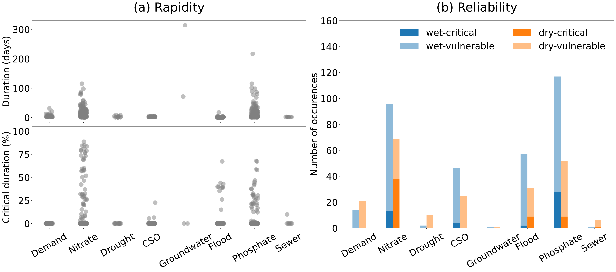
Resilience assessment per water system component
Event-level: rapidity and reliability
Lower and less variable, the better
Extreme events – groundwater drought > 300 days
Long duration of pollution events
Chronic versus
acute issue
High % of below critical threshold events

Slide 19
Resilience assessment per water system component
Event-level: rapidity and reliability
Lower and less variable, the better
Extreme events – groundwater drought > 300 days
Frequent versus infrequent issue
Flooding happening during dry season as well
Long duration of pollution events
Chronic versus
acute issue
High % of below critical threshold events
Frequent issues with flooding and water quality
dry (May-October)
wet (November-April

