Slide 1





STORMS: Strategies and Tools for Resilience of Buried Infrastructure to Meteorological Shocks
Xilin Xia, Nikolaos Reppas, Ali Mashhadi, Phatharaphong Yensri
Soroosh Sharifi, Asaad Faramarzi, Nicole Metje, David Hannah
University of Birmingham
Steven Cole, Bob Moore, Adam Griffin, Alison Kay, Steven Wells
UK Centre for Ecology & Hydrology
Andrew Hughes
British Geological Survey
DAFNI Annual Conference 2024

Slide 2
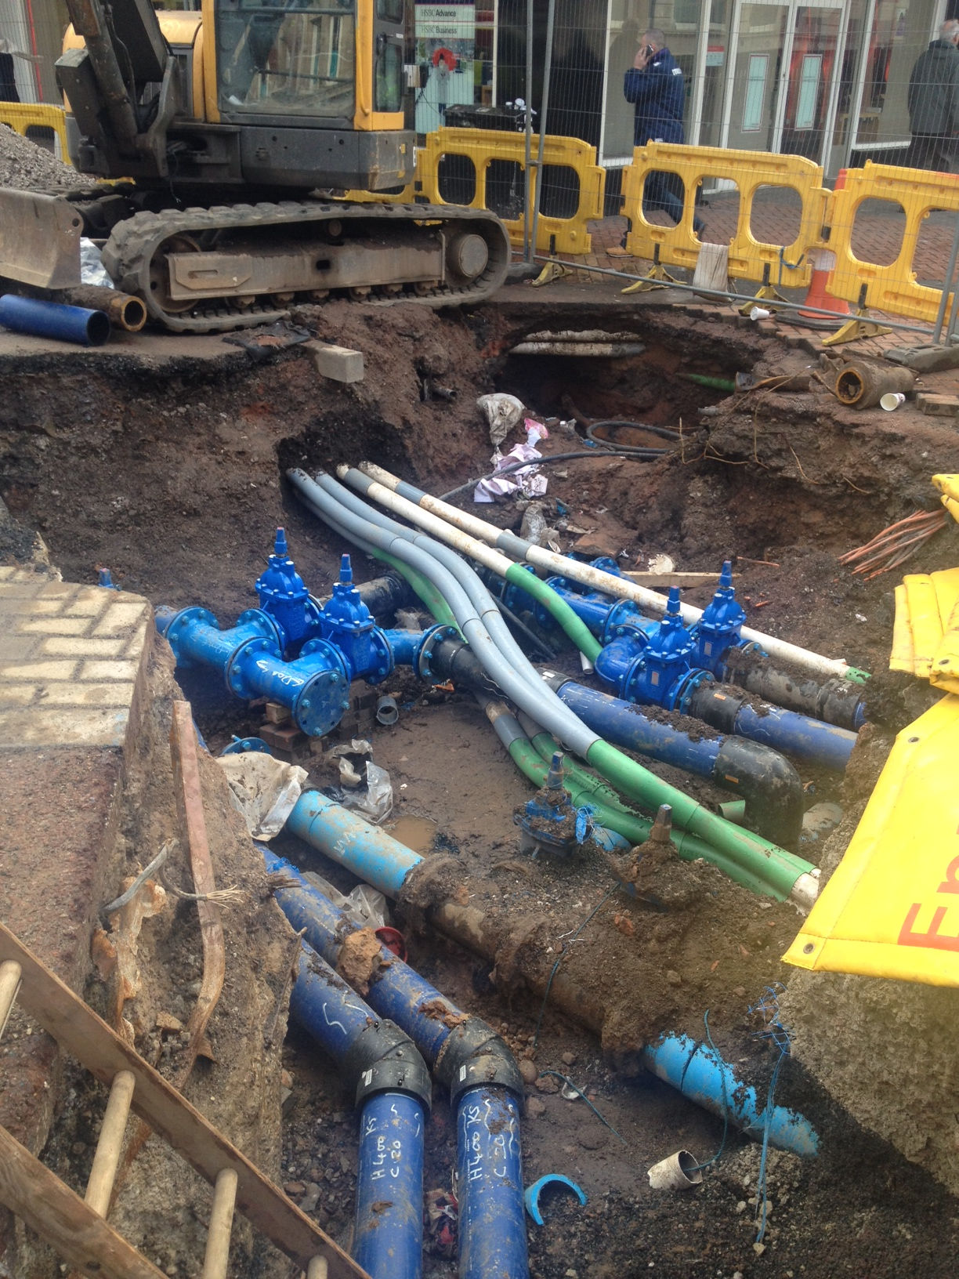
Why buried Infrastructure?
Buried infrastructure provides essential services: Water, Energy and Communication

Slide 3
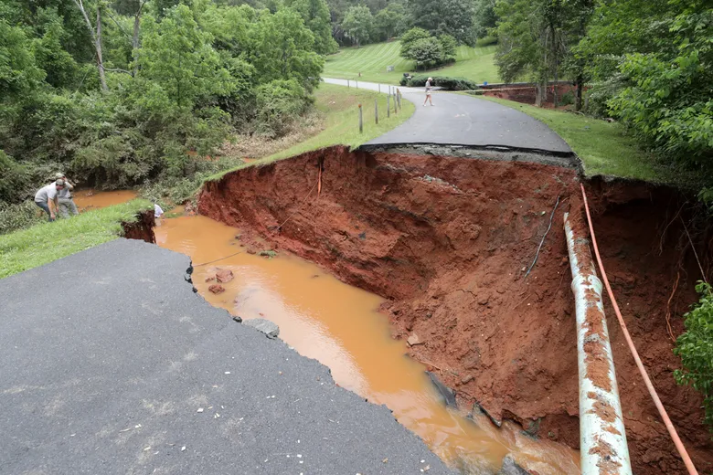
Climate and weather impacts
Damages to buried infrastructure is costly – over £2.4 billion per year
Flooding and river/coastal erosion
Differential ground movement due to
  Wet-dry cycle
  Freeze-thaw cycle
Both types of impacts are listed in 3rd round of Adaptation Reporting Power (ARP3) and CCRA3
No national-scale risk assessment tool
No quantitative climate impact projections (CCRA3)
Barton et al. (2019)

Slide 4
Aim and progress so far
Develop a comprehensive weather-related risk assessment framework to understand the potential impacts of scenarios under both current and future climate
Co-develop adaptation measures with stakeholders to increase resilience to extreme weather events and climate change
Progress so far
  Defined impactful weather/climate scenarios and confirmed them by sensitivity analysis
  A framework for climate risk assessment for buried pipes on DAFNI
  Engagement with stakeholders (Cadent Gas, LSBUD, Thames Water and Northumbrian Water) and received feedback from them

Slide 5
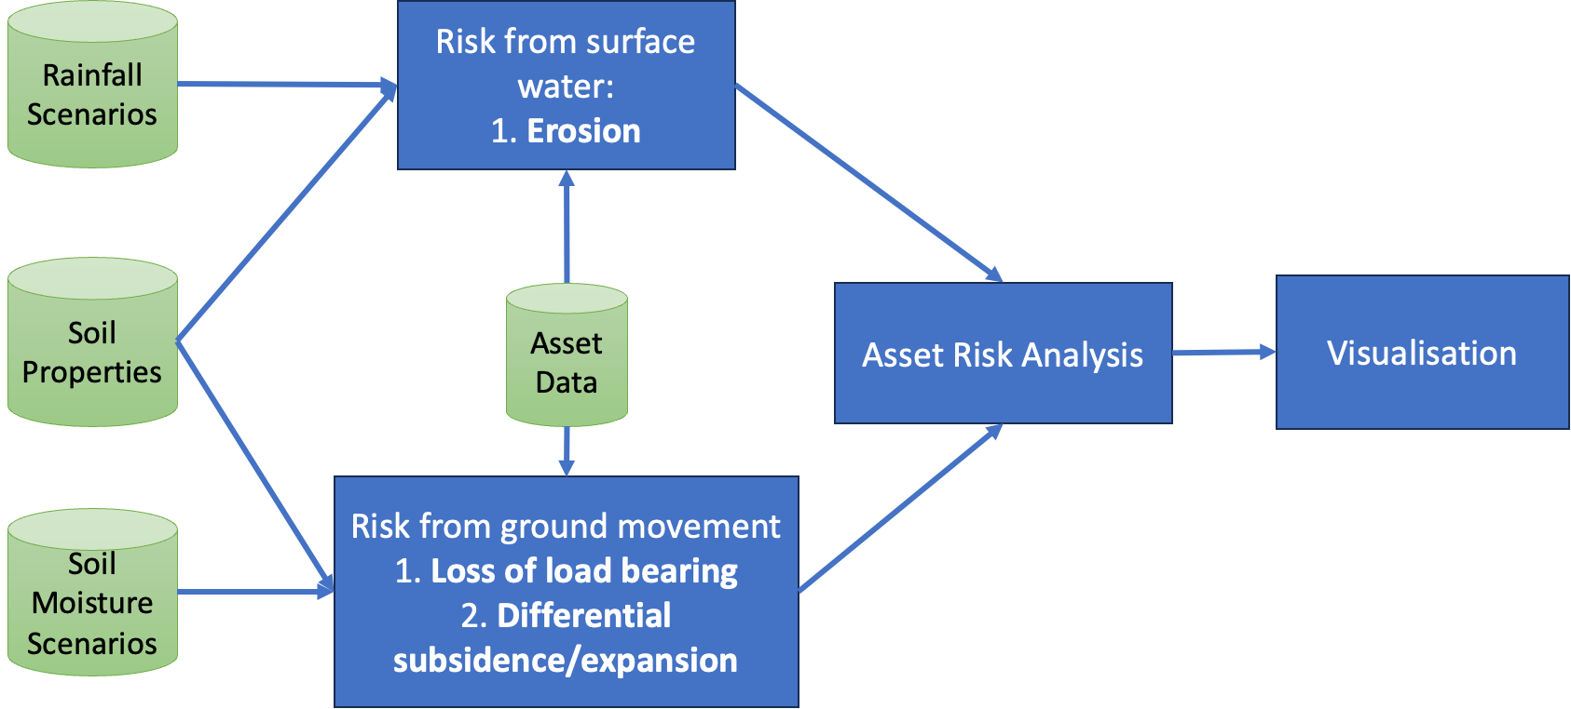
Climate Risk Assessment Model Overview

Slide 6
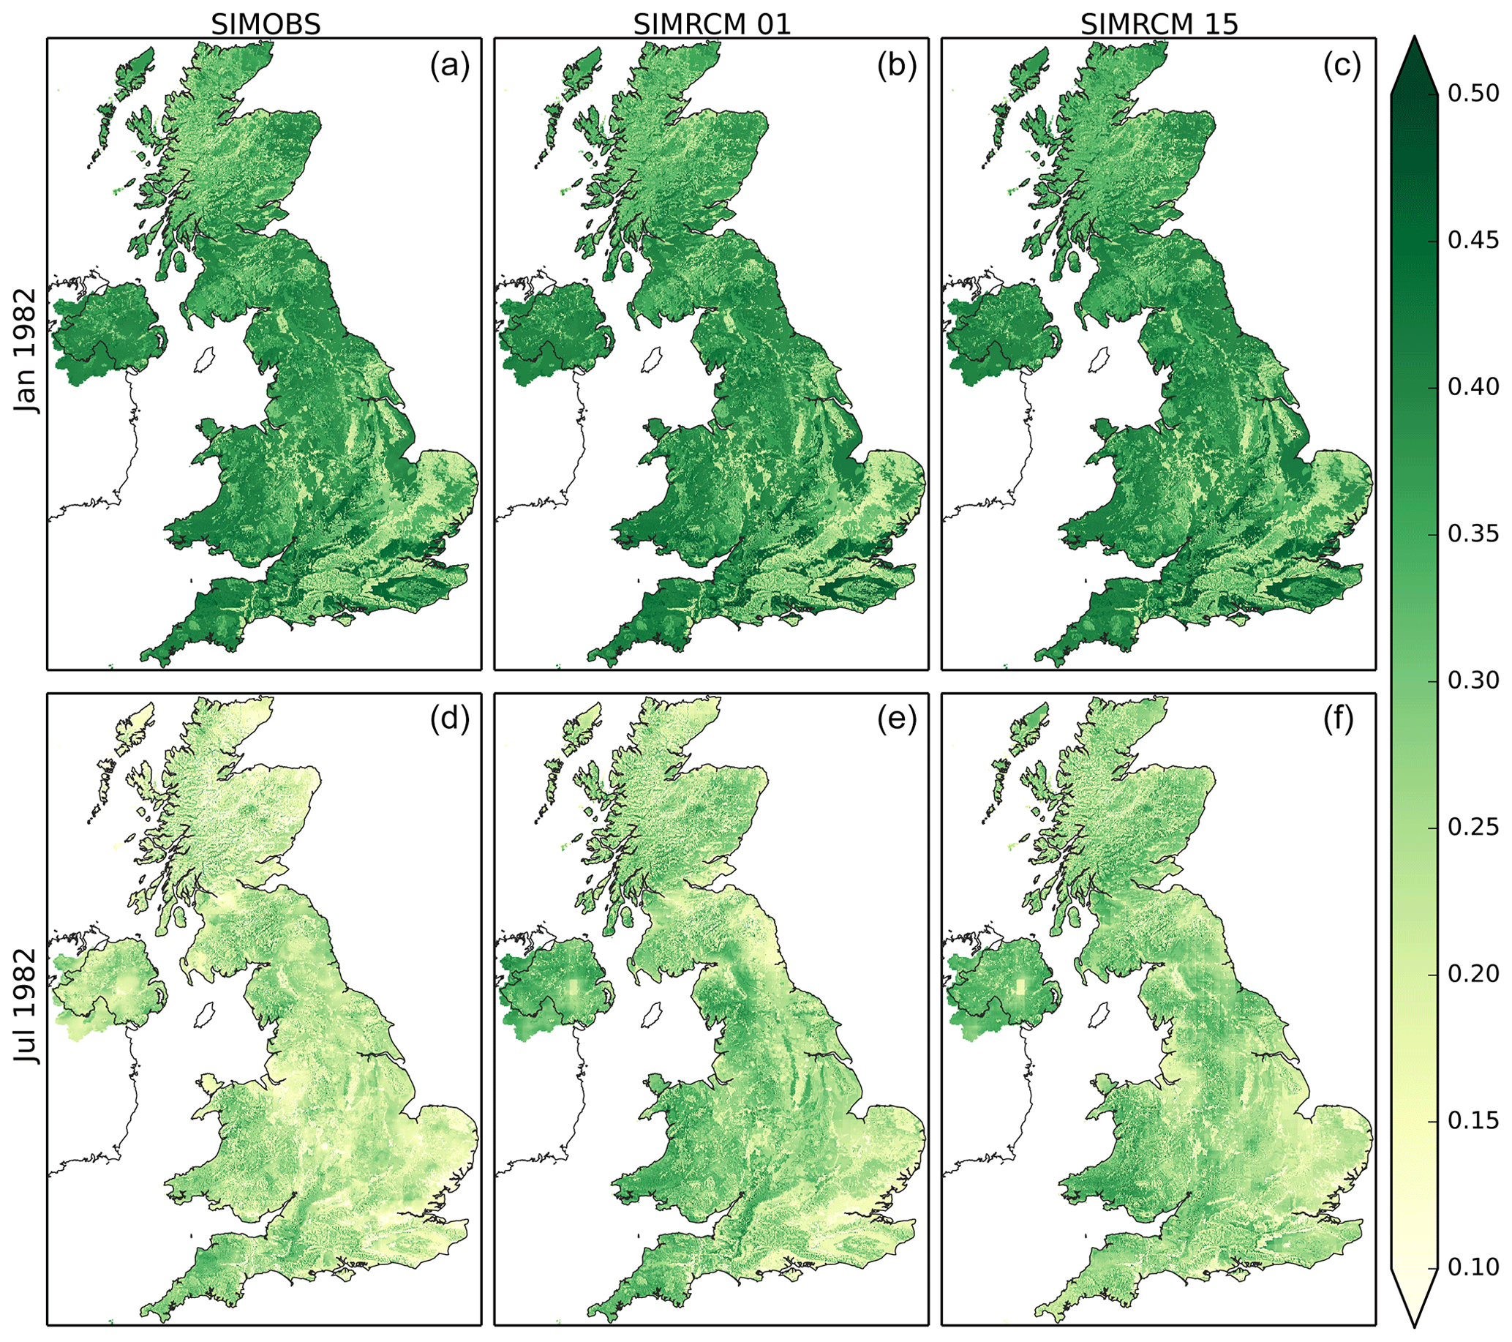
UKCP18 Soil Moisture Data
Probabilistic Climate Projection for RCP 8.5 (UKCP18)
Monthly mean soil moisture product (Kay et al., 2023) from UKCEH, based on UKCP18
Using Grid-to-Grid hydrological model with 12 ensemble member (1 km² resolution)
Mean soil moisture data for Great Britain from 12 ensemble member stacked (a single GeoTIFF file per month for period 1980–2080, available on DAFNI)
Working on an enhanced version with new data from Hydro-JULES programme, e.g., the British Groundwater Model (BGWM)
Maps of monthly mean soil moisture content (m water / m soil) for January and July 1982 from SIMOBS and two SIMRCM ensemble members. (Figure and caption from Kay et al., 2023)

Slide 7
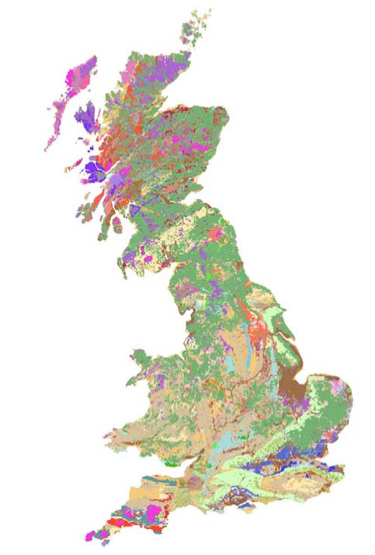
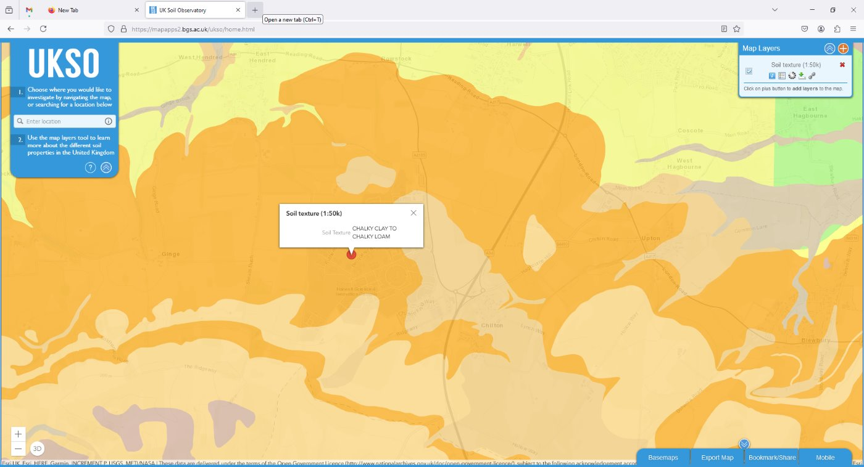
Soil Parent Material
British Geological Survey product
Soil Parent Material for the UK
(1 km² resolution, 1:50k also available)
Dataset includes “Soil Depth” and “Grain Size” that are used as hazard factors and inform parameterisation of pipe damage modelling
Developed method for accessing the data from UK Soil Observatory (Web access from DAFNI in progress)
Overview of BGS Soil Parent Material map of
Great Britain. (Figure from BGS.)

Slide 8
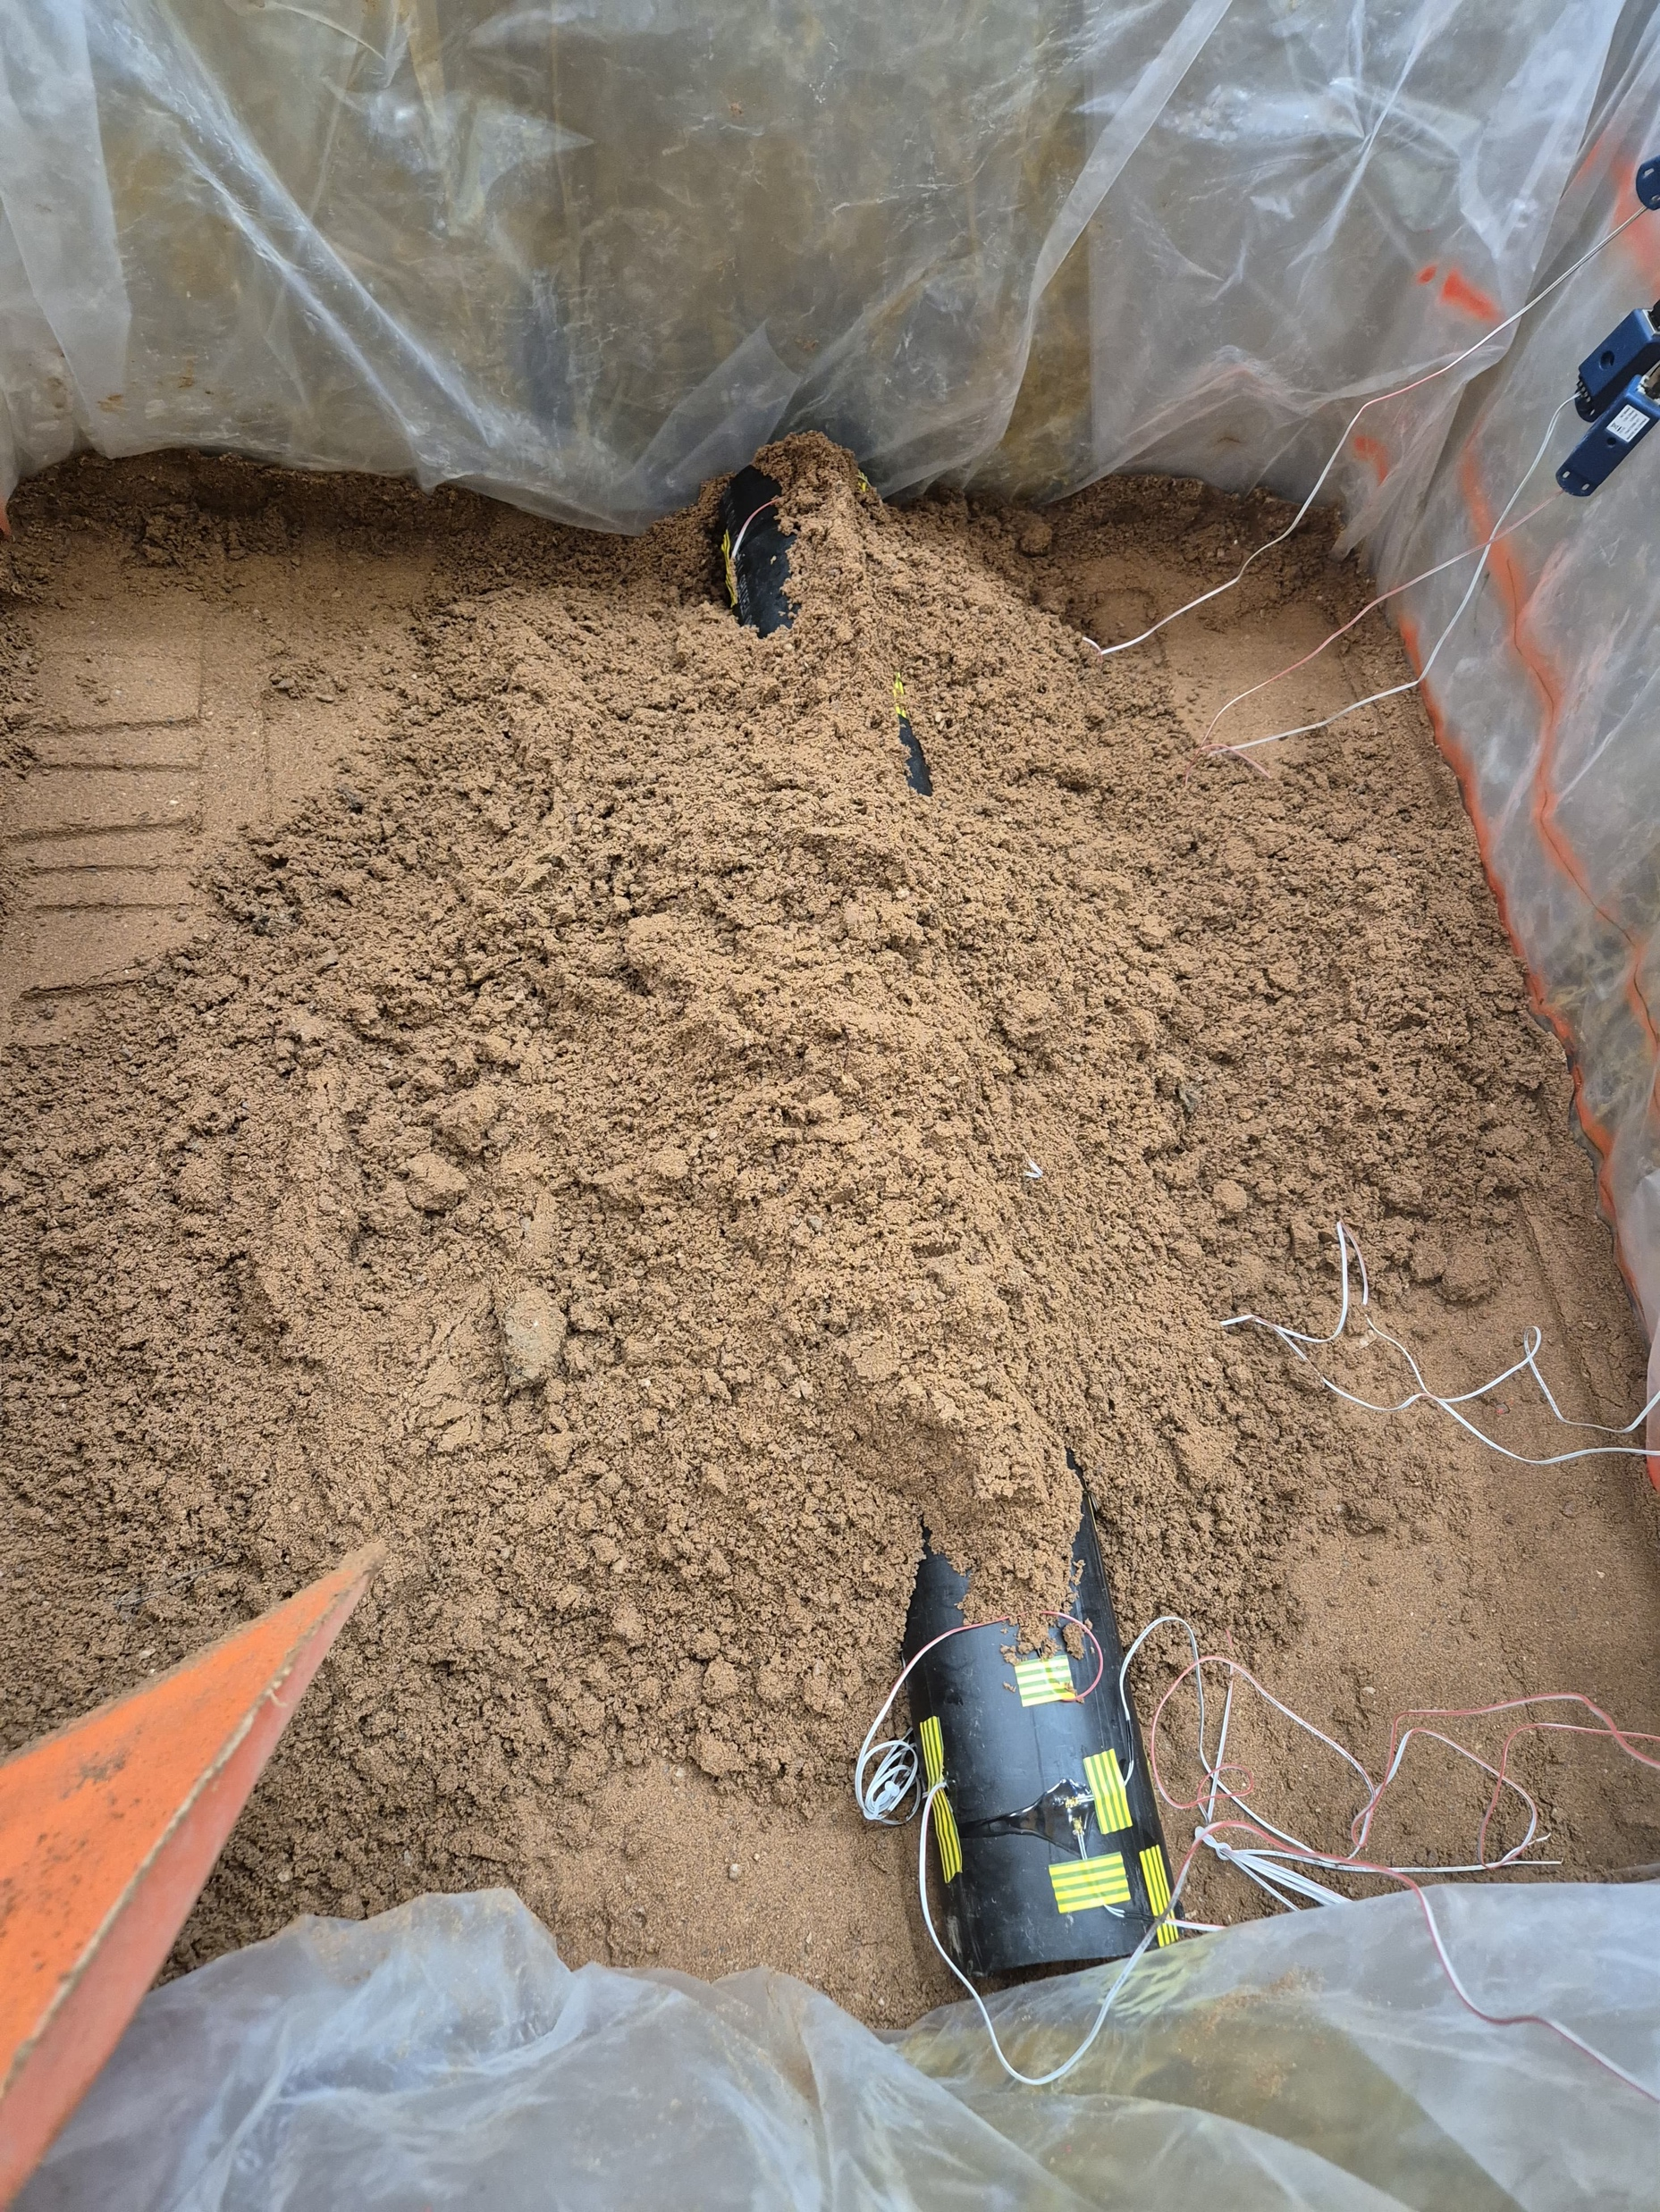
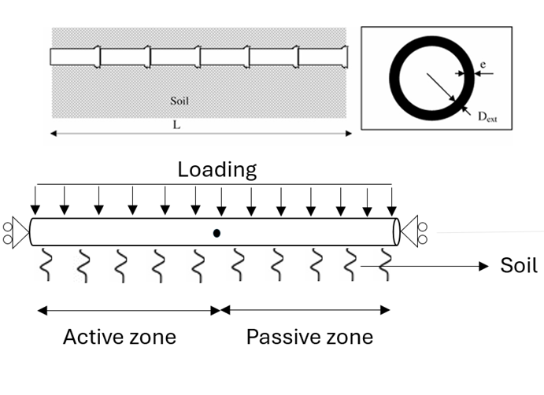
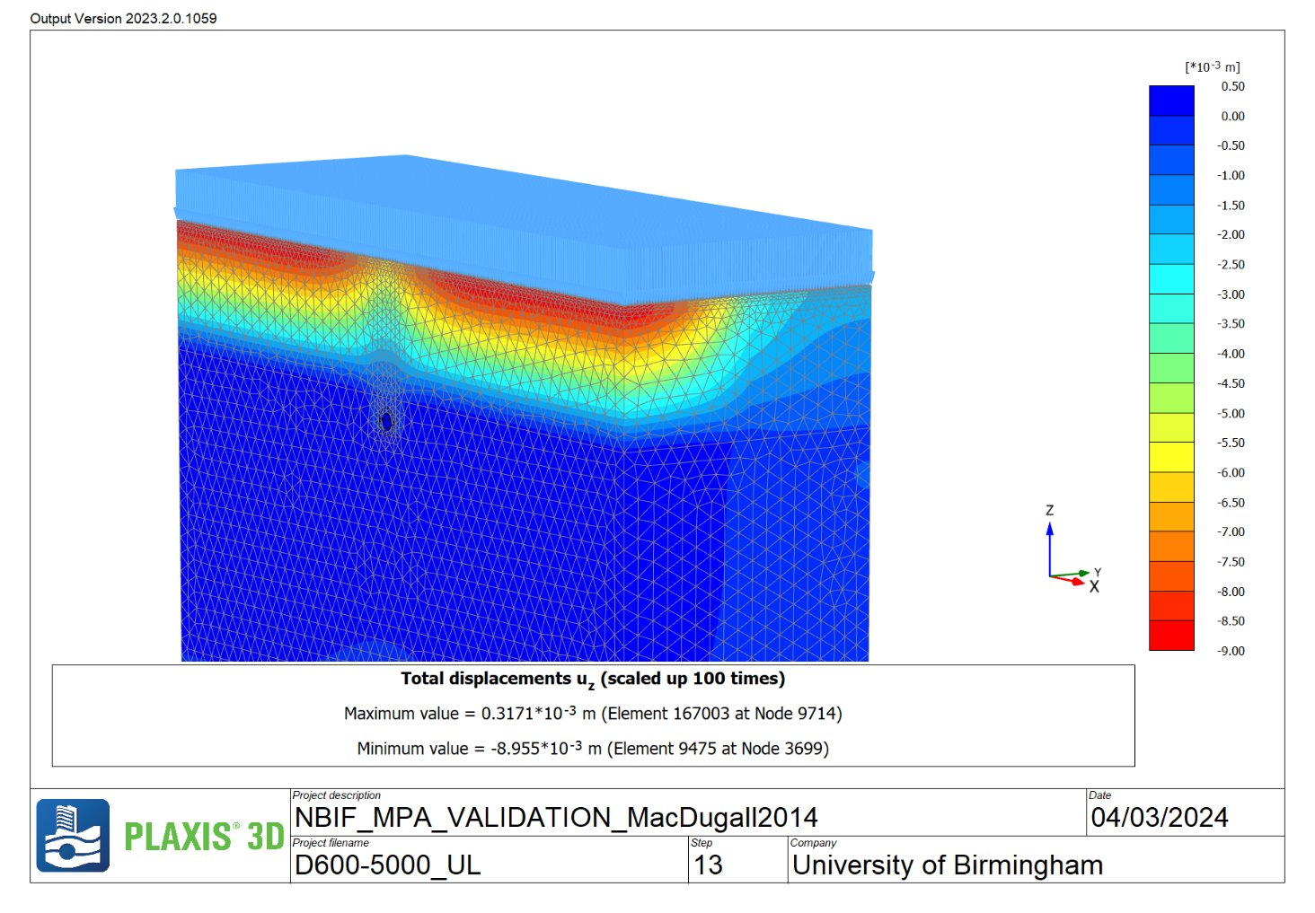
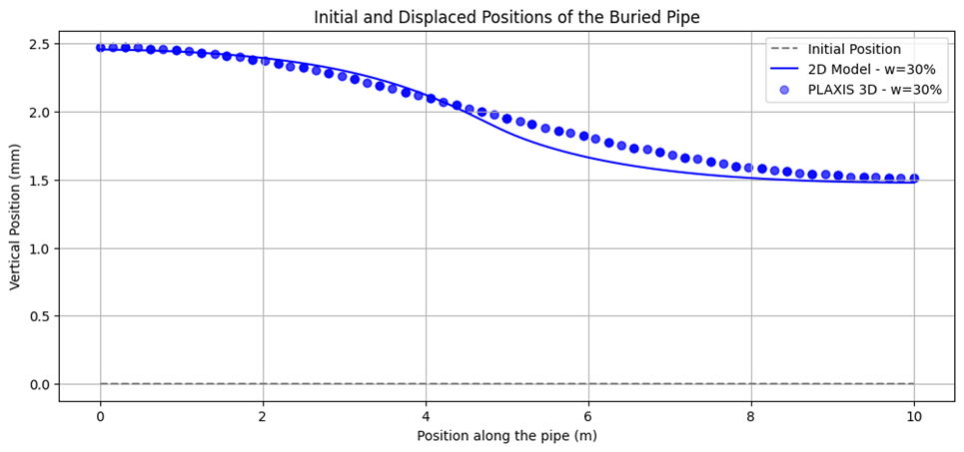
Damage Calculation for Buried Pipes – Finite Element
2D FEM model constructed to simulate soil-pipe interaction
Soil moisture used to estimate soil stiffness and expansion/shrinkage volume
Validated by 3D FEM model developed at NBIF (experiment in progress)

Slide 9
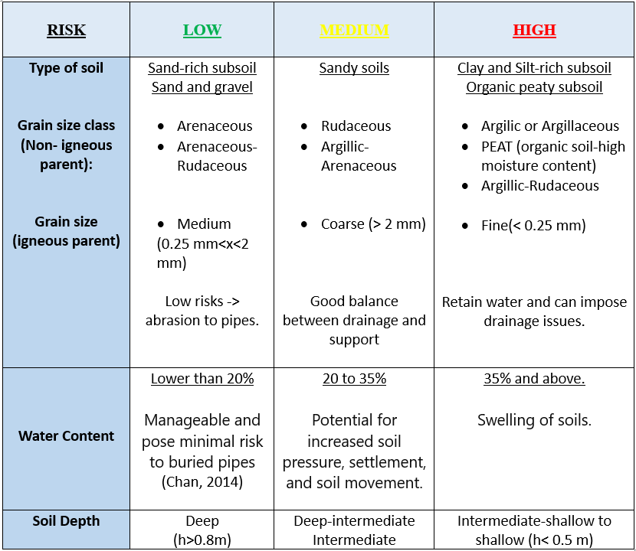
Risk Coding
Risk mapping using matrix-based approach
Risk mapping using FEM
Low Risk-> Green colour
displacement/failure displacement < 40%
Medium Risk-> Yellow colour
40% ≤ displacement/failure displacement < 80%
High Risk -> Red colour
80% ≤ displacement/failure displacement

Slide 10
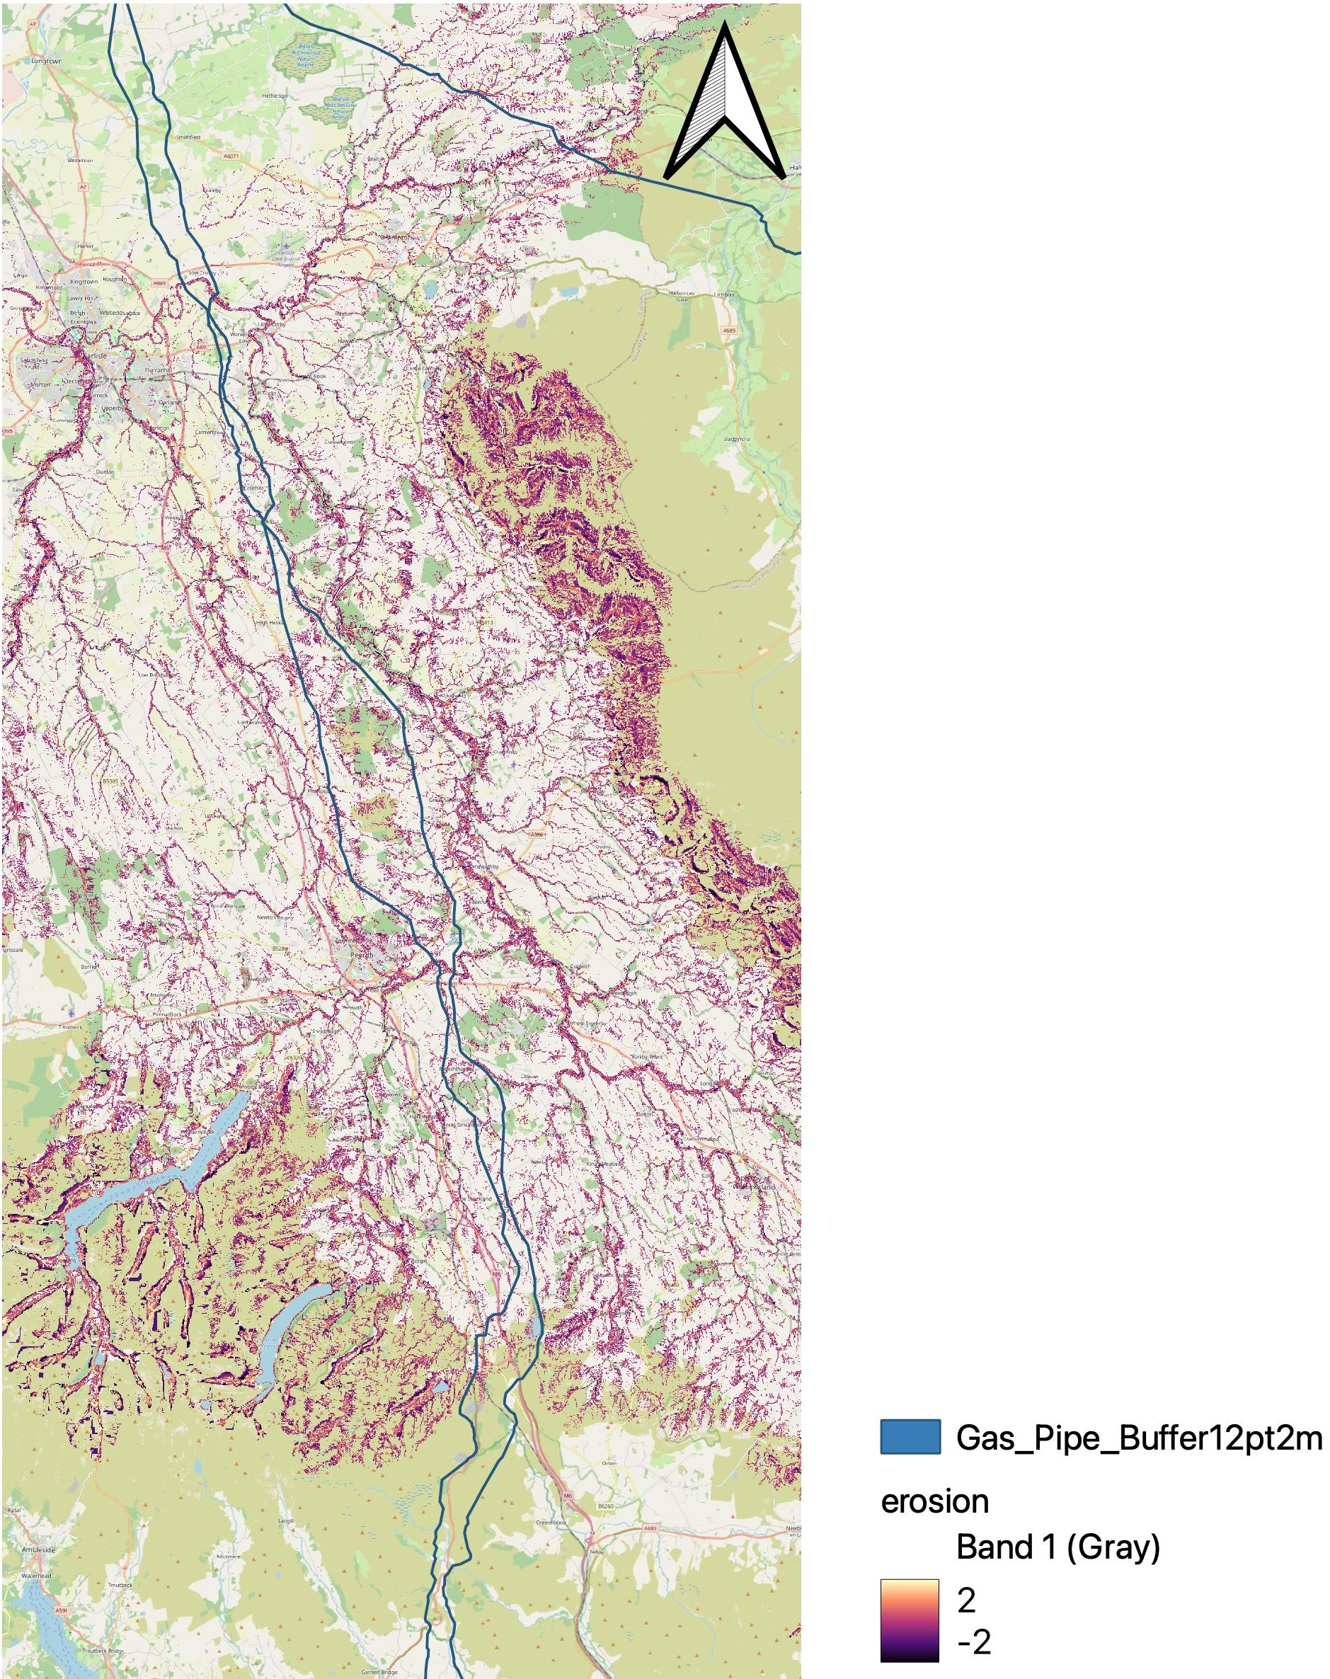
Risk from surface water
Simulated erosion/deposition during Storm Desmond 2016 for North-East England
Rainfall scenarios are based on frequency analysis using UKCP18 climate projection
Erosion is calculated using open-source SynxFlow hydrodynamic model (further development of HiPIMS-CUDA)
Include damages from both exposed pipes and deep soil cover

Slide 11
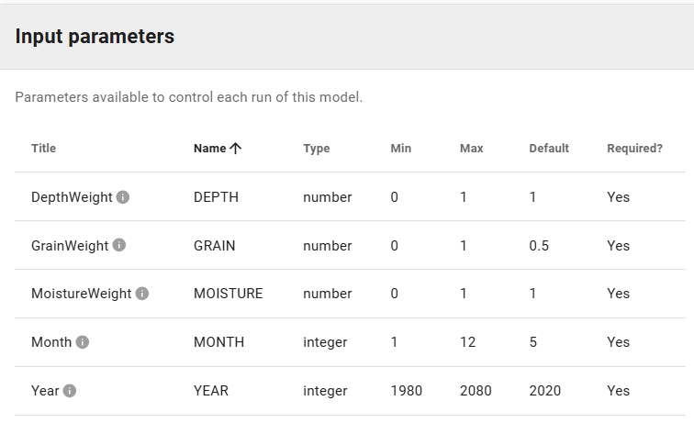
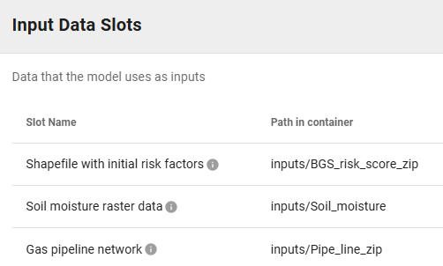
Workflow on DAFNI
Parameters and data slots:

Slide 12
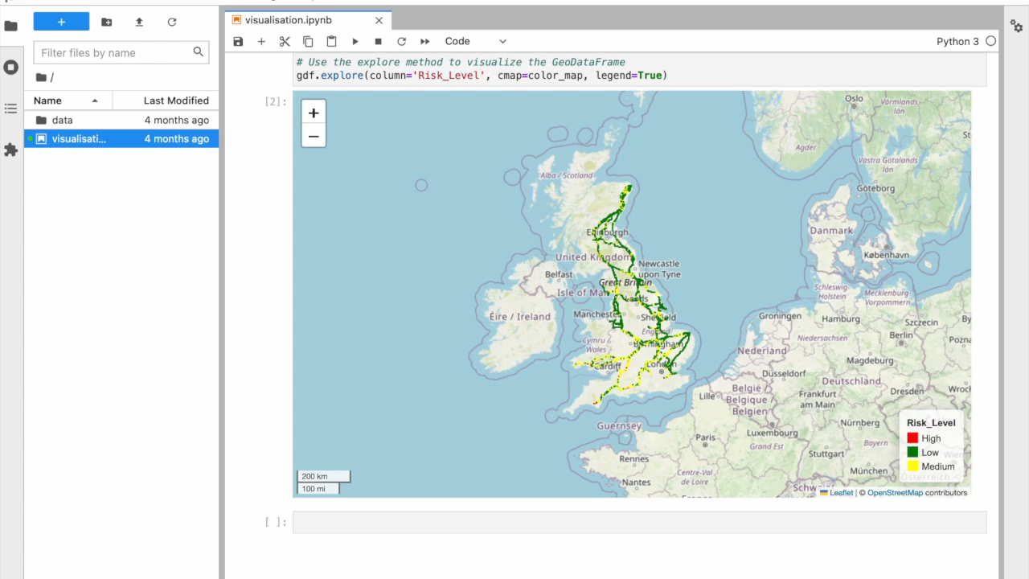
Visualisation on DAFNI: Risk Mapping of National Gas Transmission Pipeline

Slide 13
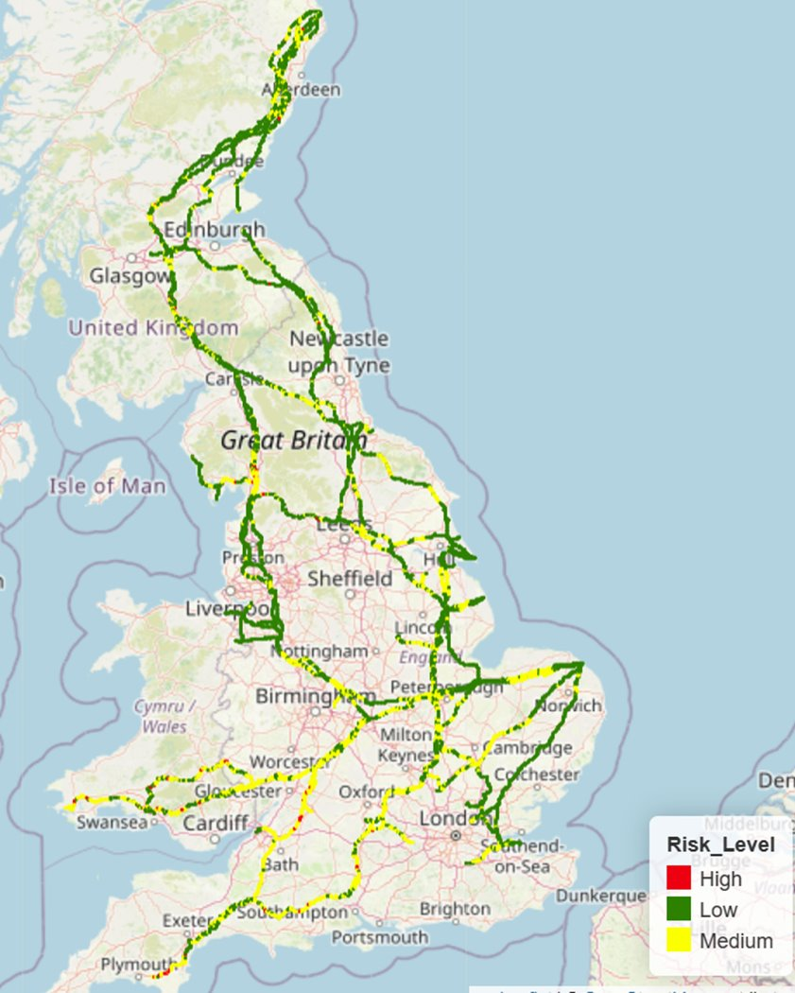
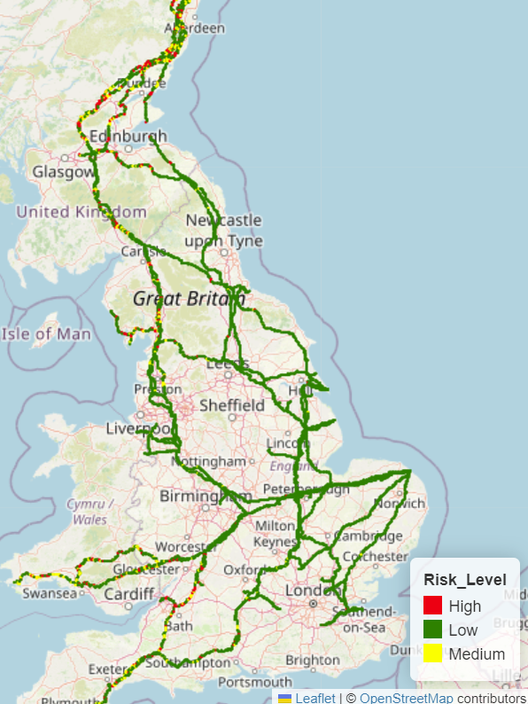
Results: Matrix-based Risk Calculation vs FEM
Risk mapping using matrix-based method
May 2020
Risk mapping using FEM
May 2020

Slide 14
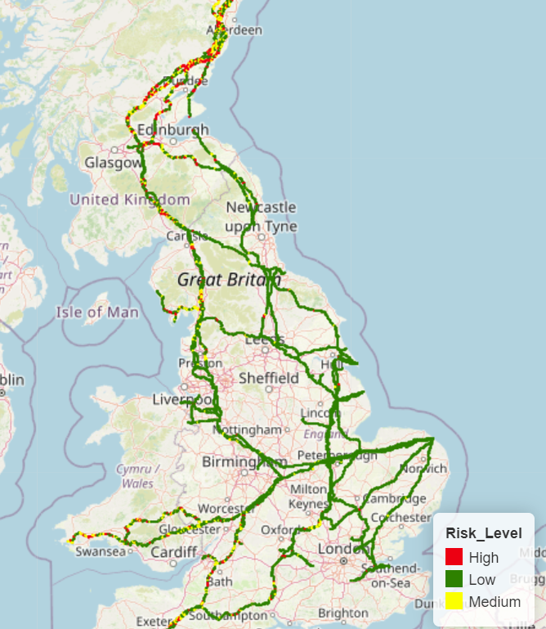
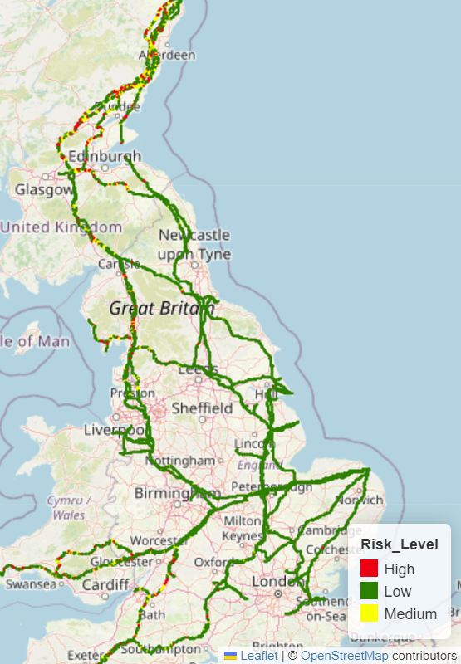
Results: Current vs Future Risk Coding
FEM risk model for May 2020
FEM risk model for May 2080

Slide 15
Impact, challenges and ongoing work
Impact – helping adapt to Climate Change and increase resilience
  Understand network-wide and national-scale climate risk comprehensively, and inform national guidance, e.g., CCRA4
  Test different scenarios of adaptation measures (benefit of being a process-based model)
Challenges during the project
  Validation and uncertainty
  Cross-organisational data sharing
Ongoing work
  Completion and validation of the risk assessment framework
  National-scale risk assessment using new climate scenarios
  End-user engagement (webinar, workshop and training session)
  Explore linkage with other data portals, e.g., JASMIN and NUAR

Slide 16
Thank you!
For more information, please email Xilin Xia [x.xia.1@bham.ac.uk]

