Slide 1
Building risk-informed redundancy in energy systems transitioning to net-zero (BRINES)
Dr Hannah Bloomfield, Dr Ji-Eun Byun, Dr Colin Manning, Prof Sean Wilkinson

Slide 2
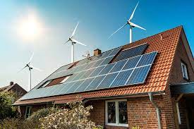
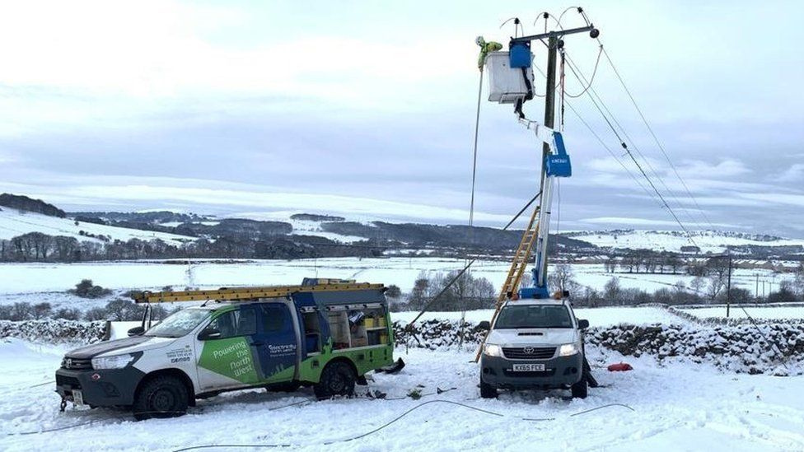
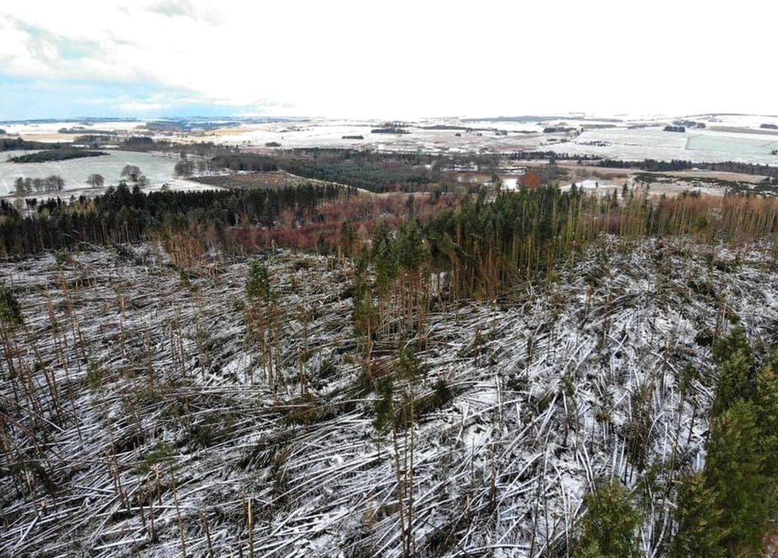
The Project Challenge
Energy systems are becoming more weather-dependent to reach net-zero targets (both demand and supply).
Climate change means we’re seeing more extreme weather events which could damage energy infrastructure.
It is therefore critical that the amount of redundancy required in energy systems is quantified.
To do this we must use the best-possible weather and climate data, but this is not easy for energy system modelers to work with.

Slide 3
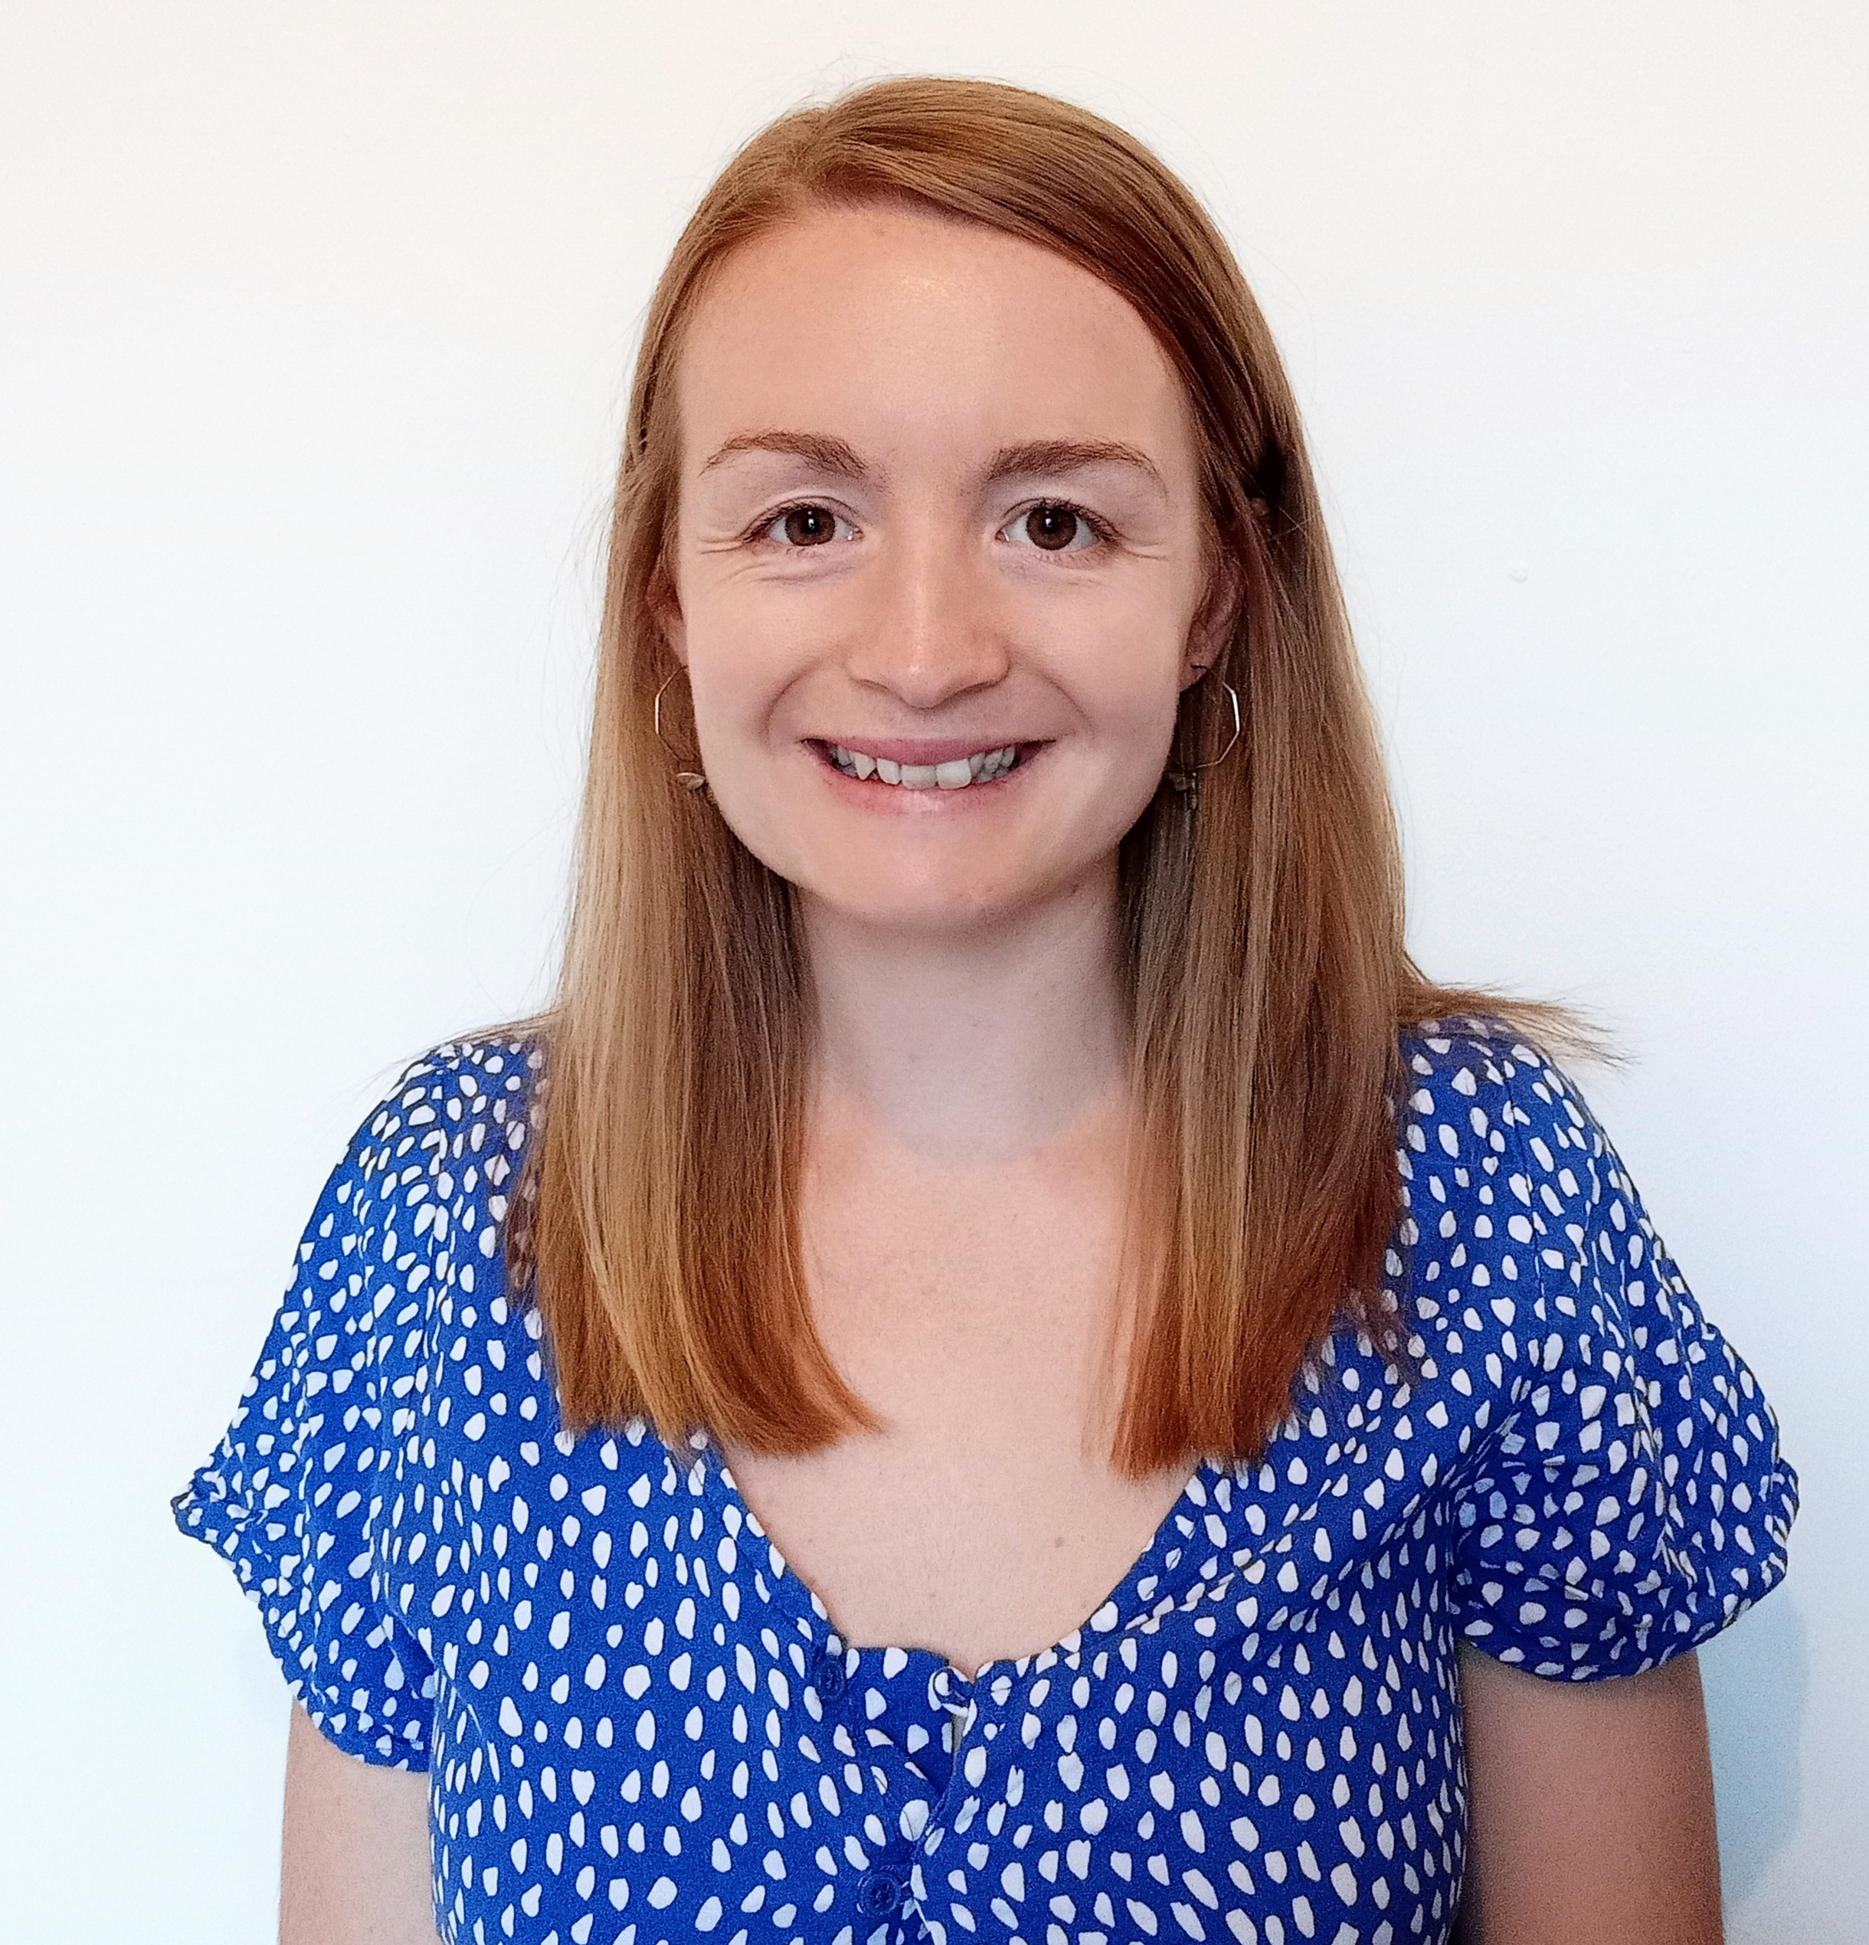
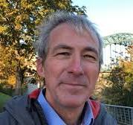
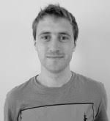
Dr Ji-Eun Byun
Expert in modelling system redundancy. Flexible python toolkit to assess this for transport systems
Our Team
Dr Hannah Bloomfield
Expert in European demand, wind power and solar power modelling.
Fellowship project data creation: How can we move towards climate resilient energy systems?
Dr Colin Manning & Prof Sean Wilkinson
Experts in energy system resilience
CS-NOW project, developing risk indicators for electricity and gas distribution network operators.
BRINES

Slide 4
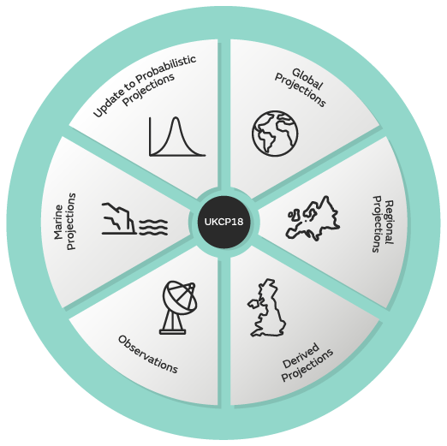
Datasets for DAFNI platform
Security of Supply
Hourly Electricity demand, wind power and solar PV data from ERA5 reanalysis. (Bloomfield et al., 2022)
Infrastructure damage
Daily indicators of extreme weather (wind gusts, maximum temperatures, maximum precipitation). Manning et al., (in prep)
And again with UKCP18 data over the UK

Slide 5
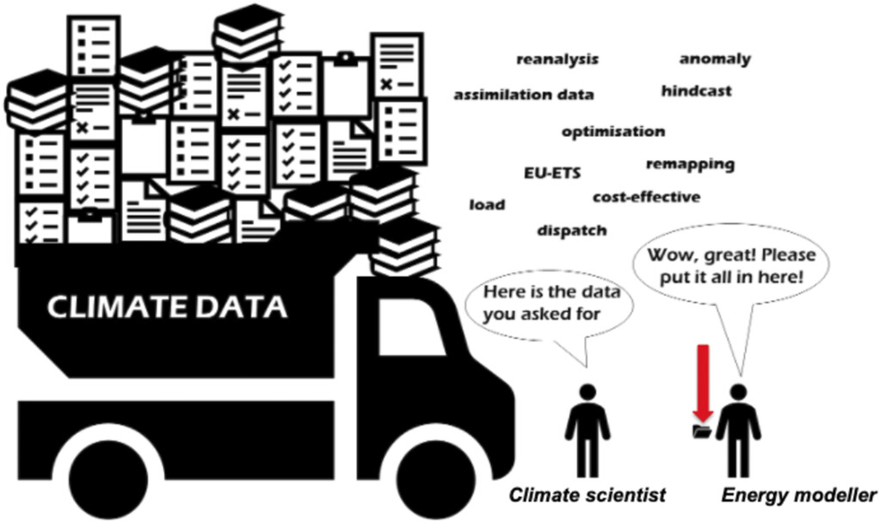
Why is this useful?
There are huge technical barriers for energy modellers who are unfamiliar with climate data. This project will allow new users access to a wide variety of energy-relevant climate data.
Bloomfield, et al.,(2021). https://doi.org/10.1175/BAMS-D-20-0256.1

Slide 6
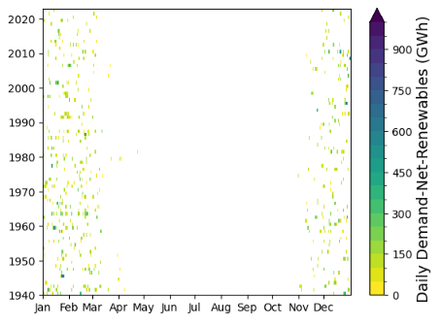
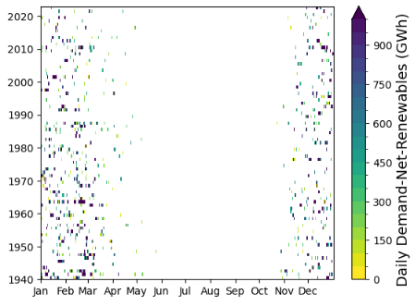
What can you do with these?
Security of Supply
Hourly Electricity demand, wind power and solar PV data from ERA5 reanalysis. (similar to Bloomfield et al., 2022)
Changes in power system setup
Increasing wind power and solar power
Electrification of demand
Reduction of gas use.
Storage?
https://essd.copernicus.org/articles/14/2749/2022/essd-14-2749-2022.html

Slide 7
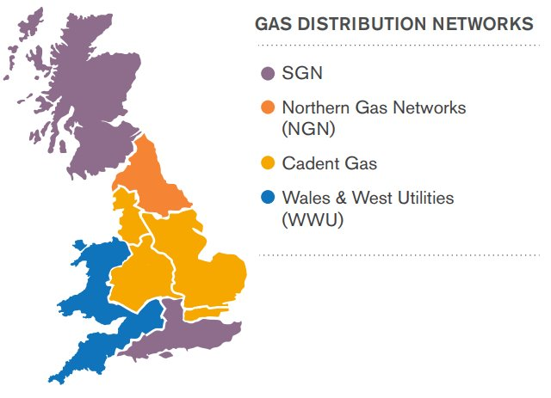
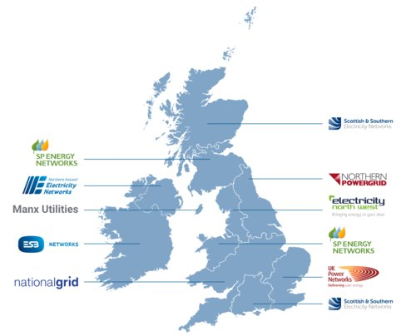
What can you do with these?
Time series of variables for each Electricity and Gas DNO
Hourly mean temperature
Hourly mean accumulated rainfall
3-Hourly 98th percentile wind gust
The wind gust that at least 2% of grid squares exceed in a given hour

Slide 8
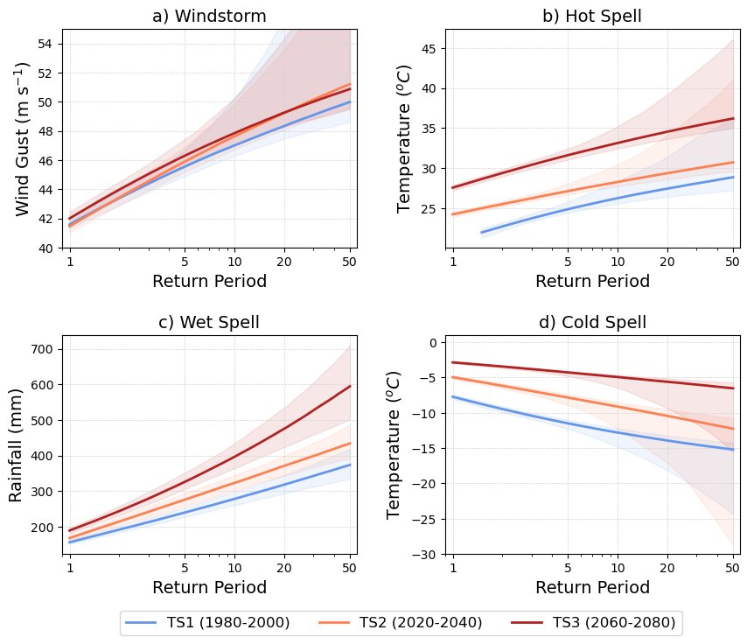
What can you do with these?

Slide 9
An example event: Storm Arwen
Asset failures
Reduced redundancy
strong winds
Loss of supply
Reduced wind energy as turbines switched off in strong winds
Difficult conditions for event response teams (potential risks to EV fleet in future)
Difficulty meeting demand
Cold temperatures
Higher demand for heating
Solutions for reduced wind energy:
- position wind farms in various locations
- Source energy from Europe
- increase storage or interconnectors, where can we obtain supply?
- storage planning and what could be done with existing infrastructure
Solutions:
- position wind farms more distributed locations
- Source energy from Europe

Slide 10
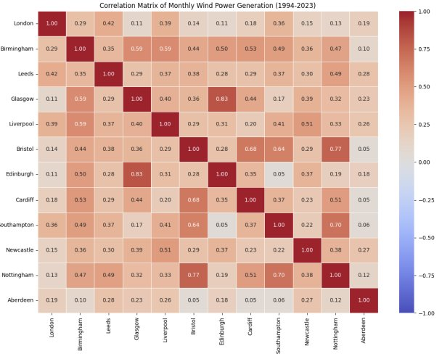
What can you do with these?
Multi-decadal synthetic timeseries are useful to consider correlation between renewables at a site level
This is then useful to understand potential issues around system redundancy, before the full modelling framework is implemented.

Slide 11
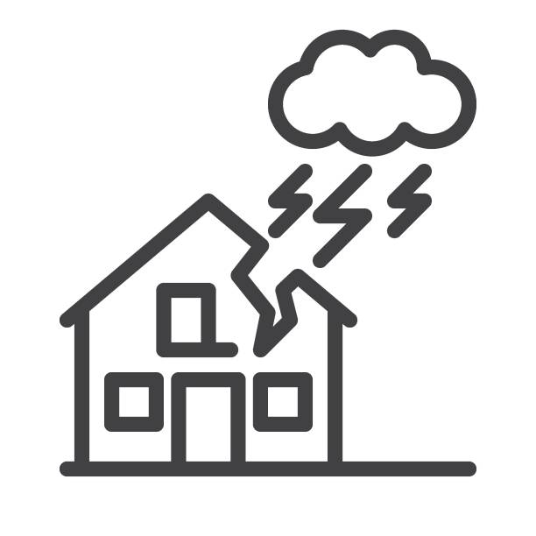
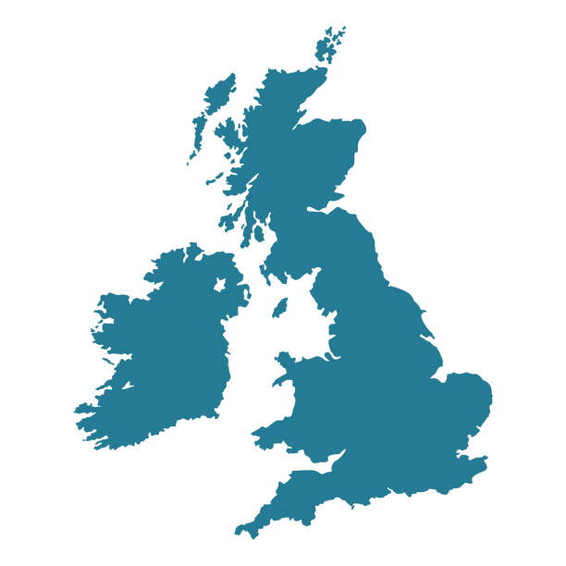
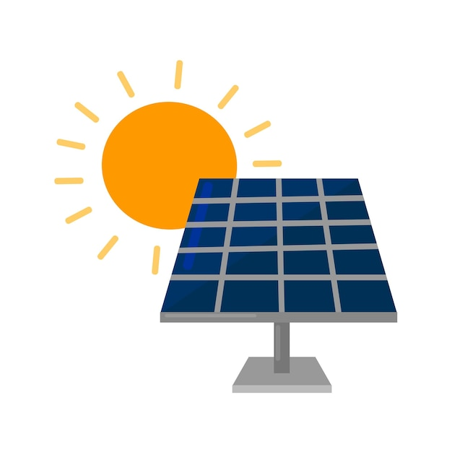
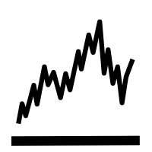
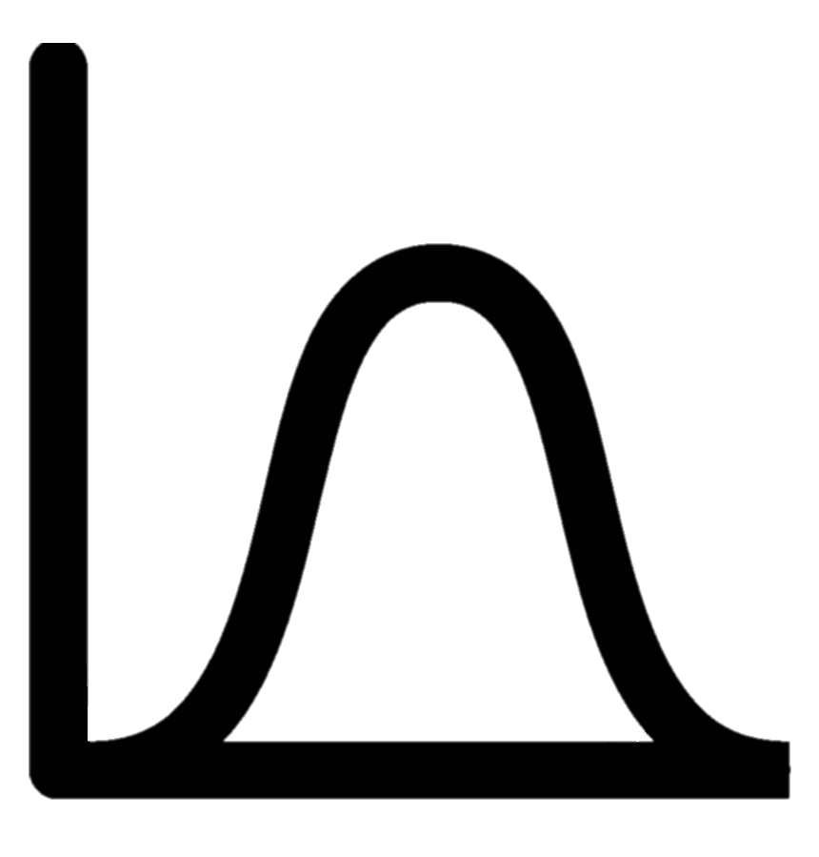
Long-term plan:
This is a useful prototype for future projects!
Climate data timeseries
- ERA5: 1940-2023
- UKCP18: 1980-2080
Collaborative UK model chain for power systems in:
- present day
- future
Explore options to optimise redundancy based on wind farm deployment
Redundancy Model:
$$W$$
Probability of System
performance
…
$$G_{1}$$
$$G_{N}$$
…
$$D_{1}$$
$$D_{M}$$
$$S$$

Slide 12
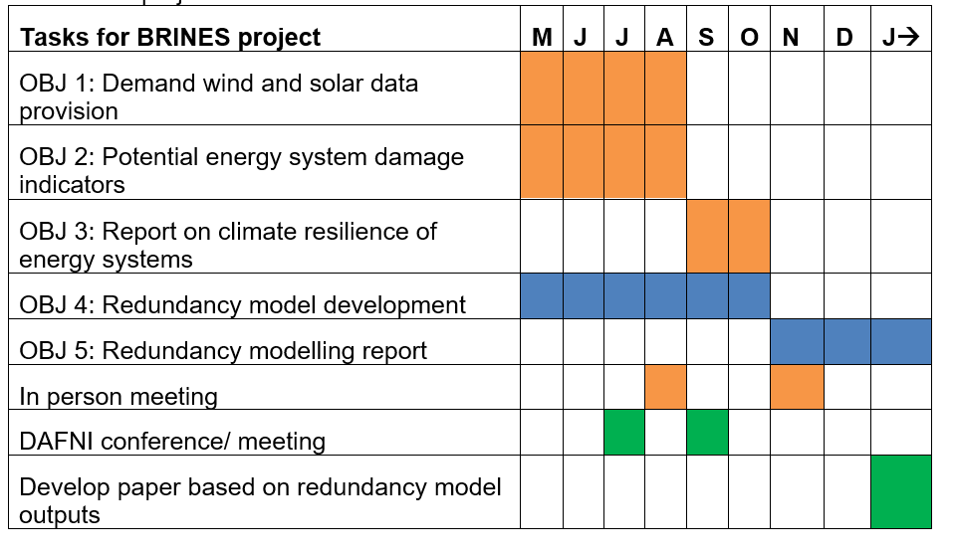
Where are we now?

Slide 13
Summary
Our project will explore risk-informed redundancy options for energy systems transitioning to net-zero.
We will produce, two datasets, a model and a workflow on the DAFNI platform.
This project is an important methodological step forward in modelling the impact of climate variability and climate change on energy system operations.
The project will help remove key technical barriers for energy system modelers wishing to work with weather and climate data.

