Slide 1
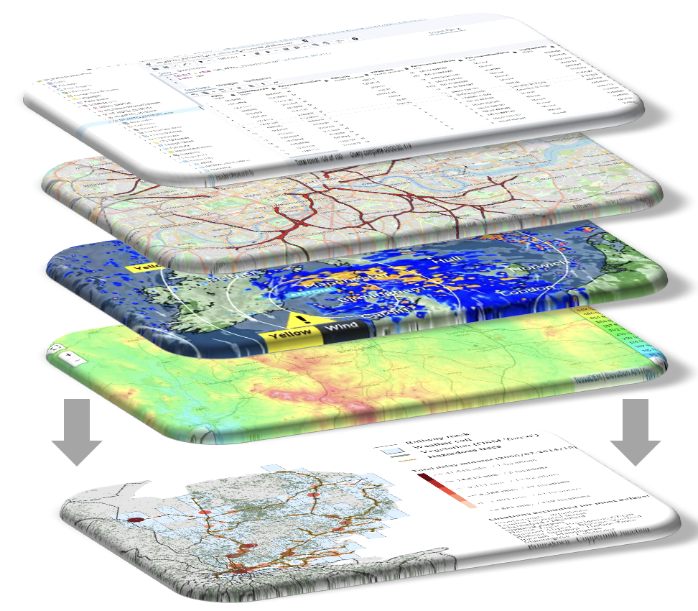

DAFNI Transport Sandpits 2024​
​
Forecasting resilience of railway network under propagating uncertainty
Team: ClimaTrack Solutions
DAFNI Conference, 10 September 2024

Slide 2







Team composition
Co-PI: Giuliano Punzo (University of Sheffield)
CoPI: Ji-Eun Byun (University of Glasgow)
Co-PI: Researcher Co-I: Qian Fu (University of Birmingham)
Co-I: Iryna Yevseyeva (De Montfort University)
Co-I: Tohid Erfani (University College London)
Co-I: Konstantinos Nikolopoulos (Durham University)

Slide 3
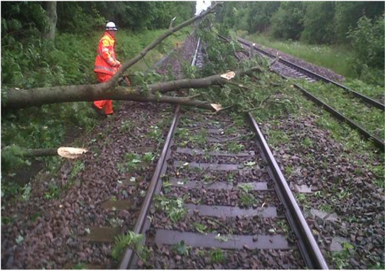
Key challenges
Network Rail bears up to £100 million loss per year due to weather events:
Can we better forecast weather-related disruptions of railway service?
Can we identify weak links in a network system?
Key challenges
Data integration across datasets with diverse codifications
High uncertainty in weather events and asset failures
Uncertainty propagating through jointly performing assets
Lack of ready-use computational tools for decision-making
(Credits: Network Rail)
Notes:
For wind we look at operational uncertainty, while for heat we are interested in the uncertainty linked to climate change

Slide 4
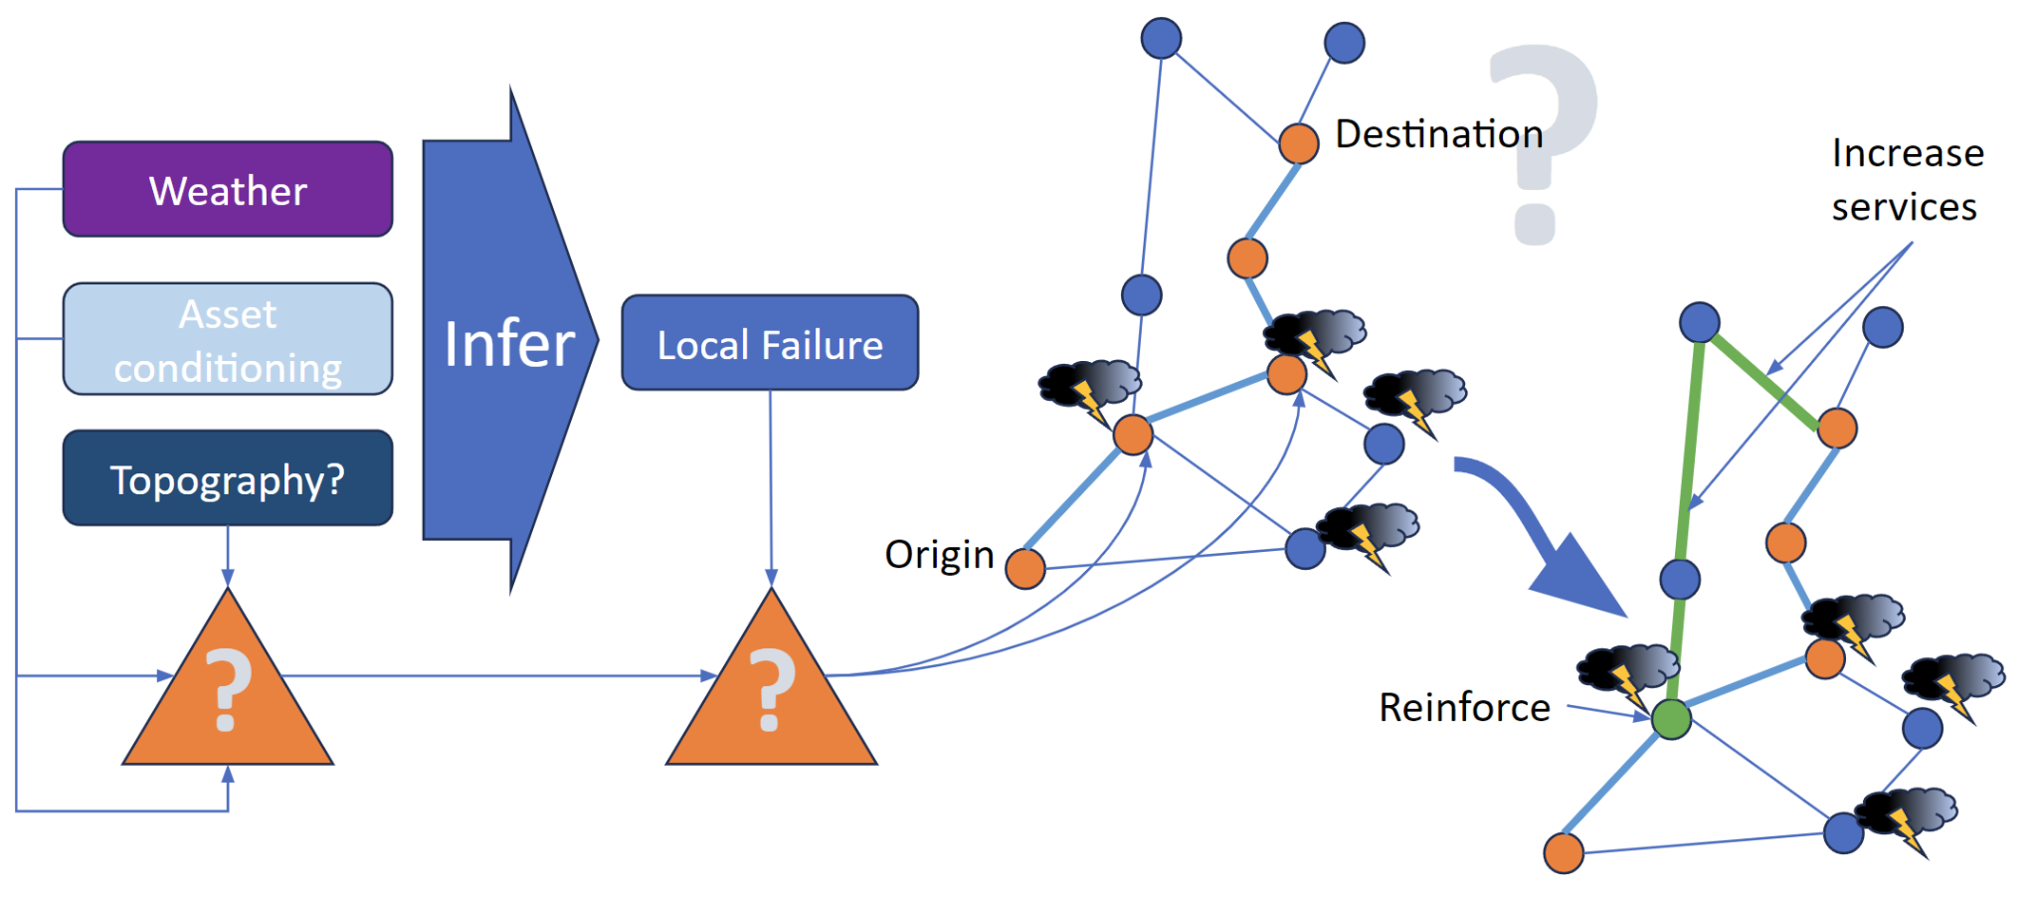
Proposed solution
Next steps
Key challenges
Data integration
High uncertainty
Uncertainty propagation
Lack of ready-use
computational tools
This project

Slide 5
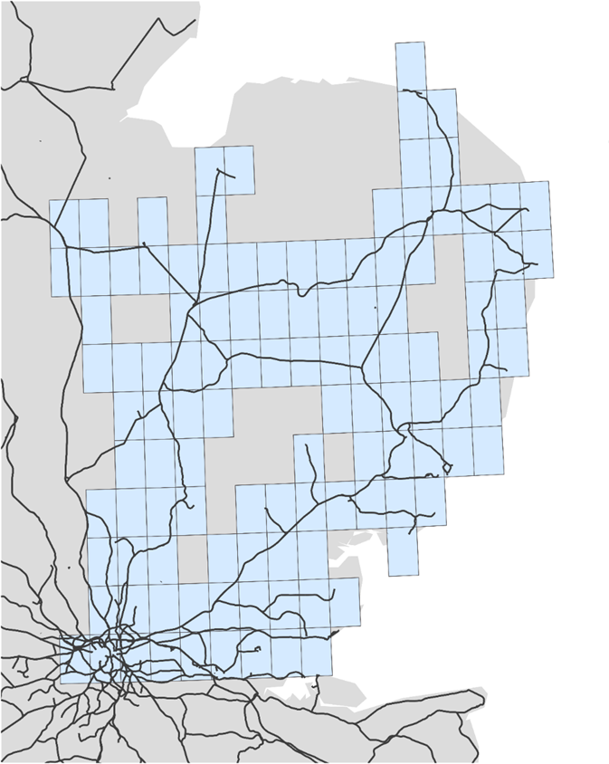

Data and Complexity control
Data on Anglia region
Historical rail delays (04/2006 – 03/2015)
  Network Rail TRUST data (incl. time, location, incident, causation reasons and delay minutes)
Asset (railway tracks )
Lineside vegetation coverage (15 species)
Weather (5× 5 km grids )
  Temperature
  Wind speed/direction
  Precipitation
  Relative humidity
  Snowfall

Slide 6
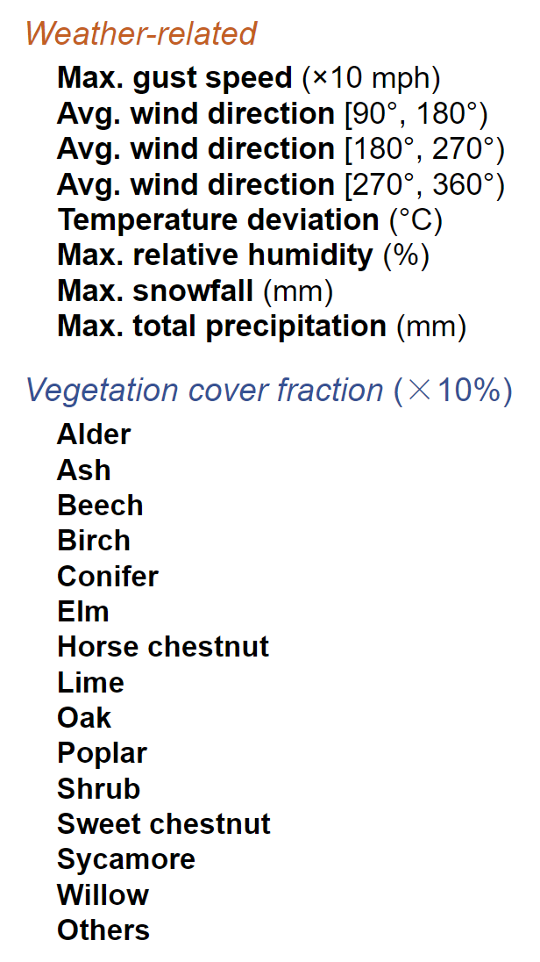
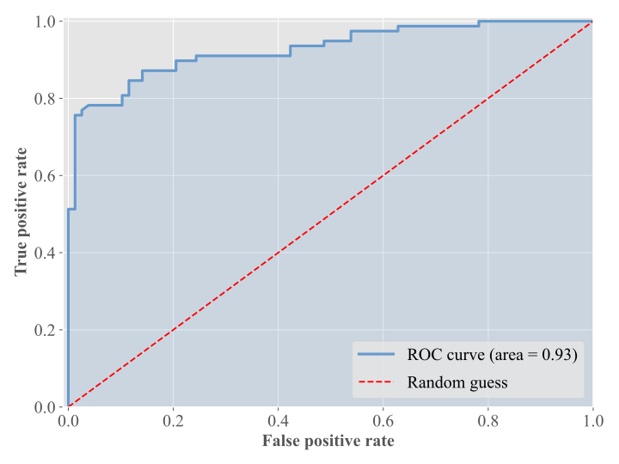
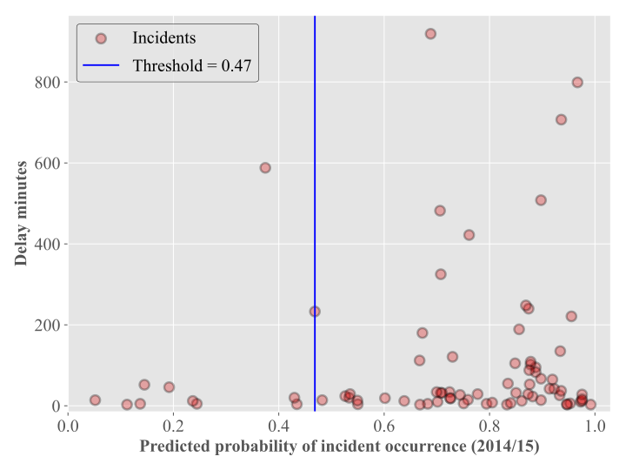
Logistic regression (No. of records in the test set: 156)
Local Fragility
Incidents captured: ~85%
<1% drop in accuracy by removing the vegetation variables

Slide 7
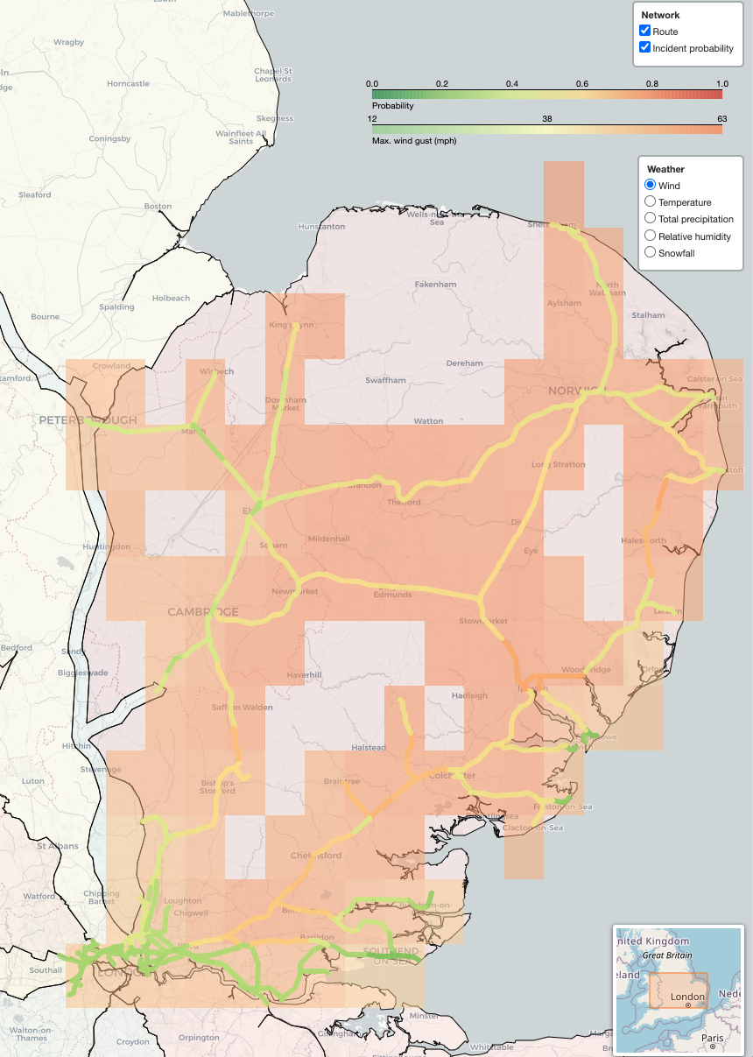
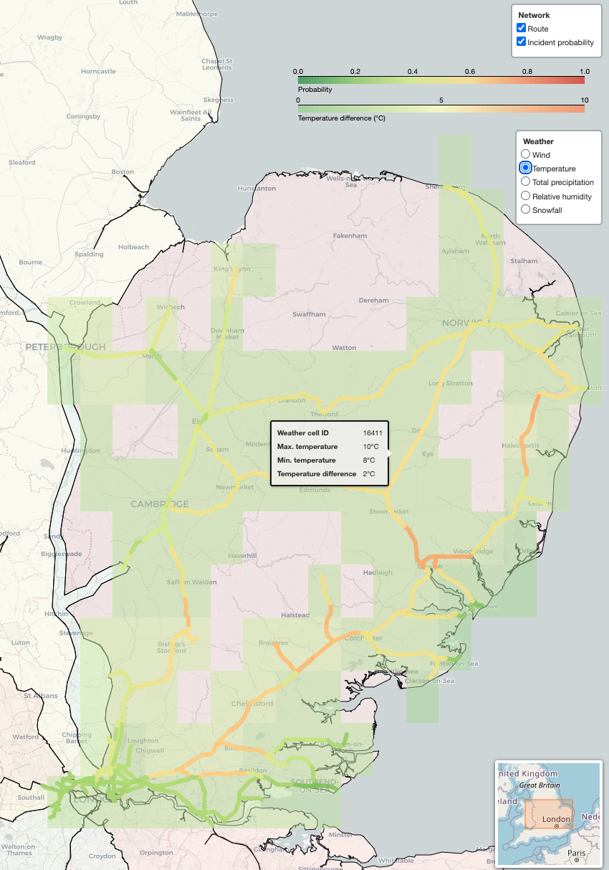
Wind
Temperature

Slide 8
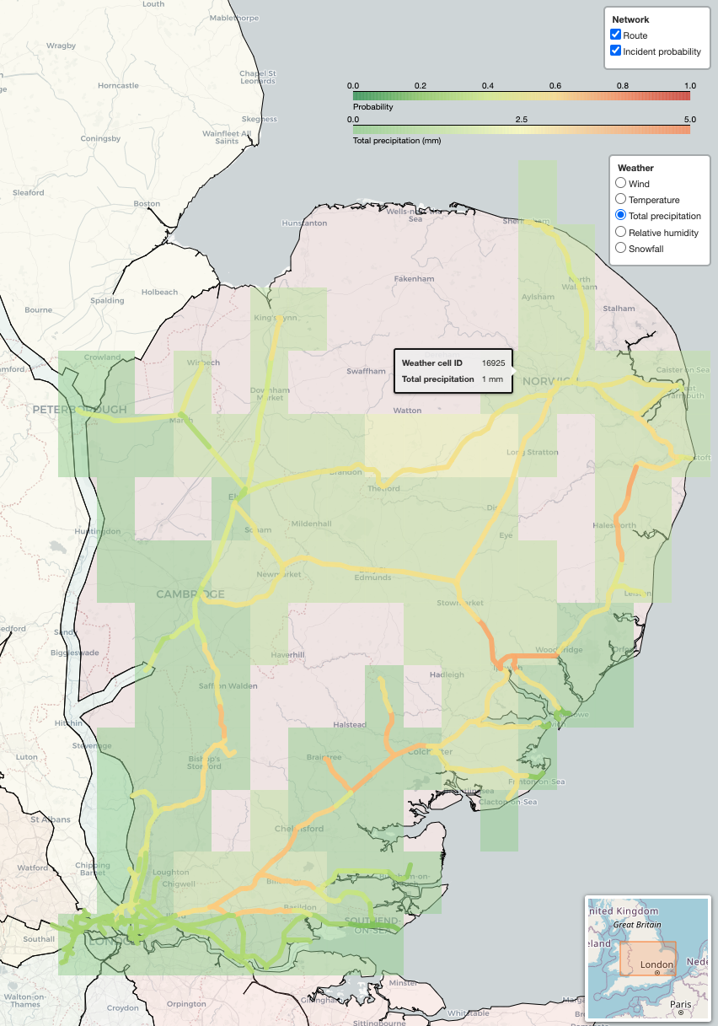
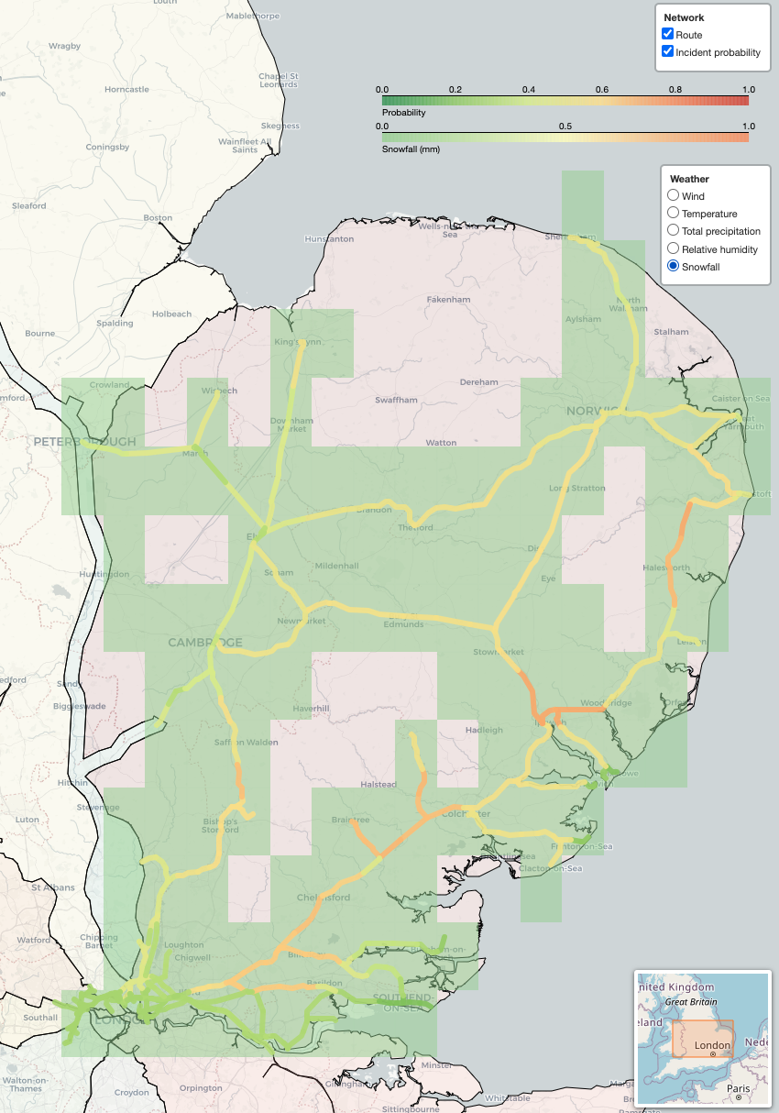
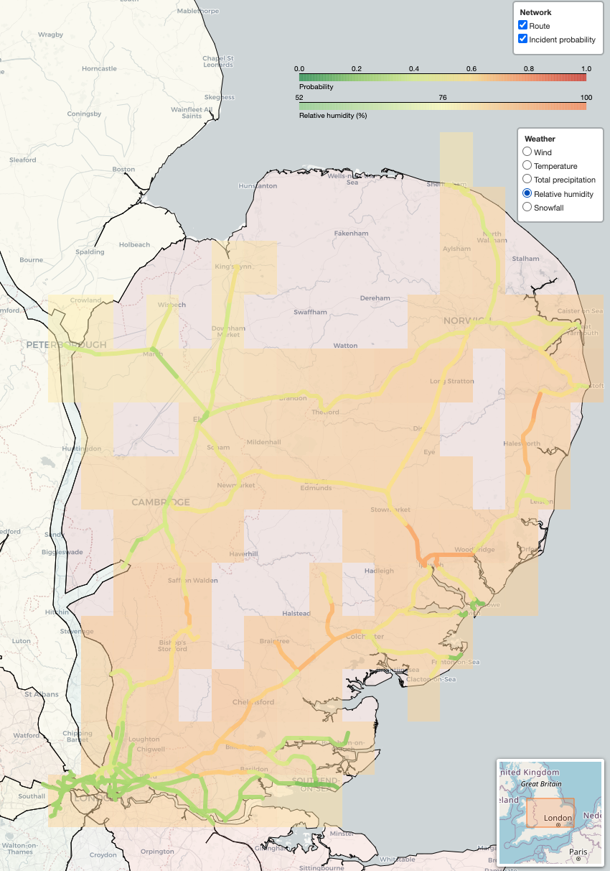
Beyond the Objectives
Total precipitations
Snowfall
Relative humidity

Slide 9
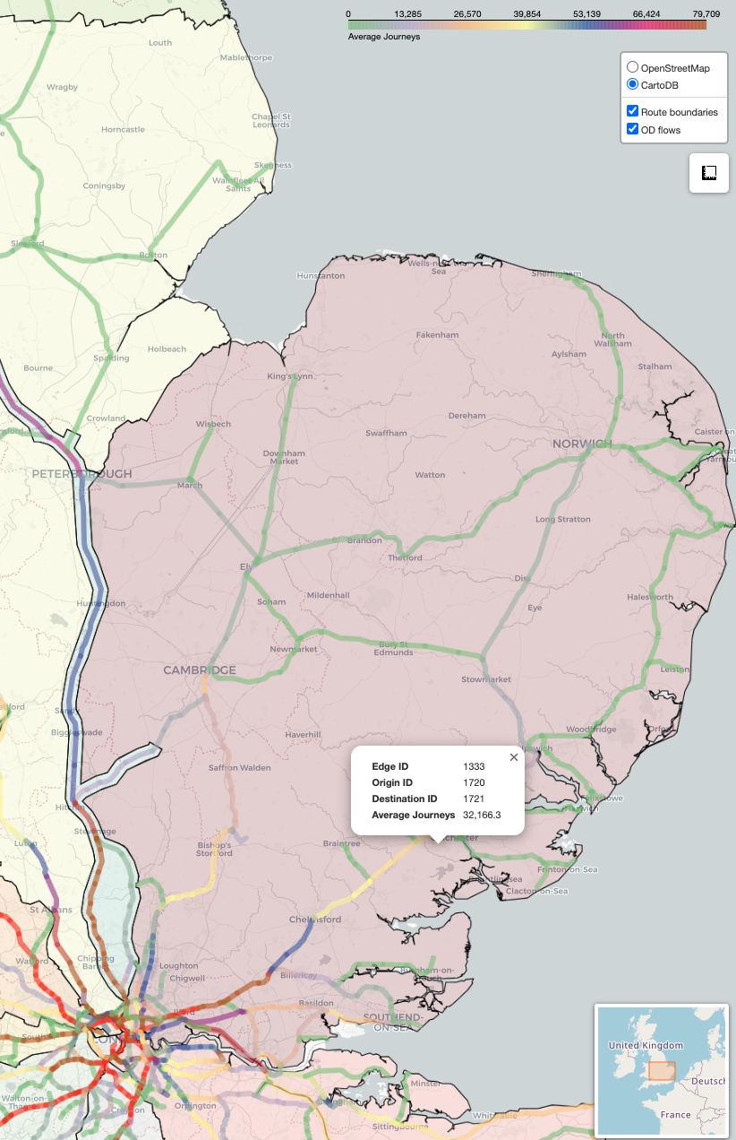
Rail network simulation
Simulation of rerouting and unmet demand
Rerouting: Edmonds-Karp algorithm
Demand and Supply:
Averaged Data from Network Rail
Residual demand =
Total original demand -
demand using damaged/removed edges +
demand rerouted to avoid damaged edges

Slide 10
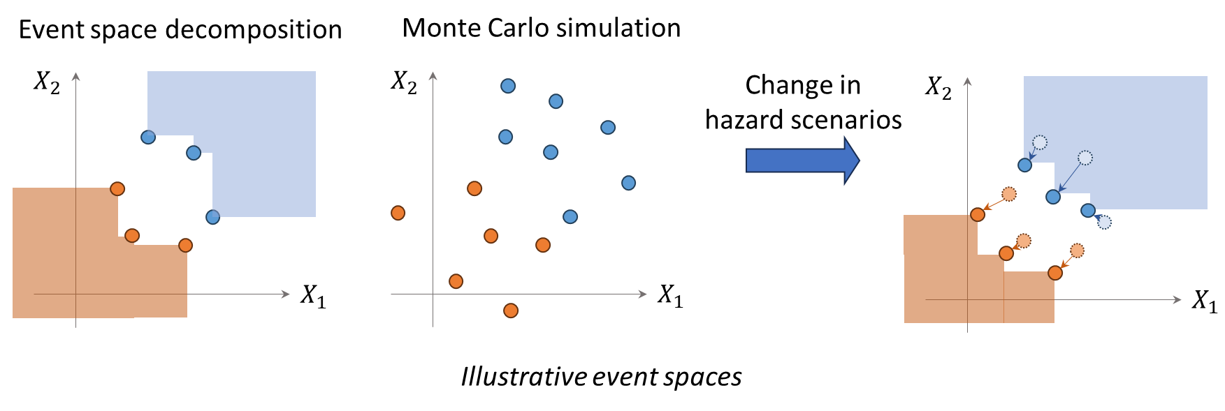
System reliability methods
Event decomposition algorithm for coherent systems
Better component states do not worsen a system state.
Less time and memory than brute-force MCS or AI methods.

Slide 11
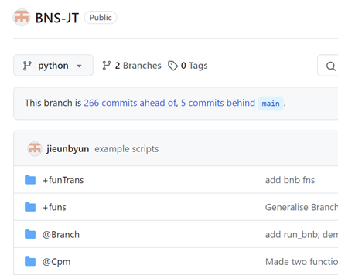
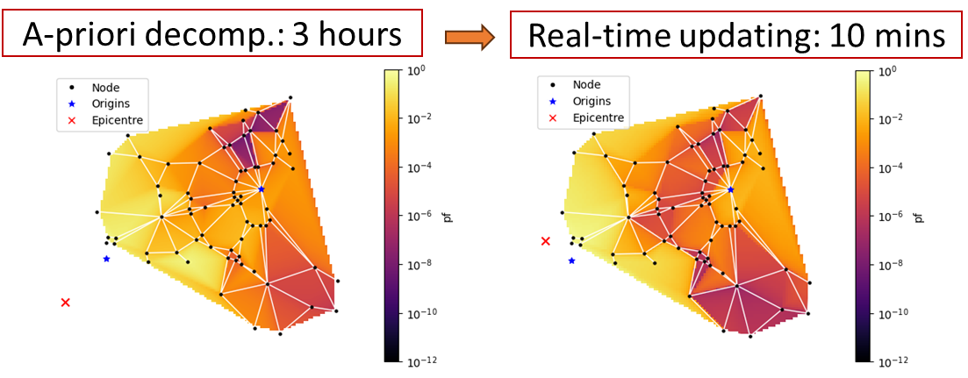
System reliability methods
MBNpy toolkit
A general, open-source tool for system reliability methods
Example: Highway network & seismic risks
24

Slide 12
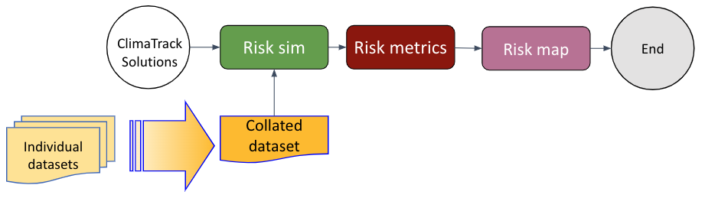
Outputs on DAFNI platform
National infrastructure database (NID)
Focus on strong wind and heatwaves
D1- Aggregated datasets of weather-related disruptions
D2 - A weather-related risk map of the railway network in the Anglia region
National infrastructure modelling service (NIMS)
D3 - A risk mapping software (in Python)
DAFNI workflow

Slide 13
Conclusion
Problem: Increasing weather-related disruptions on railway services
Objective: Risk assessment tools and data compilation on railway network, with a particular focus on system-level performance
Output: Probabilistic models of weather + Fragility models of railway assets + Simulation of railway operation + System reliability engineering tool
= Ready-use risk assessment tool of a railway network
Significance:
[Public] Resilient operation on railway network
[R&I community] A collaborative risk assessment tool applicable for
general railway networks

