Slide 1




Small Changes, QUANT and AI Resilience
(SCQUAIR)
Dr. Richard Milton
Prof. Michael Batty
Xinyi Liu
Yuet Yung Lung (Alison)
Bartlett Centre for Advanced Spatial Analysis, UCL
10 September 2024

Slide 2
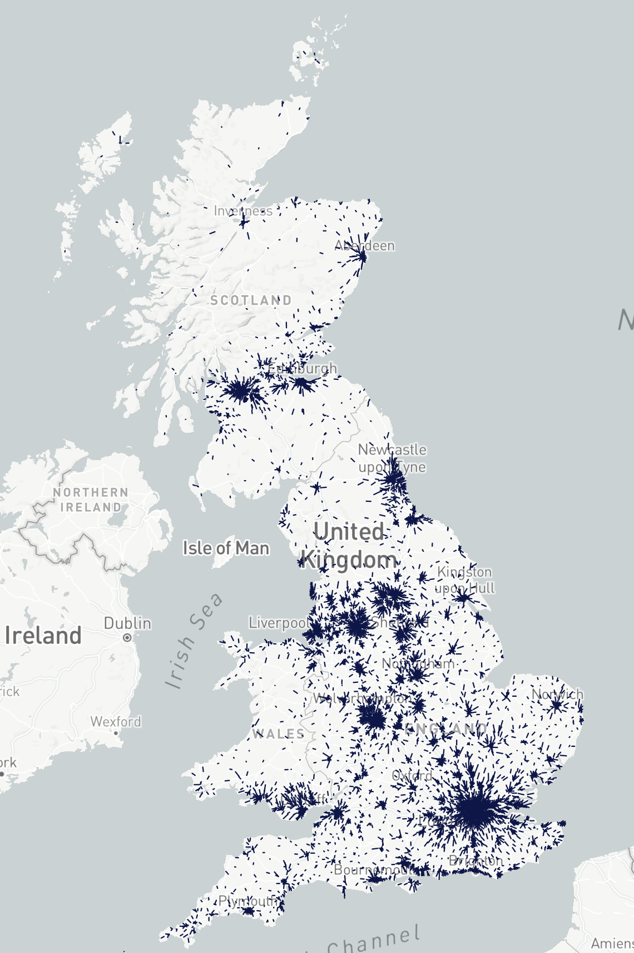
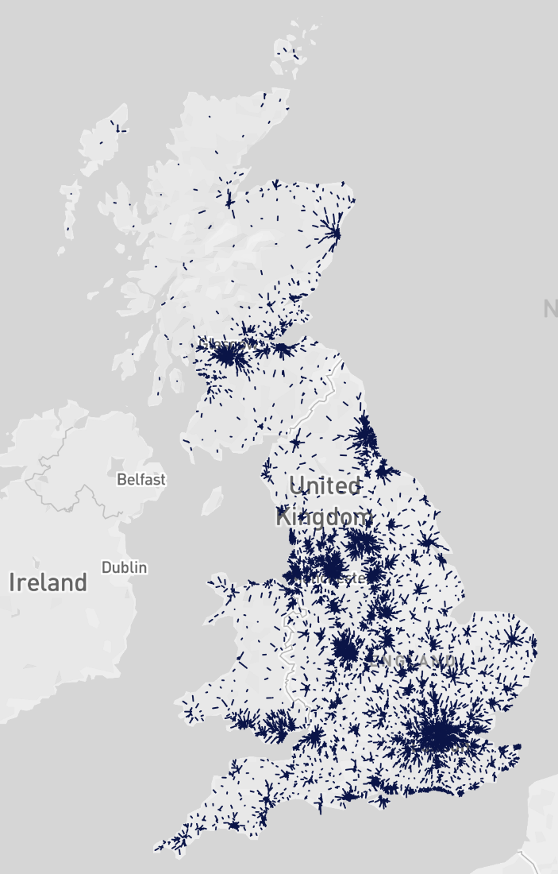
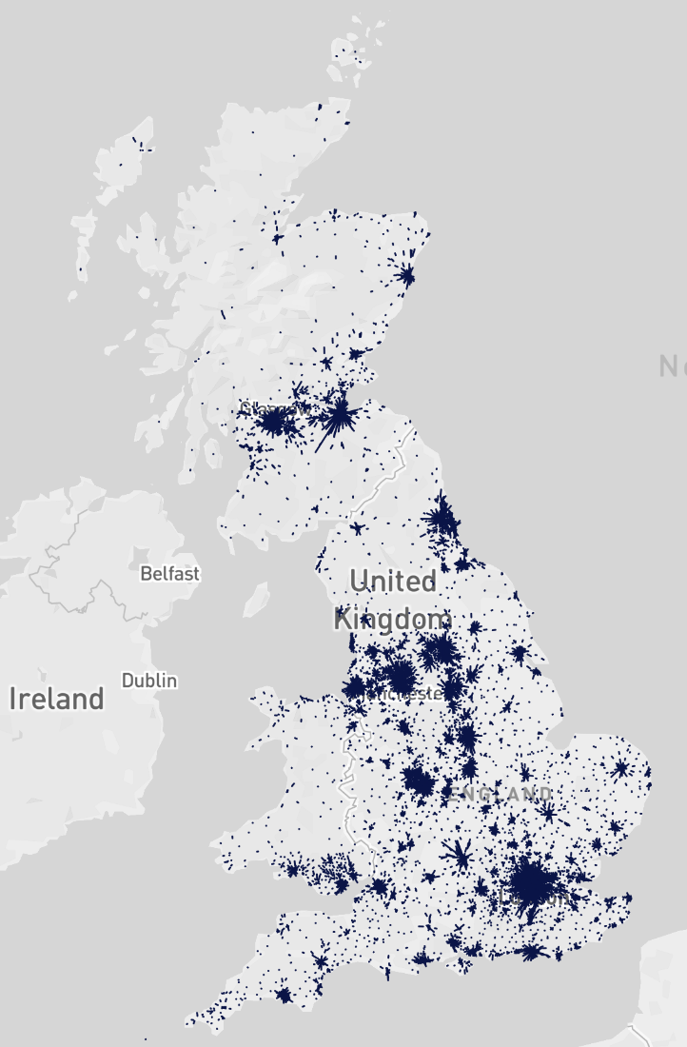
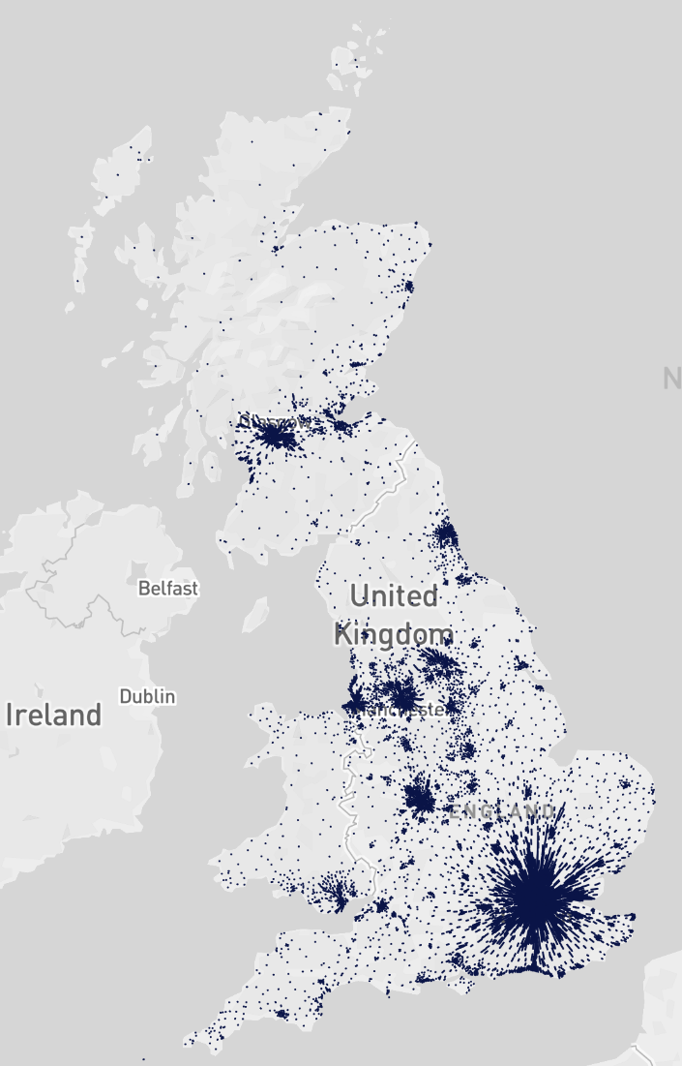
Travel to Work: Cycle, Road, Bus, Rail
Flow lines show mean magnitude and direction of people commuting
Cycle
Road
Bus
Rail

Slide 3
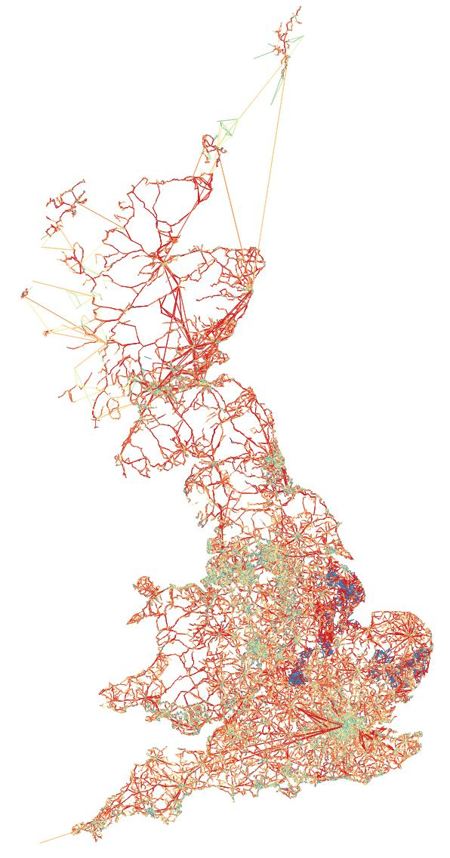
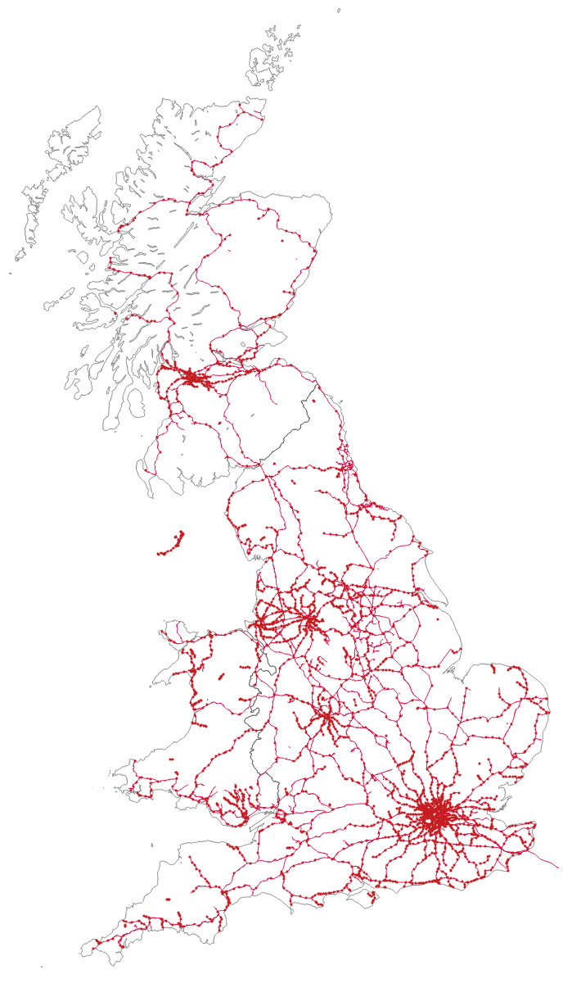
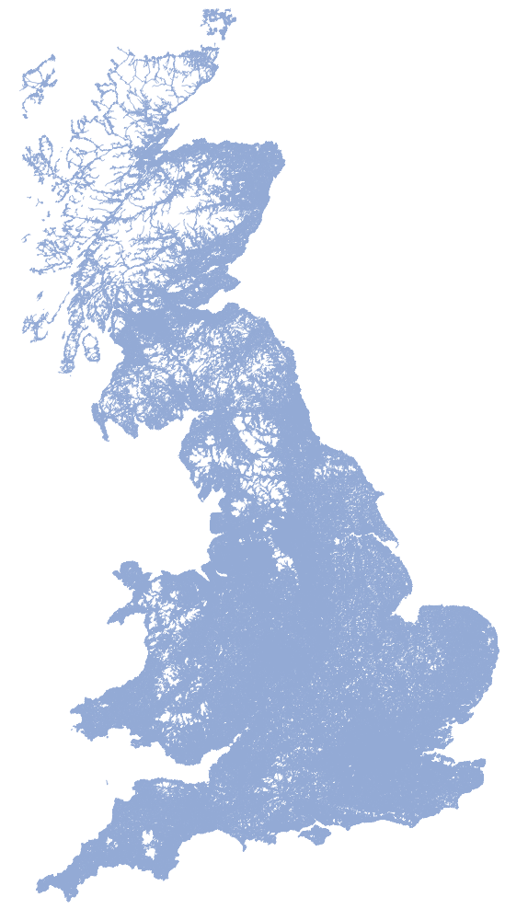
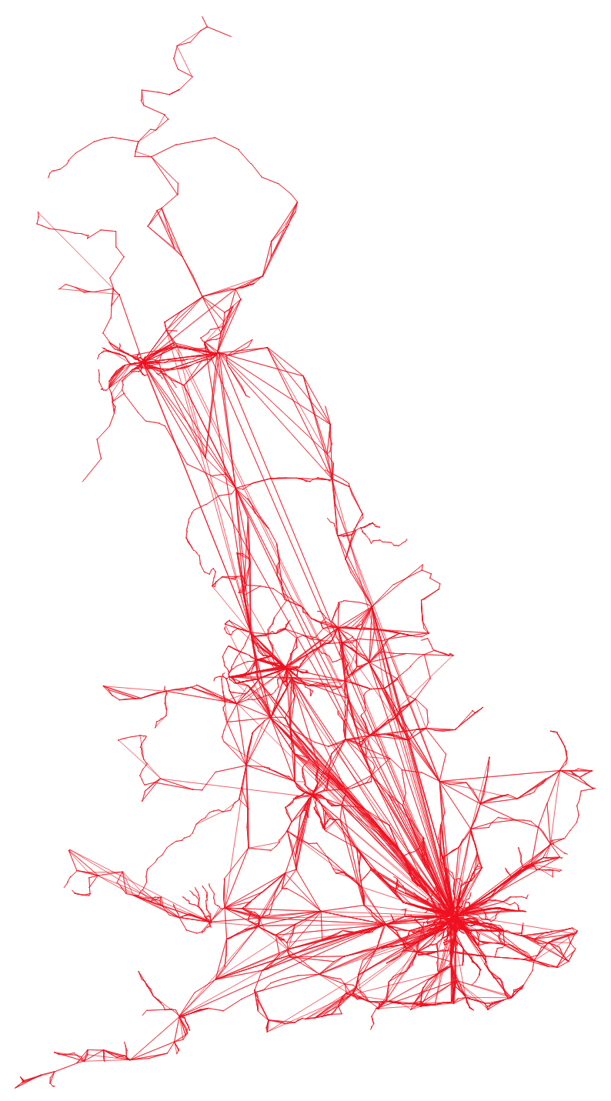
Transport Networks
Road,
v=3.5M, e=8.4M
Bus, Ferry,
v=0.29M,
e=0.42M
Rail, v=3165, e=10,269

Slide 4
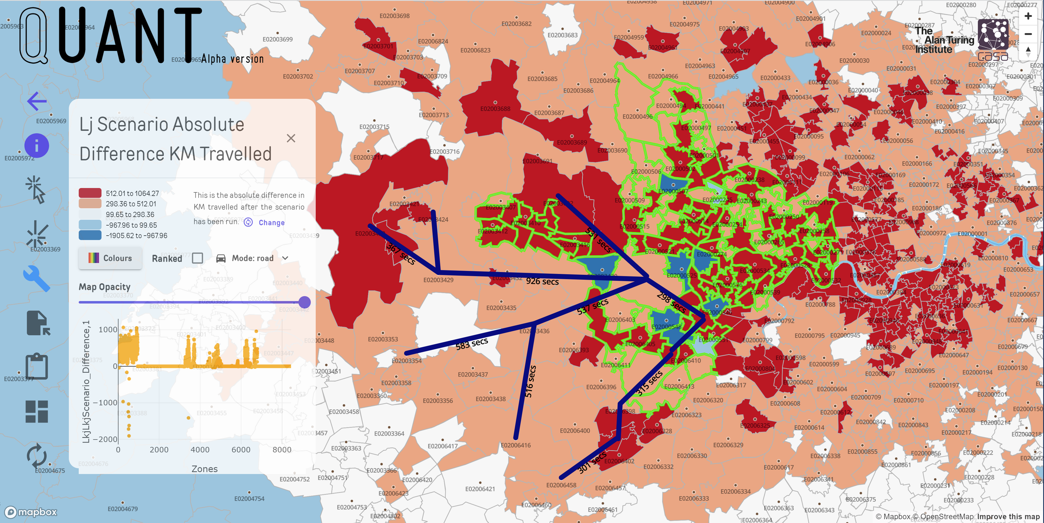

HEATHROW 3rd RUNWAY
Road: 529,797KM
Rail: 1,296,217KM
(193KM)

Slide 5
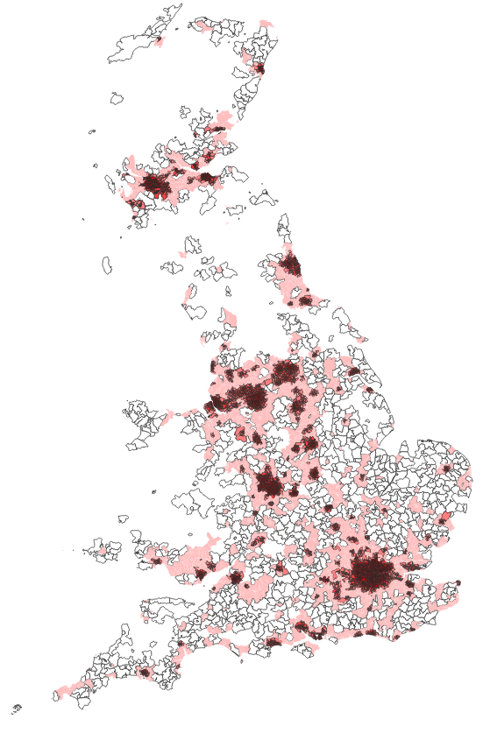
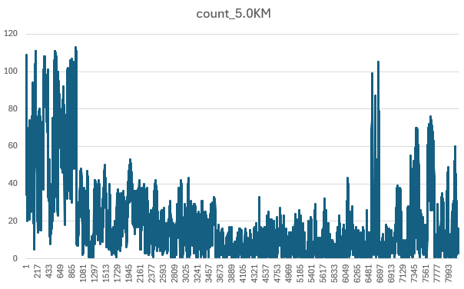
Methodology: 5km One Link Scenarios (175,000)
5KM Radius
Methodology: test every zone within 5km of an origin
Count of the number of zones within 5km of each of the 8436 origin zones

Slide 6
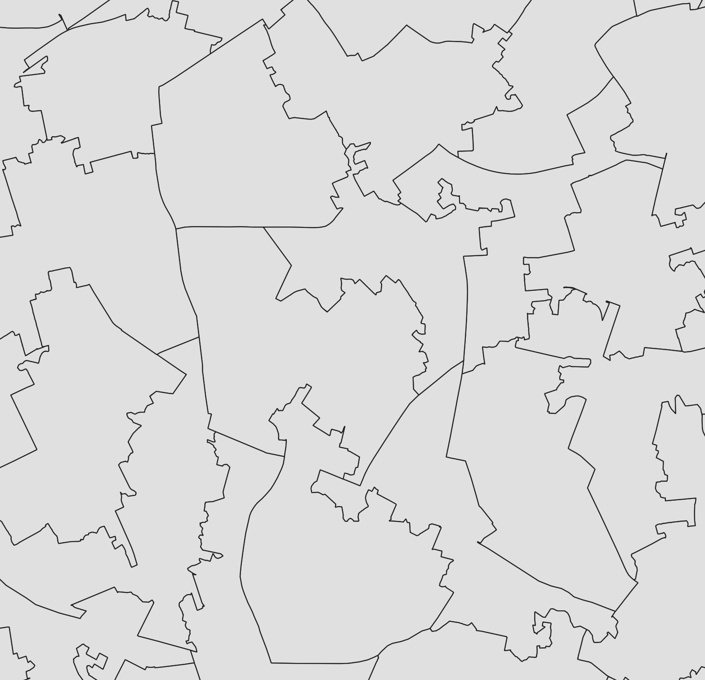
Single Links and Double Links
Random Two Links: 3,500,000 (162 days)
Exhaustive Single Links: 175,000

Slide 7
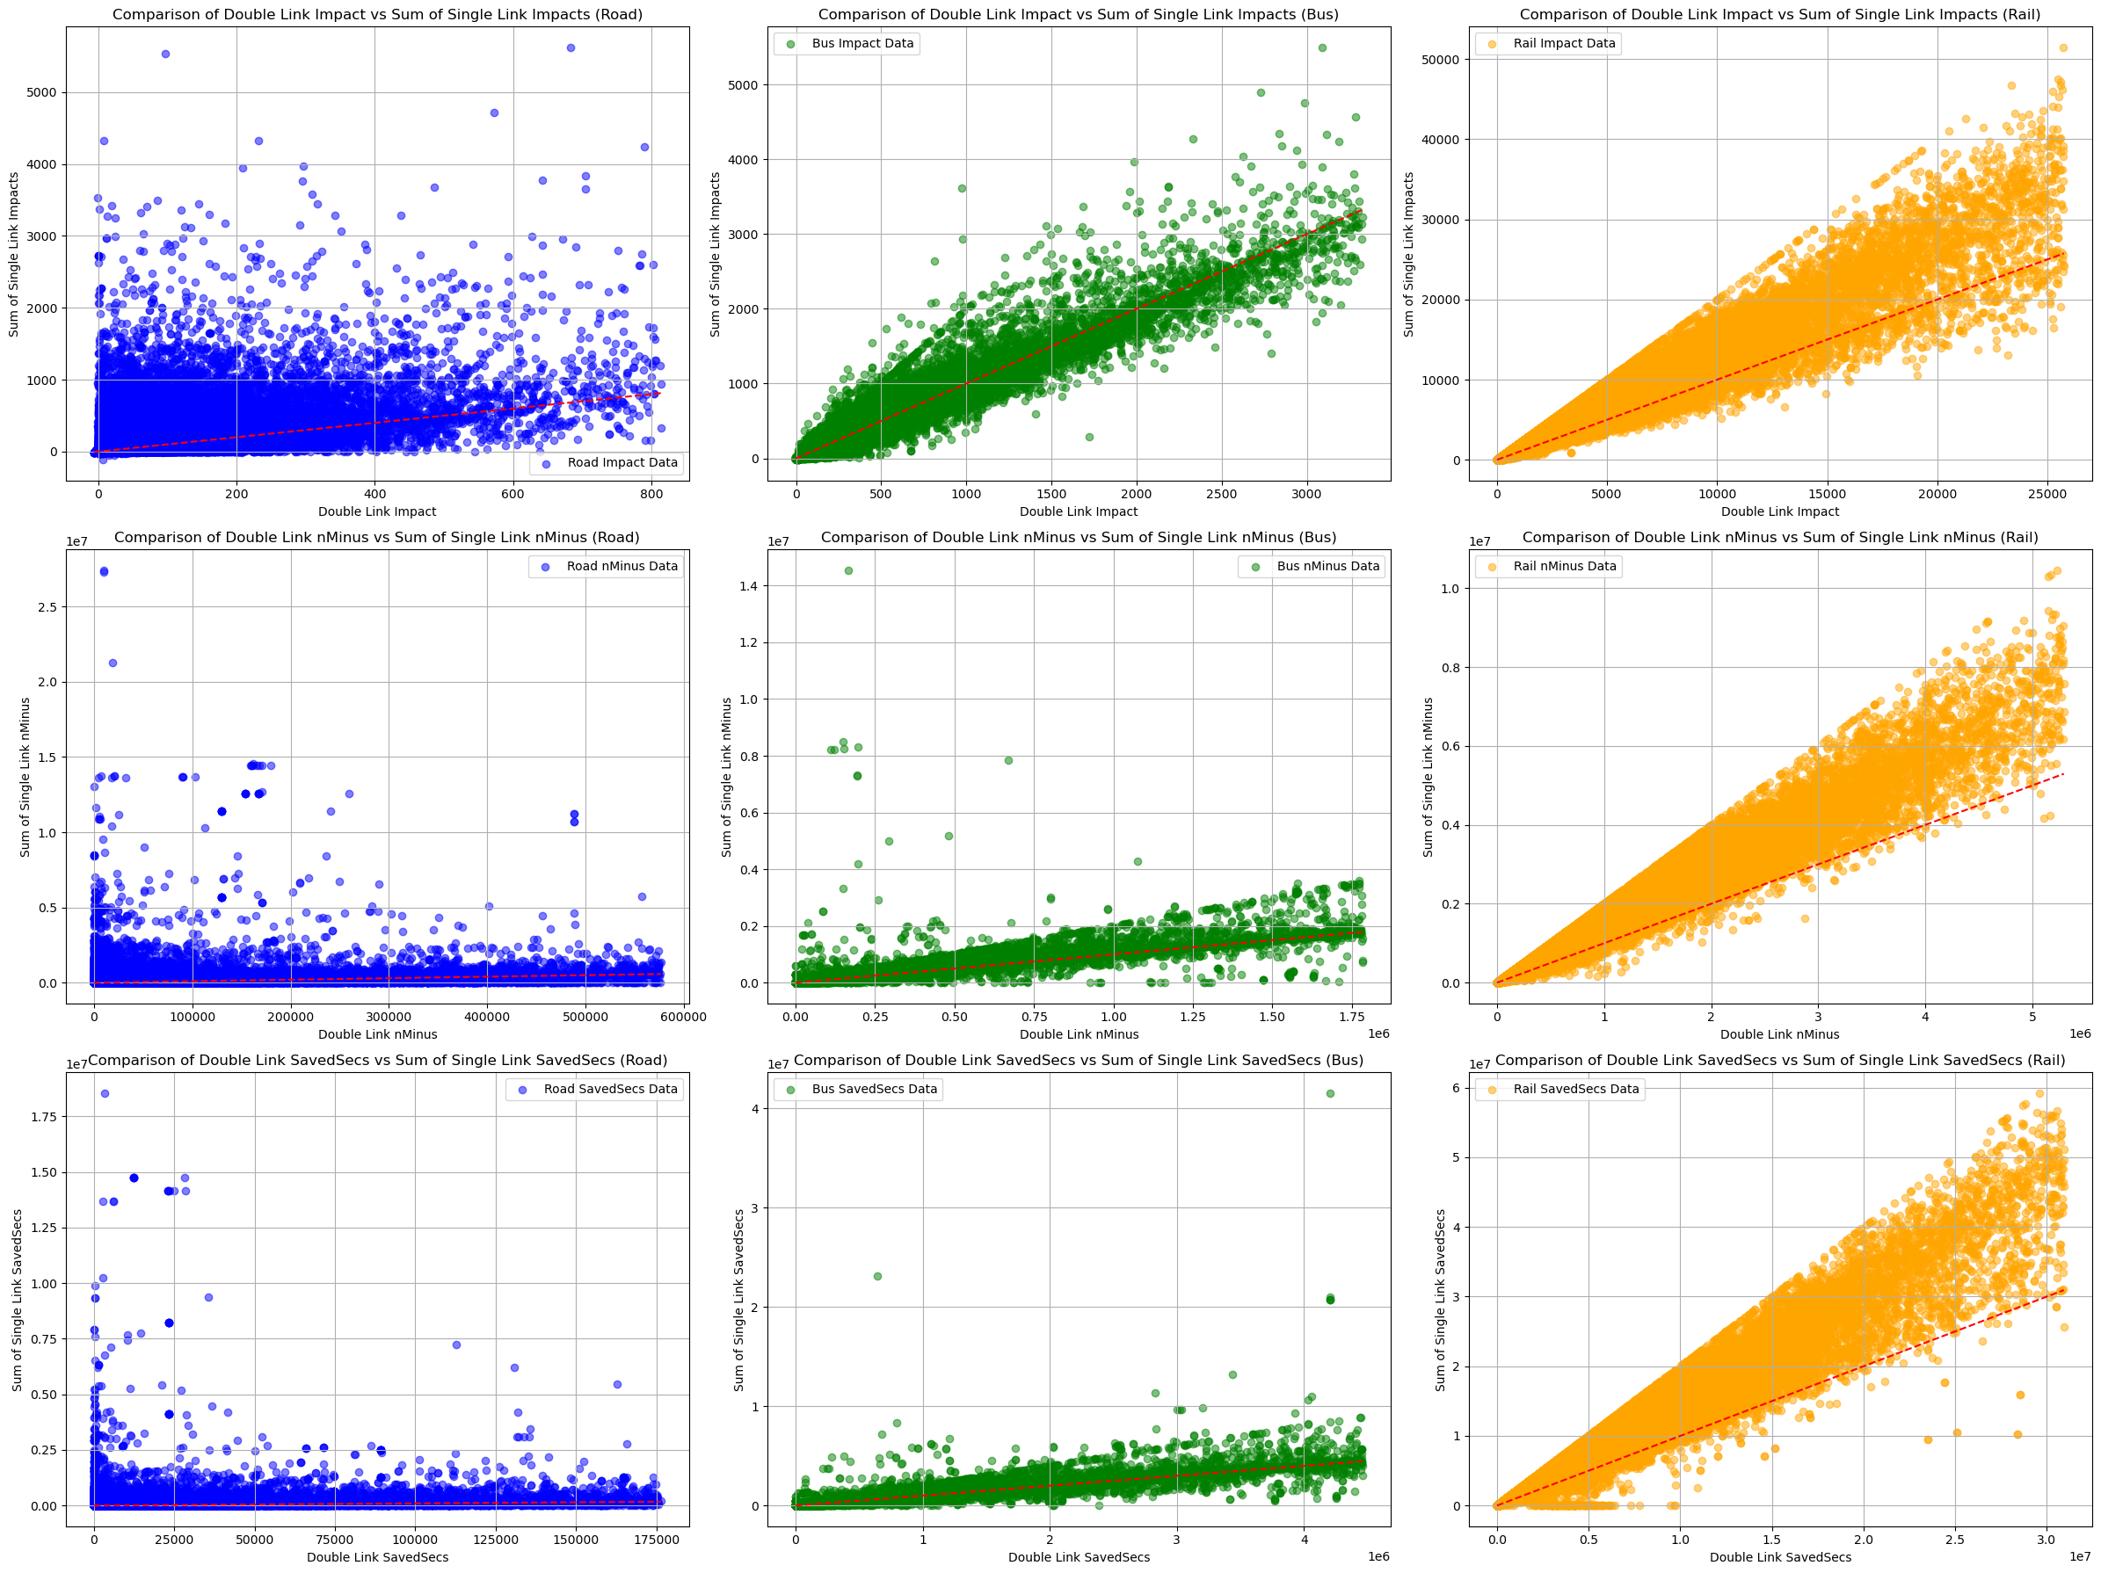
Additive Small Changes
Change in People Count
What happens if we add the impacts from two single link scenarios together and compare them to a combined two link scenario?
Count Improved Links
Rail scenarios behave in an additive way, bus scenarios are less strongly correlated, while road data behaves differently.
Network Change
ROAD
BUS
RAIL

Slide 8
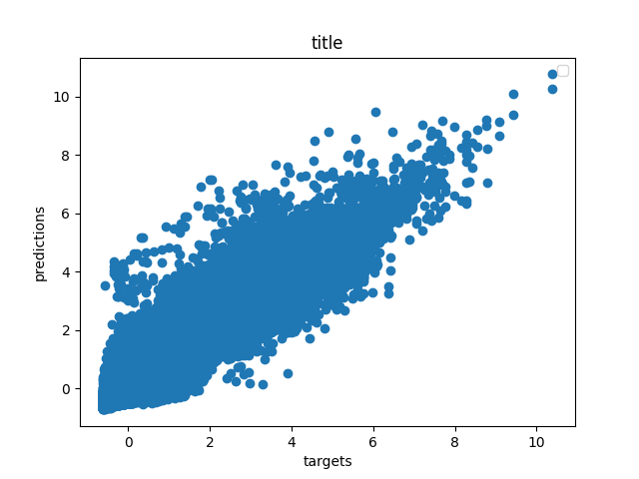
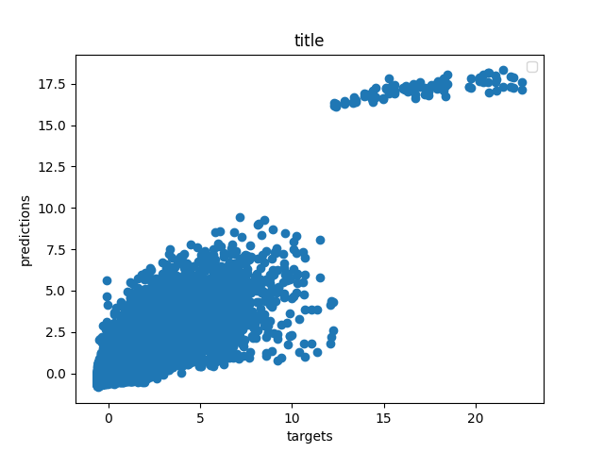
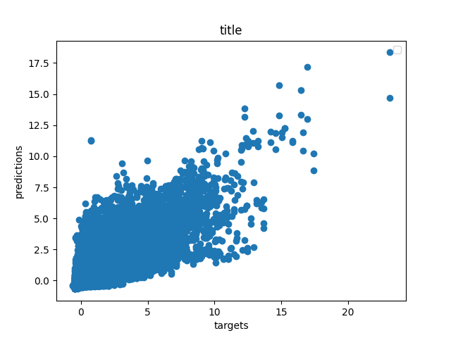
Predictive - emulators
net_i
net_j
R² Rail=0.88
R² Bus=0.78
R² Road=0.68
1024
net_secs
256
savedSecs_rail
32
32
8
1
CkDiff_rail
net_i_Oi_rail
Linear
net_i_Oi_all
net_j_Dj_rail
ReLu
The scenario’s origin and destination zone, network changes, residential and working population are used to predict the size of the mode switch
net_j_Dj_all

Slide 9
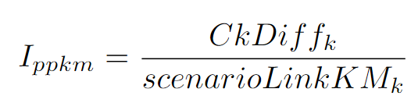
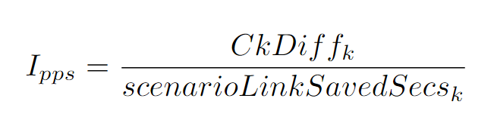
Challenges: Impacts, Costs and Benefits
Counts of People
Network Changes
Costs?
Number of people switching mode
New Link – saved secs
Secondary saved secs
Count improved routes
Track KM
Time saved
Distances
Metrics
Distance in KM on each mode e.g. road vs rail
Robustness
Resilience
I_{ppkm} and I_{pps}

Slide 10
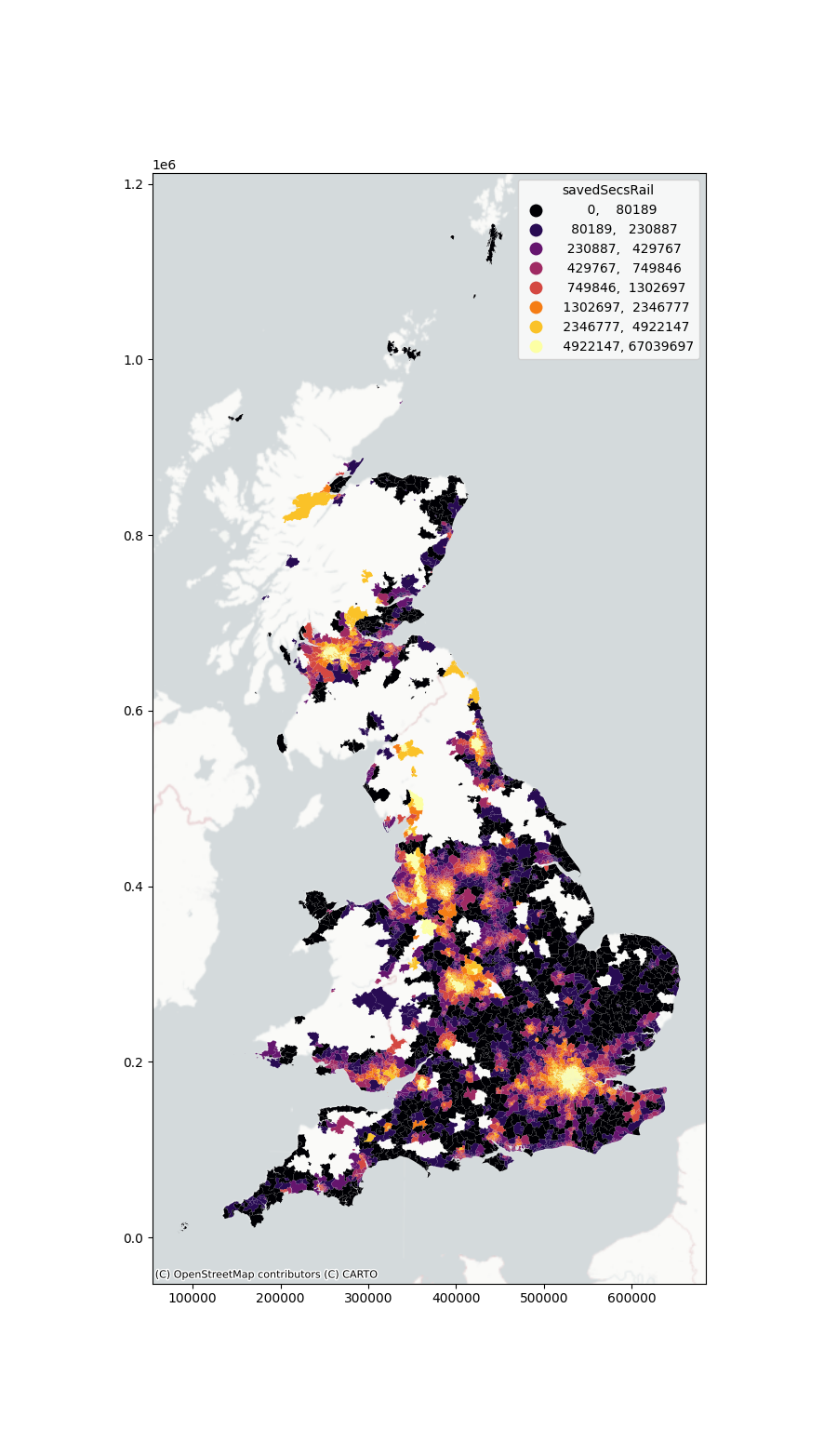
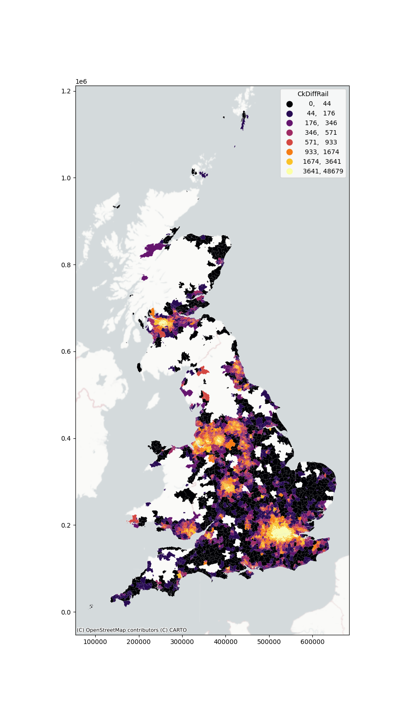
Visualisation of Rail Scenarios
What impact statistics do we need to show to a human urban planner to enable them to make better scenarios and how do we visualise the data?
Network changes (seconds)
Mode change (count of people)

Slide 11
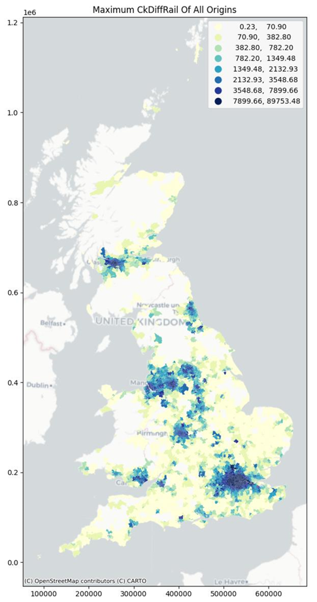
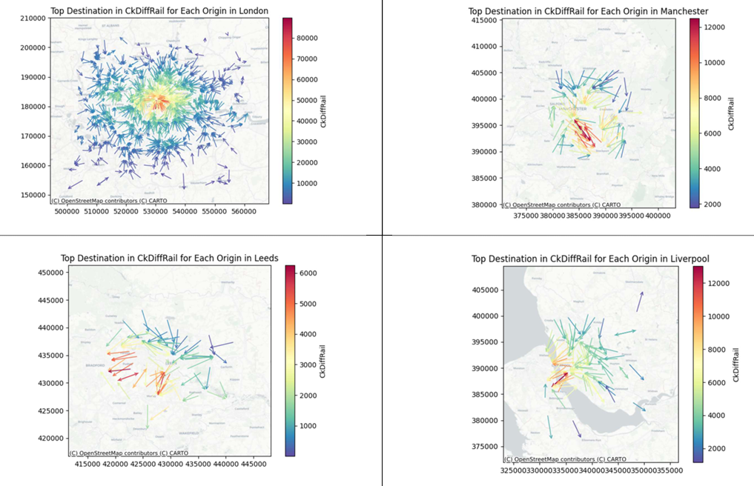
City Centre Data
London
Manchester
Leeds
Liverpool

Slide 12
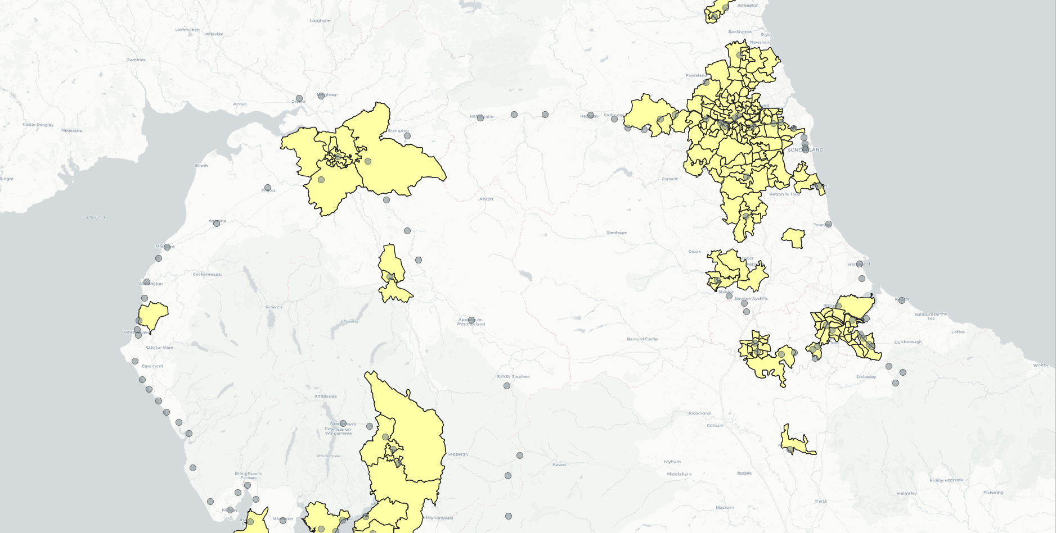
UK2070 Commission: Tyne Tees Cluster and Existing Rail Stations
Existing rail stations

Slide 13
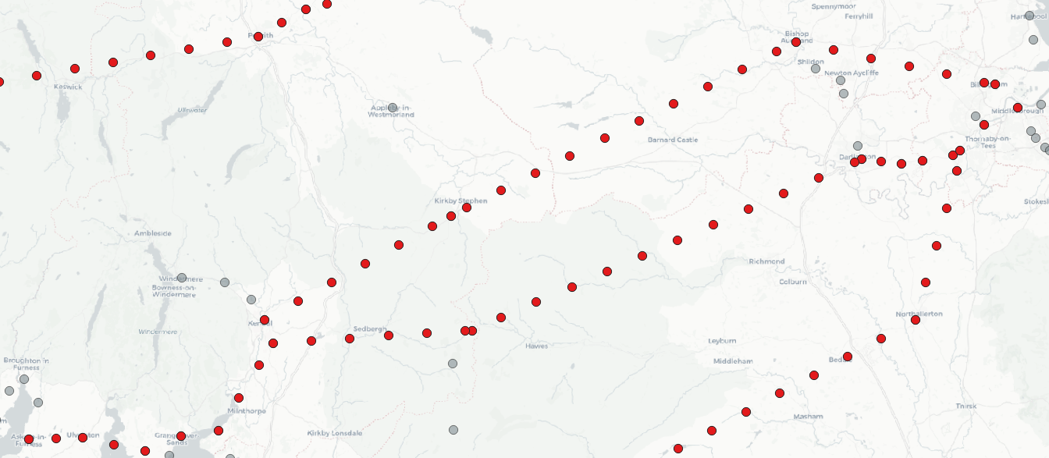
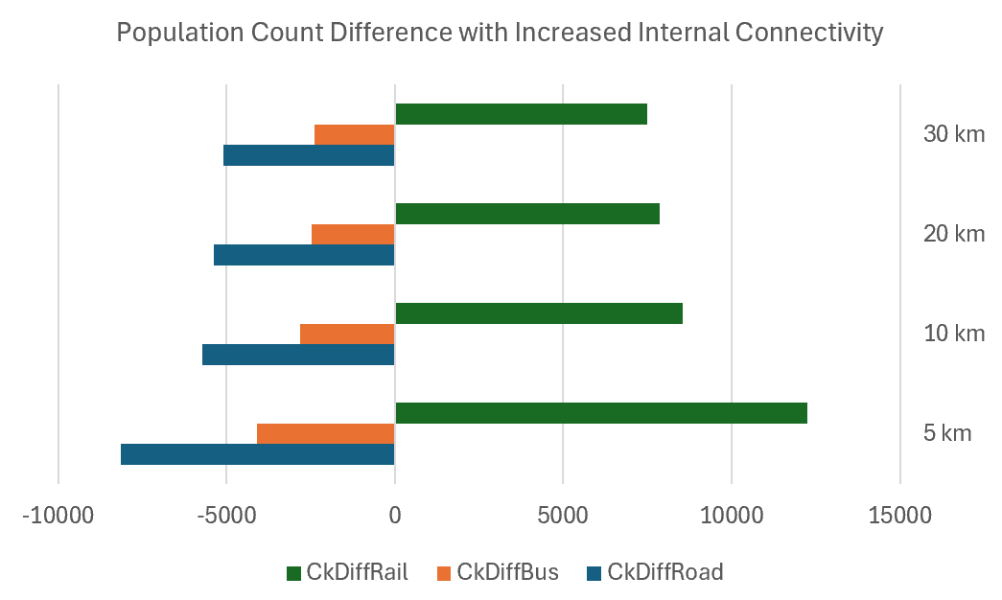
Small Changes
5KM
Testing the same route, but with different station spacing: 5KM, 10KM, 20KM and 30KM
H3 - Route 2
Station spacings: 5, 10, 20 and 30KM

Slide 14
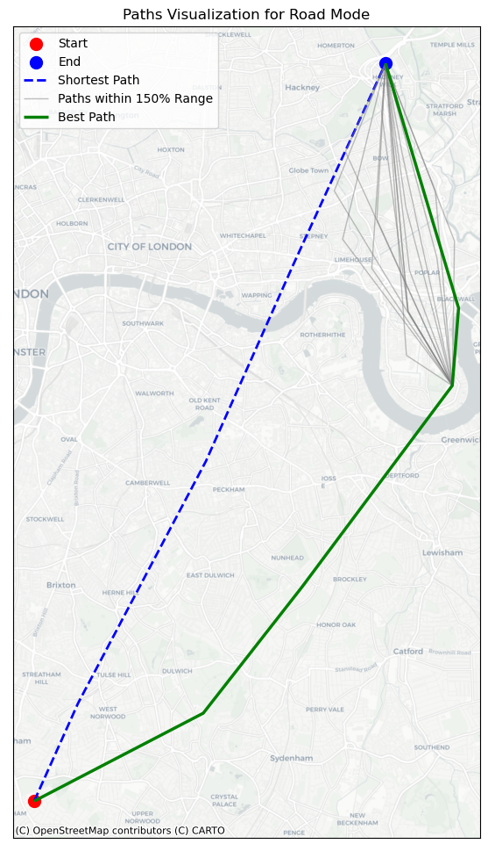
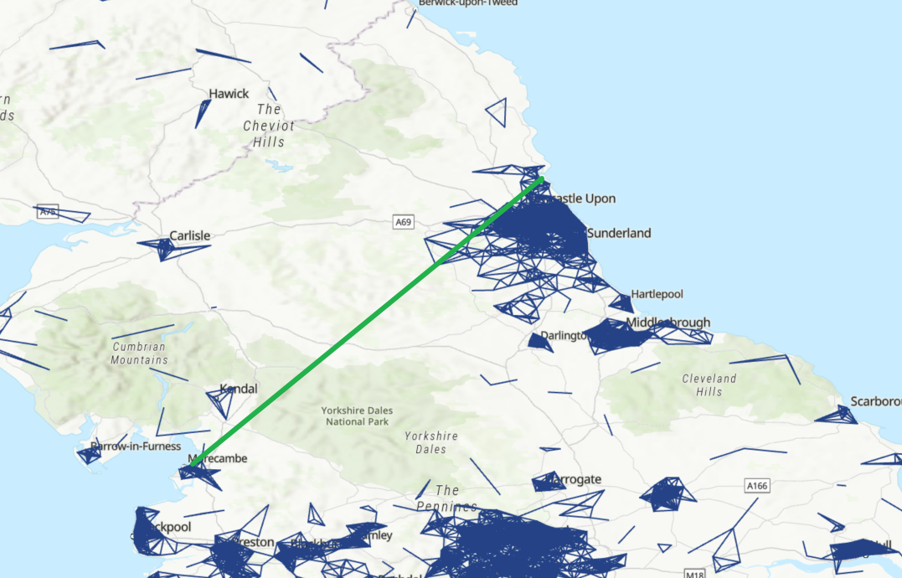
Generative Urban Modelling
Build an AI tool to use all the 5KM data to build high impact routes between two points – BUT, there’s a problem…
London test: connecting
two points

Slide 15
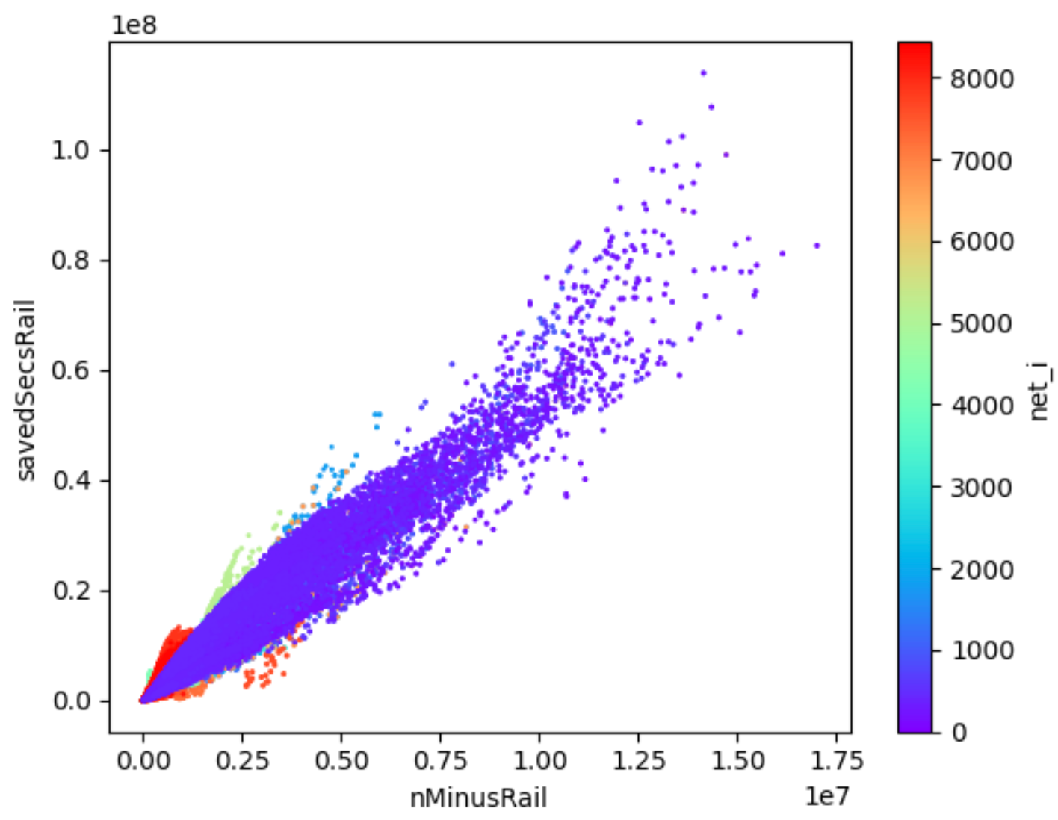
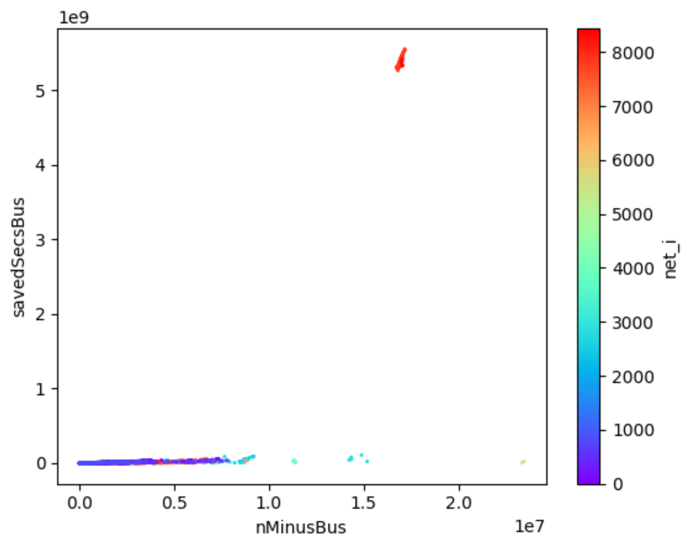
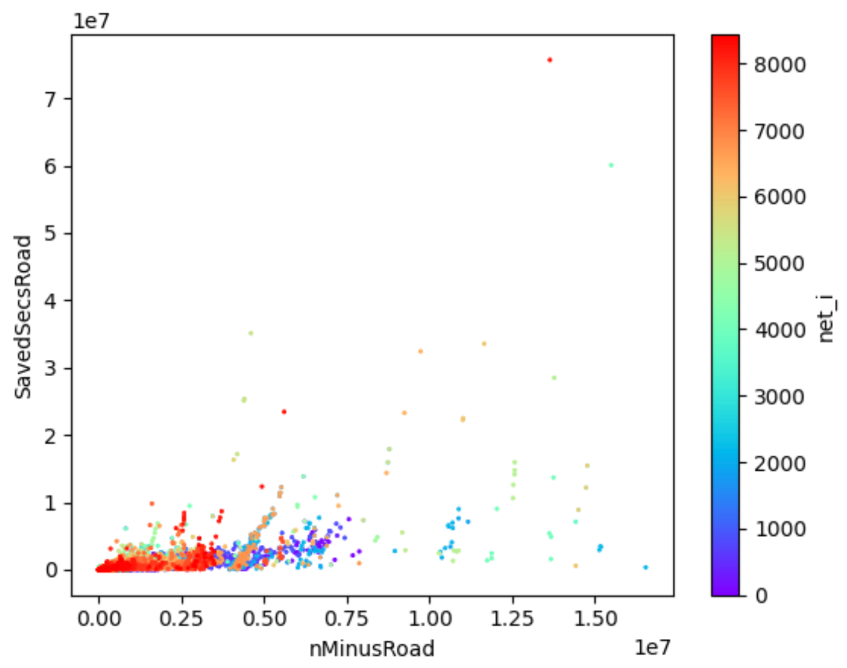
BUILDING A SECURE AND RESILIENT WORLD
Network Resilience: Reachable Locations and Recovery Time?
Over 1 million data points for researchers to analyse
Heuristics for combining small changes into complex scenarios
Evidence that the small changes idea works
Network saved seconds against count of improved routes: rail, bus, road

Slide 16

Dr. Richard Milton
richard.milton@ucl.ac.uk
Professor Michael Batty
m.batty@ucl.ac.uk
Xinyi Liu
Yuet Yung Lung (Alison)

