Slide 1


Slide 2
​
D-RES: Provision of distributed grid resilience using EVs during extreme weather events
DAFNI Annual Conference 2024

Slide 3
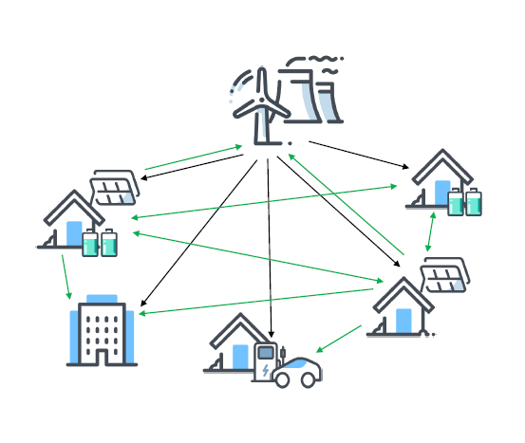


D-RES Team
Title - D-RES: Provision of distributed grid resilience using EVs during extreme weather events
Desen Kirli (team lead)
Laiz Souto (Bath lead)
Peter McCallum
Killua Qin

Slide 4


The Challenge
Natural hazards and extreme events are an increasing threat not only to humans but also power grid resilience - a direct impact is the power cuts, e.g., Storms "Dudley", "Eunice" and "Franklin" in February 2022 left over a million homes without electricity.
Increasing adoption of EVs pose a challenge for the existing infrastructure but can be coordinated to provide distributed resilience – if managed effectively.

Slide 5
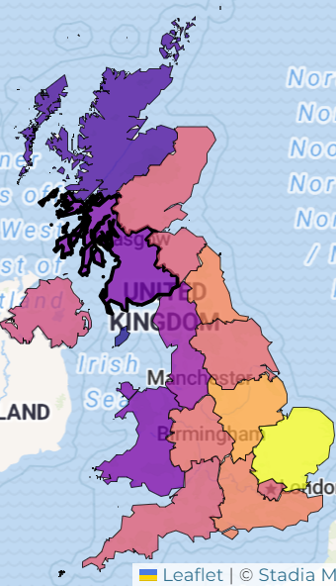
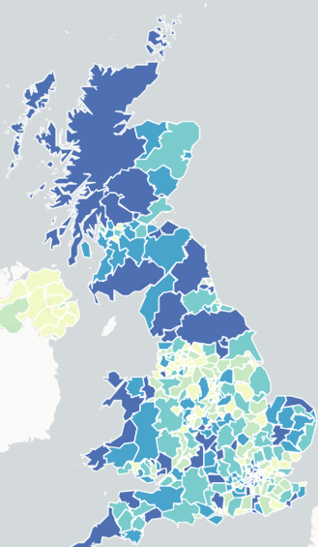
Motivation
Existing infrastructure, benefits to various stakeholders
Need for coordination
D-RES will increase awareness about distributed resilience in decision making
  The Government and Ofgem are looking to identify priority actions for enabling deployment of V2X.​
Instrumental in operational planning
https://uk-cri.org/
https://maps.dft.gov.uk/ev-charging-map/index.html
Climate risk
(Median days/year with "record-breaking weather")
EV charging infrastructure
(No of charger per 100,000 people)

Slide 6
The D-RES Model
D-RES
Model
Weather
Signals
Services
normal
BAU
Time-of-use
if
volatile
Pre-event
Frequency services
Start
Decision framework
Decision framework
EV availability
low
during
STOR (S/T op.res.)
if
high
post
Black-start

Slide 7
Deployment Schema
MODELS
►
PyPSA_go
D-RES
WORKFLOWS
►
D-RES-Orkney
►
PARAMETERS & SETTINGS
Configured using `model_definition.yaml`
Set by user(s) in DAFNI UI
DATA
►
Data 1
Data 5
Data 2
Data 6
Data 3
Data 7
Data 4

Slide 8
Deployment Schema: re-use
MODELS
►
PyPSA_go
D-RES
WORKFLOWS
►
D-RES-Orkney
D-RES-Shetland
etc…
DATA
►
Data 1
Data 5
Data 8
Data 12
Data 2
Data 6
Data 9
Data 13
Data 3
Data 7
Data 10
Data 14
Data 4
Data 11

Slide 9
Deployment Schema: wider integration
MODELS
►
PyPSA_go
D-RES
{another_model}
WORKFLOWS
►
D-RES-Orkney
{another_workflow}
DATA
►
Data 1
Data 5
Data 5
Data 15
Data 2
Data 6
Data 6
Data 16
Data 3
Data 7
Data 7
Data 4

Slide 10
Understanding the impact of extreme weather on power grids
Before
During
After
►
►
►
Preventive load scheduling
Equipment damage and failure
Restore power supply
Check and harden the device
Power interruption
Equipment repair and replacement
Load fluctuation
Load management and power supply scheduling

Slide 11
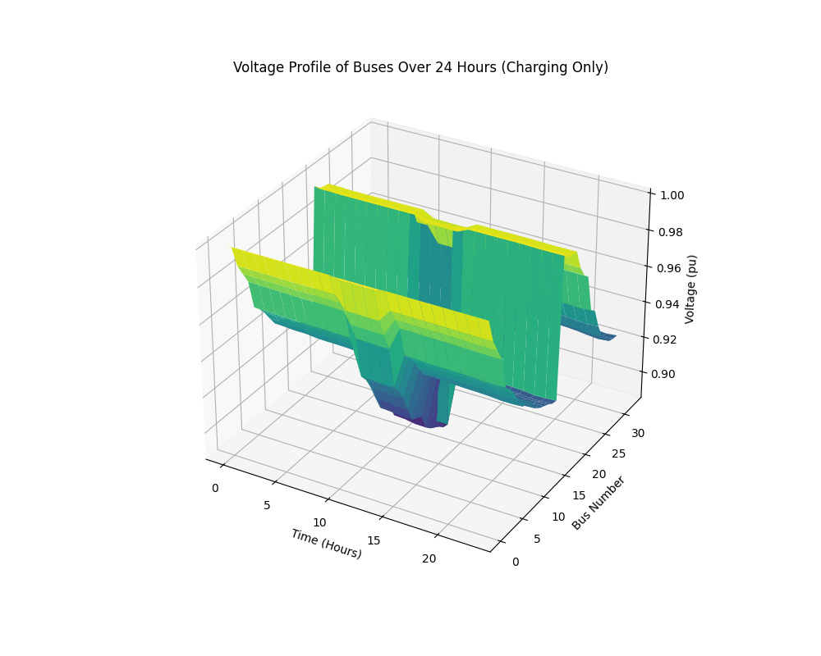
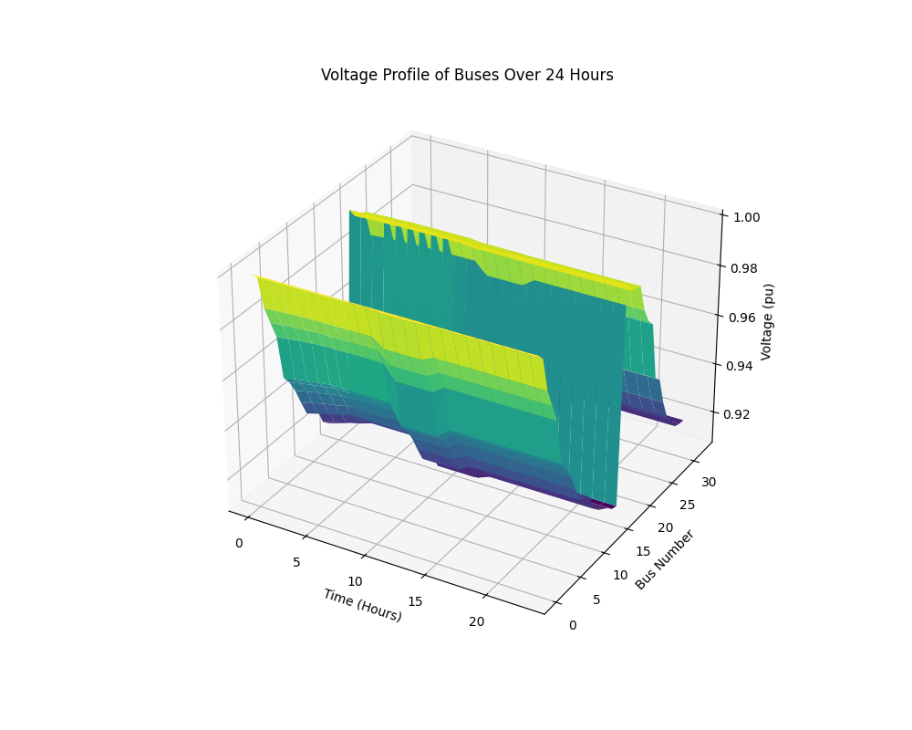
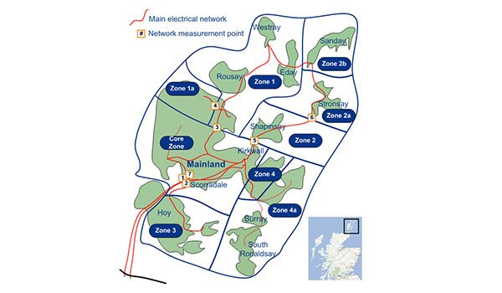
Ongoing work
Pre-event
►
Balancing services to maintain distribution network stability.
During the Event
►
As a spare capacity to provide short-term emergency power supply to the grid.
Post-event
►
Provision of support to restore grid operation
A demonstration example based on IEEE 33 distribution network

