Slide 1
MARS: Modelling Aviation Resilience Scenarios
Dr Fabian Steinmann
Dr Irene Moulitsas
Dr Desmond Bisandu
DAFNI CONFERENCE 2024 10th September 2024, Birmingham

Slide 2
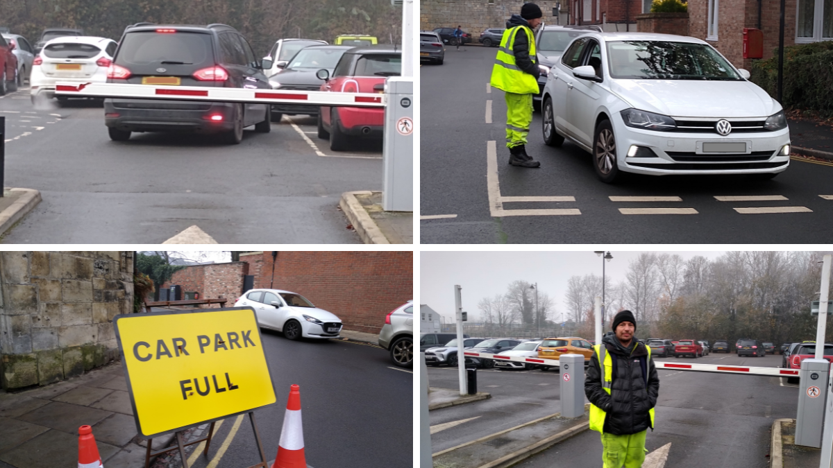
Slide Title, Arial Bold 28pt
The York Press

Slide 3

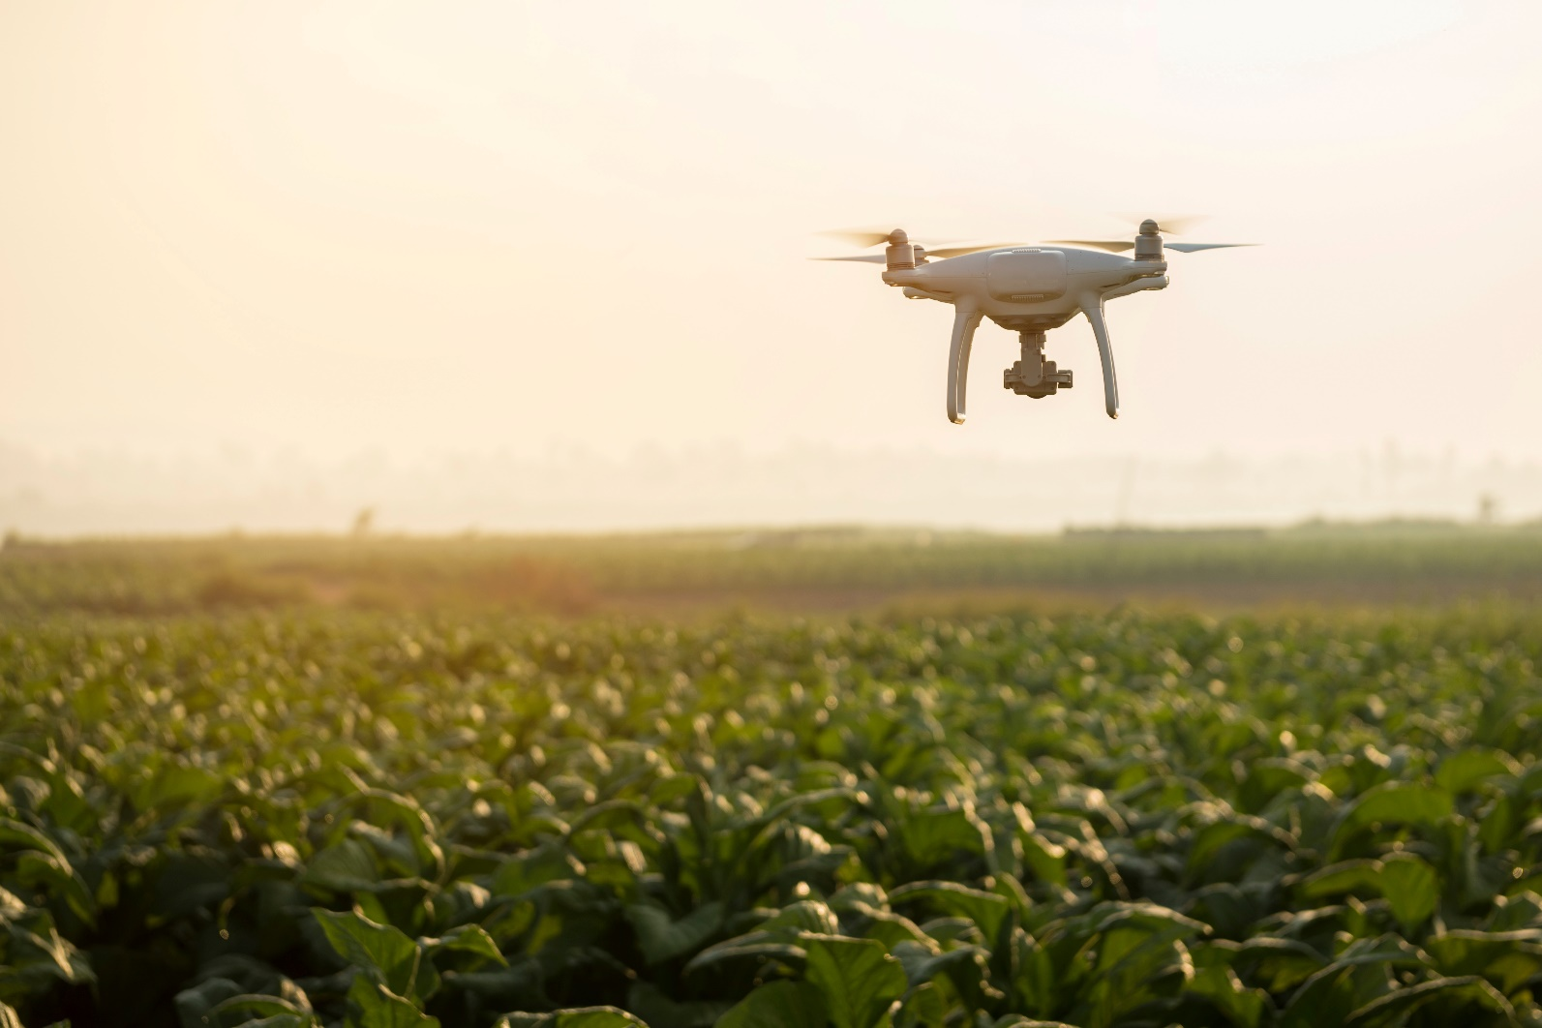
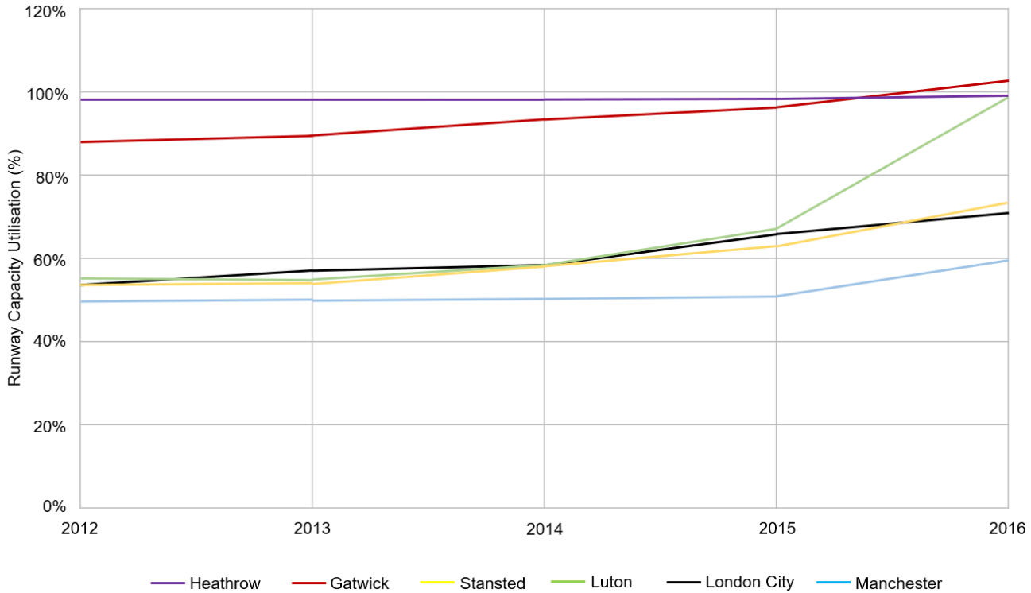
UK Air Transportation System

Slide 4
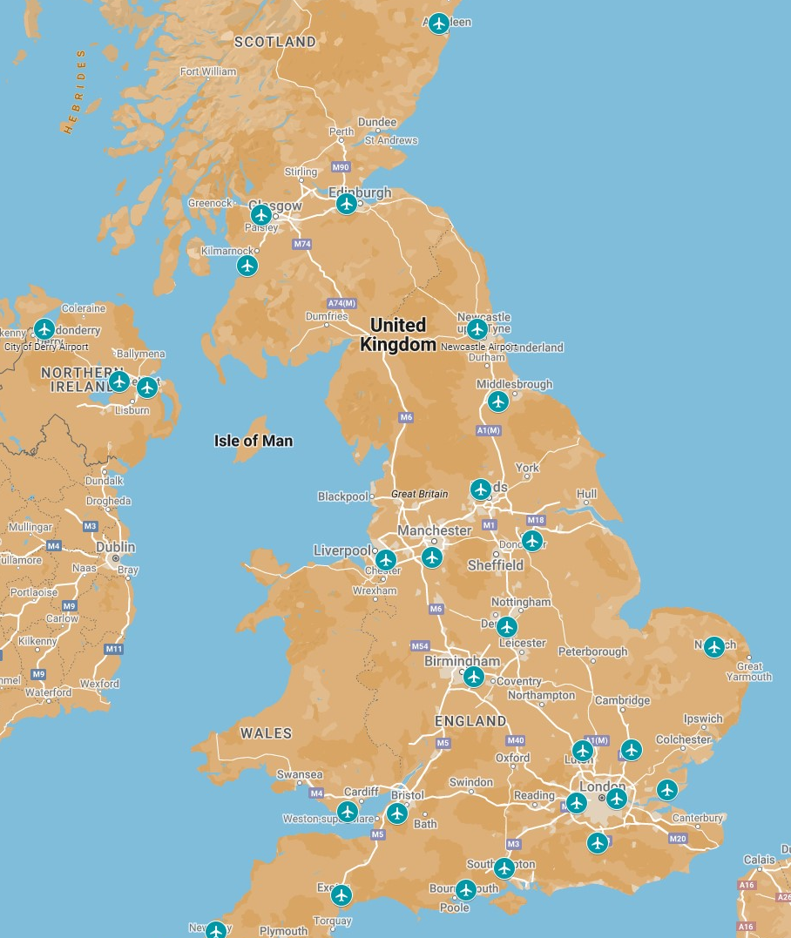




Slide Title, Arial Bold 28pt
34 UK airports
Scheduled Arrivals – London Gatwick (LGW)
Time | Flight number | Airline | Aircraft type | Code | 1st Diversion | 2nd Diversion
12:20 | W95776 | Wizz Air | A321neo | C | LTN | BHX
12:25 | VY6009 | Vueling | A320neo | C | LHR | MAN
…
Stand availability – London Heathrow
Code B | Code C | Code D | Code E | Code F
0 | 7 | 0 | 2 | 1
Additional Runway capacity – London Heathrow (LHR)
8
Contractual agreement - Vueling
LHR | MAN | BHX | GLA | NCL | EDI | ABZ | BRS | CWL | …
Yes | Yes | Yes | No | No | Yes | No | No | Yes

Slide 5

Outputs
Scenario planning
Outputs expected to contribute to understanding of resilience of UK air transportation system
Input variables can be adjusted
Data set & Computational model uploaded to National Infrastructure Database
Model scalable and could be extended in other transportation methods

Slide 6

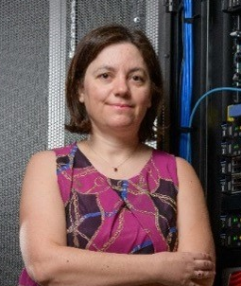




Get in touch:
Dr Fabian Steinmann
Dr Irene Moulitsas
Dr Desmond Bisandu
Thank you for joining the session!

