Slide 1


Slide 2
DAFNI Sandpits 2024​
​
IMproving flood-disruPted road networks resilience with dynAmic people-Centric digital Twins (IMPACT)

Slide 3
Project Team
Role | Name | Organisation | Division or Department
PI | Qiuchen Lu | University College London | Bartlett School of Sustainable Construction
Co-I | Tao Cheng | University College London | Dept of Civil, Environ & Geomatic Eng
Named Researcher | Xuhui Lin | University College London | Bartlett School of Sustainable Construction
Named Researcher | Xianghui Zhang | University College London | Dept of Civil, Environ & Geomatic Eng
Team Member | Tohid Erfani | University College London | Dept of Civil, Environ & Geomatic Eng
Team Member | Trung Hieu Tran | Cranfield University | Centre of Design Engineering

Slide 4
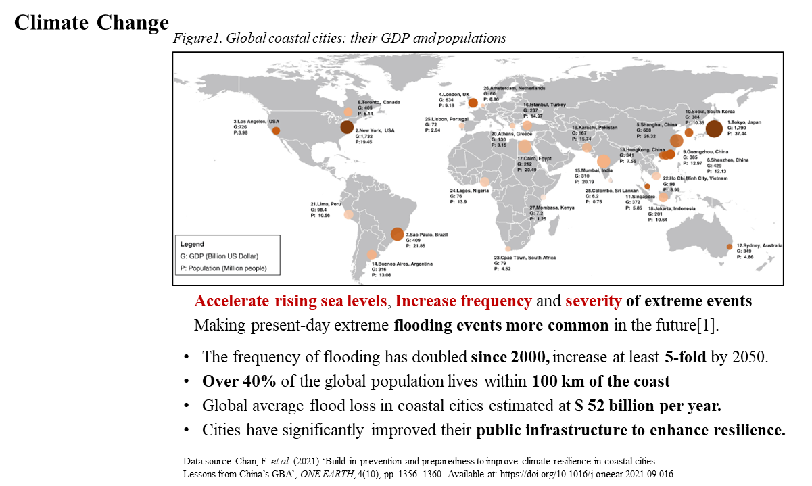
Research Background

Slide 5
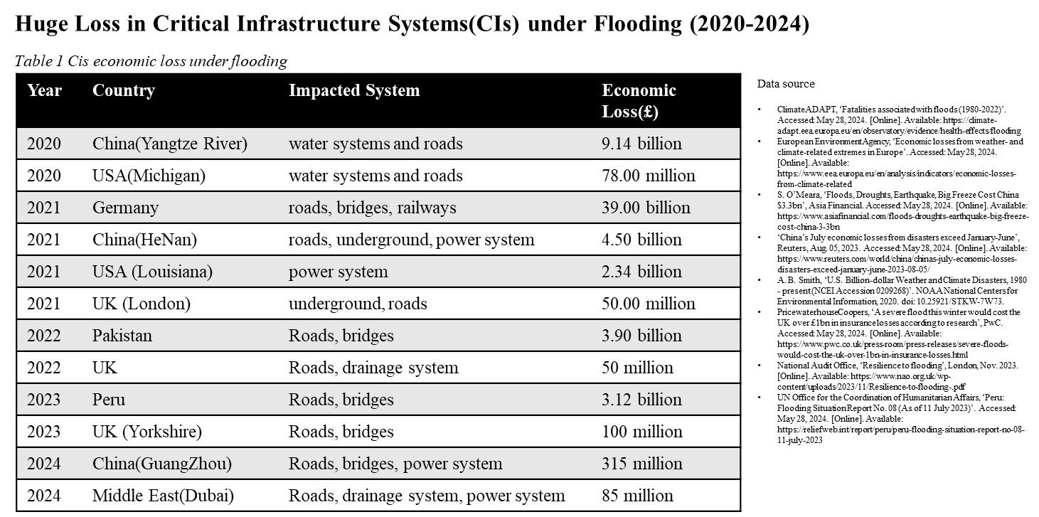
Research Background

Slide 6
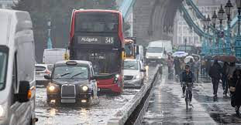
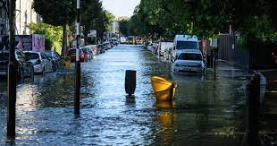
Current Facts
In the UK, escalating flood increasingly affect people and property, intensifying pressure on national road networks [1].
The A303 has been closed for days after heavy rainfall-induced flooding since Storm Ciarán in November 2023.
Approximately 6,600 kilometres of UK roads are within regions prone to flooding, and this is anticipated to increase by up to 160% by the 2080s if adaptation measures are not implemented [2].
Traffic congestion is the most common risk to the road network, which is an important part of assessing road network service capacity and demonstrating road network resilience [3].
[1] Climate Change Committee (2021). Advice to Government for the UK’s third Climate Change Risk Assessment. https://www.theccc.org.uk/wp-content/uploads/2021/07/Independent-Assessment-of-UK-Climate-Risk-Advice-to-Govt-for-CCRA3-CCC.pdf (Latest accessed 18/09/2023)
[2] Begum, S., Fisher, R. S., Ferranti, E. J., and Quinn, A. D. (2022). Evaluation of Climate Change Resilience of Urban Road Network Strategies. Infrastructures, 7(11), 146.
[3] Chen, H., Zhou, R., Chen, H., & Lau, A. (2022). A resilience-oriented evaluation and identification of critical thresholds for traffic congestion diffusion. Physica A: Statistical Mechanics and its Applications, 600, 127592.

Slide 7
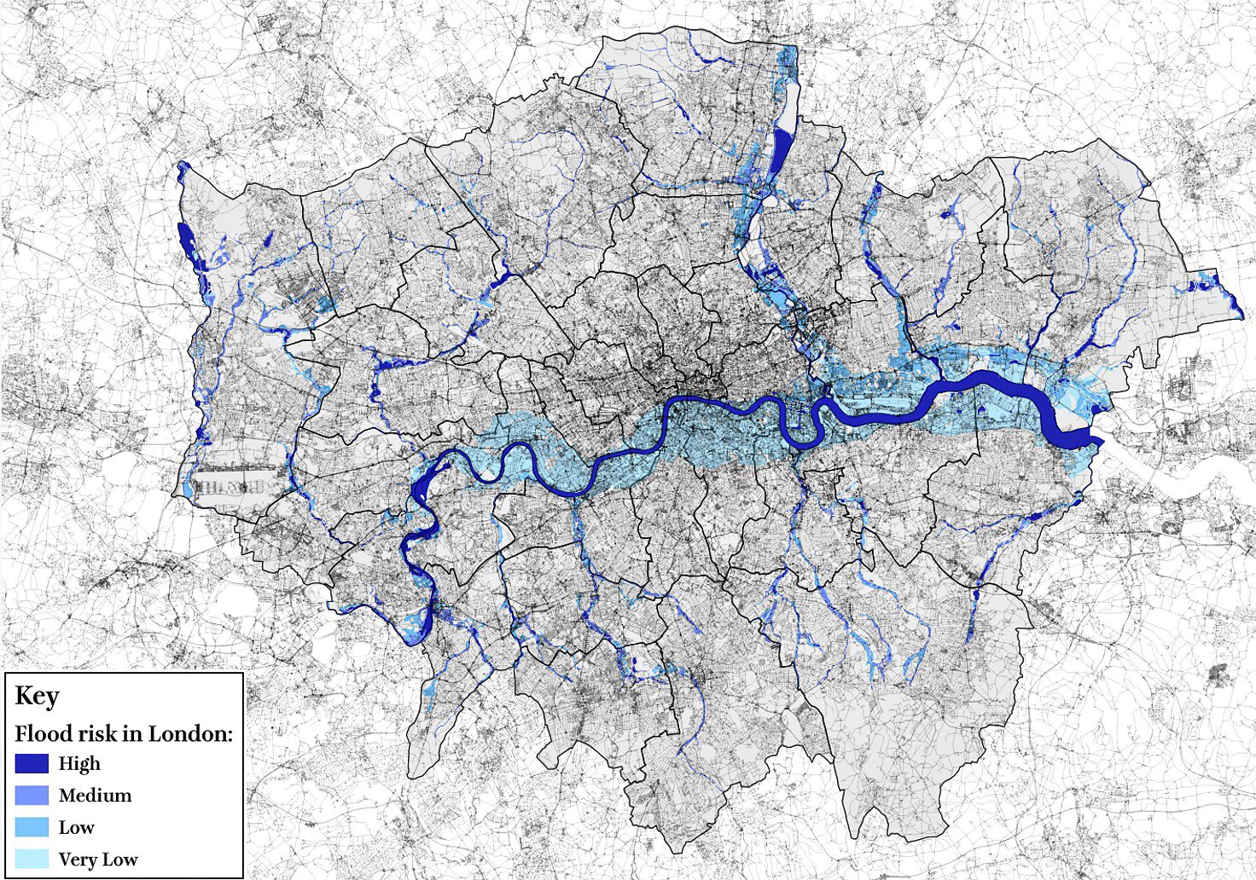
Research Challenge
This project will address three key challenges of UK road networks that will be:
Dynamic – Static: sensitive to sudden changes in true conditions (assessing congestion risk in flood is however hindered by interaction complexity and dynamic nature of ‘user-road-flood’ cross-domain system);
Cross-domain Integration: informative on flooding events (current approaches ignore the integrated flood-road-user characteristics);
Multimodal Nature: capable of performing human-centric assessments and multimodal data sharing.

Slide 8
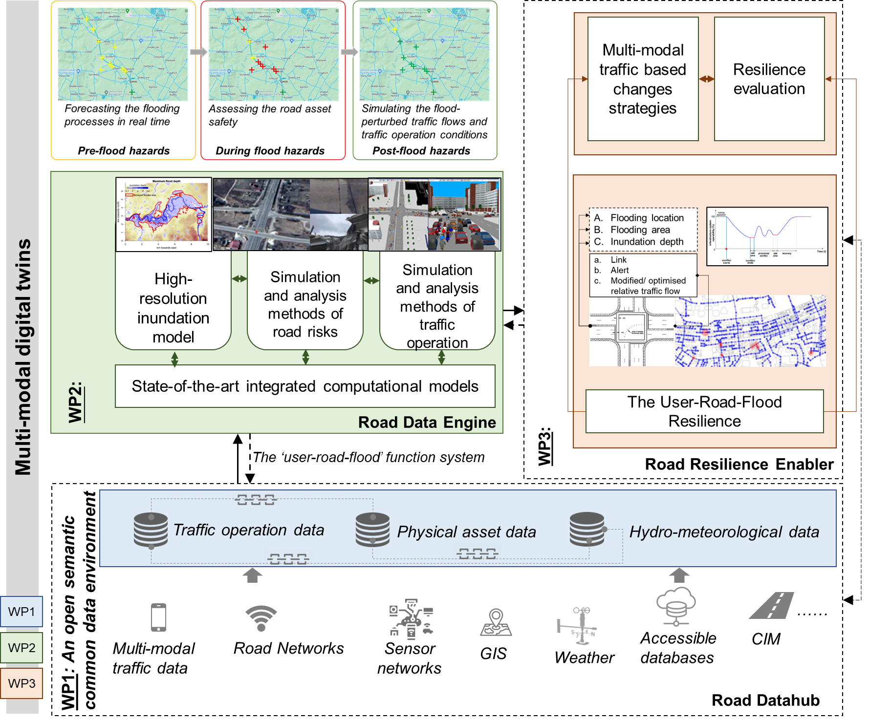
The goal is to assess and improve the resilience of road networks in fast-changing flood through the multimodal data – based dynamic people-centric digital twin.
WP1:
WP2:
WP3:
WP4: System Integration and Validation
Projects 1,2,3
1 | 2 | 3 |  | 30 | 36 | 42 | 48 | 54 | 60
Multi-Modal people-centric digital twin
6 | 12 | 4 | 5 | 6 | 7 | 42 | 48 | 54 | 60
6 | 12 | 18 | 24 | 6 | 7 | 8 | 9 | 54 | 60
6 | 12 | 18 | 24 | 30 | 36 | 42 | 9 | 10 | 60

Slide 9
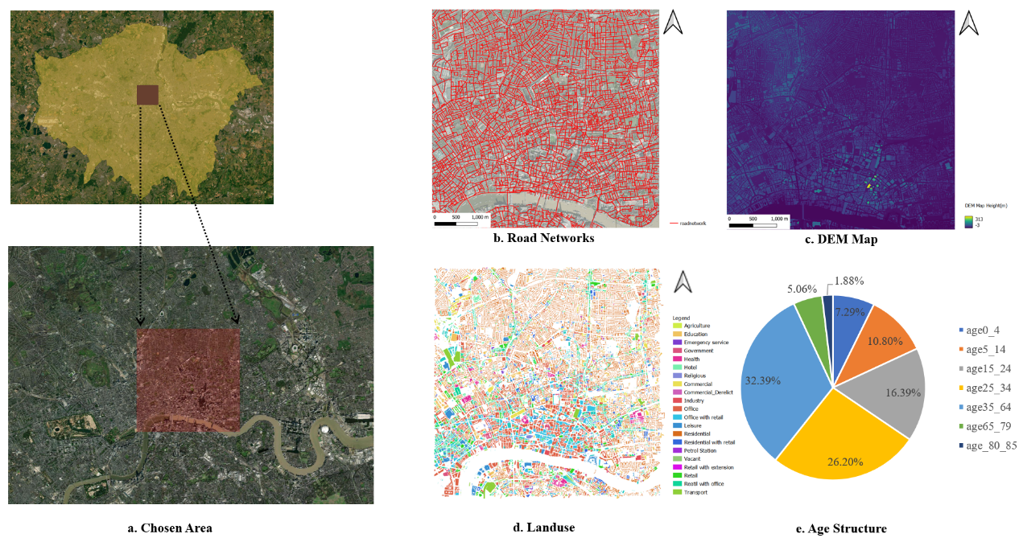
Research Progress
Data Source (A chosen area in London: King’sCross to Farringdon)
Road Segments: 7820
DEM: 2m × 2m
Size: 5000m × 5000m
DEM data
Buildings Map
Road Networks
Age Structure
Landuse Data
Multimodal Traffic Data
Figure. Data source in chosen area
29

Slide 10
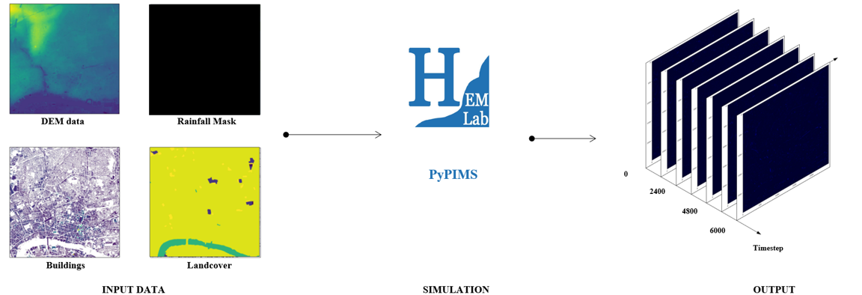
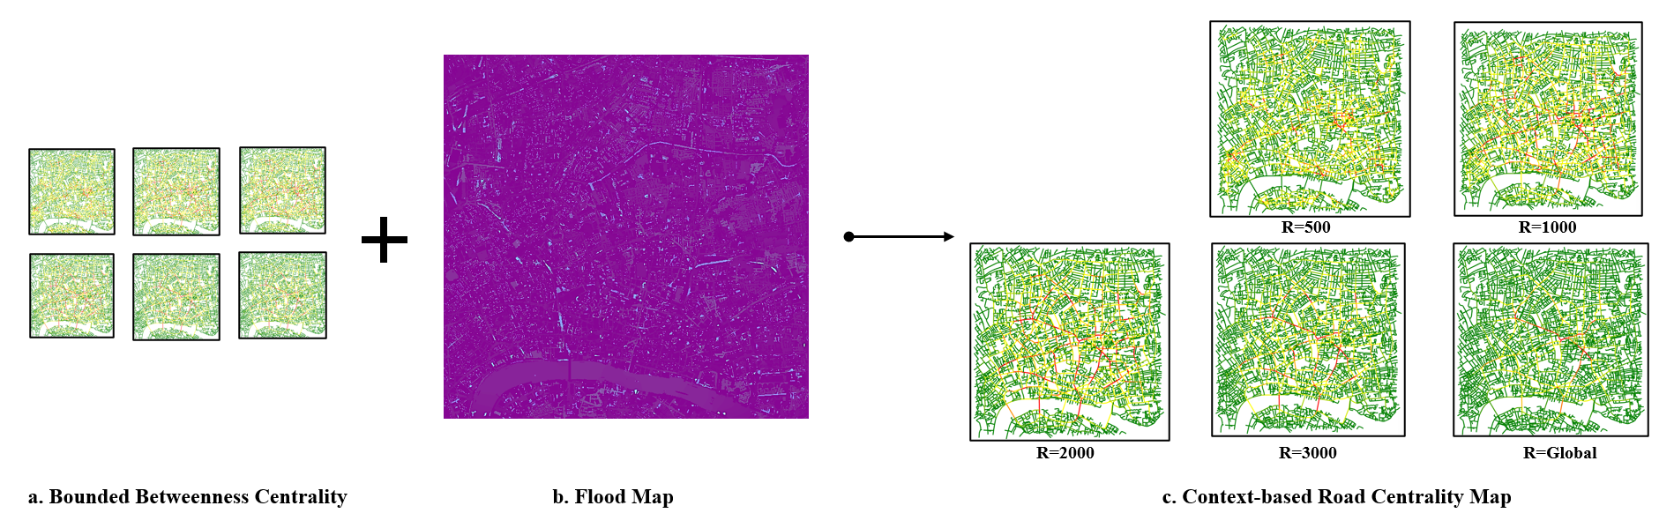
Research Progress
1. Generating Flood Map
Figure. The calculation process of flood map
Input:
DEM data, Buildings Map
Rainfall Mask, Landcover Mask
Output:
Flood Map in two hours (Water Depth)
2. Generating Topological Integrating Centrality Map
Figure. Context-based bounded centrality transportation networks
Algorithm:
Apply context-based bounded centrality calculation to capture the impact of local disruptions
R=500, 1000, 2000, 3000, Global
Output:
Centrality Map(Local, Regional, Global)
30

Slide 11
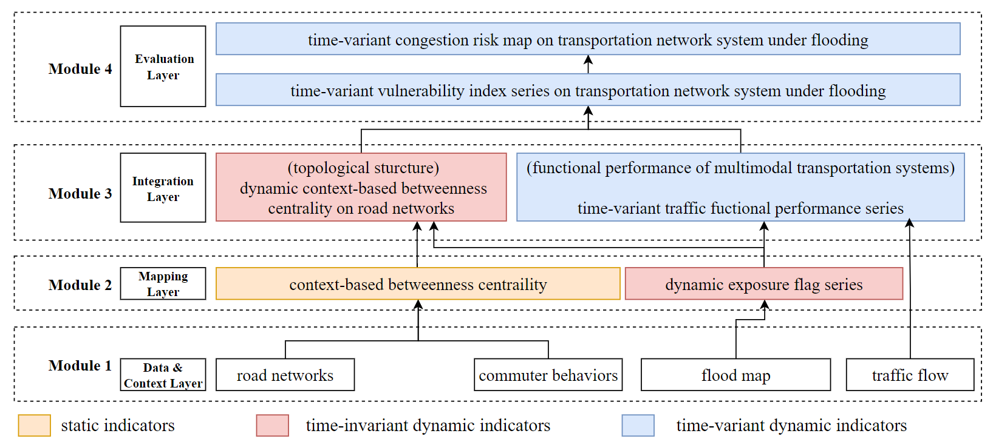
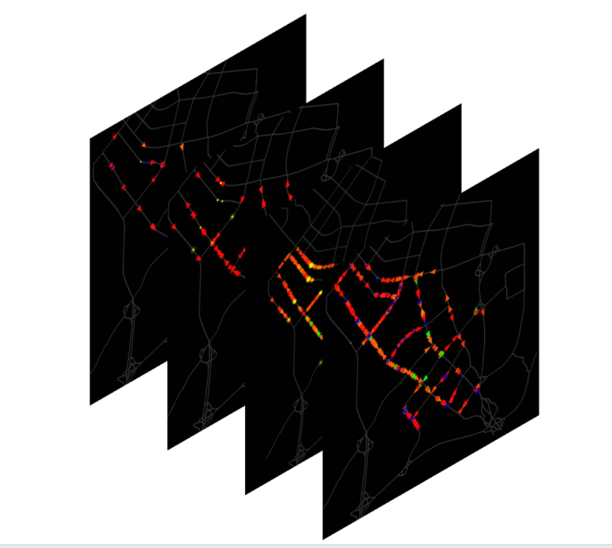
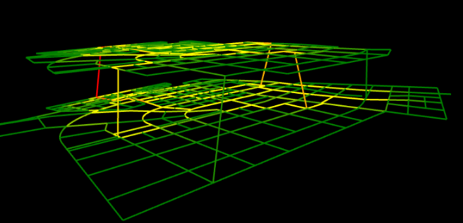
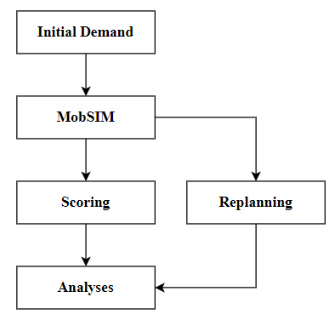
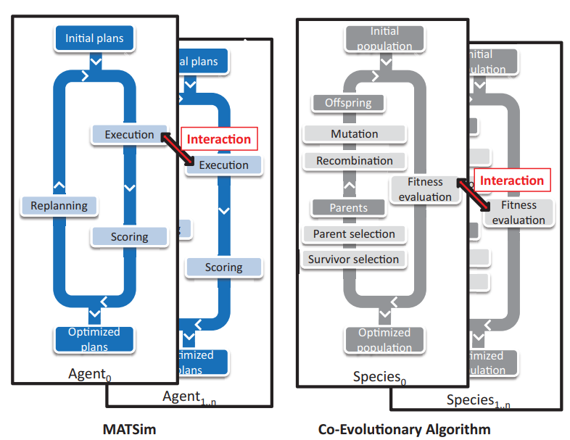
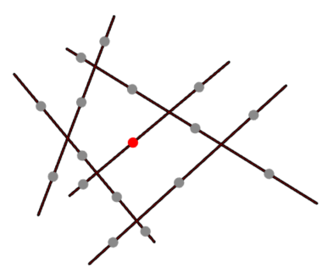
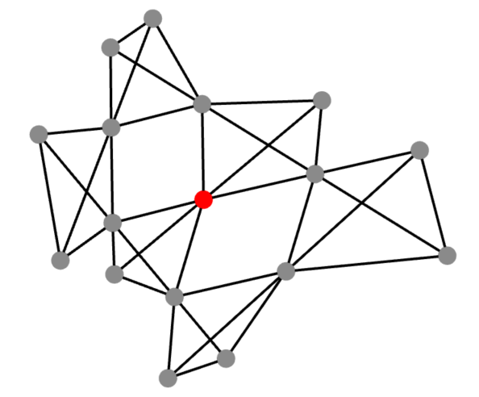
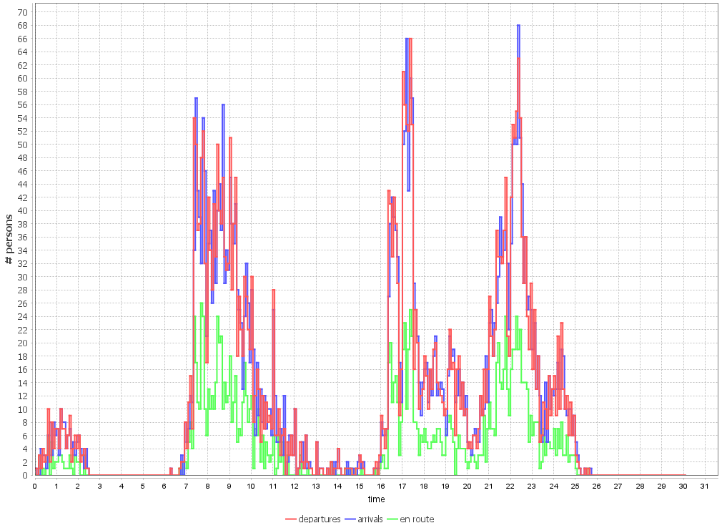

Framework form IMPACT
Figure 1. Framework structure for IMPACT
Data and Context layer
1. Integrate and contextualise primary multimodal data, encompassing road networks, commuter behaviour patterns and flood map
Mapping and Integration layer
1. Establish connections between topological structure analyses of road networks and the functional performance of multi-modal transportation systems.
2. Validate result with traffic flow data.
Evaluation layer
1. Introduce novel indicators for assessing vulnerabilities and dynamic risks
Dynamic context-based betweenness centrality on road networks
Time-variant traffic functional performance series
(Based on MatSIM)
c. Micro-simulation
Road → line graph
a. Topology structure
b. Multi-modal network
d. Traffic flow analysis
c. Core algorithm
a. Agent-based Modelling
b. Co-evolution algorithm

Slide 12
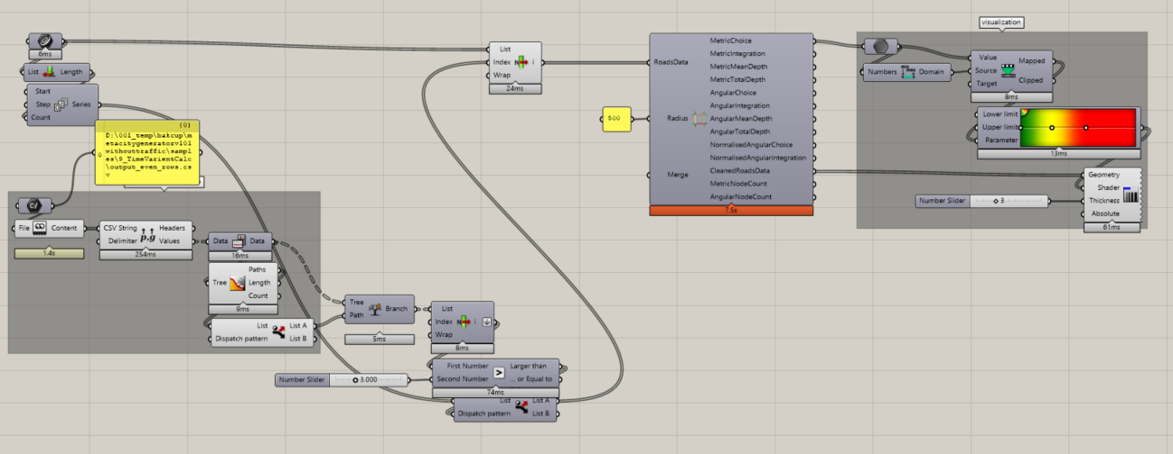
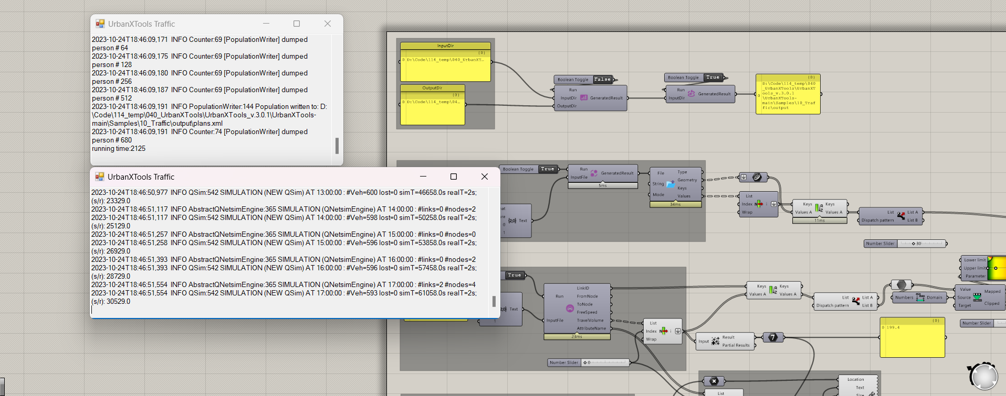
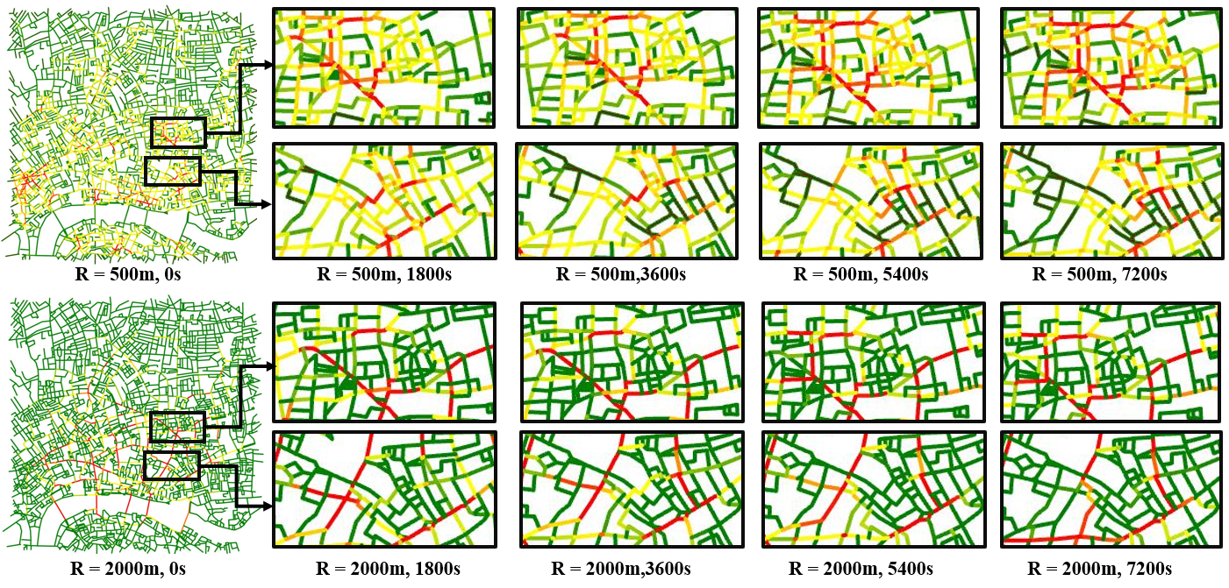
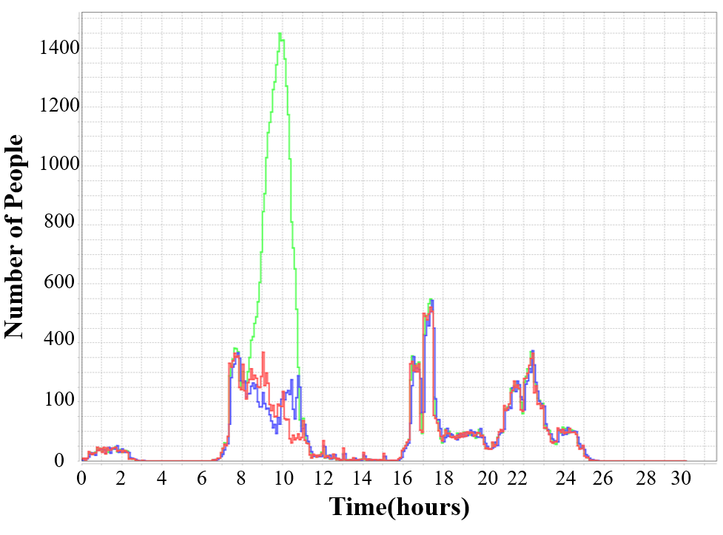
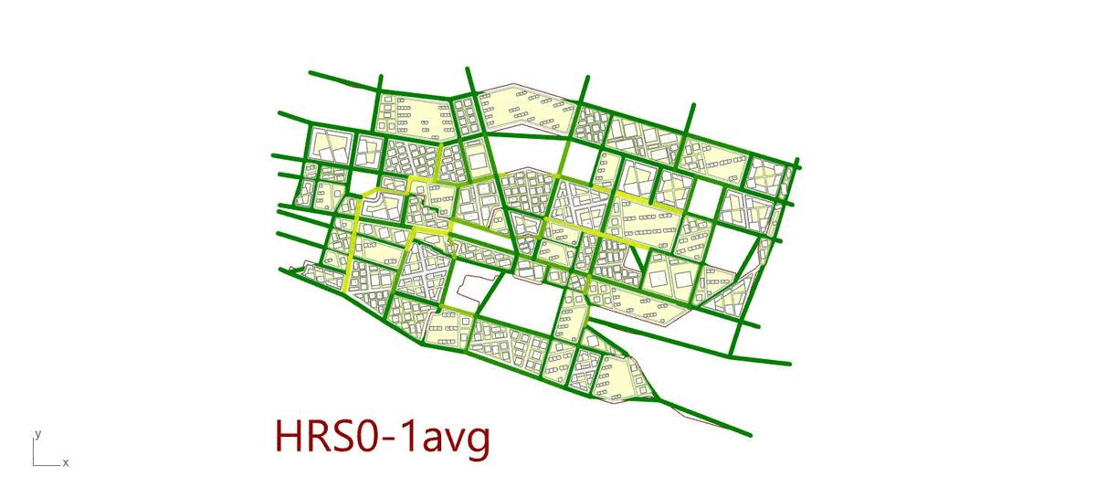

Calculation in IMPACT
Dynamic context-based betweenness centrality on road networks
Time-variant traffic functional performance series
(Based on MatSIM)
Calculation process
Calculation process
Calculation output
Calculation output
traffic
performance
centrality
0.0
Low
0.0
Low
0.5
0.5
1.0
High
1.0
High
a. Dynamic topological analysis on road networks
a. Spatial - temporal distribution
b. Traffic performance analysis

Slide 13
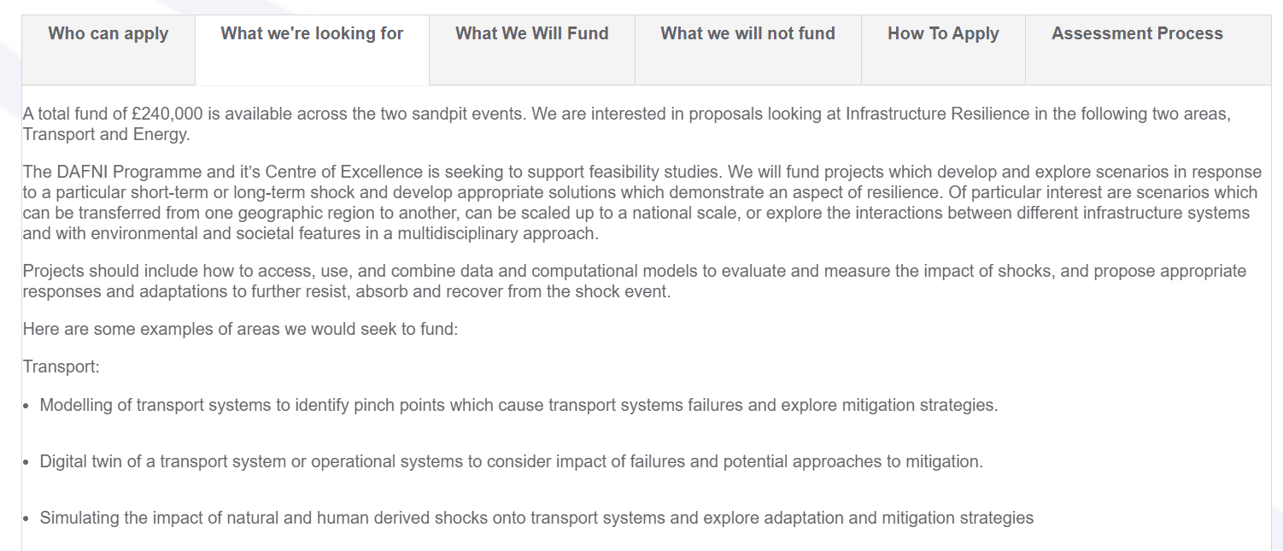
Outputs on DAFNI and BSRW & DSIT aims
1. The dynamic people-centric digital twin; including three modules.
(1) a web platform demonstrator based on DAFNI and (2) a trial platform with the London case study.
2. The novel ‘user-road-flood’ data-sharing strategies for multi-scale and multi-modal traffic data to meet the DSIT ‘Challenges and solutions to data sharing’ strategy.
(1) large-scale multimodal datasets for the London area as a live implementation of DAFNI, (2) mechanisms and strategies for data querying, sharing and communicating.
Dynamic People-Centric ← Challenge 1
‘User-Road-Flood’ ← Challenge 2
Multimodal and Multi-resources Data (bicycle, bus car on roads)← Challenge 3

Slide 14
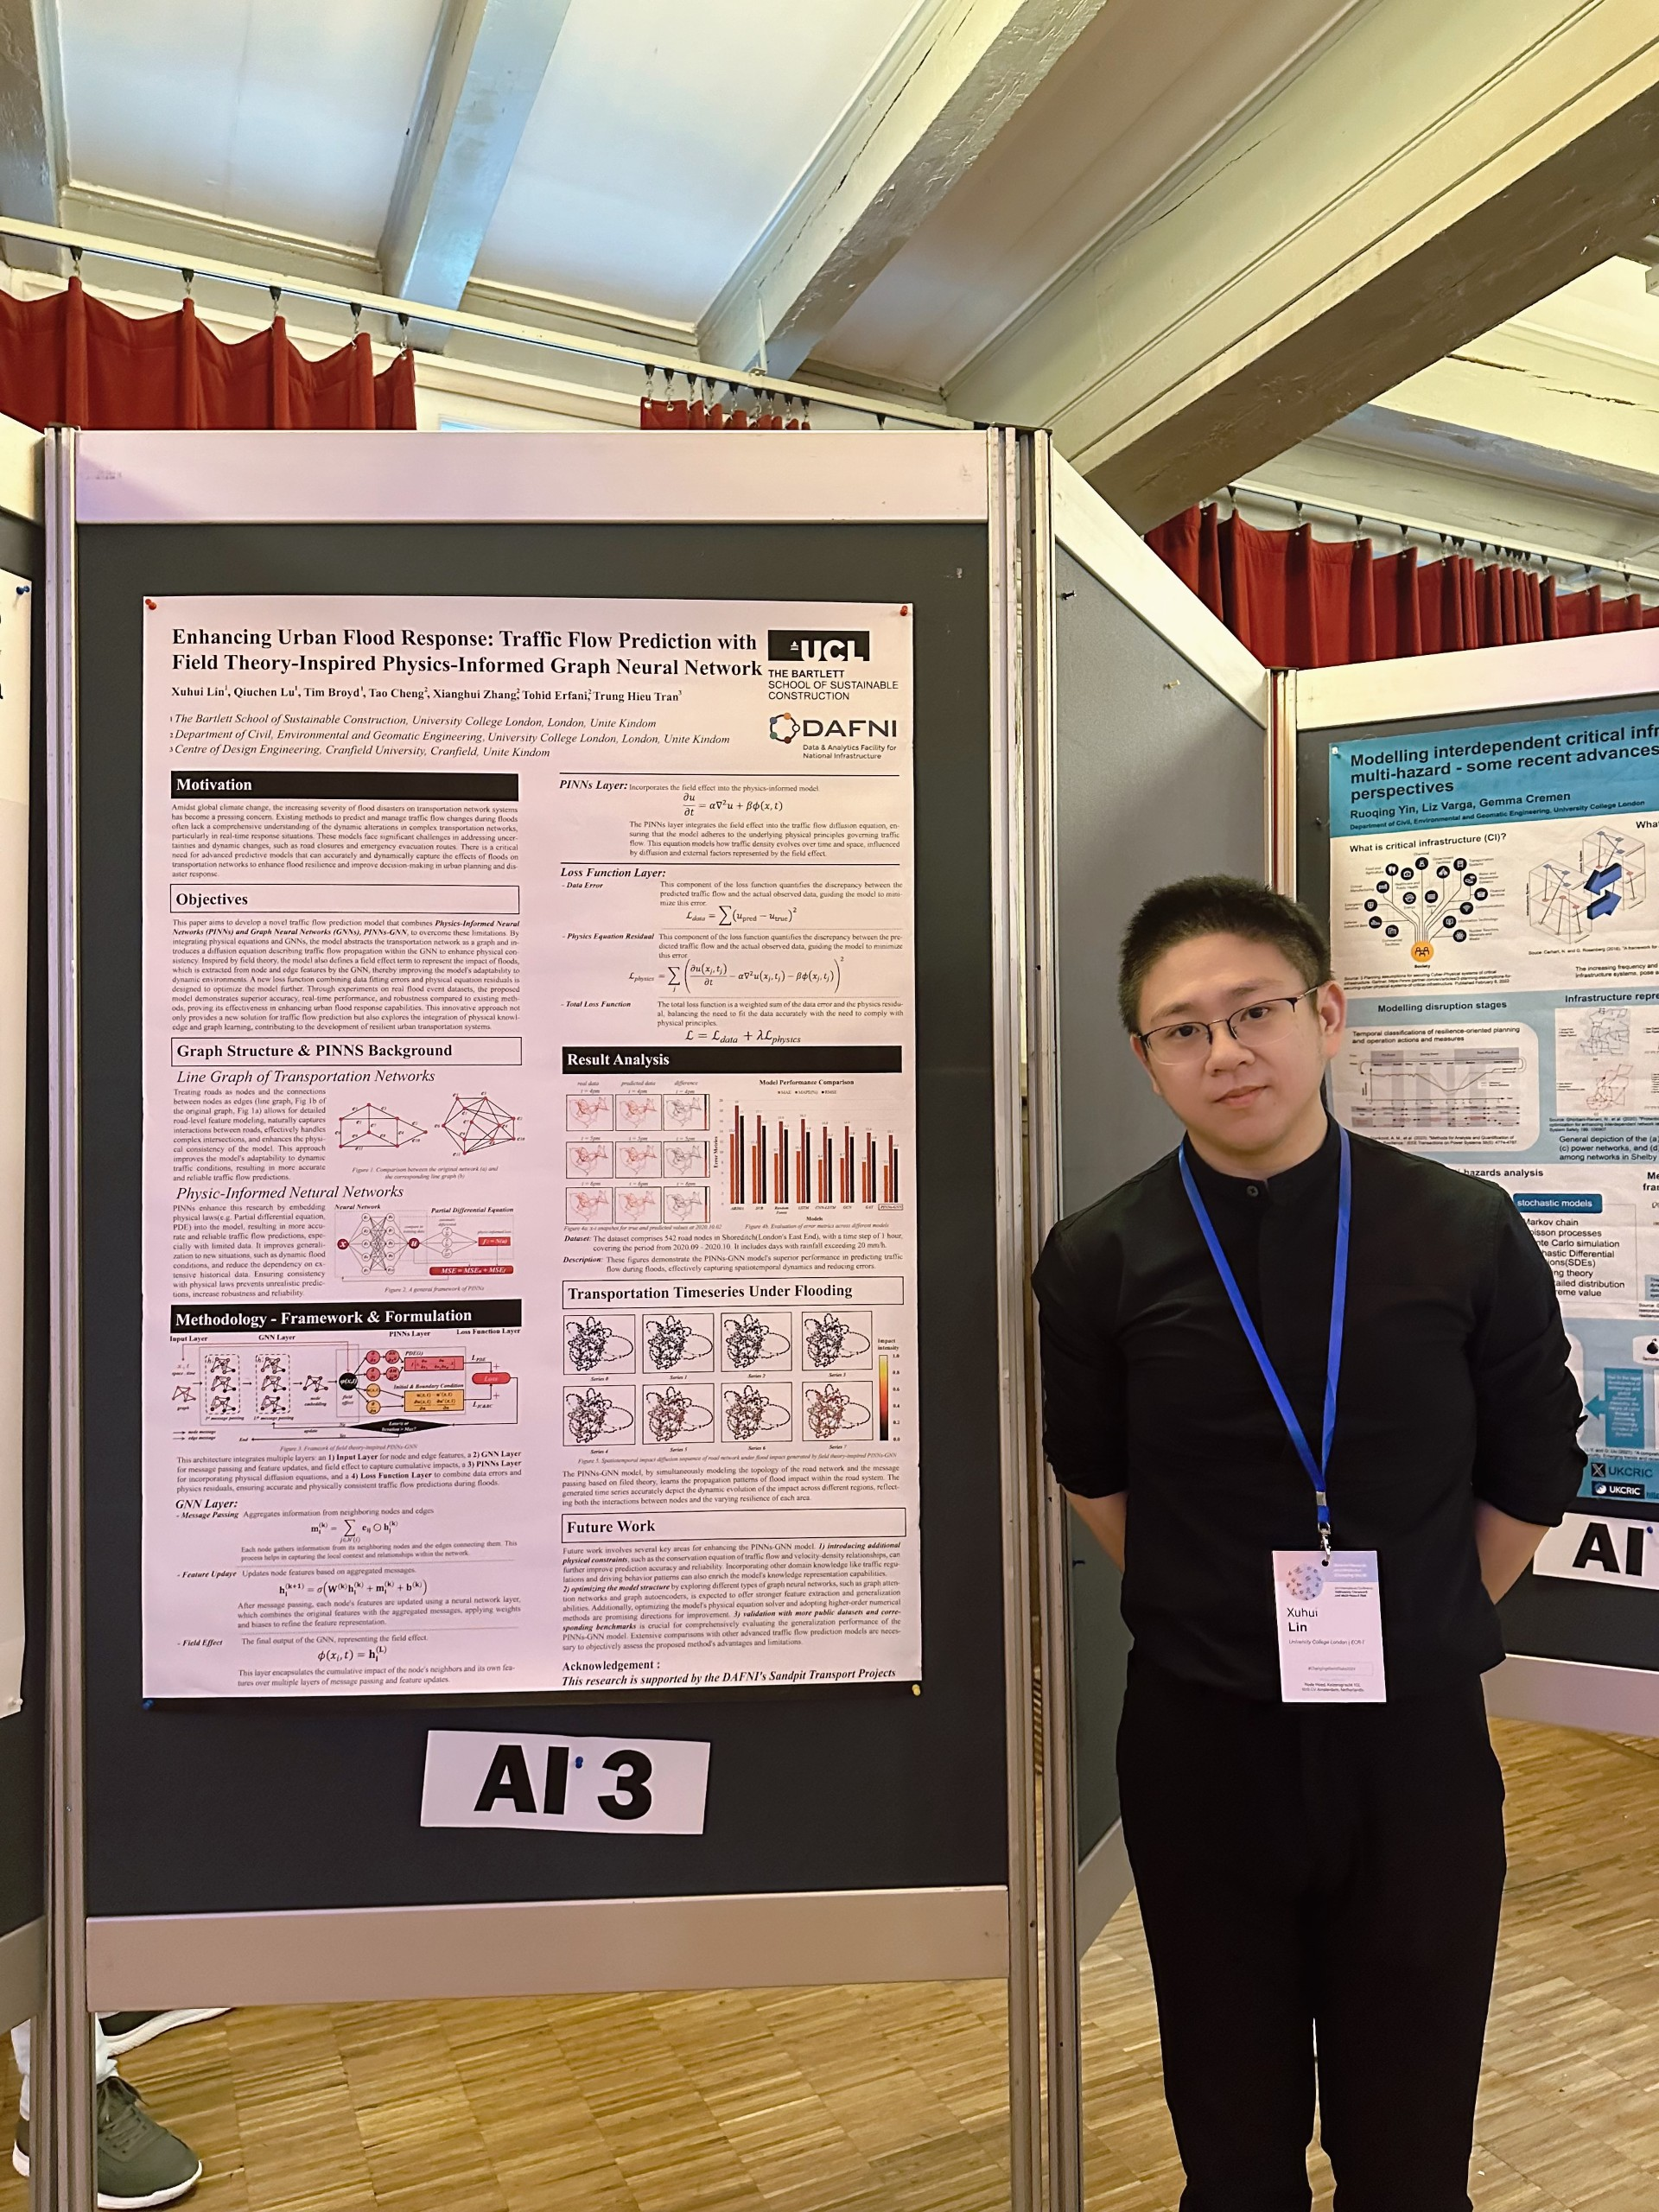
Poster Presentation:
The 3rd International Conference Natural Hazards and Risks in a Changing World: Addressing Compound and Multi-Hazard Risk

Slide 15
Thank you so much and Q&A
Qiuchen LU MPhil Ph.D. MCIOB A.M.ASCE
RAEng / Leverhulme Trust Research Fellowships
Associate Professor in Digital Built Asset and Facility Management, The Bartlett School of Sustainable Construction, University College London, UK
Email: qiuchen.lu@ucl.ac.uk

