Slide 1





Pywr-WREW
A Water Resources model for England and Wales to enable strategic analysis of the drought resilience of water supply infrastructure
Dr Anna Murgatroyd, Prof Jim Hall, Tom Russell

Slide 2
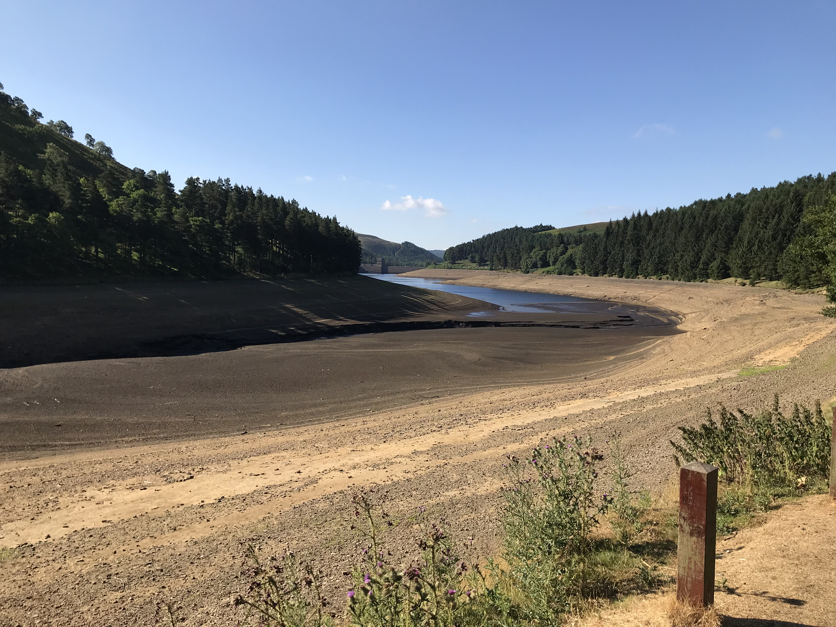

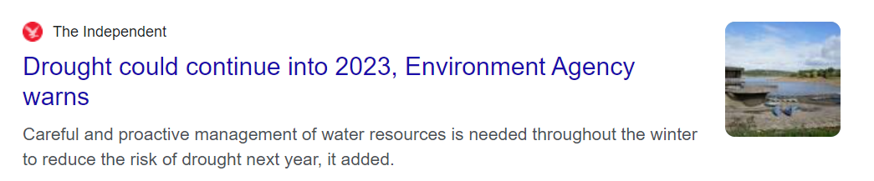
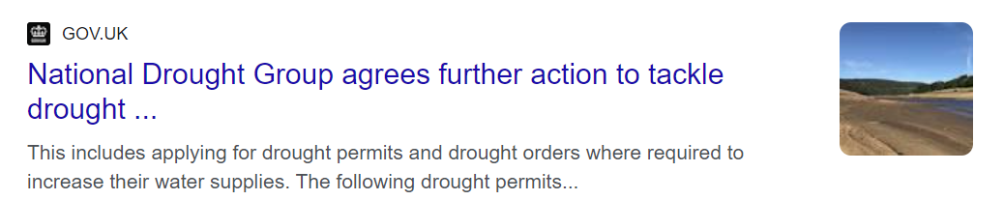


Slide 3

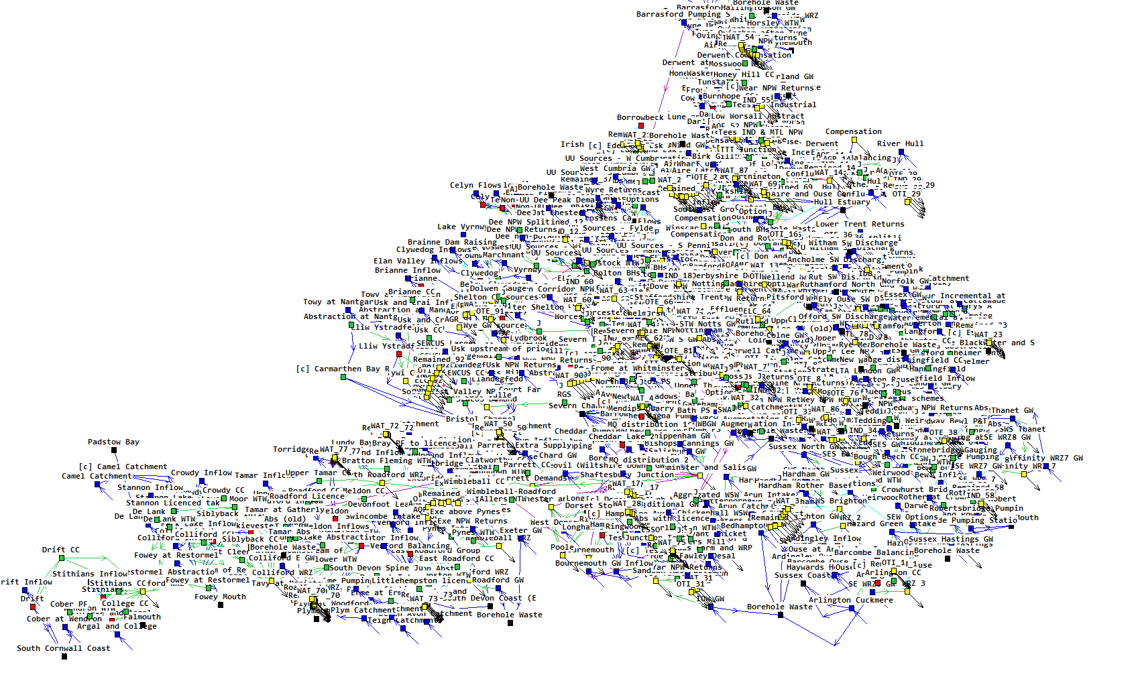


Slide 4

Open-source: Pywr’s source code is available on GitHub. Given that the framework is devised entirely in the widely-used Python programming language, users can easily detect and fix bugs, as well as implement new features.
Free to use: Pywr has been designed to be free end-to-end. This means that models can be formulated and solved using open-source optimisation solvers (e.g., GLPK), avoiding expensive license fees.
Strong support base: Pywr’s userbase spans the globe, which provides a strong support base for users. Since Pywr is currently the only open-source water resources modelling framework, its documentation and features are continuously growing.

Slide 5
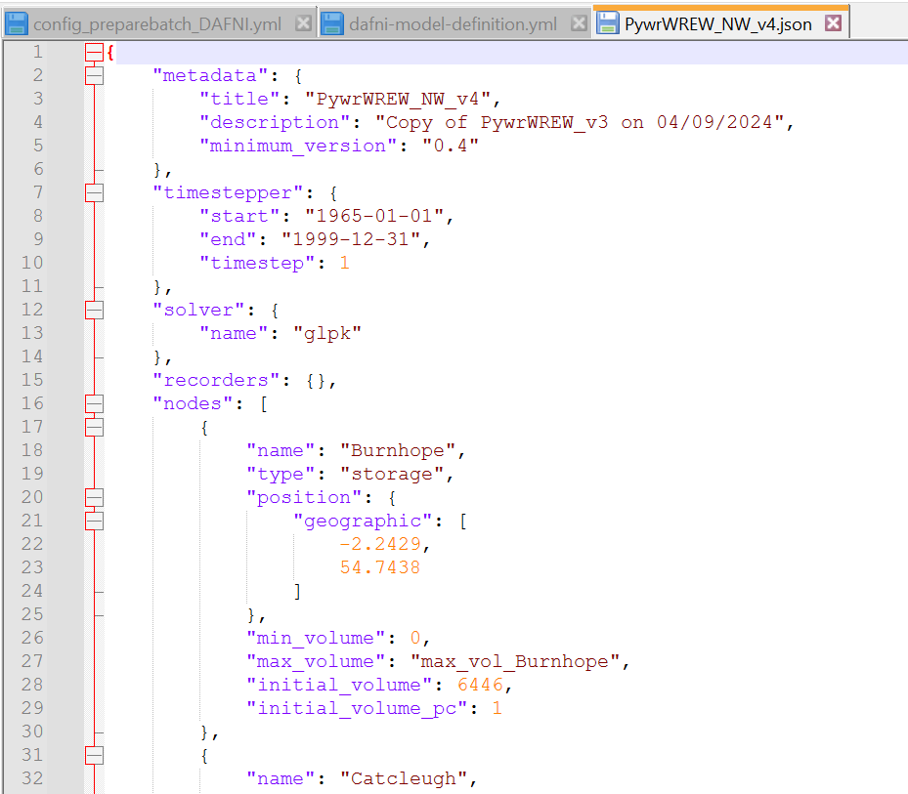
The model is described in a JSON document, consisting of:
  Metadata
  Timestepper
  Solver (glpk)
  Nodes
  Edges
  Parameters
Data can be read in from external files, using the pandas module:
  Comma separated values (.csv)
  Excel (.xls, .xlsx)
  HDF5 (.h5)

Slide 6
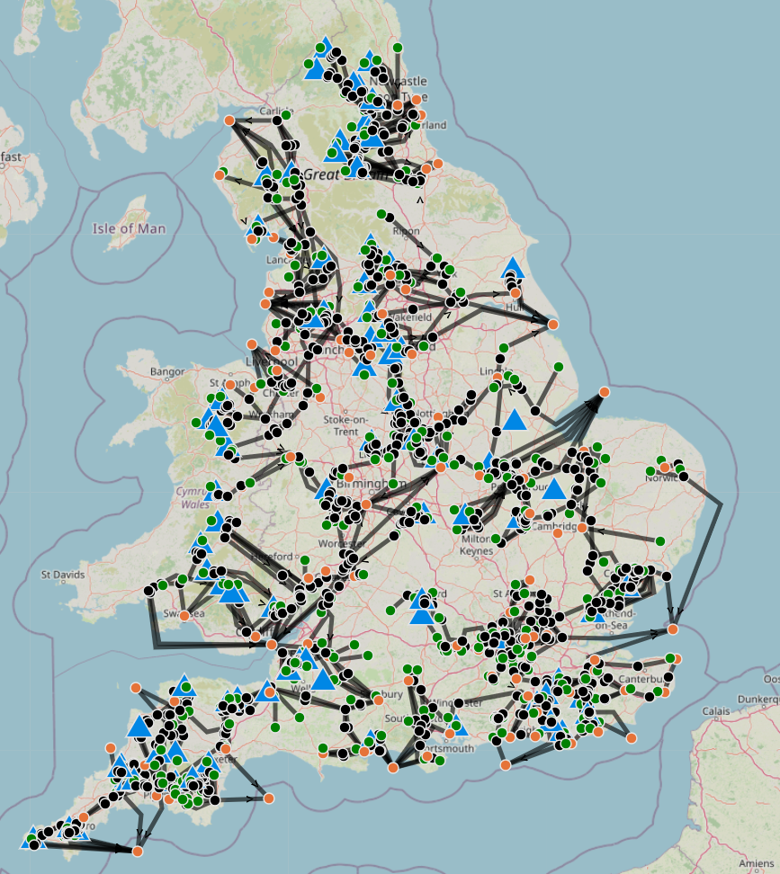
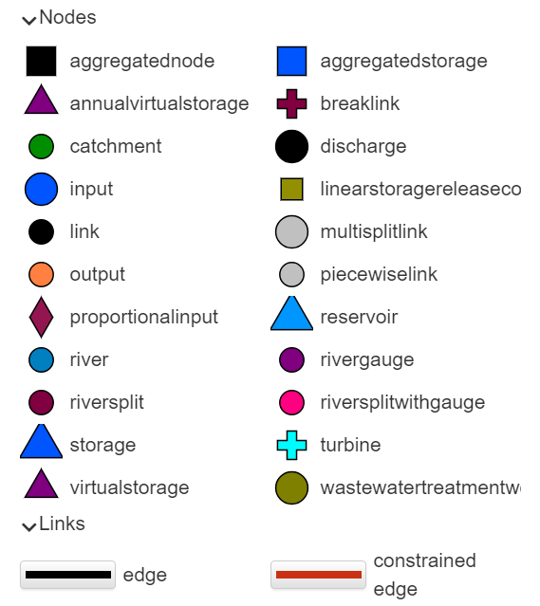
Pywr-WREW A Water Resources model for England and Wales to enable strategic analysis of the drought resilience of water supply infrastructure
Project Aims Build working national model in Pywr Document model and data (Best effort to) previous modelling results (National System Simulation Modelling project) Pywr-WREW workflow on DAFNI

Slide 7
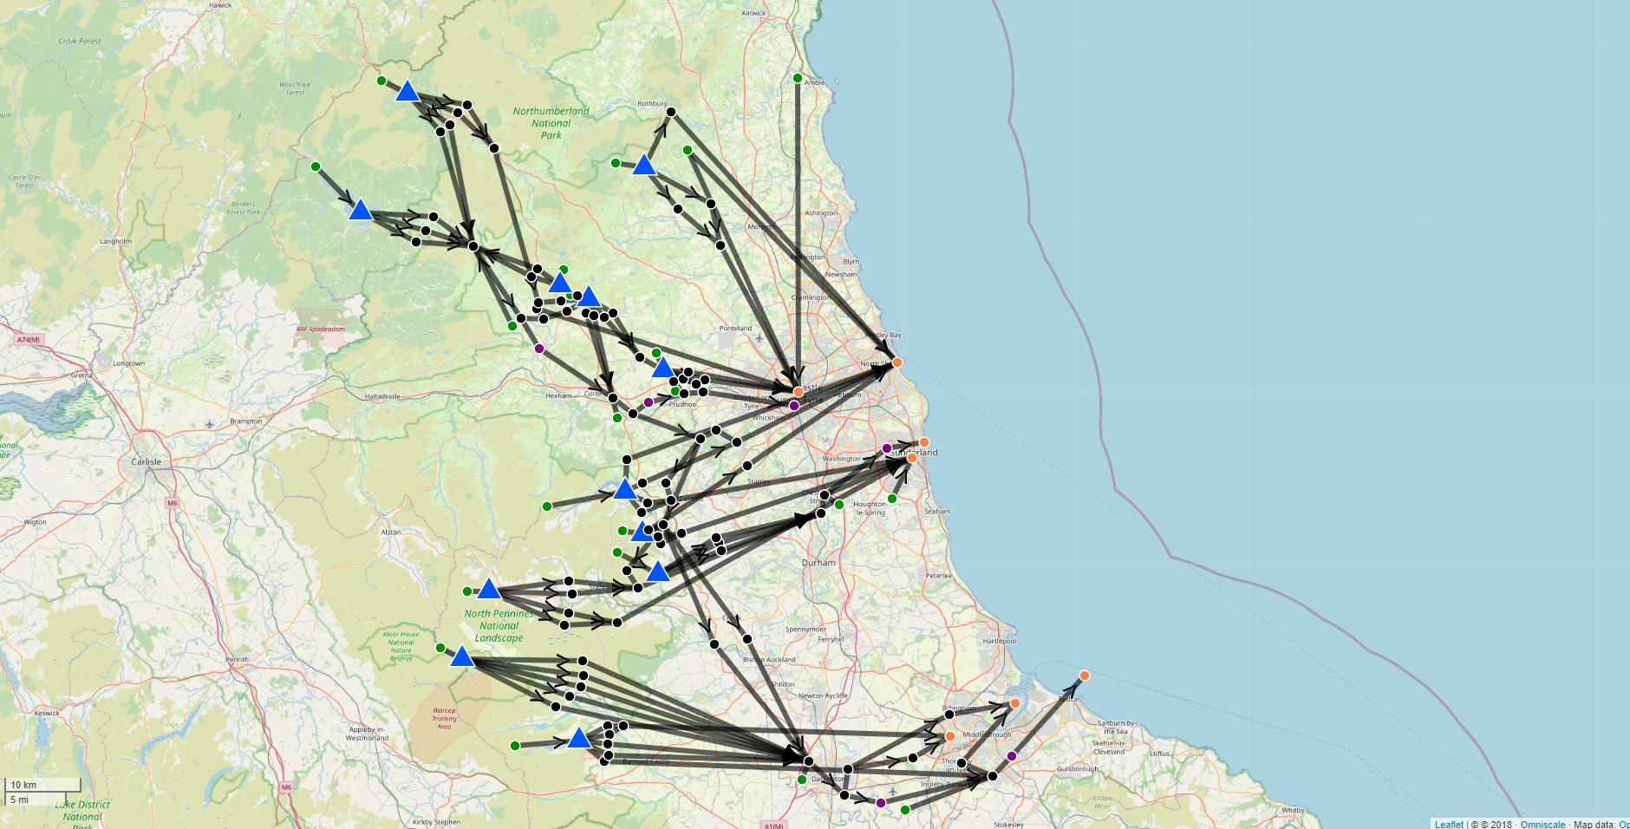
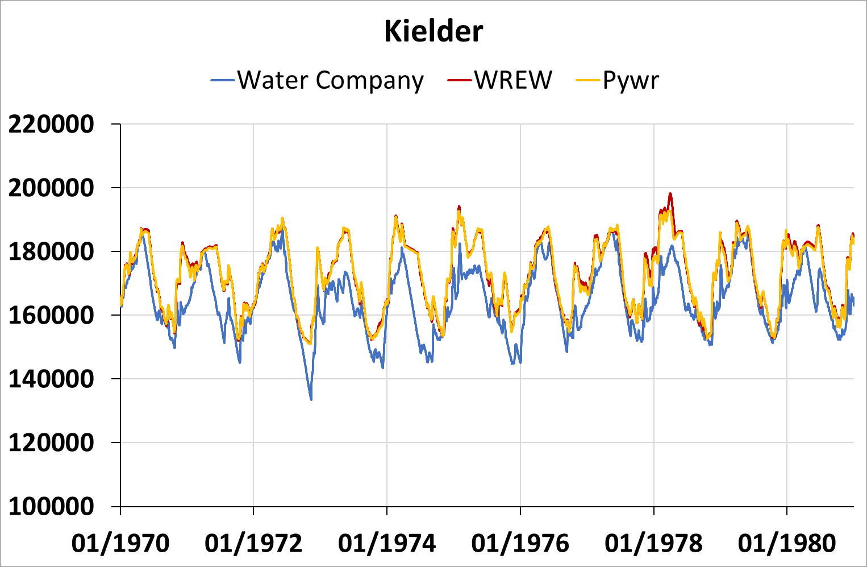

Slide 8
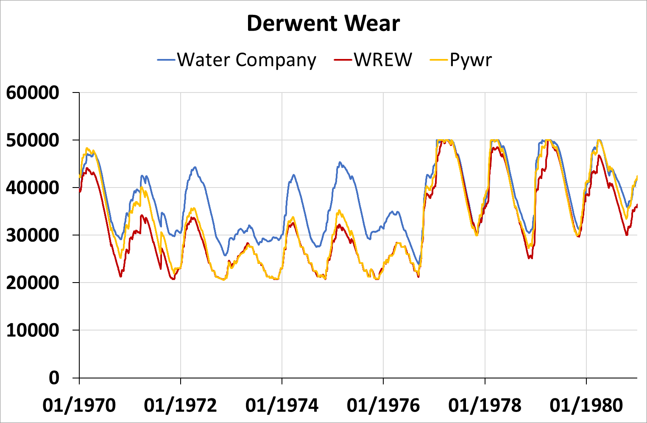

Slide 9
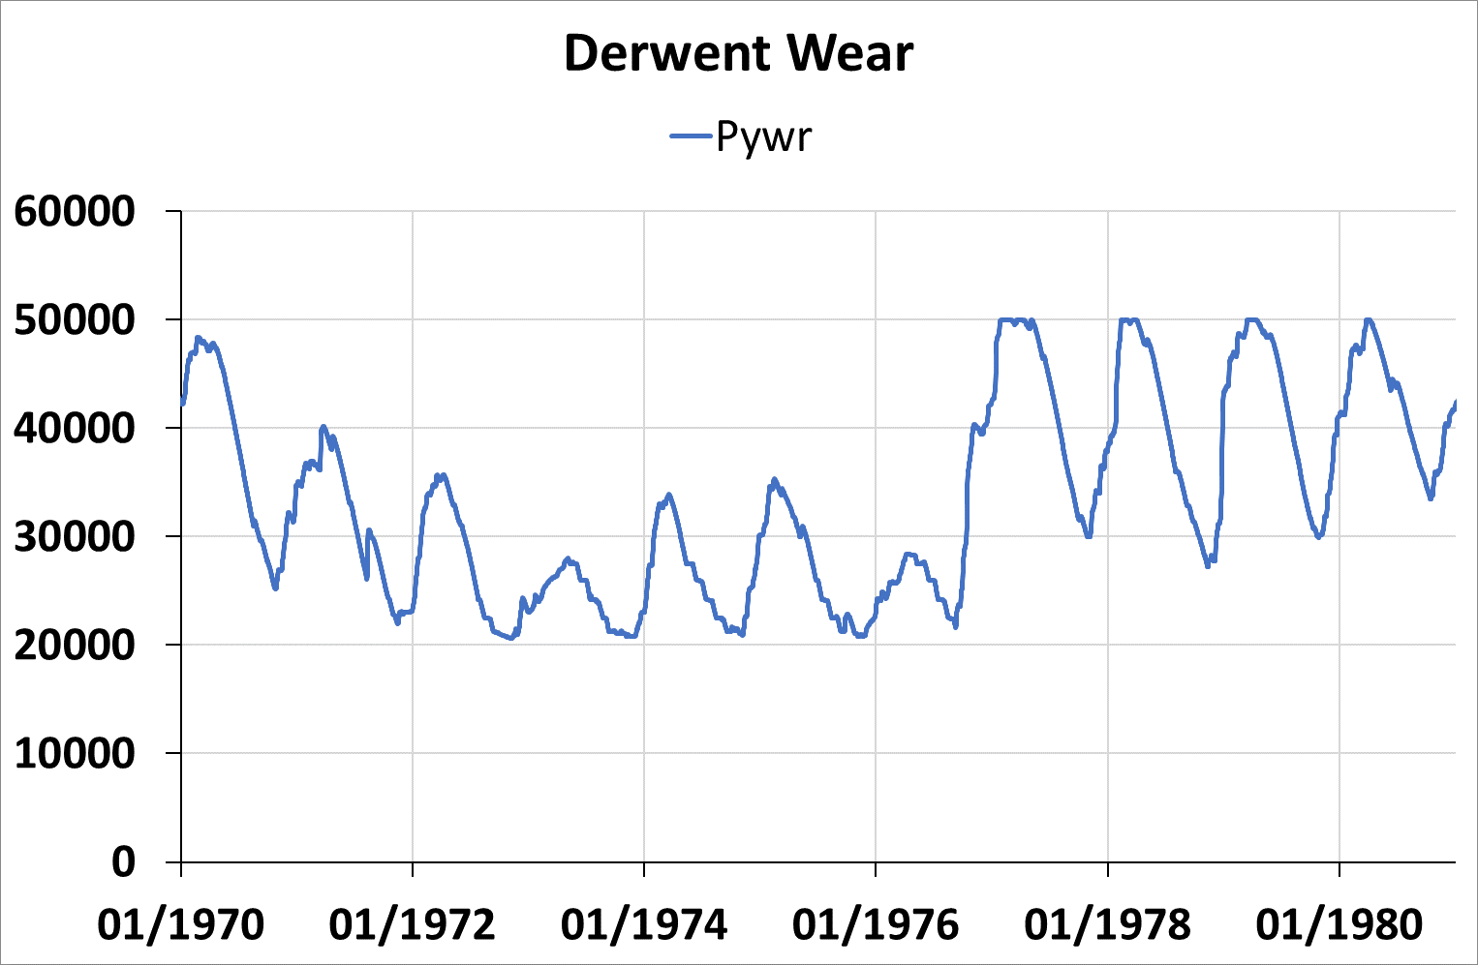
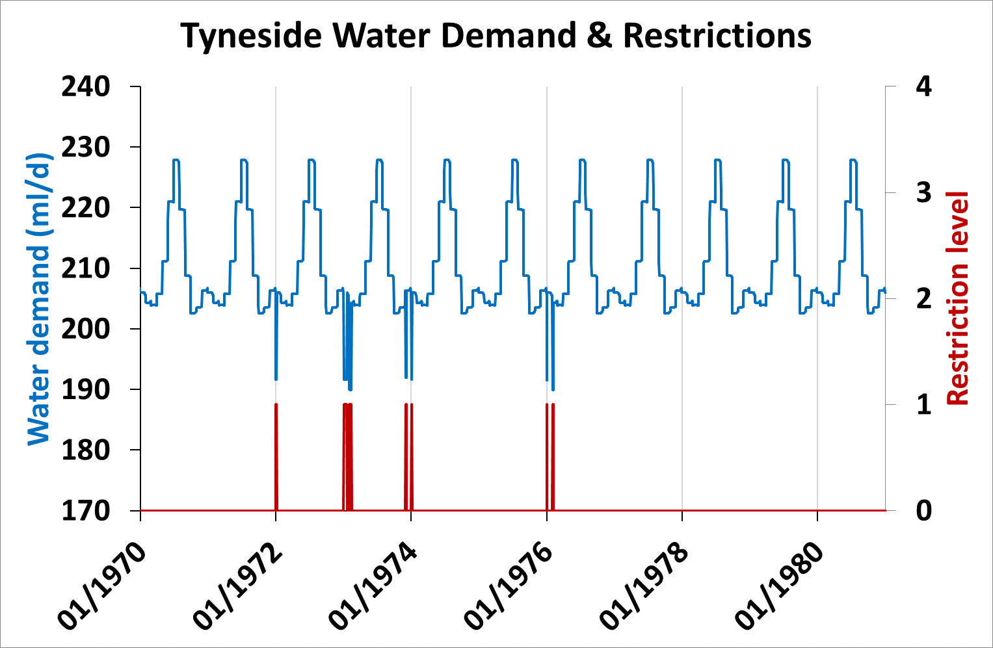

Slide 10
Workflow
Start
run-model
publish
River flow and groundwater timeseries
Water demand timeseries
Storage and edge capacities
Hdf5 file with simulation outputs
Minimum required flows
Reservoir and abstraction control curves
Node costs
Parameters
JSON file
Simulation period

Slide 11
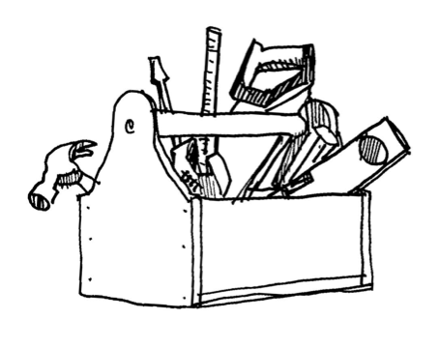

Workflow
Start
run-model
publish
River flow and groundwater timeseries
Water demand timeseries
Storage and edge capacities
Hdf5 file with simulation outputs
Minimum required flows
Reservoir and abstraction control curves
Node costs
JSON file
Simulation period
Uncertainty quantification and sensitivity analysis for resilient infrastructure systems

Slide 12
What’s next?
Dockerise model & run on DAFNI Development & testing of other regions Simulations with future climate products USARIS collaboration

Slide 13
Pywr-WREW
A Water Resources model for England and Wales to enable strategic analysis of the drought resilience of water supply infrastructure
Questions?

