Slide 1


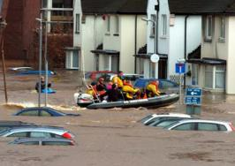
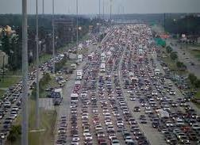
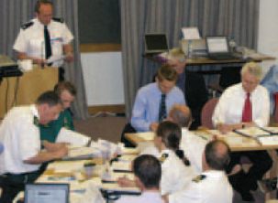




An Agent-Based Model of Flood Infrastructure Resilience
richard.dawson@newcastle.ac.uk
@profrichdawson
richard-dawson-newcastle

Slide 2
Typical assessment of flood risk
Property location
Probability of flooding
Flood Risk
(Expected Annual Damages)

Slide 3
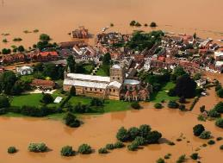
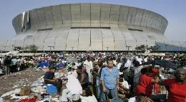

Flood resilience
Why do some floods generate higher damages or lead to greater loss of life – even in the same location?
Why are some communities ‘back on their feet’ much more quickly?
Role of individuals, communities, organisations in mediating short term risks and preparing for long term risks are crucial
Resilience to a flood event does not just come from big flood defences but timely warnings, temporary barriers, evacuation
Resilience is also enabled and enhanced by land use planning, design and operation of infrastructure networks etc.

Slide 4
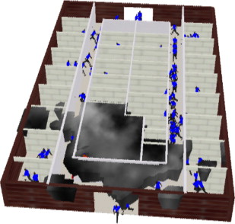
ABM to capture flood incident responses
Spatial data:
  Flood defences
Ground elevation
Transport network
Property type and location
etc.
Behaviour rules:
  Normal interaction
Response to warning
Response to floodwater
etc.
Resilience actions:
  Evacuation strategy
Flood warning etc.
ABM Platform
Hydrodynamic simulation
Agent simulation
Event conditions:
  Storm surge
Failed defence
Time of day etc.
Vulnerability information:
  Economic
Drowning
etc.
Risk analysis

Slide 5
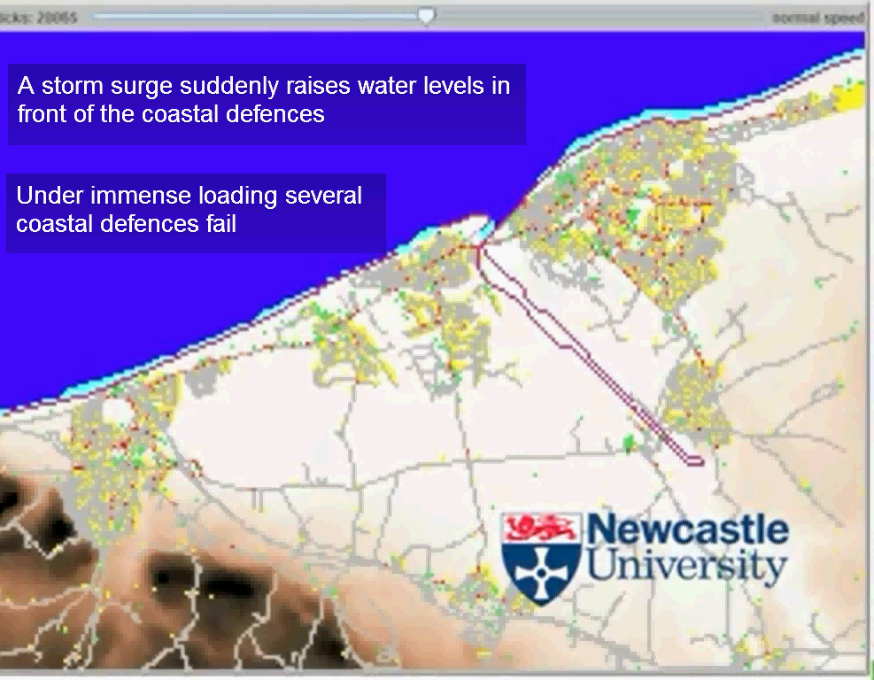
http://www.youtube.com/watch?v=o0EOlc5n9O8

Slide 6
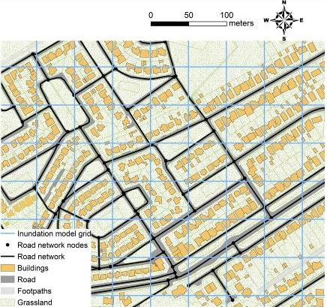
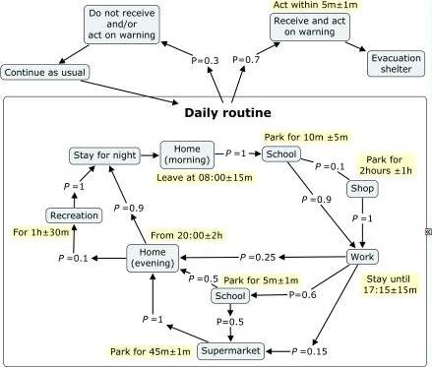
Behaviour model for different demographic and agent types

Slide 7
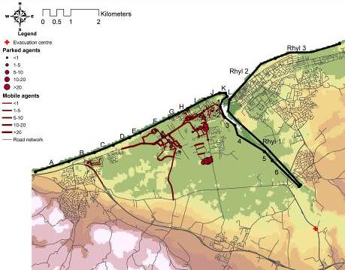
Spatial impacts: Single defence breach
Breach location

Slide 8
Risk to people vs. property
Rank | Population | Economic
1 | I | B
2 | H | C
3 | J | E

Slide 9
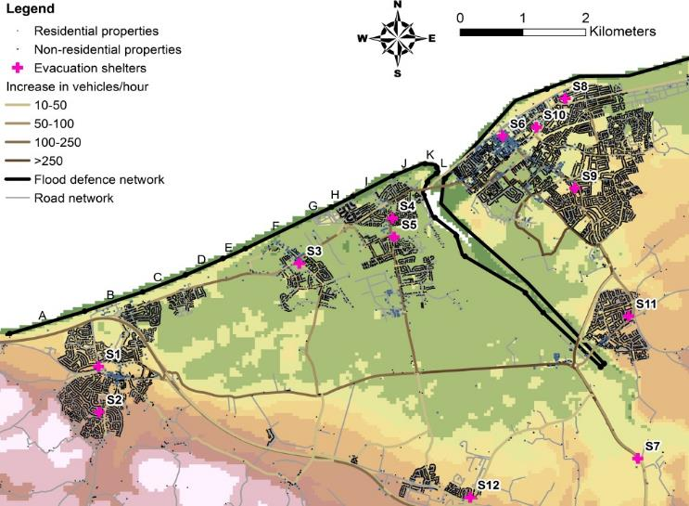
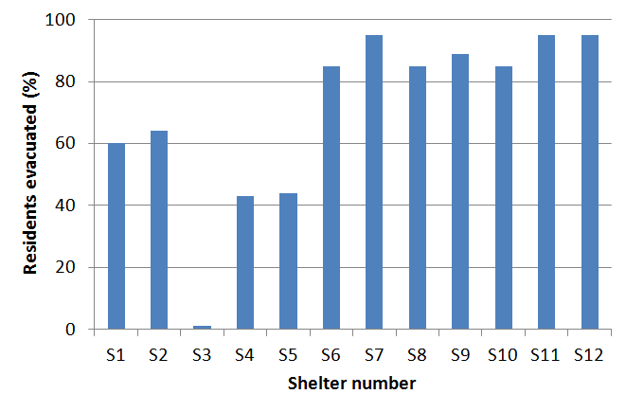
Evacuation location
Breach location

Slide 10
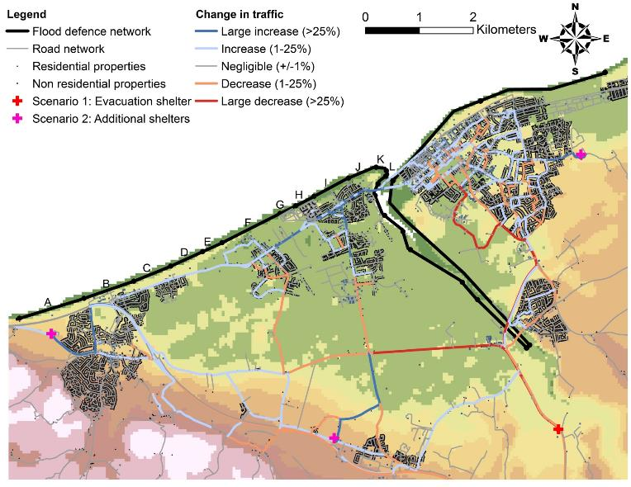
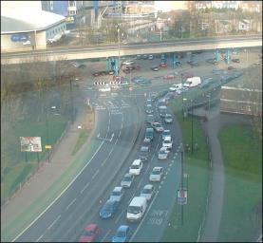
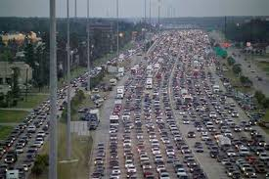
Congestion
Coventry, 2008
Breach location
Houston, 2005

Slide 11
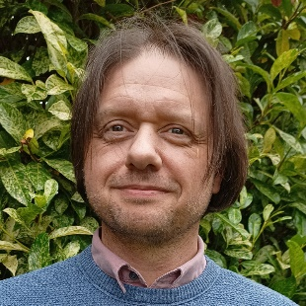
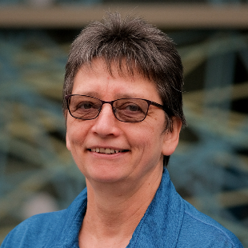

Centre of Excellence project
Recode in Python and put on DAFNI (PyFIRM v1)
Data pre-processing toolkit and workflow
Upgrade model (PyFIRM v2)
  Improve visualisation
  Use DAFNI’s workflow capabilities to enable third party flood model coupling (e.g. CityCAT)
  Extend resilience options
Robin Wardle
Jannetta Steyn

Slide 12
An Agent-Based Model of Flood Infrastructure Resilience
richard.dawson@newcastle.ac.uk
@profrichdawson
richard-dawson-newcastle

