Slide 1


Slide 2
DAFNI Sandpits 2024​
​
FORNet: DAFNI FORecasting Services for Energy Networks
May 2024 – January 2025
DAFNI Conference - 10-9-2024

Slide 3

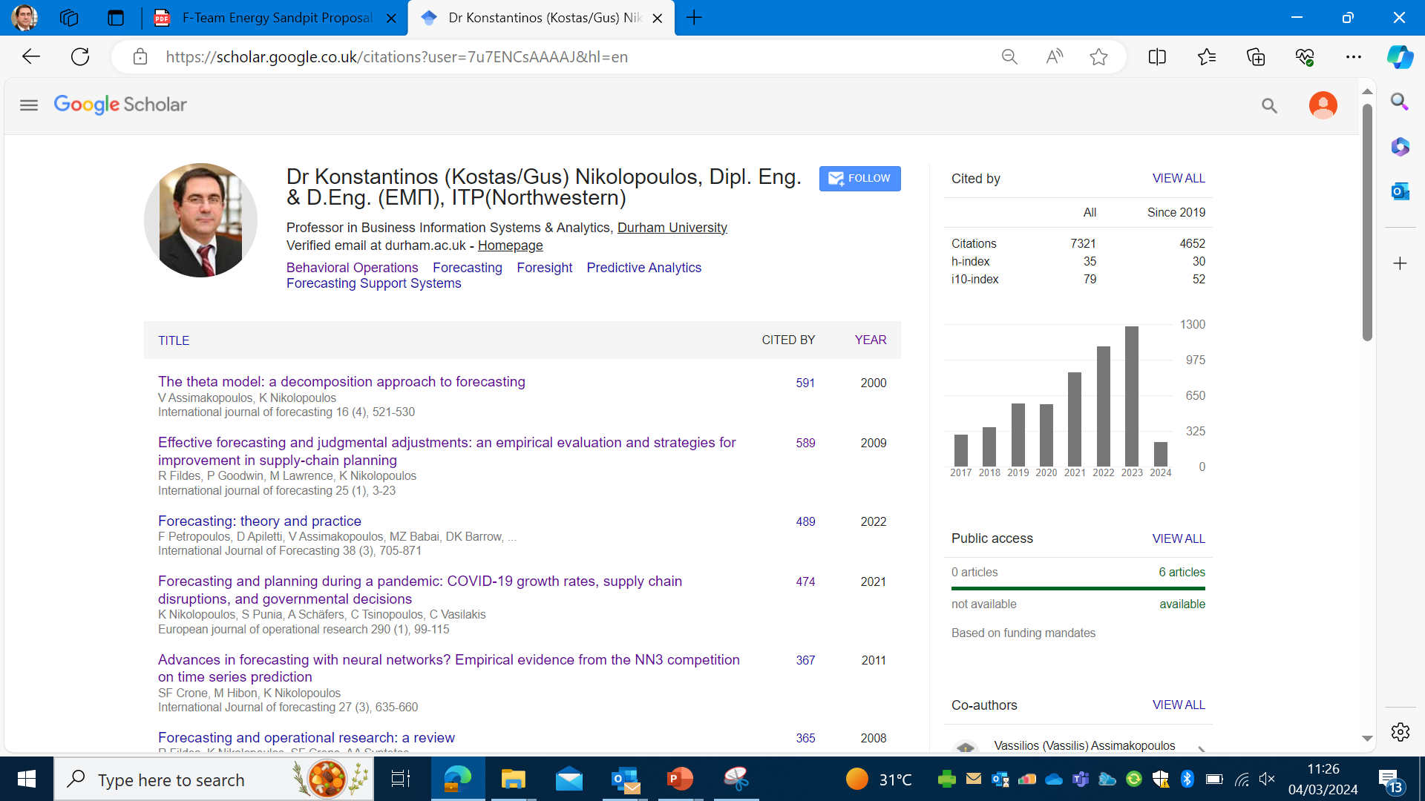
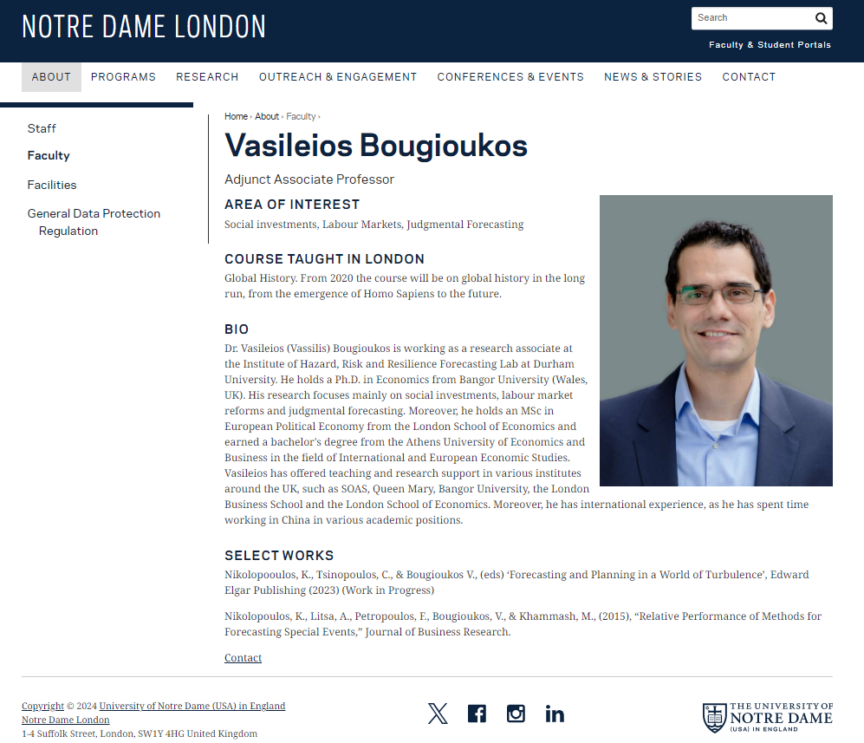
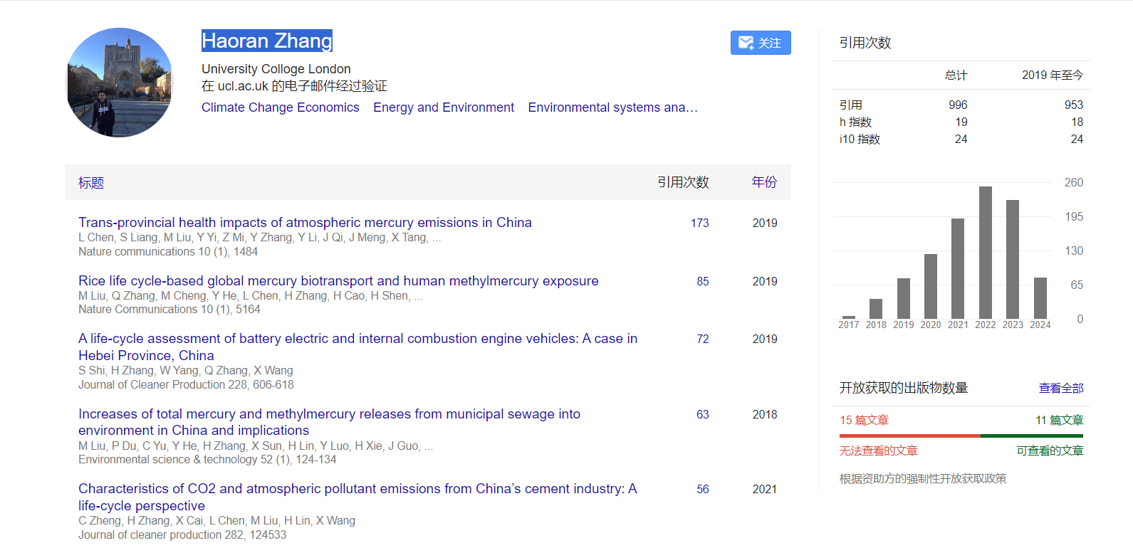
Team expertise
This project

Slide 4
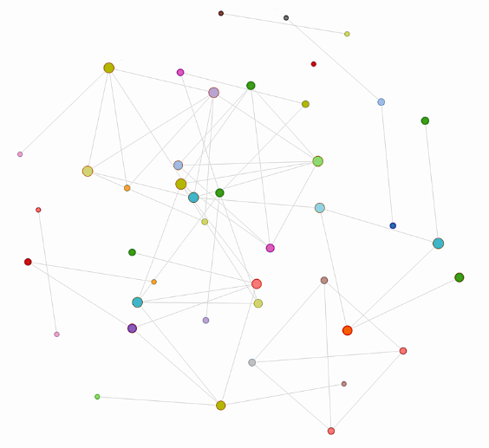
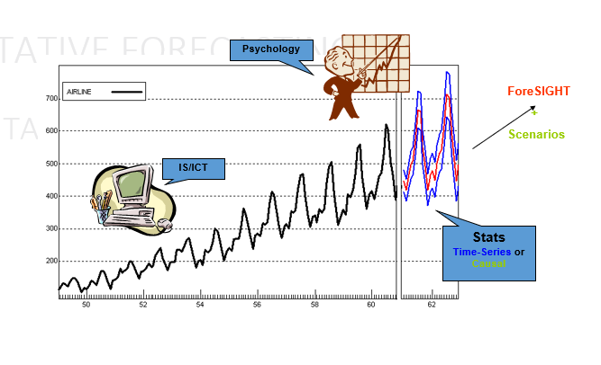
Real time forecasting in the nodes of a network through data from clever sensors and behavioural data plus extreme events cues.

Slide 5
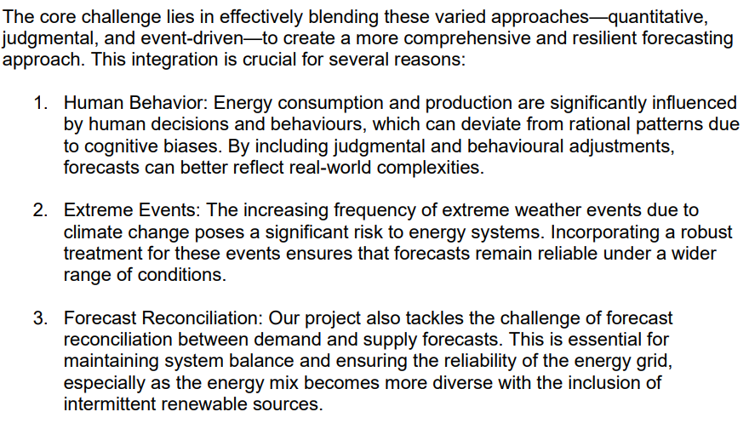
Problem addressing and key challenges

Slide 6
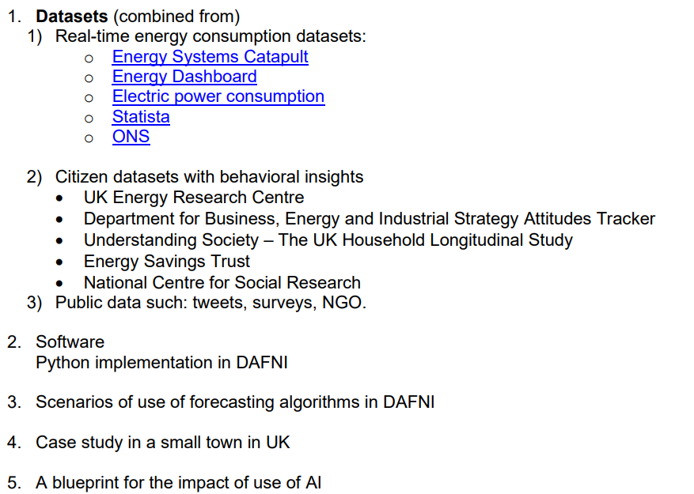
Outputs on DAFNI platform

Slide 7
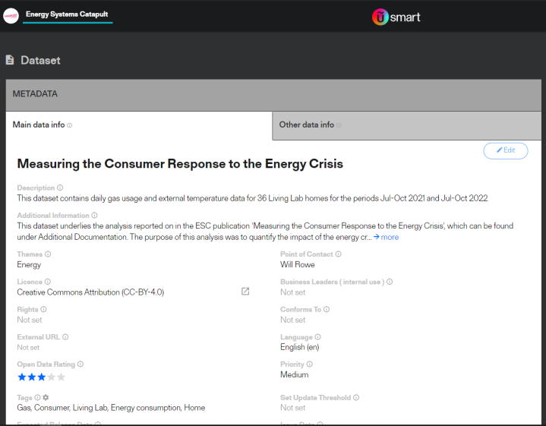
Progress
Usage of the catapult dataset as our main dataset (2021 -2022 July to October) for our research in this stage – 36 homes, high frequency
Identify Behavioral elements – subsidies, supply chain disruptions, pandemic (use of office space), bad weather
To find policies or other initiatives that affected behaviour (any support/subsidy from the government)
Weather data in which level we could use to integrate with the home’s dataset
Contact the dataset provider ( no email as only you could send via the platform message)
Plan A:
  3 different forecasting scenarios
    2021 forecast for 2022
    July -Sept train the model and then forecast Oct
    Crossection, 30 instances and tried to forecast the other 6 home labs.
  Double exponential smoothing, triple exponential smoothing (weather, behavioural)
  (Machine Learning ones only in later stages with a more extensive dataset)
Plan B: data and interviews from the home labs –Energy Catapult dataset with locations NW and Wales
Plan C: Data from Dr Hannah Bloomfield – Newcastle University
Plan D: data from other sources like energy providers Octopus, British Gas
Plan E: primary data collection in block of flats – smartmeters plus interviews
Methods: R Forecast library, TBATS, ETX, ARIMA, Regression , NN, MLP vs BA+WA_TES Behavioral & Weather adjusted Tripple Exponential Smoothing
Training after the conference in Sep 2024 - on a nearby date
Ethics application to conduct interviews

Slide 8
Impact
Energy forecasts at the household and potentially other nodes of the grid/network to be used for subsequent optimisation of the grid and respective decision making
Informing the use of AI-driven solutions in this context
Exploitation of regional data and network topology
Capitalizing on the project funding for a full-nation scale in partnership with The Grid, ONS, Energy Providers, Government aiming for a major UKRI bid
Notes:
This opens up post-project opportunities of incorporating, for example,
climate change models,
real-time monitoring data (e.g. Network Rail’s aerial image data),
operation/expansion planning.

Slide 9
?

