Slide 1


Sewer Overflow Flood Risk Analysis MOdel Dafni Enabled
Vassilis Glenis, Claire Walsh, Chris Kilsby
James Mckenna, Christos Iliadis, Stephen Birkinshaw
Newcastle University

Slide 2
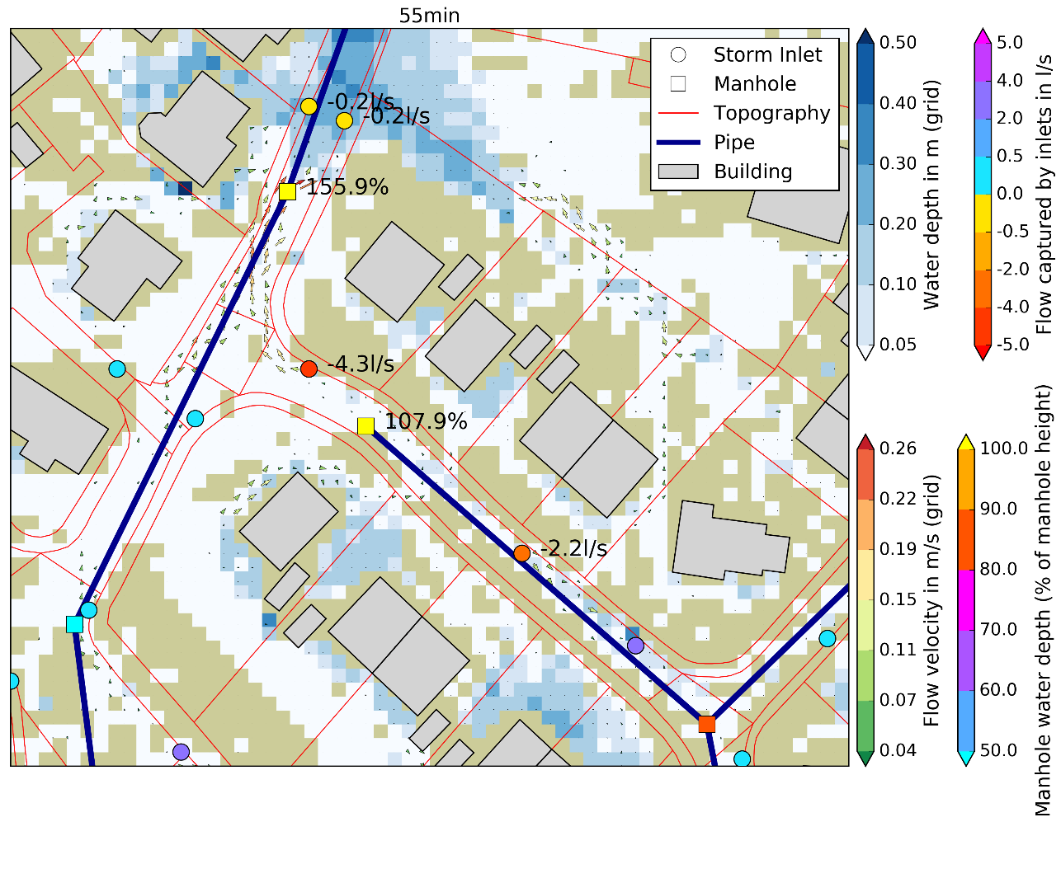
Aim of the project
Develop and demonstrate a platform on DAFNI for understanding and simulating urban drainage for any UK city.
Functionality to design and test a range of strategies to mitigate Storm Overflows spills

Slide 3
City Catchment Analysis Tool - CityCat
CityCAT is a software tool for modelling, analysis and visualisation of surface water flooding. ​
​
It enables assessment of combined pluvial and fluvial flood risk and effects of different flood alleviation measures.
OUTPUTS​
Maps and time series of flow depths & velocity vectors​
Flow conditions in the pipe network (surcharged pipes)
INPUTS
Topography
Basemap (buildings, greenspaces & linear features)
Drainage pipe network
Rainfall
Flow boundary conditions
MODEL PROCESSES​
Numerical grid ​
Flow model​
Infiltration model​
Roof storage​
Sewer network (fully coupled with the surface flow model)

Slide 4
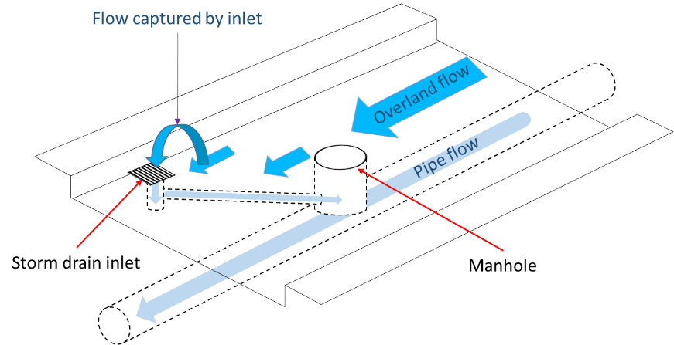
CityCat – Drainage network
Subsurface drainage model can handle realistic conditions, i.e. both free-surface and pressurised flows as well as two-way flows
Model scenarios such as pluvial flooding due to blocked sewers and flooding from sewers due to insufficient capacity.
Bertsch (2019)

Slide 5
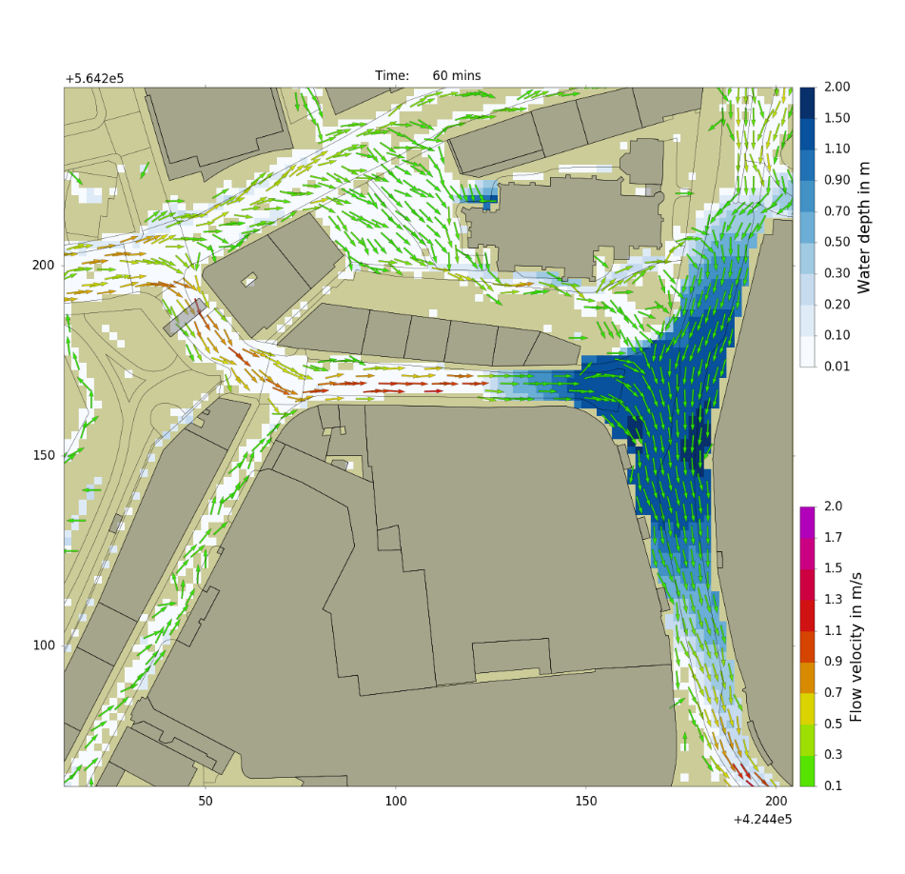
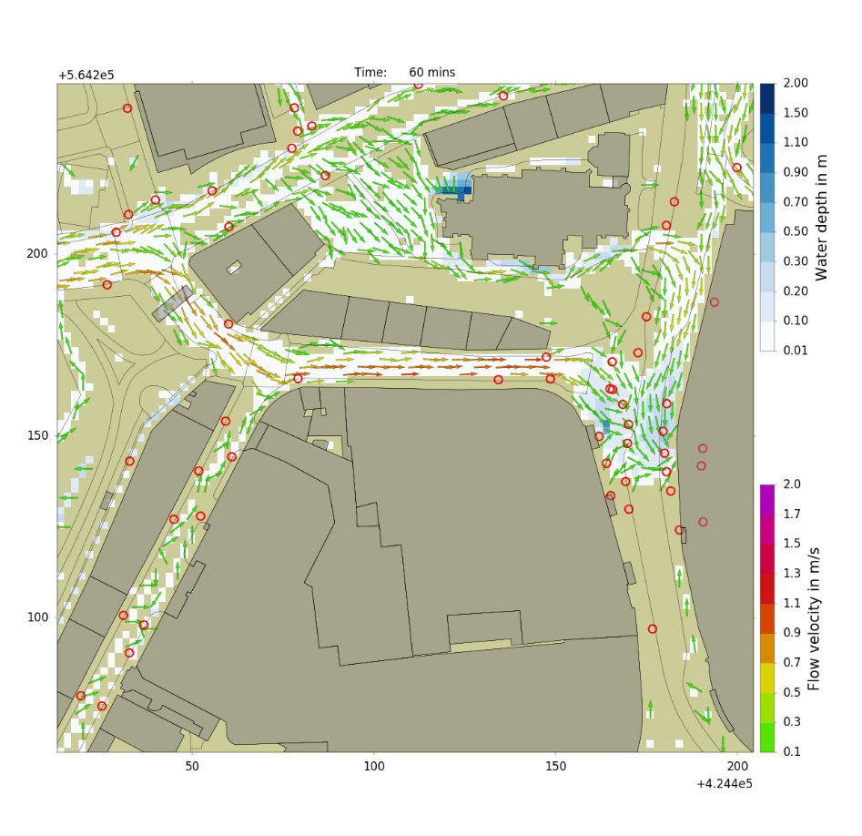
Surface flow model only vs Fully-coupled surface and drainage network model
CityCat – Drainage network

Slide 6
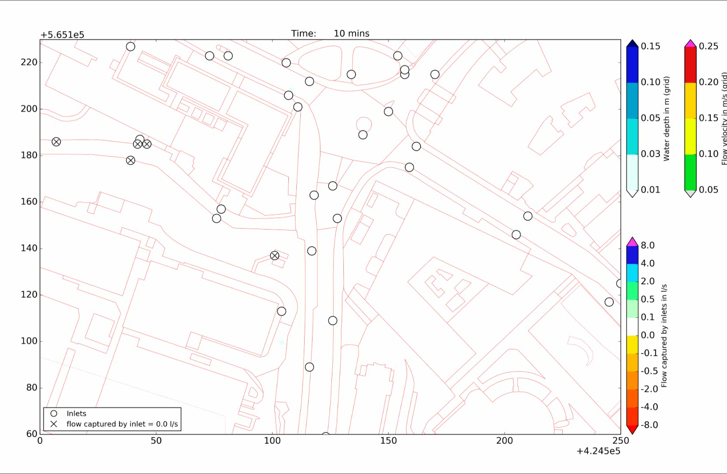

Slide 7
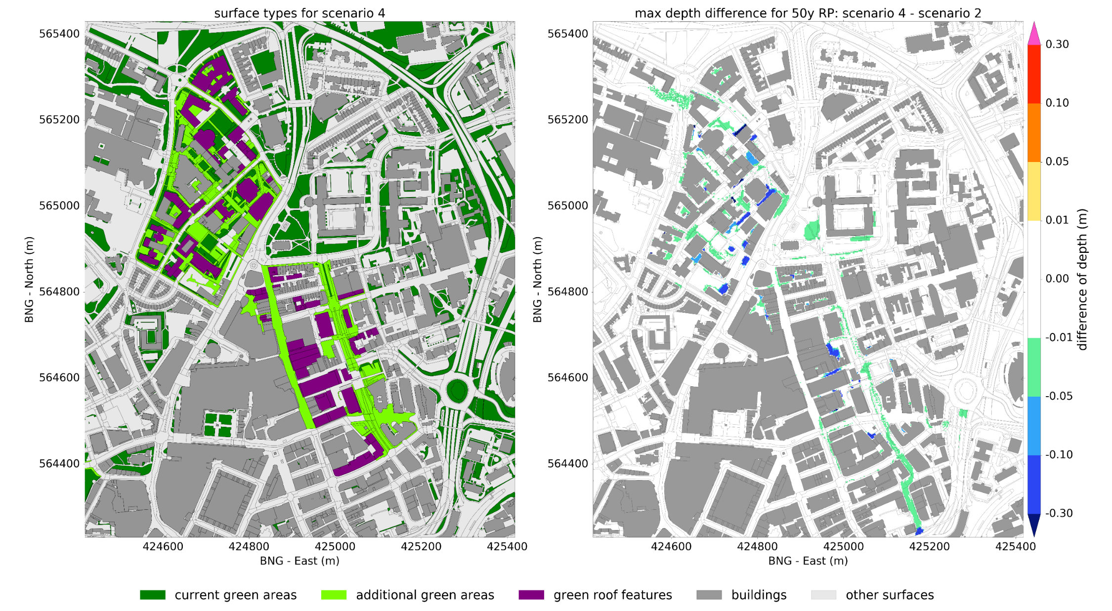
CityCat – Blue-Green infrastructure
Intervention
Impact

Slide 8
CityCat on DAFNI

Slide 9
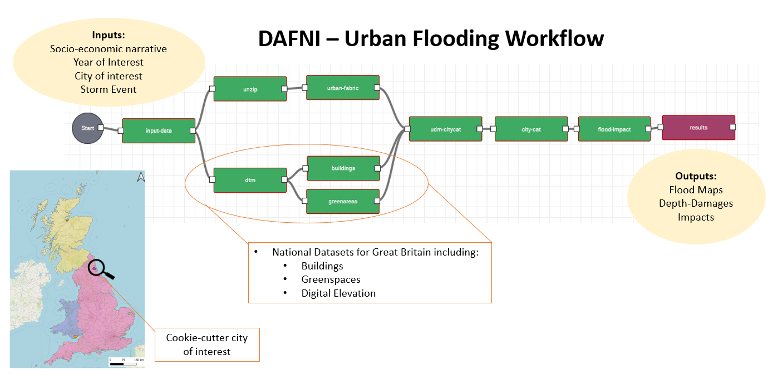
CityCat on DAFNI
CityCat was deployed on DAFNI (OpenCLIM project)
The existing “Urban flooding workflow” allows users to run models to assess flood risk
Models can be setup for any city in the UK for a range of storm events

Slide 10
Aim of the project
Develop and demonstrate a platform on DAFNI for understanding and simulating urban drainage for any UK city.
Functionality to design and test a range of strategies to mitigate Storm Overflows spills
How?
Extend functionality to allow users to assess the effectiveness of blue-green mitigation features
Optimise BGI design using a Genetic Algorithm tool to optimise the location of BGI to allow users to assess flood and storm overflow risk
Develop and demonstrate a platform on DAFNI for understanding and simulating urban drainage for any UK city.
Functionality to design and test a range of strategies to mitigate Storm Overflows spills

Slide 11
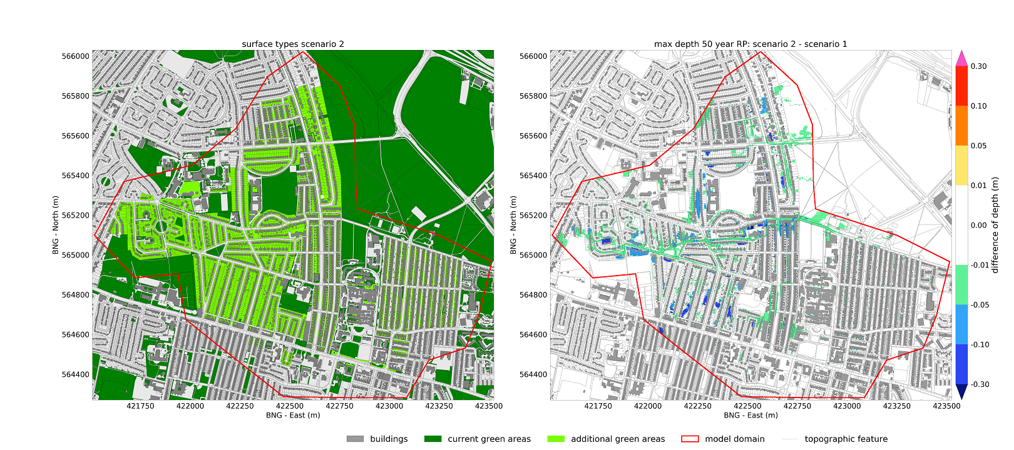
Extended functionality and modelling of blue-green features
Permeable Surfaces: Intervention Impact

Slide 12
Multi-Objective Optimisation Algorithms for
Automated Design
i.e. where to put the interventions?

Slide 13
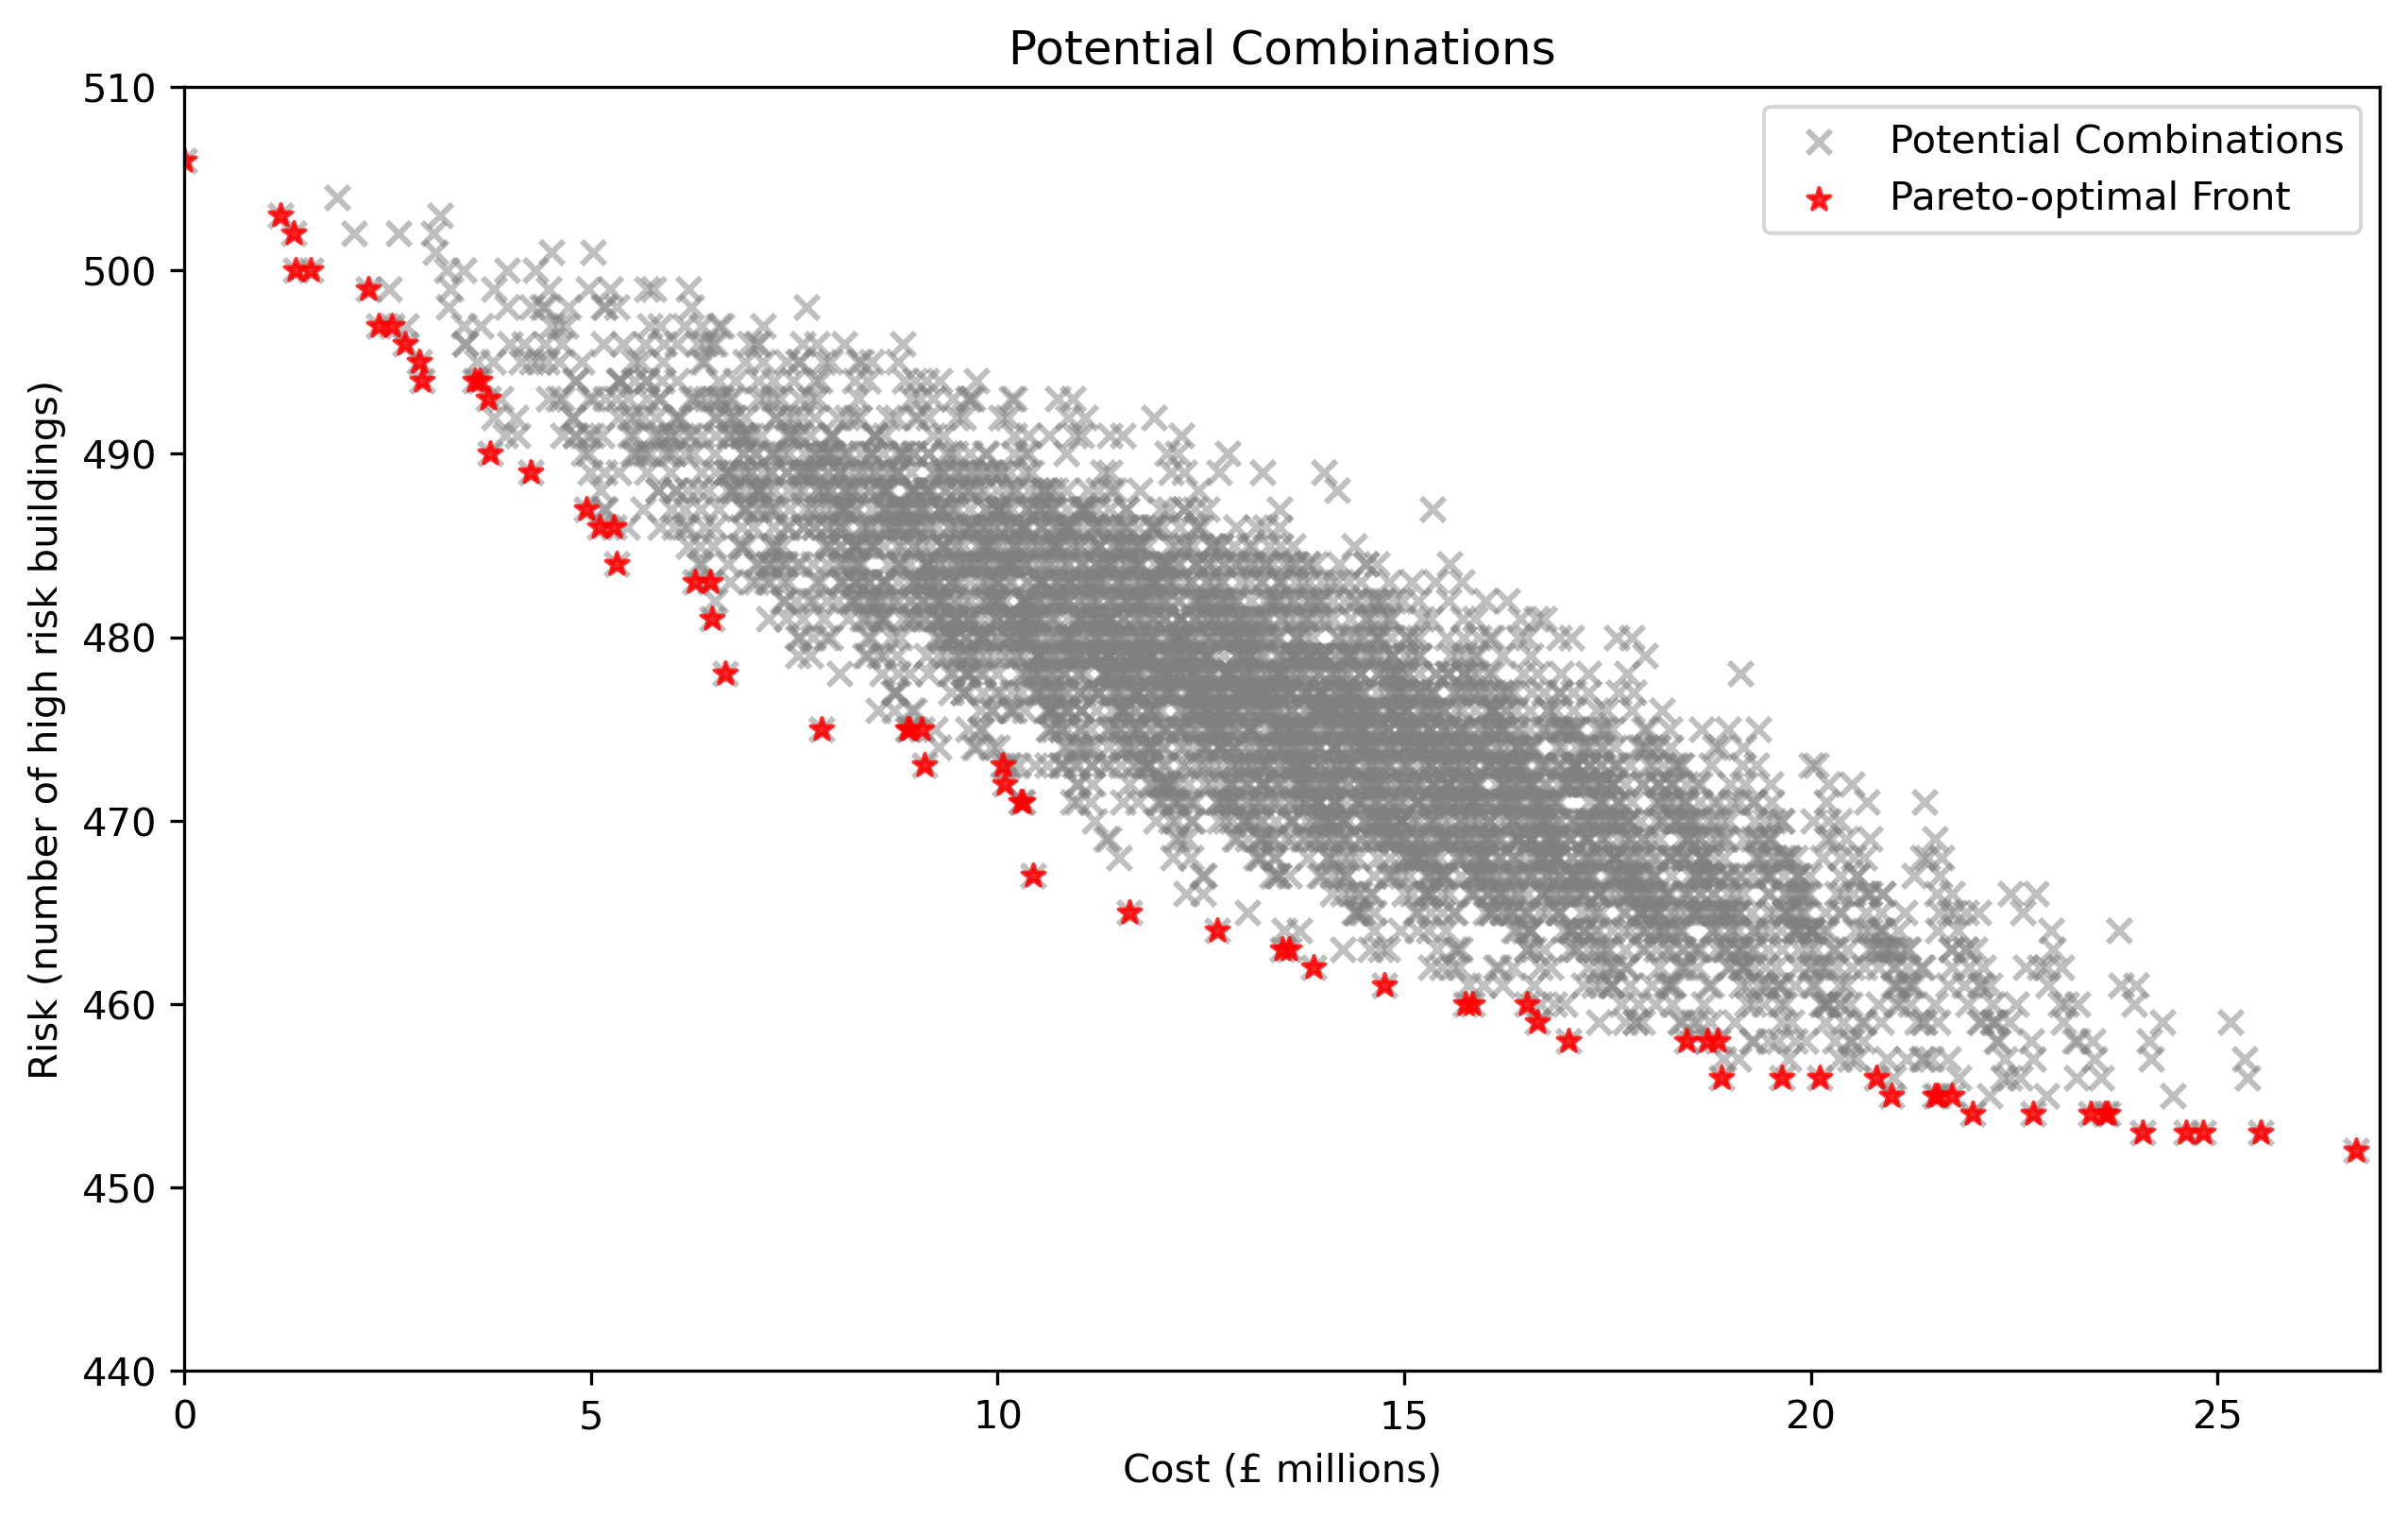
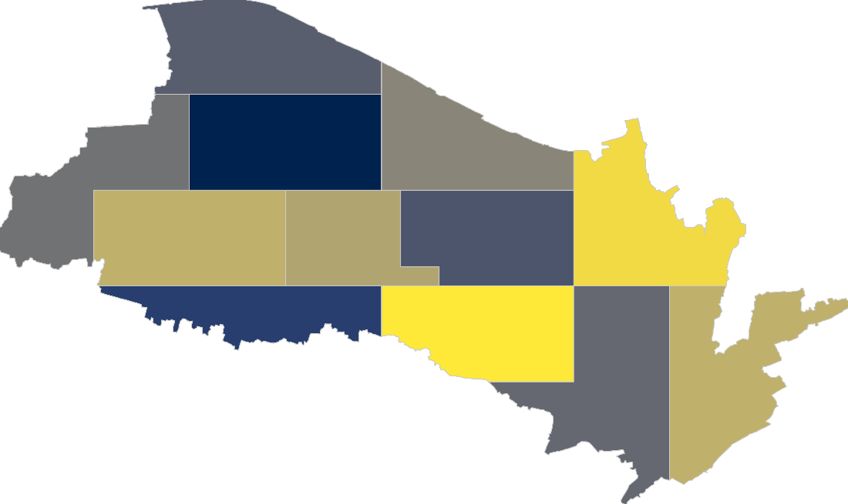
Zone 12
Zone 11
Zone 4
Zone 8
Zone 10
Zone 3
Zone 7
Zone 2
Zone 6
Zone 1
Zone 5
Zone 9
[0, 0, 0, 0, 0, 0, 0, 0, 0, 0, 0, 0]
No interventions in any zone
…….
…….
…….
…….
…….
…….
…….
…….
…….
…….
…….
…….
2^{No. Zones} Combinations
[1, 1, 1, 1, 1, 1, 1, 1, 1, 1, 1, 1]
Interventions in all zones
2
1
3
7
4
6
8
9
5
10
11
12

Slide 14
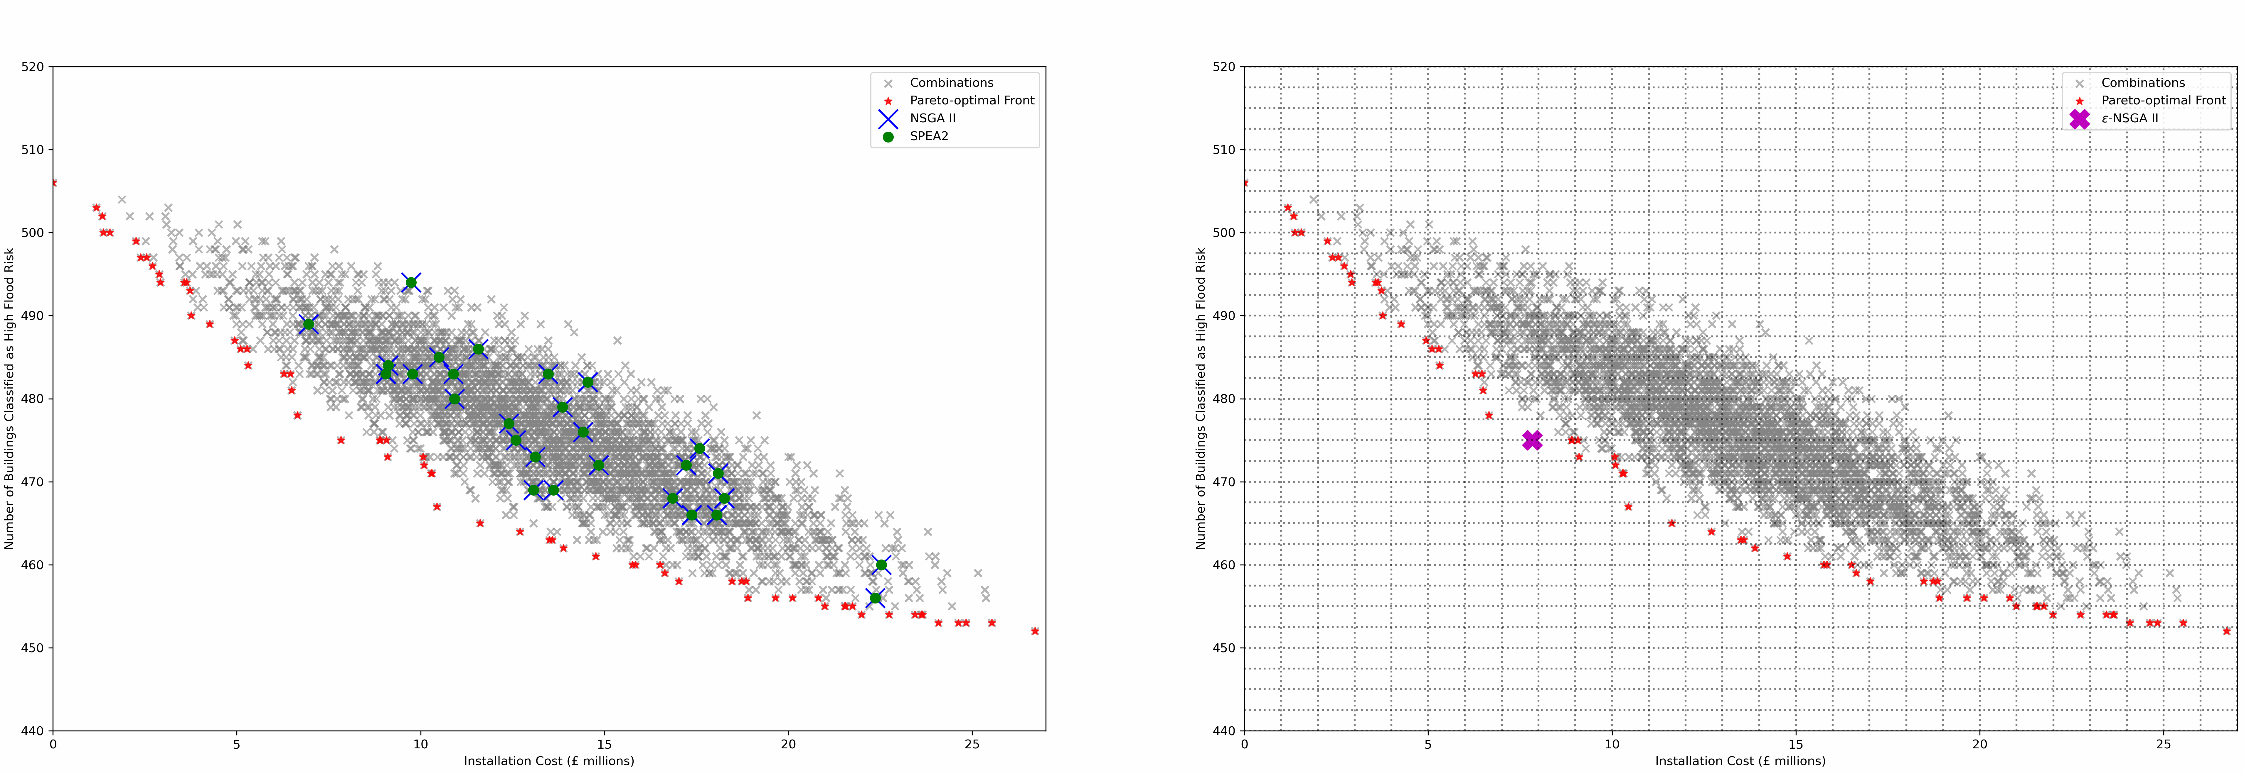
SPEA 2 & NSGA II
Fixed population size
Use distance metrics to encourage spread of solutions
Seeks Pareto optimal set
ε-MOEA
Dynamic population size
Objective space divided into hypercubes to ensure spread of solutions
Seeks ε-Pareto optimal set

Slide 15
Epsilon MOEA
More efficient than standard NSGA-II and SPEA 2 algorithms
Use of epsilon dominance concepts enables a practitioner to customise the number of optimal options the algorithm will seek
Finding entirety of the Pareto set is costly and inefficient since practitioners are dealing with uncertainty whereby small differences in neighbouring solutions are meaningless
Key features:
Adaptive population sizing
Self-termination criteria based on convergence

Slide 16
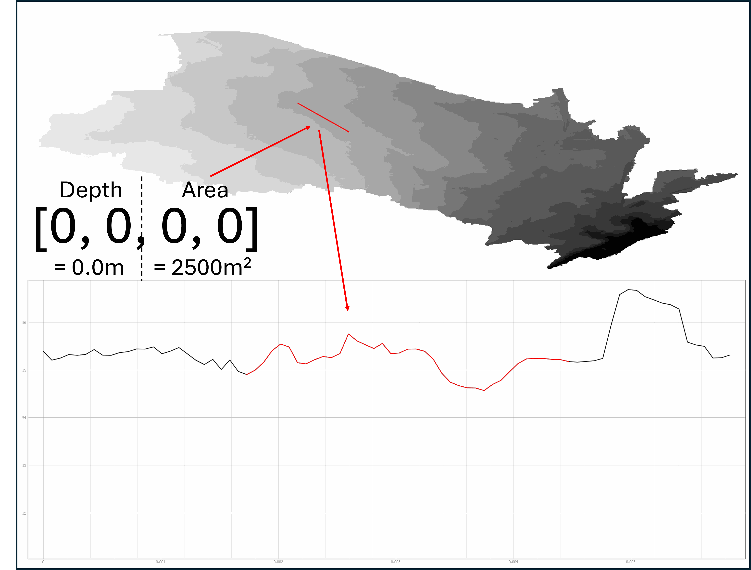
Detention basins

Slide 17
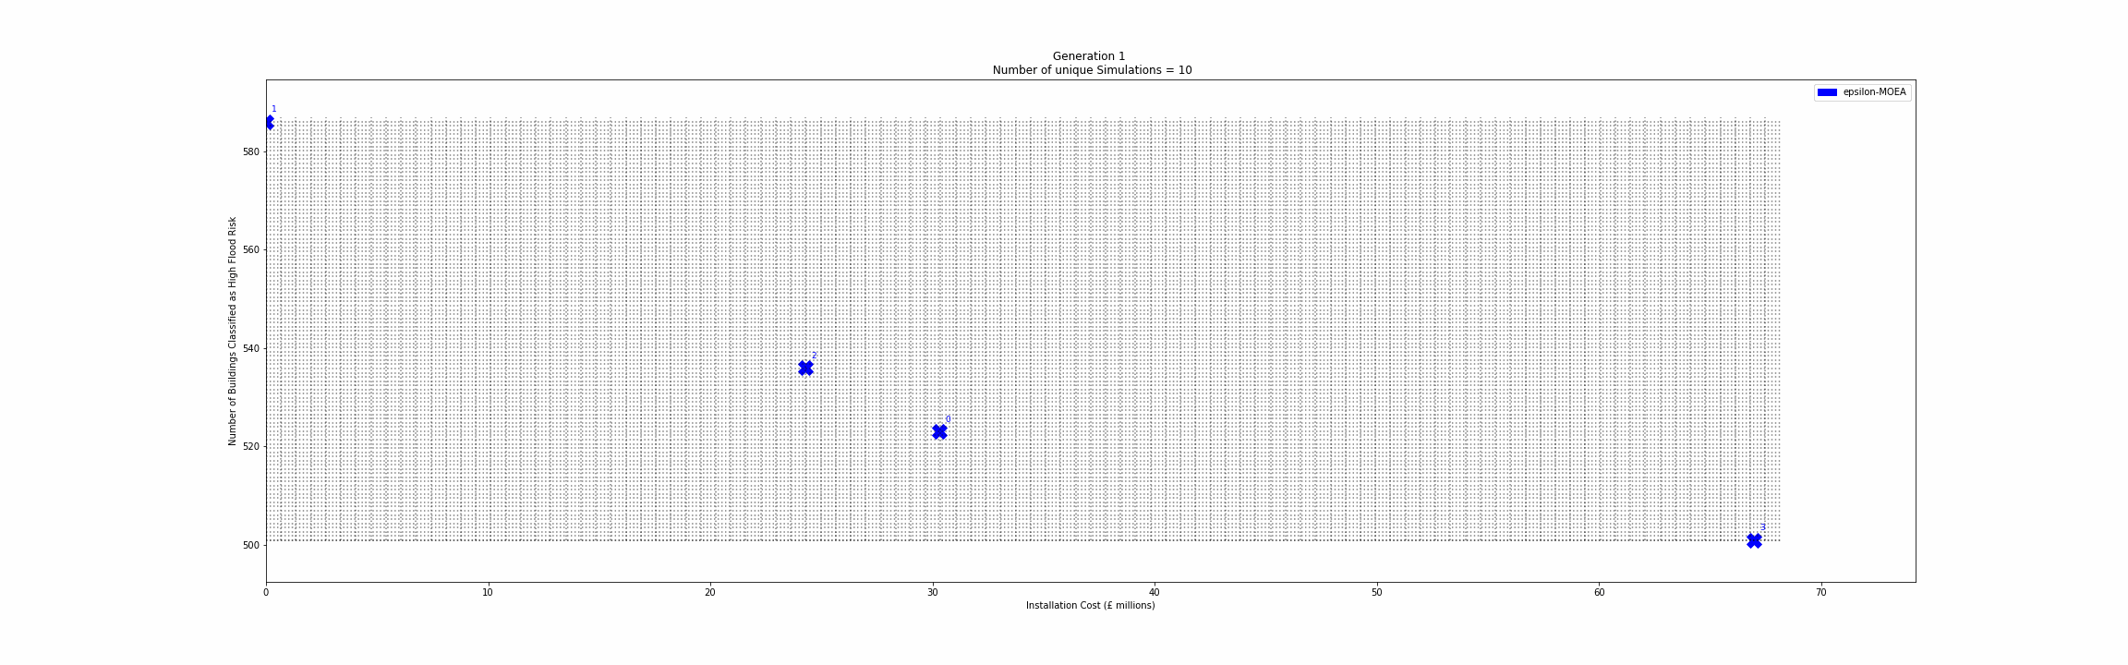
Example solutions
Max 100 solutions -> total simulations ~ 6000 taking ~weeks

Slide 18
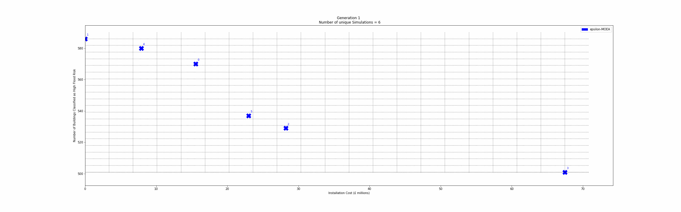
Example solutions
Max 10 solutions -> total simulations ~ 250 taking ~1 day

Slide 19
Notes:
Notes:

Slide 20
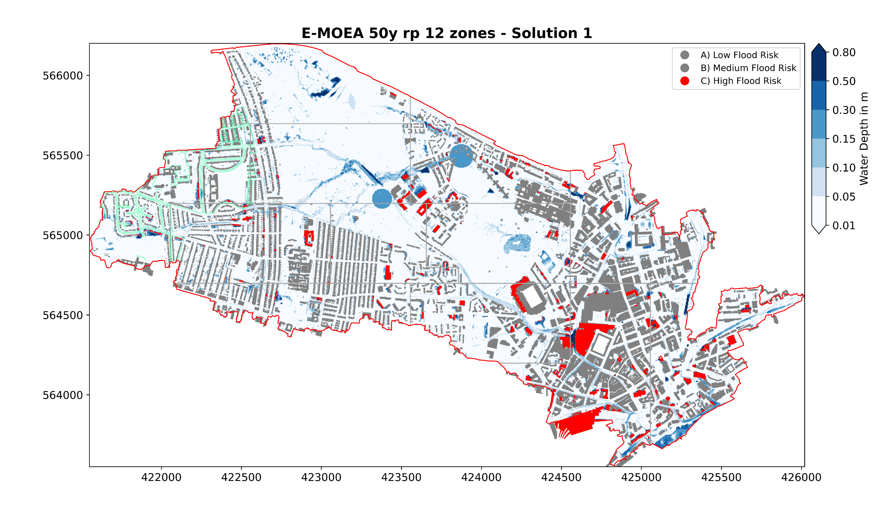

Slide 21
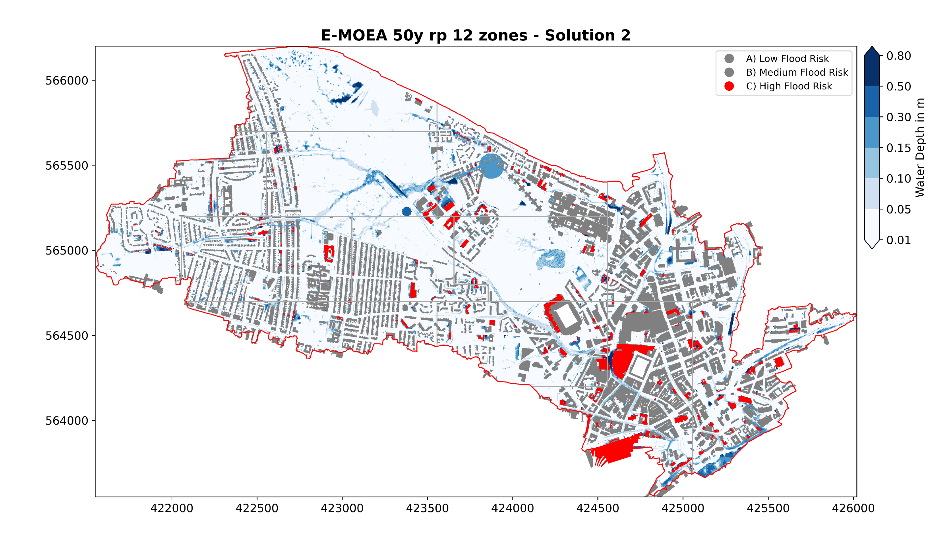

Slide 22
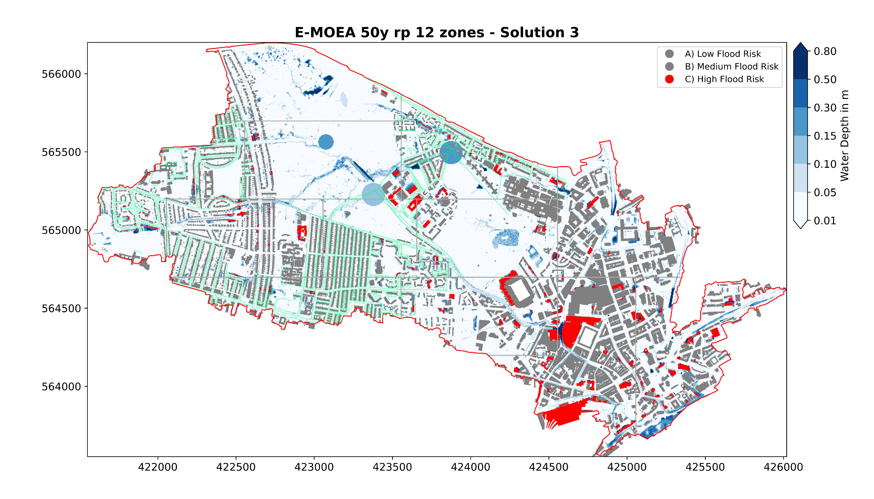

Slide 23
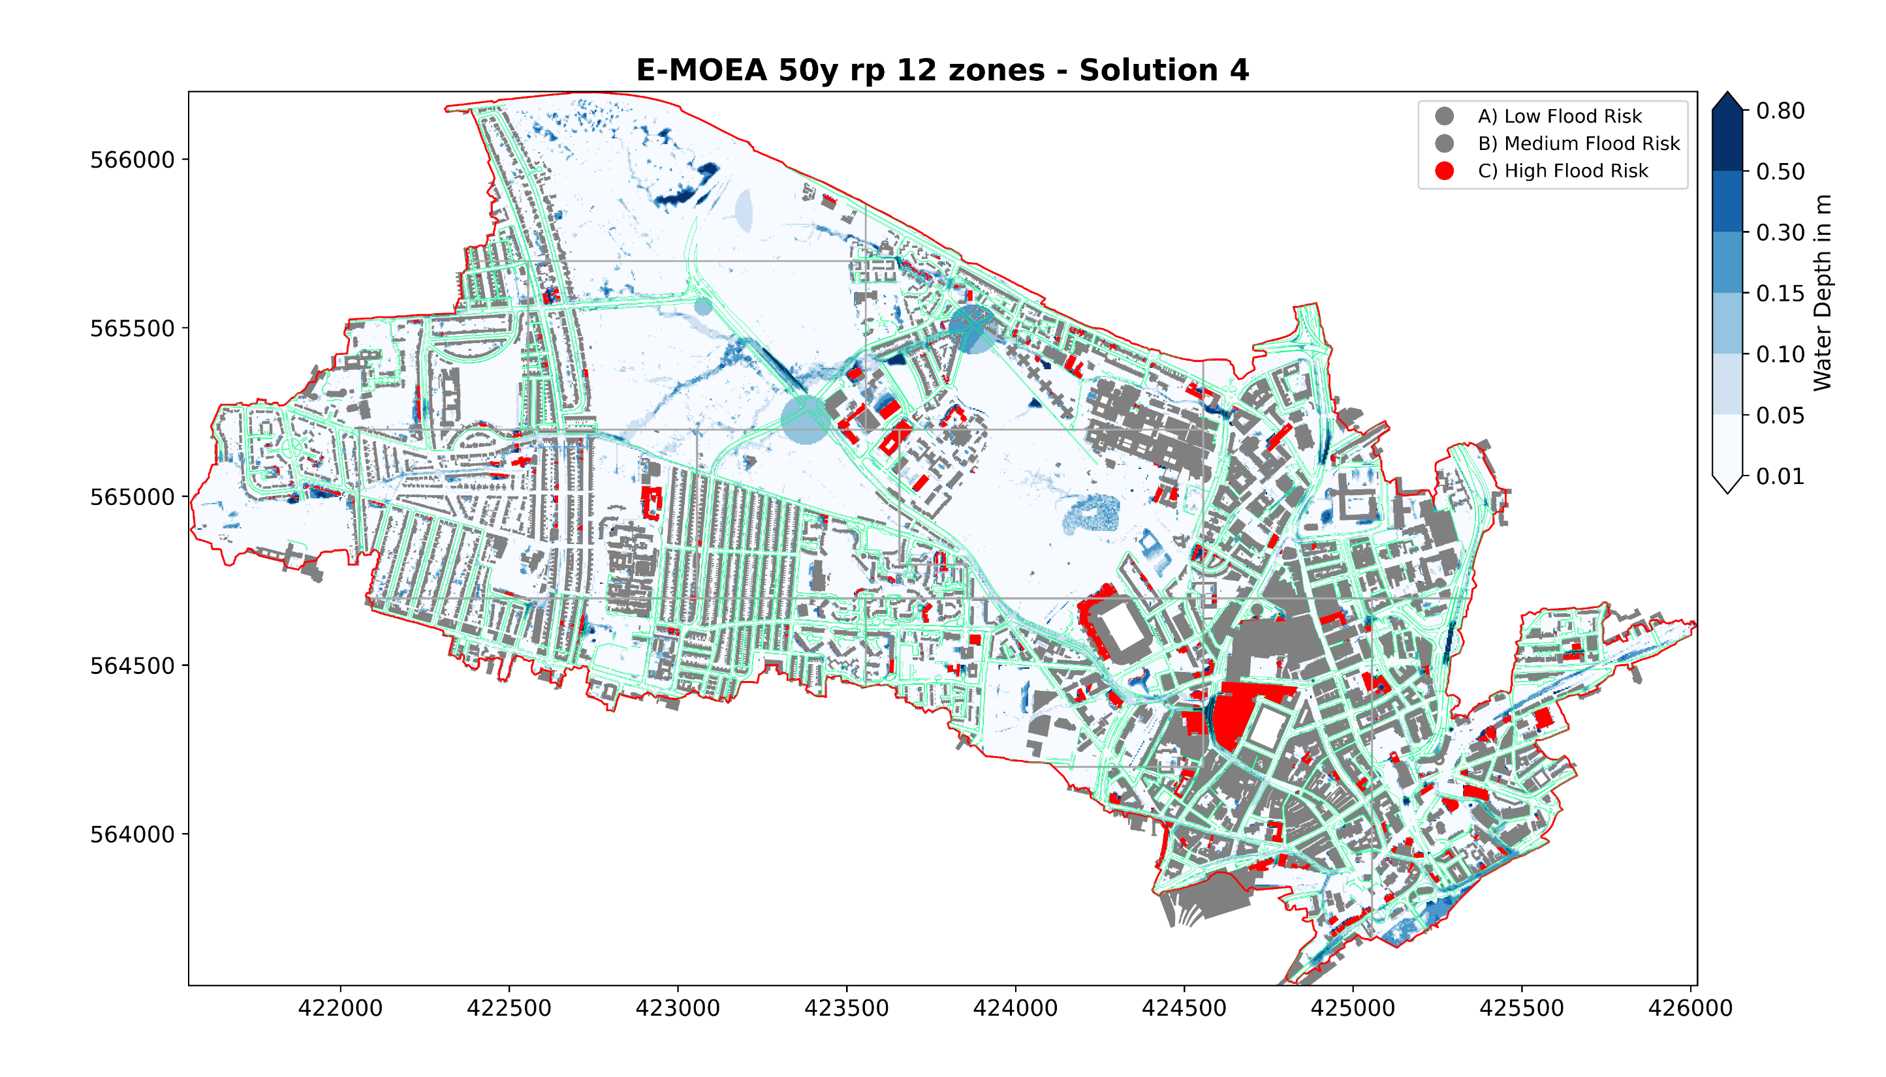

Slide 24
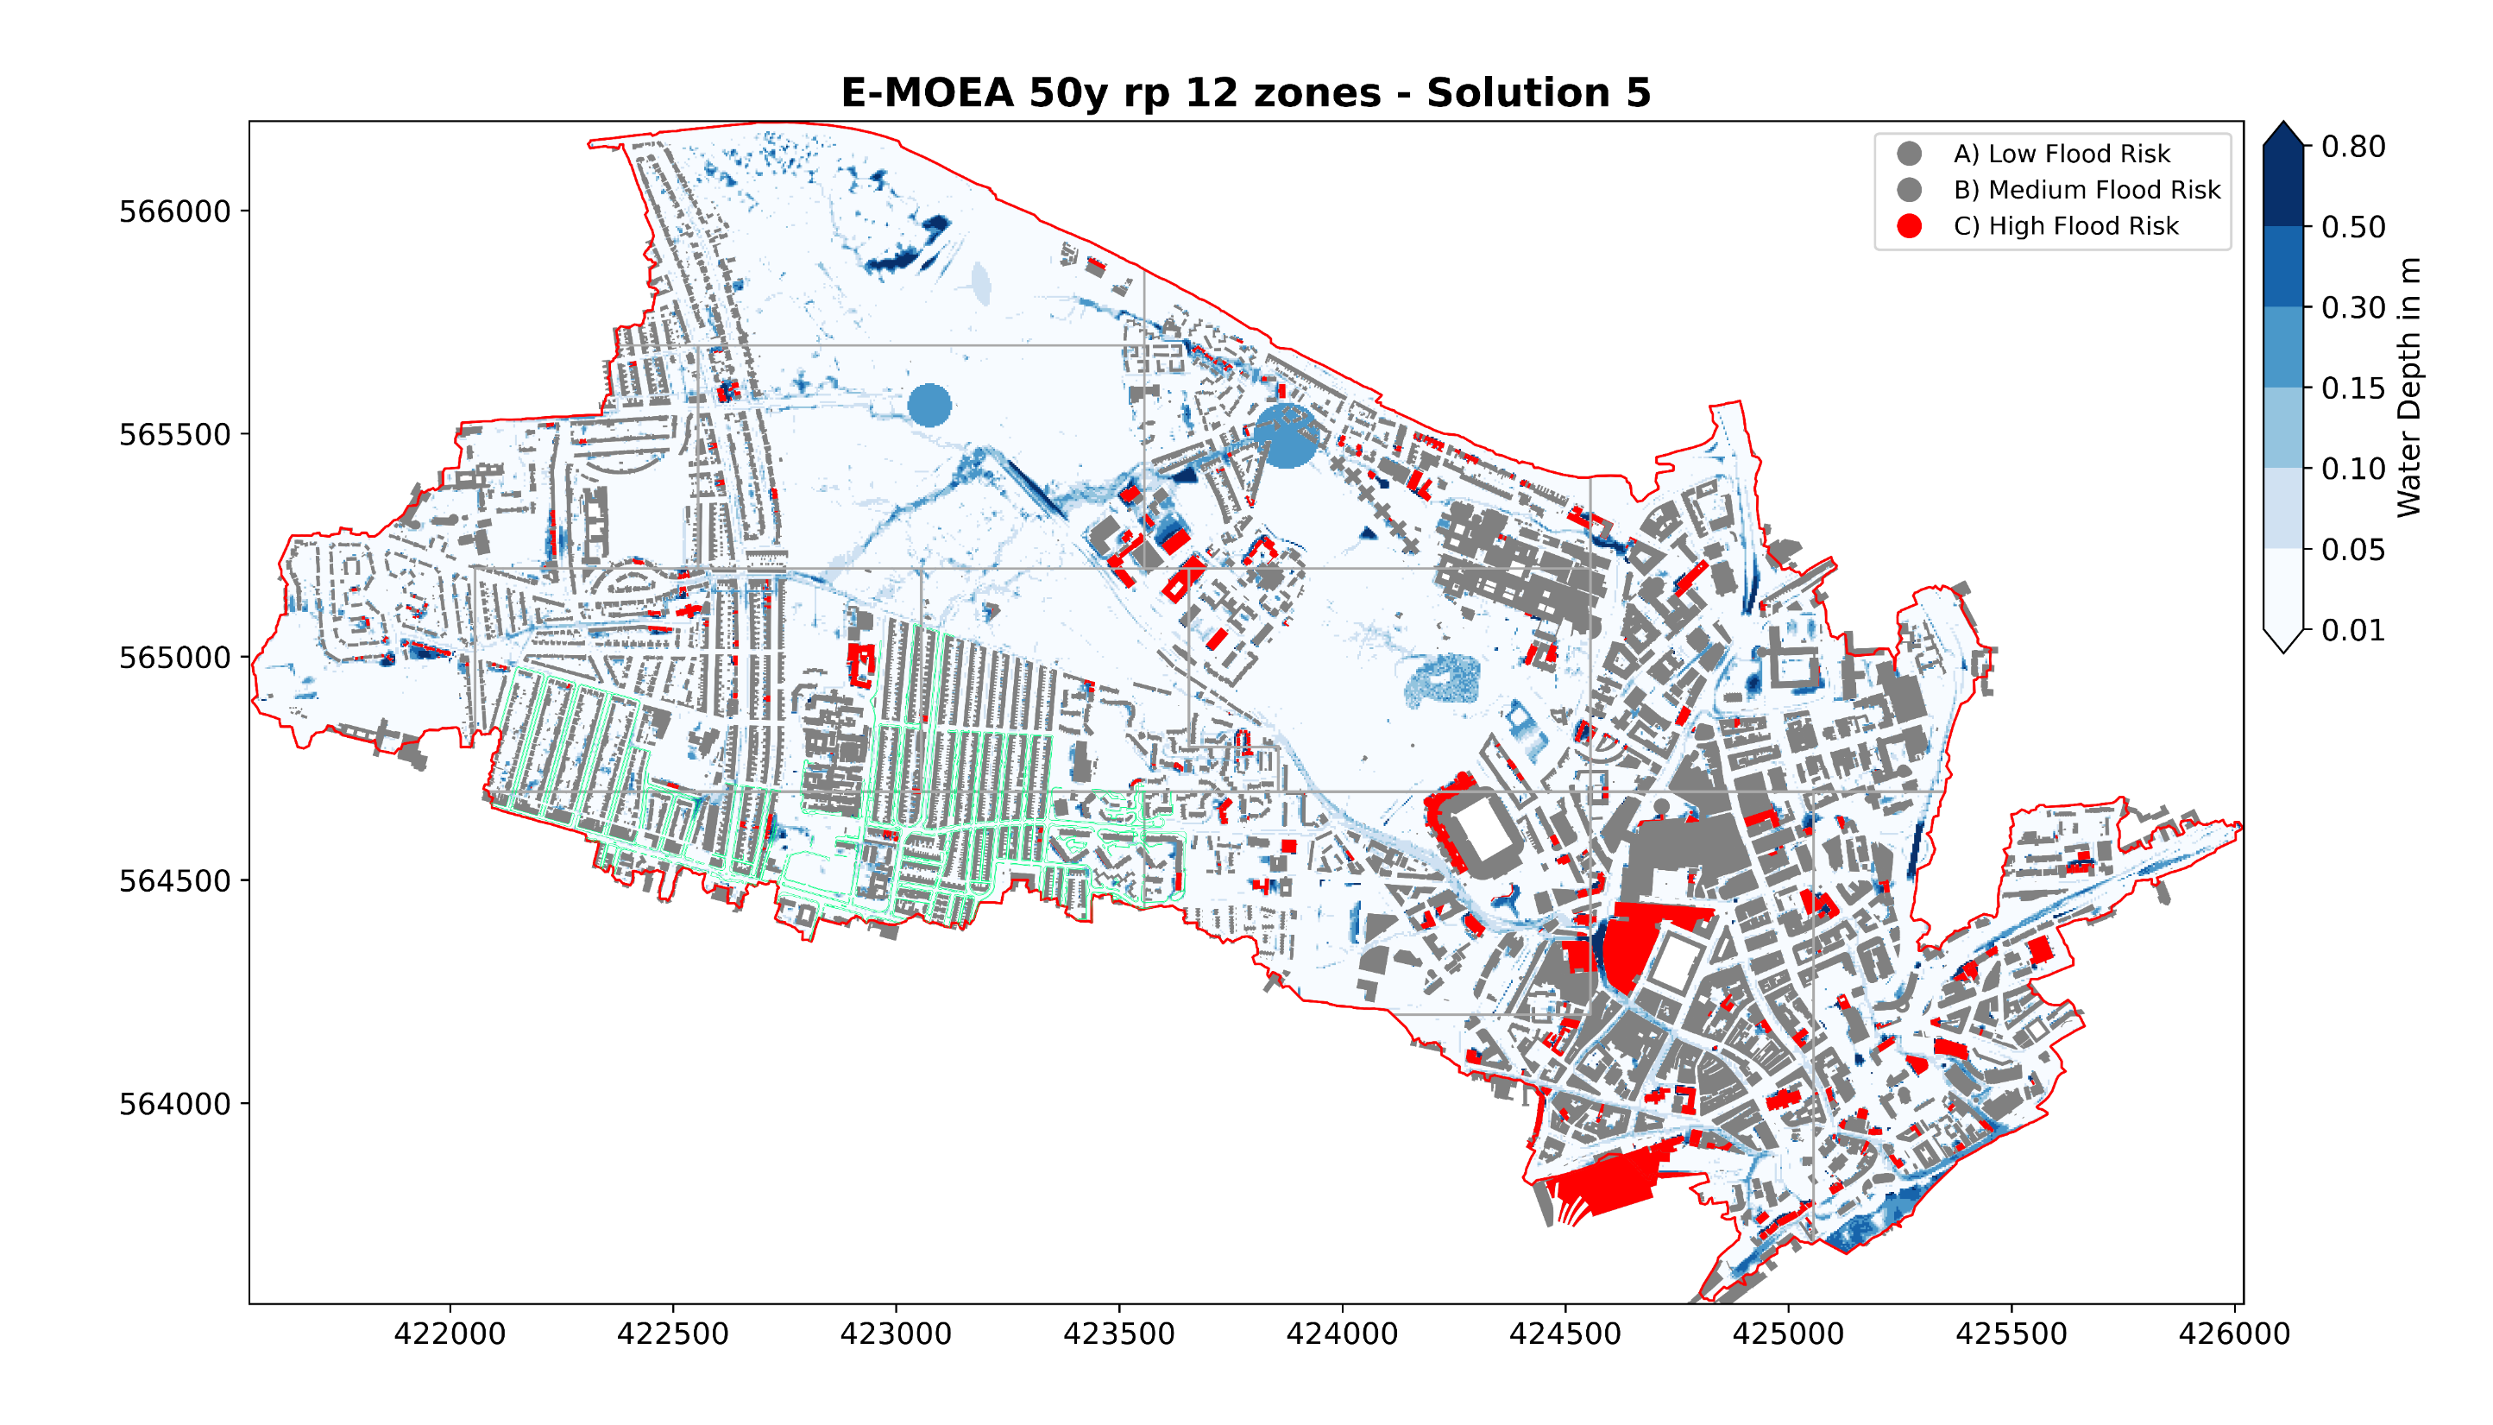

Slide 25
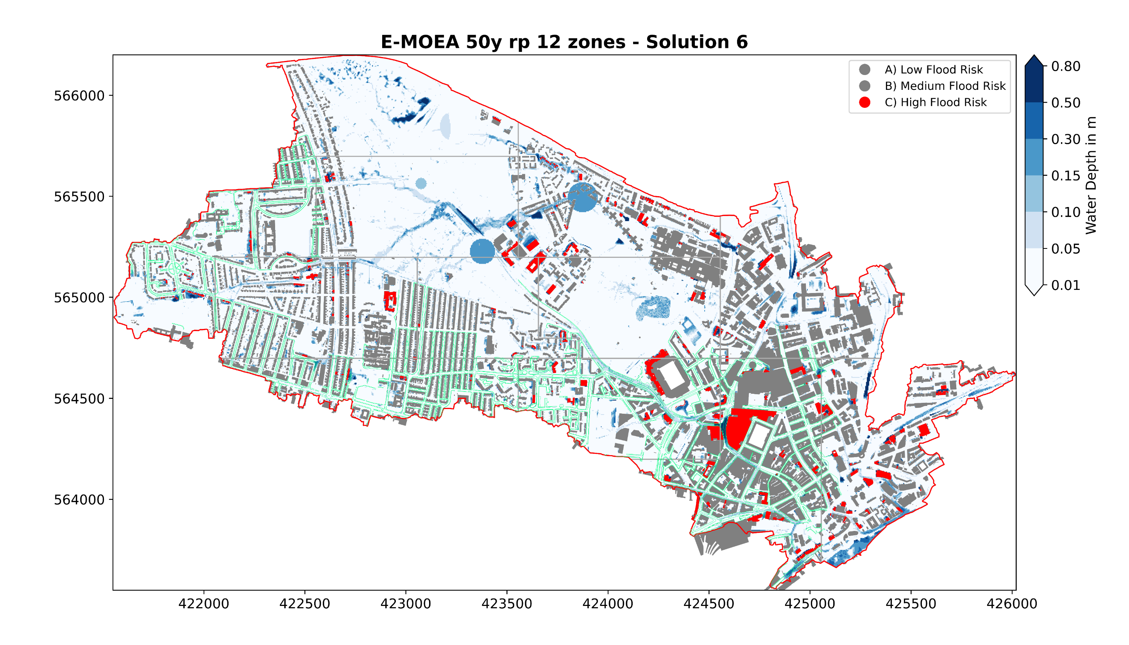

Slide 26
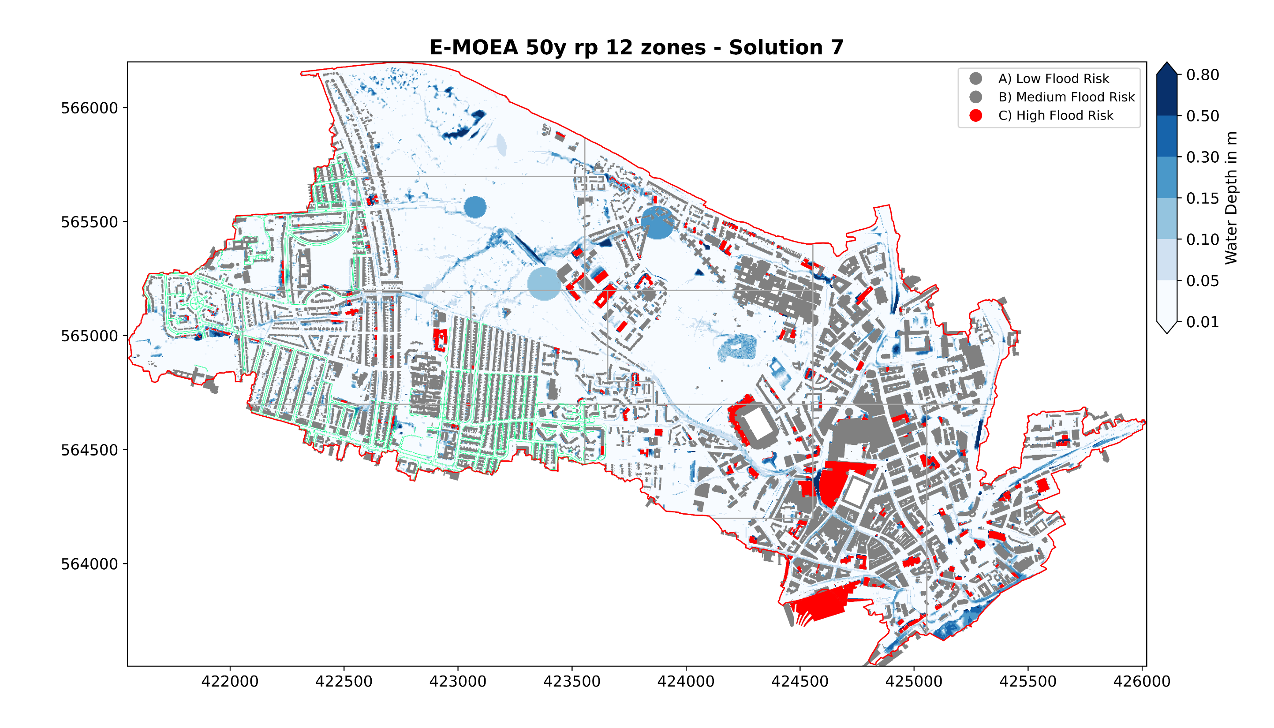

Slide 27


Slide 29
Benefits / impact of the project

Slide 30
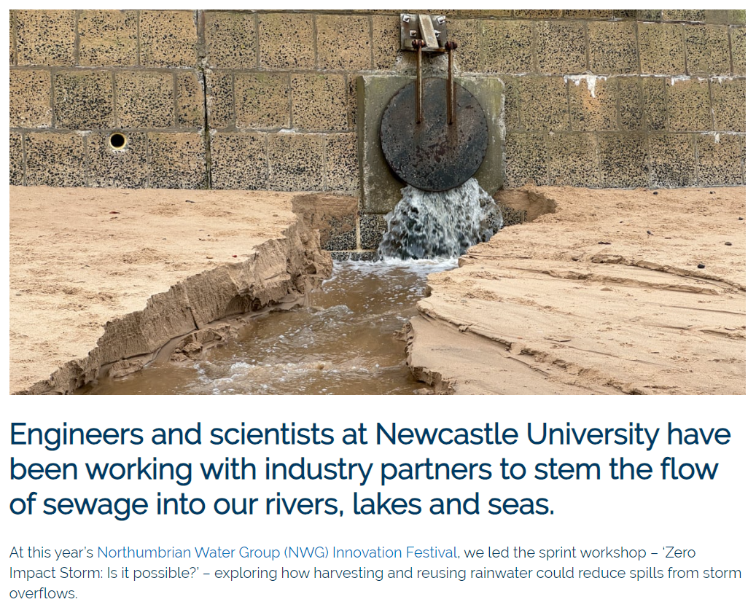
Northumbrian Water – Innovation festival

Slide 31
Newcastle City Council
Pilot Blue-Green City Project
The optimisation tool will be used to automate the optioneering of flood intervention features.
First phase: manage surface water from the Town Moore​
​
Second phase: Hunters Moor & Pandon Burn diverting surface water from Arthur’s Hill away from Gallowgate and the city centre​
​
Longer-term: introduction of green corridors

Slide 32
Next steps

Slide 33
Next steps
Develop a tool to better visualise and use the (surface and pipe) drainage network for model set up and analysis of results
Develop a methodology to flexibly explore a wide range of rainfall events and design constraints.

Slide 34
Sewer Overflow Flood Risk Analysis MOdel Dafni Enabled
vassilis.glenis@newcastle.ac.uk

