Slide 1




NIRD: Building systemic resilience of
interdependent infrastructure networks
at the national scale
Presenter: Dr.Raghav Pant, Environmental Change Institute, University of Oxford
Authors: Yue Li, Raghav Pant, Tom Russell, Fred Thomas, Jim Hall, Philip Oldham
DAFNI Annual Conference
September 10, 2024, Birmingham

Slide 2

Motivation
Recommendation
•Regulators should require a system of regular stress testing by
2024 for energy, water, digital, road and rail infrastructure
operators, to ensureresilience standards for infrastructure
services
Gaps
•Lack of understanding of systemic failures remains a major
challenge for operators in estimating and tackling climate risks
•Lack of coherent data for modelling infrastructure interactions
and inconsistent risk measures that makes it difficult to compare
resilience outcomes across different sectors

Slide 3
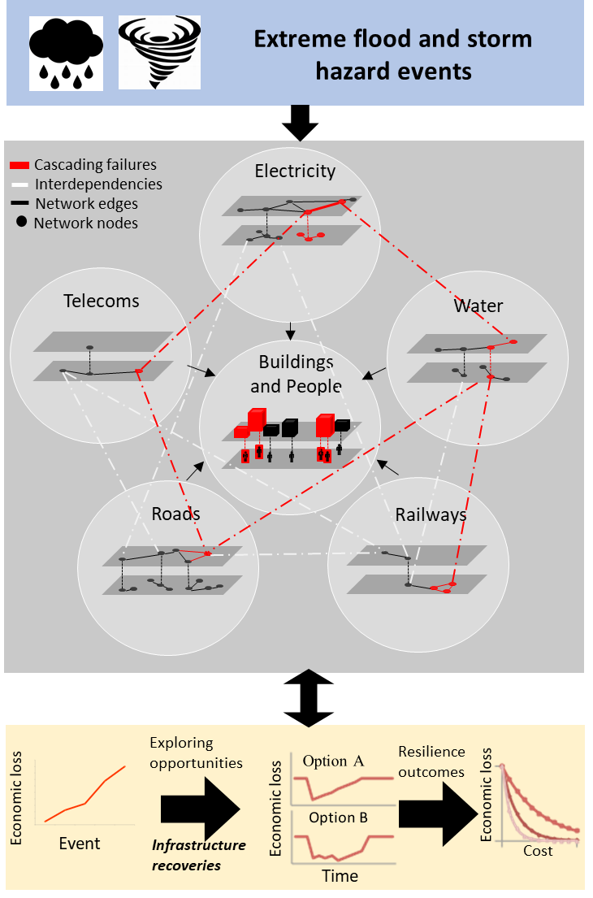
NIRD
National Infrastructure Resilience Demonstrator
Objectives
(1)Stress-test networks with extreme flood and storm events
(2)Model systemic network failure cascades to quantify losses to
people and economic activities
(3)Explore resilience options in reducing network failure losses
Project outcome
Deliver accessible national-scale modelling capability and software
toolsfor quantifying UK infrastructure risk and resilience to extreme
flood and storm events, supported by a unique spatial database of
networks, population and economic activities

Slide 4
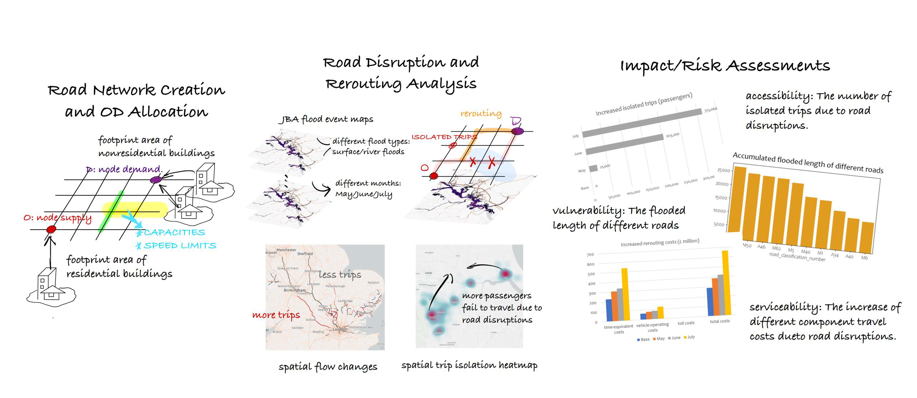
NIRD –Analysis of Road Network Disruptions

Slide 5
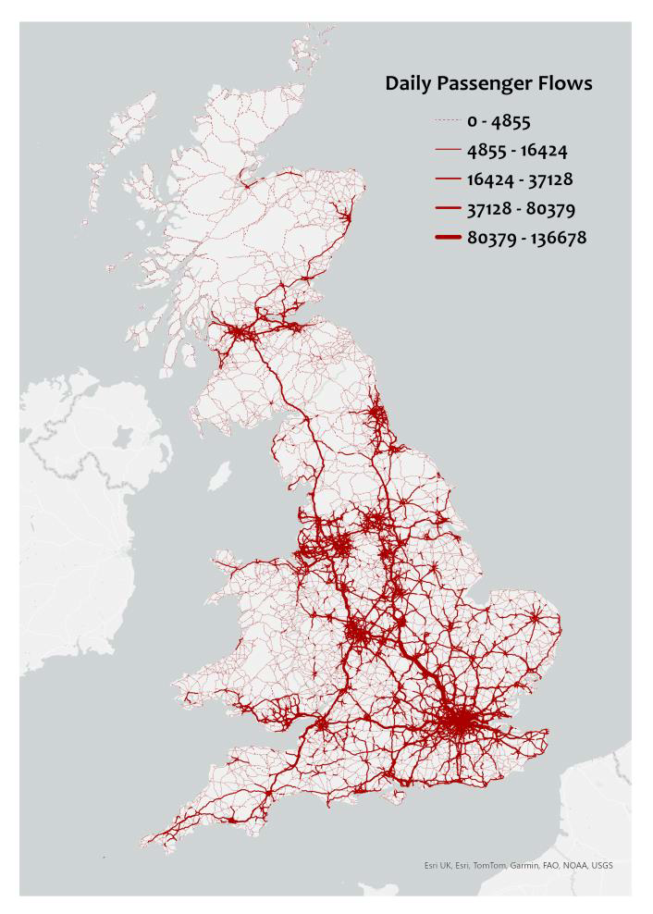
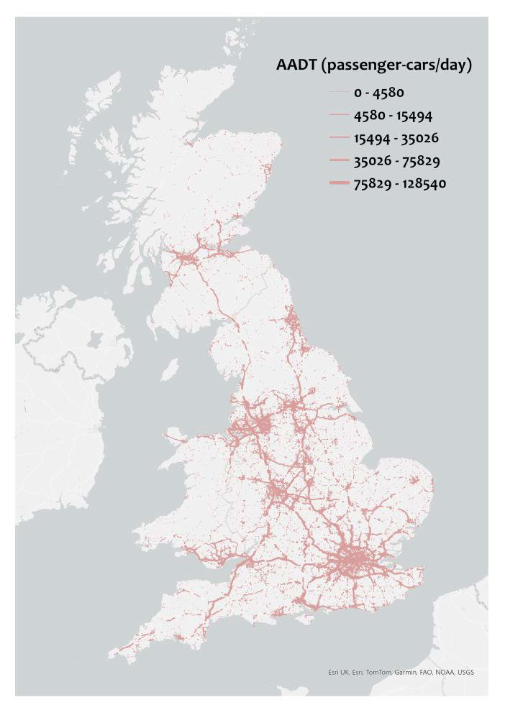
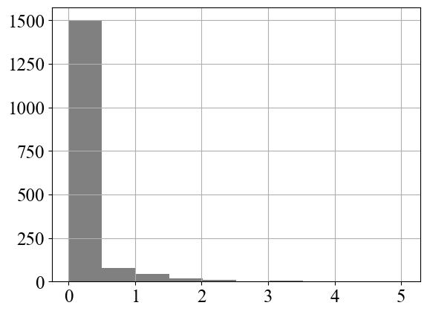
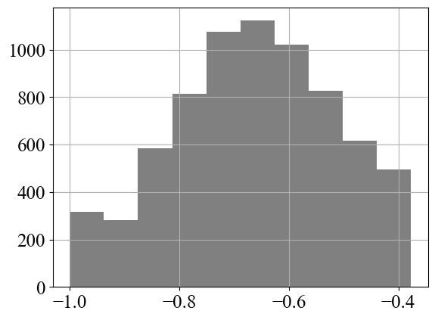
Base Scenario: Flow Simulation and Validation
2021 journey-to-work OD flows 2021 AADT car traffic counts
Overestimation
Simulation Observation
𝑆𝑖𝑚𝑢
1.6^{−𝑂𝑏𝑠}
𝑂𝑏𝑠
Underestimation
With observed traffic
counts > 10,000 cars

Slide 6
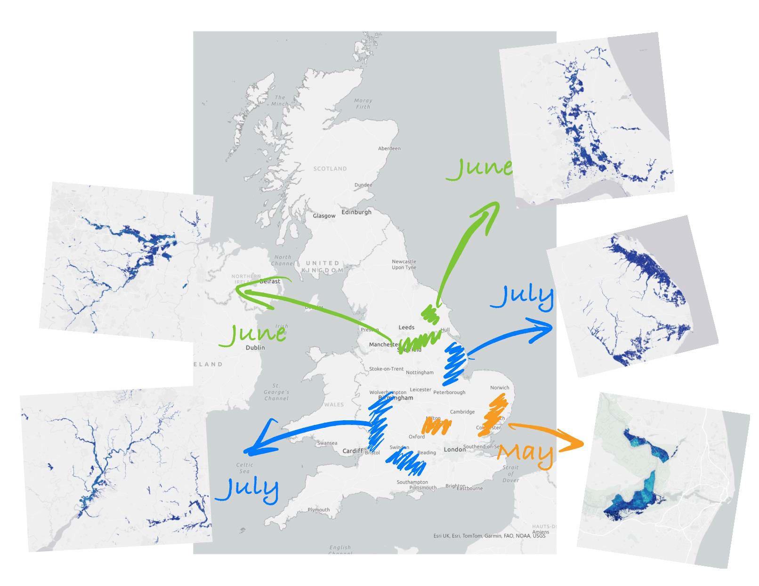
JBA Flood Event Maps –2007 UK Summer Floods
• This figure uses different color
scratches to indicate roughly
the flood extend/coverage for
May (orange), June (green)
and July (blue).
• The flood data include both
surface (FLSW) and river
(FLRF)flood event maps
across three months.
• Individual samples indicate
flood depth information.

Slide 7
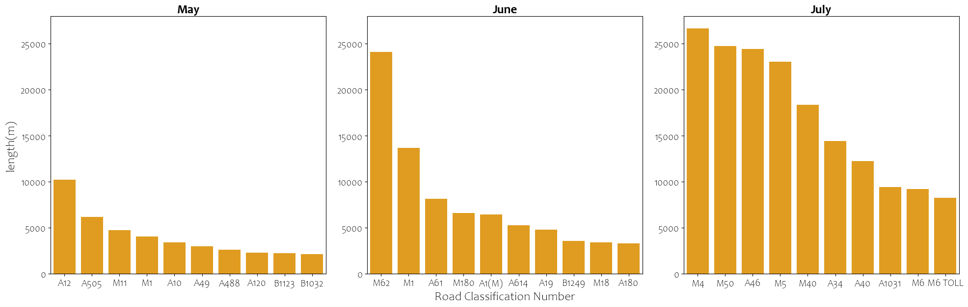
Accumulated Disrupted Length of Roads
Length of roads exposed to flood depths > 1 m

Slide 8
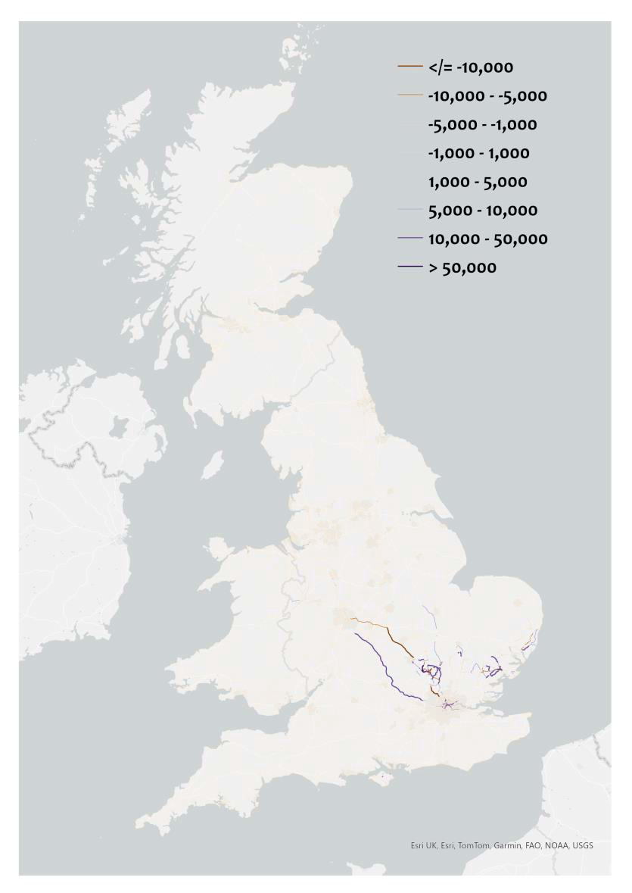
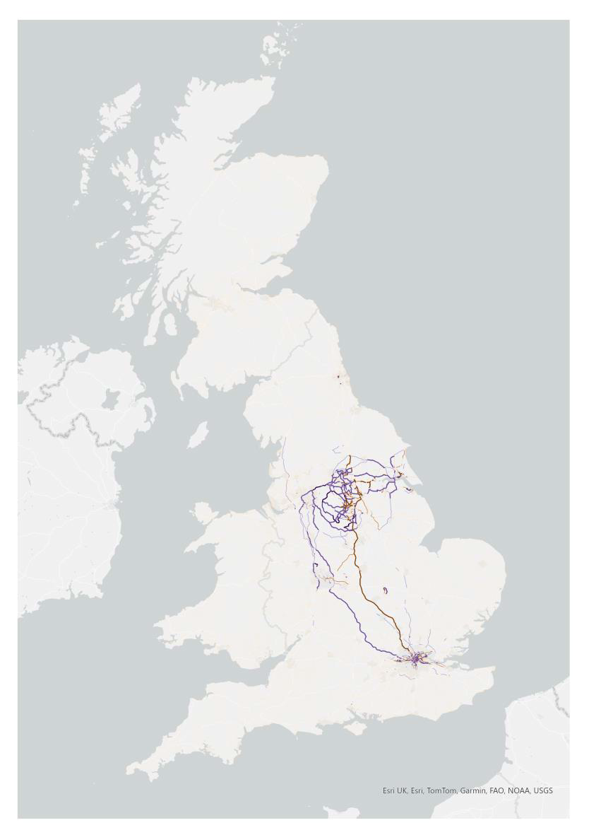
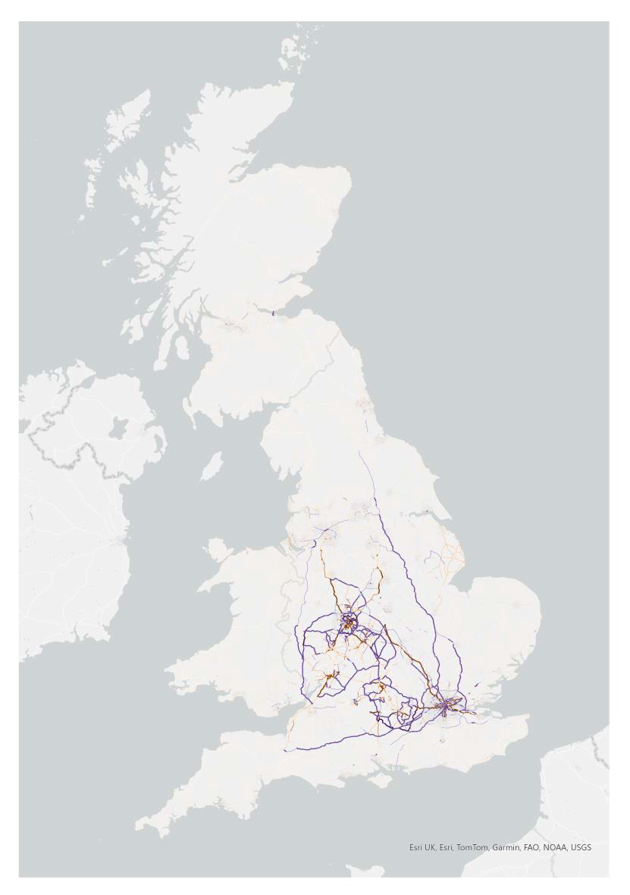
Spatial Passenger Flow Changes under UK Summer Floods
May 2007 June 2007 July 2007

Slide 9
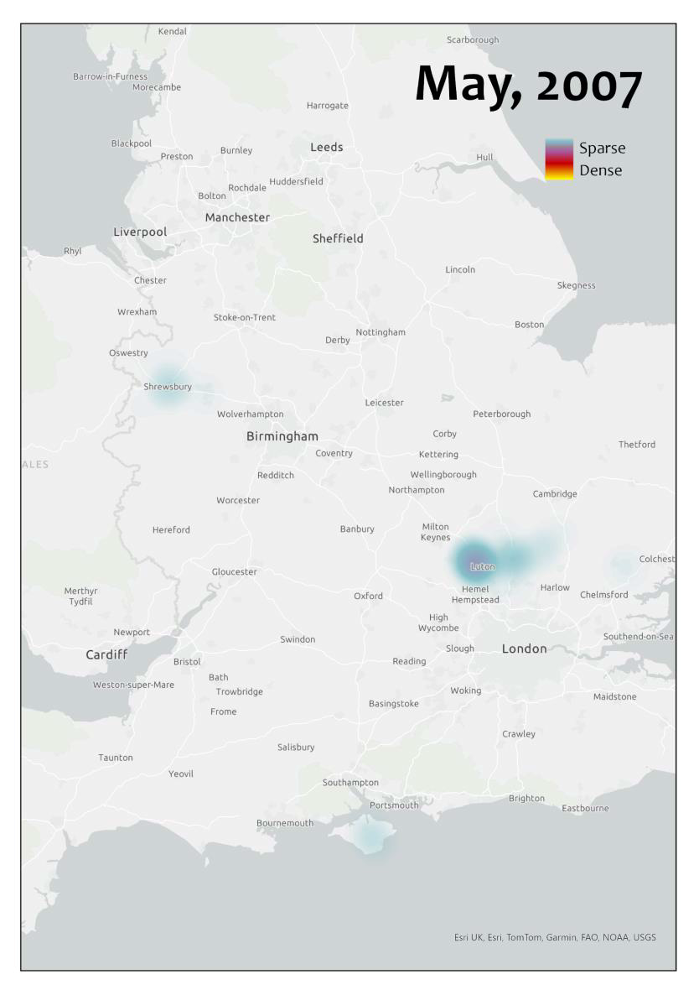
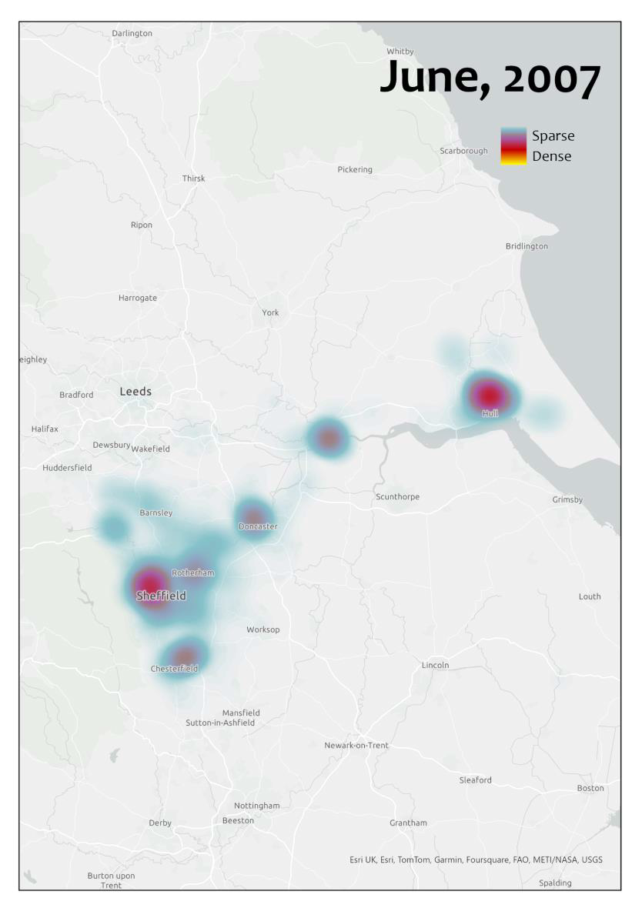
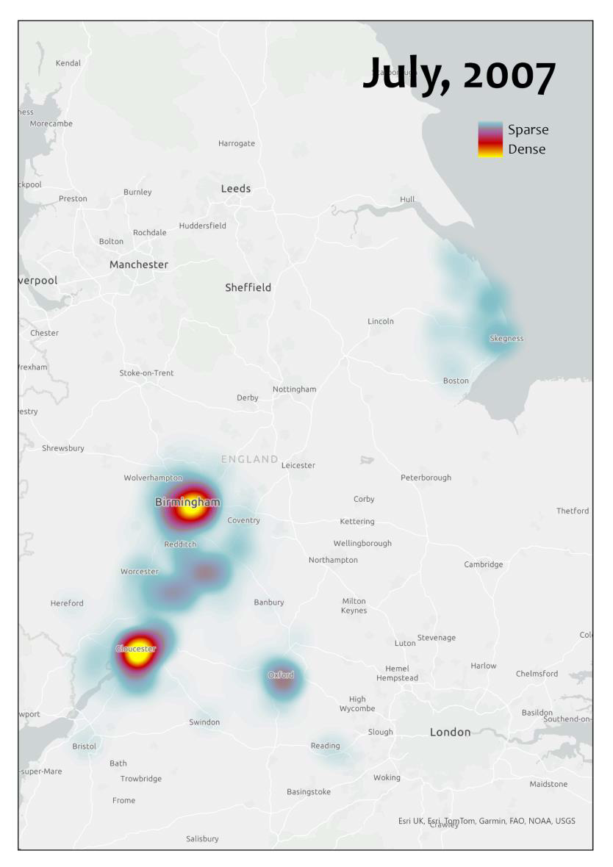
Spatial Isolated Passenger Flow Heatmap

Slide 10
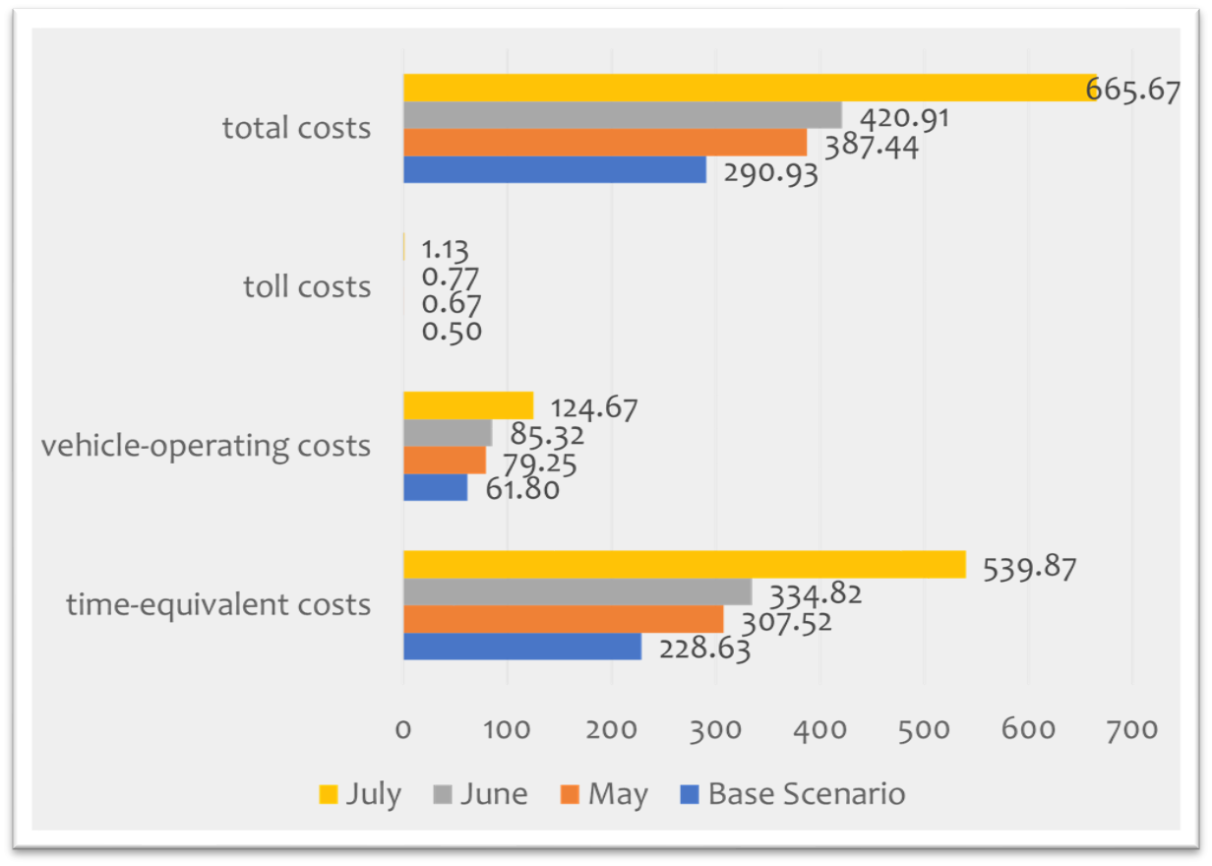
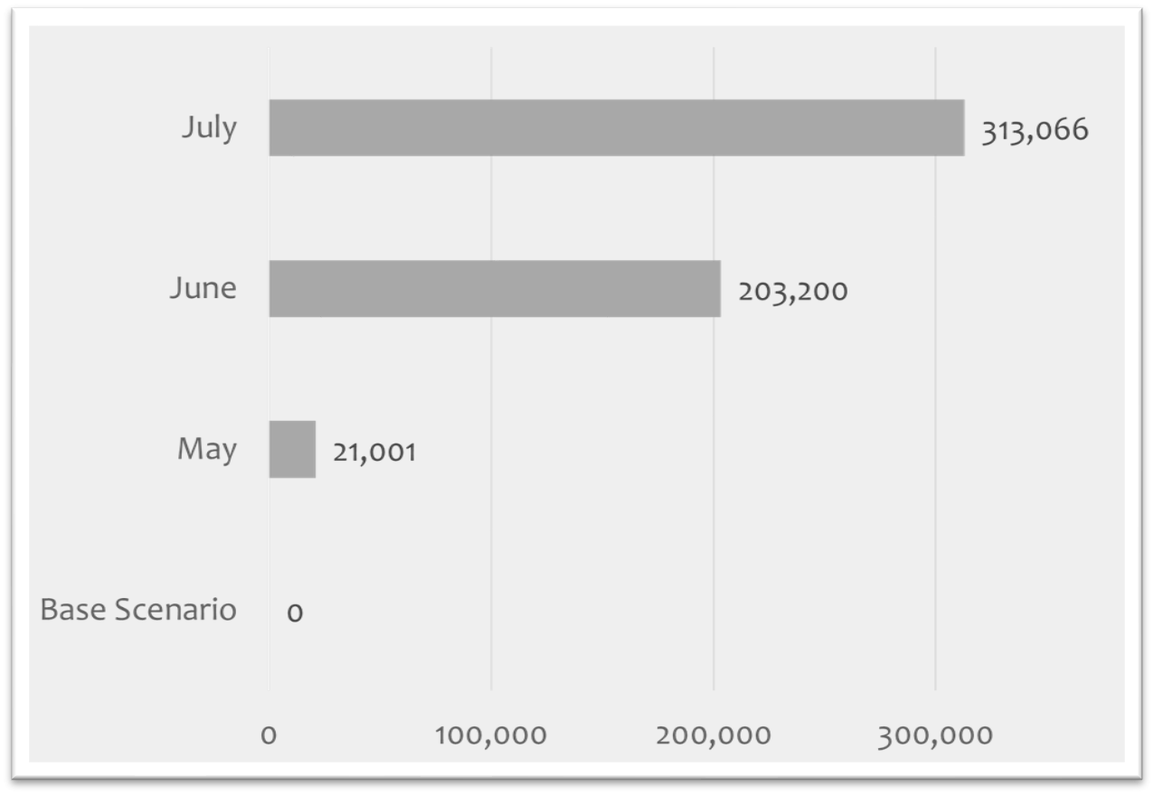
Impact Assessment
Increased rerouting costs (£ million/day) Increased isolated trips (passengers)

Slide 11
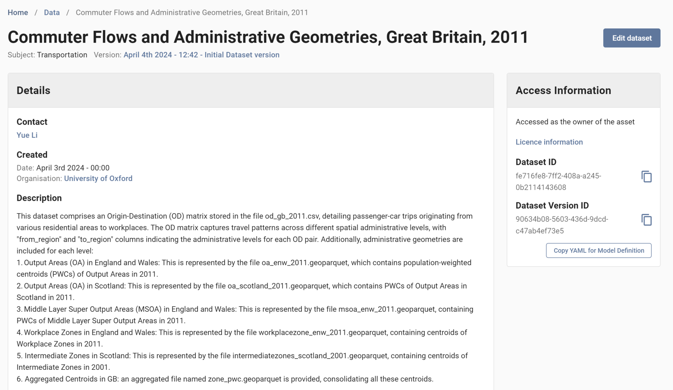
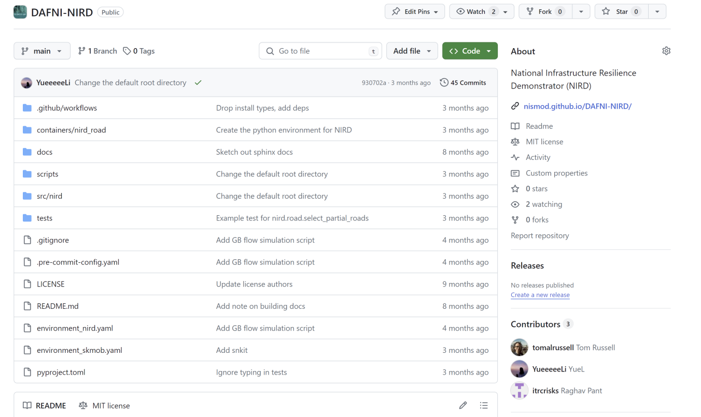
Open-access Database and Code Development
https://github.com/nismod/DAFNI-NIRD
11

Slide 12
Conclusion
Value of work
•Development of national-scale road disruption model
•Workflow creation forstress-testing under various hazard events for counterfactual analysis
•Useful for improving understanding of systemic failure impacts
Further developments
•Introduce vulnerability curves for direct damages and indirect disruption losses estimations to
quantify full event losses
•Produce similar metrics for other sectors

Slide 13
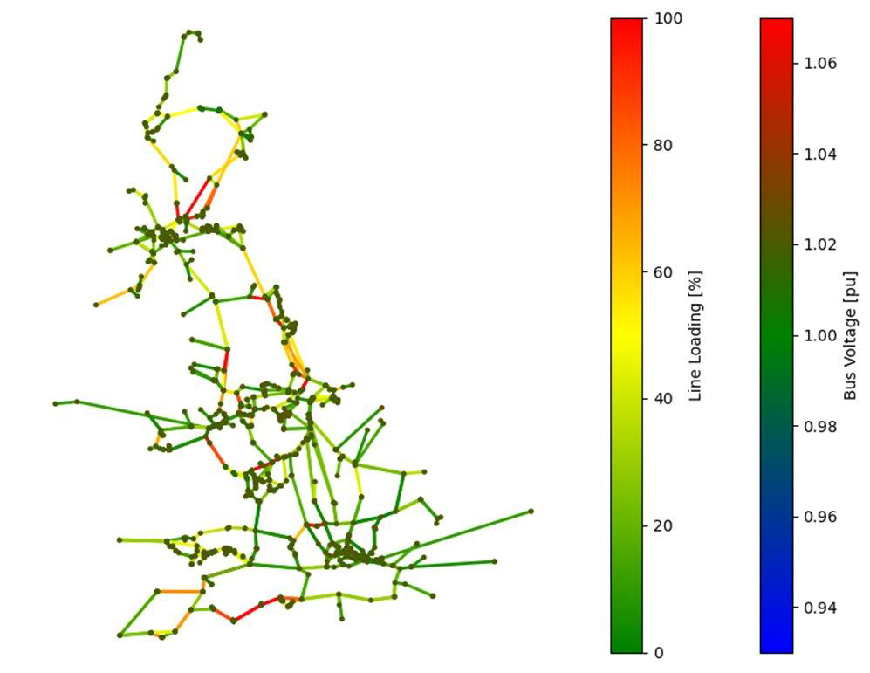
Work in progress
• Process-based network flow models
from other sectors
• E.g. -Electricity dispatch model to
represent flow allocations for power
plantsto locations of demand
• E.g. -Rail passenger flow model
development
• Resilience options for recovery
13

Slide 14
Contact:
raghav.pant@ouce.ox.ac.uk
yue.li@ouce.ox.ac.uk

