Slide 1



Uncertainty Quantification and Sensitivity Analysis for Resilient Infrastructure Systems (USARIS)
Hannah Bloomfield, Gemma Coxon, Francesca Pianosi, Saskia Salwey
Work in this presentation is funded under the DAFNI Centre of Excellence for Resilient Infrastructure Analysis within the UKRI Building a Secure and Resilient World programme, with grant number ST/Y003713/1

Slide 2
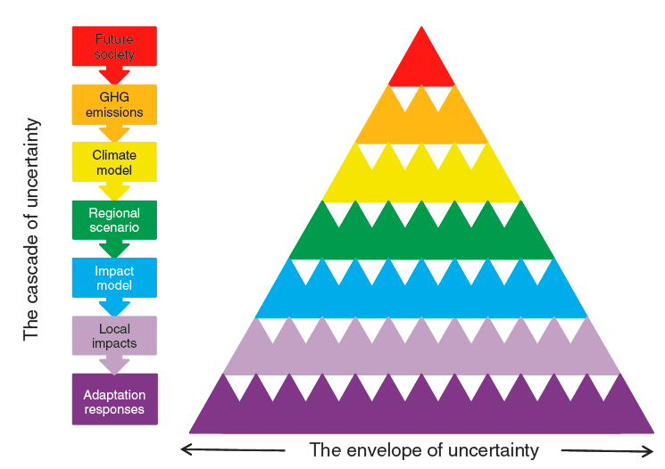
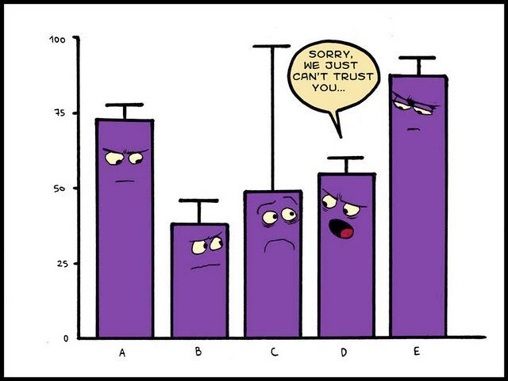
Computational models have become an essential source of information to support infrastructure decisions, but…
Model outputs are conditional on many uncertain assumptions
-- about the system’s properties and drivers
-- how drivers will evolve in the future
For models to be trustworthy and effective for infrastructure resilience
we must:
-- avoid spurious precision
-- identify key sources of uncertainty
when does the model stops being valid?
where to start to improve the model?
-- identify robust designs
which designs perform “well enough” across a range of futures?
[Wilby & Dessai 2010]
[Reading Local Group of the Royal Statistical Society]

Slide 3
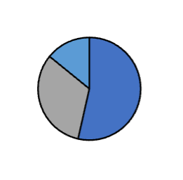
Uncertainty quantification (UQ) and sensitivity analysis (SA) provide a generic methodology to address these challenges
Step 1 propagate input uncertainties
Step 2 analyse the input-output dataset
Monte Carlo simulations
quantifying uncertainty
quantifying sensitivity
stress-testing
How uncertain are model output(s) given uncertainty
in inputs?
Which inputs mostly contribute to the output uncertainty?
What designs perform well enough across a large range of inputs?
What are threshold values in the inputs that lead to “good enough” outputs?
What is the precision and scope of validity of the model?
Design A
Design B
Design
Contribution to output uncertainty
Pop
Pop
Pop <0.2
Pop >0.2
Pop
Prec
Water System Model
Chances
of failure
Design A
Prec
Pop
Pop
Design B
Prec
Prec
Design B
Design A
Prec
Chances of Failure
Design
chances of failure:
below critical threshold
above critical threshold
unclear
Prec <0.3
Prec >0.3

Slide 4
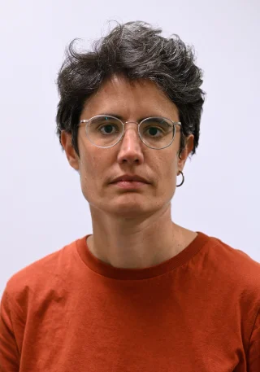
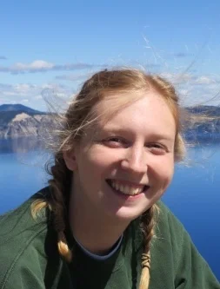
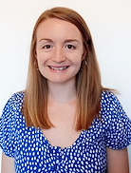

USARIS will set the foundations to include UQ&SA into DAFNI and demonstrate their value to the DAFNI users’ community
The integration into DAFNI will be conducted by developing several pilot applications (DAFNI workflows) in water and energy
-- We will rely on existing UQ&SA packages (e.g. https://safetoolbox.github.io/)
-- The workflows will be used for training and dissemination during the project
-- We will investigate scalability and provide recommendations for future developments of DAFNI
Pianosi
UQ&SA
water systems
Salwey
UQ&SA
water systems
Bloomfield
energy systems
Coxon
water systems
Notes:
Training opportunities – be more specific

Slide 5
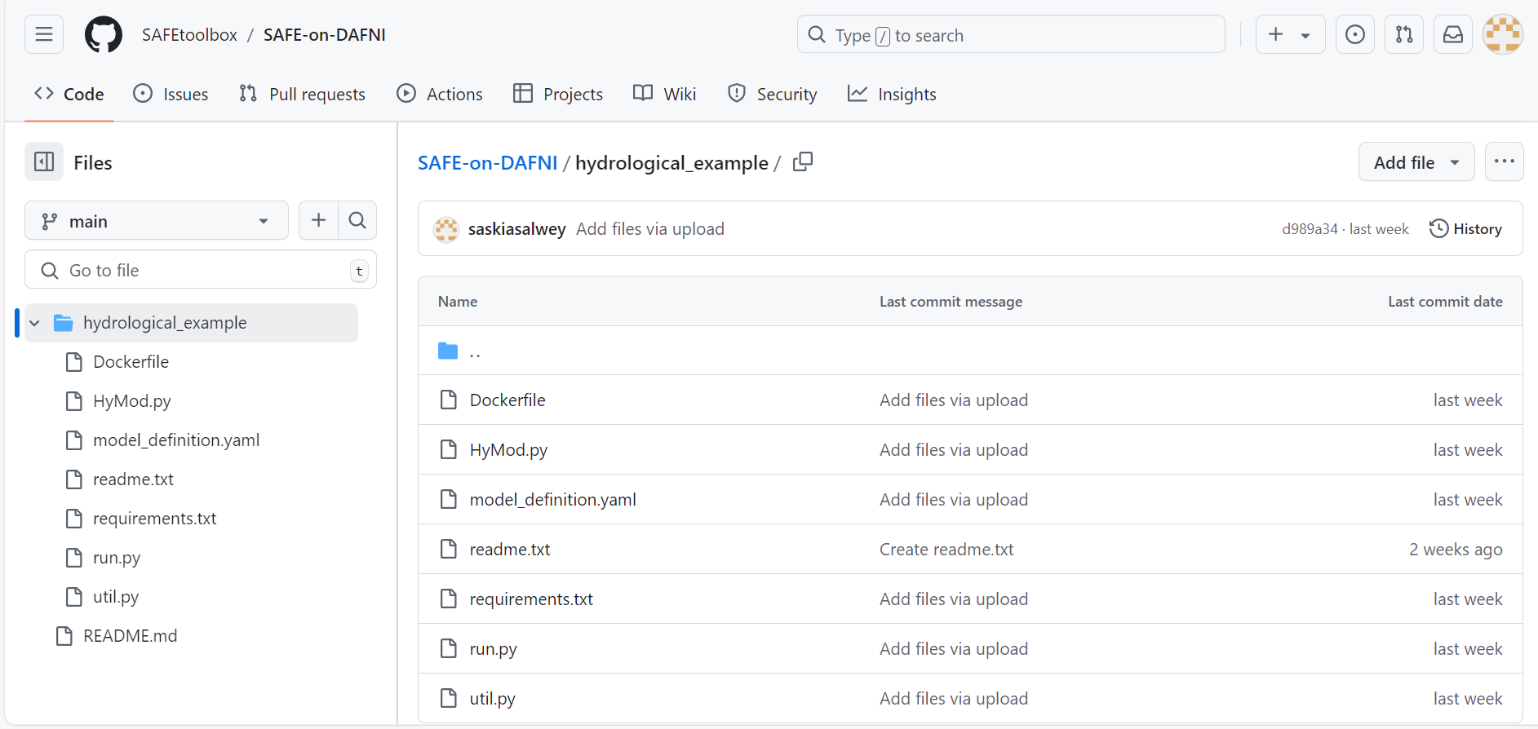
What has been done so far?
Pilot sensitivity analysis applications:
Hydrological model (HyMod) - on DAFNI as workflow
Wind power model – local analysis ongoing, hopefully on DAFNI soon!
Water resources model (Pywr-WREW) - planning has begun
We have also setup a GitHub repository containing all of our project code:
SAFEtoolbox/SAFE-on-DAFNI

Slide 6




UQ&SA on DAFNI
Upload model and data to the DAFNI platform
Run model in DAFNI workflow
Sample parameter space by looping over workflow
Visualise outputs

Slide 7
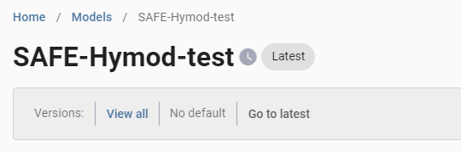
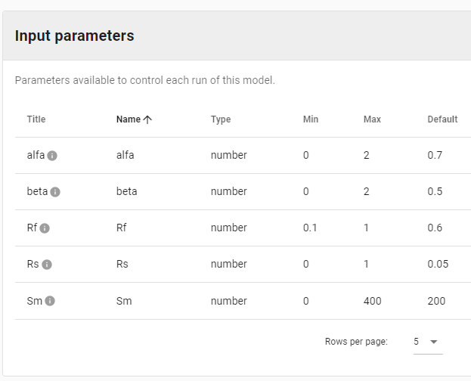



UQ&SA on DAFNI
Upload model and data to the DAFNI platform
Run model in DAFNI workflow
Sample parameter space by looping over workflow
Visualise outputs

Slide 8

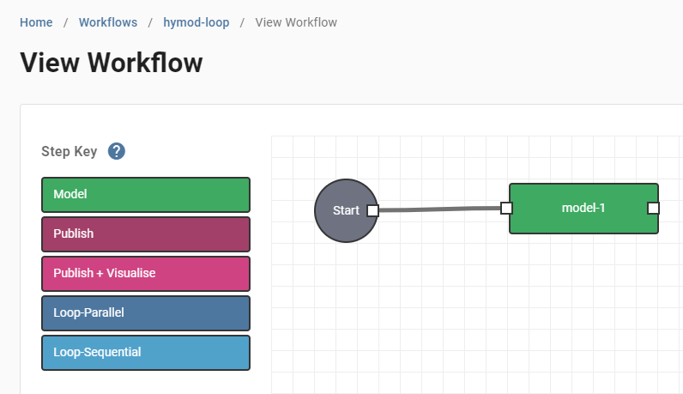
UQ&SA on DAFNI
Upload model and data to the DAFNI platform
Run model in DAFNI workflow
Sample parameter space by looping over workflow
Visualise outputs

Slide 9
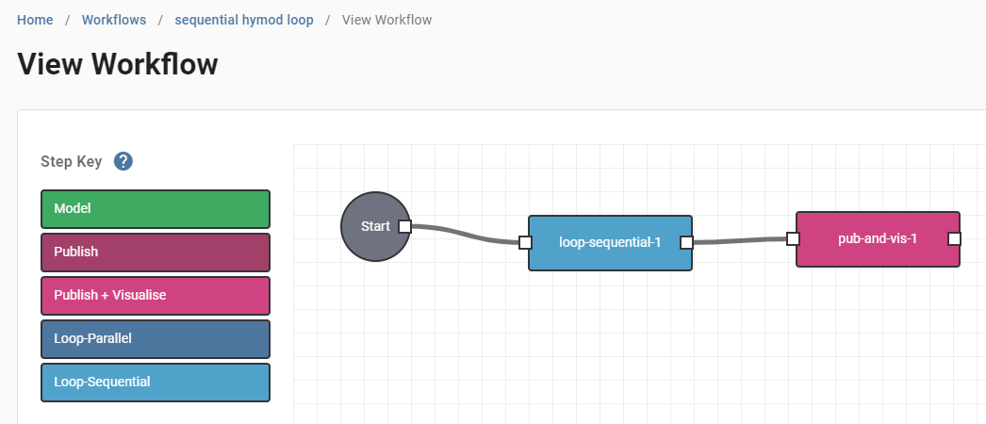
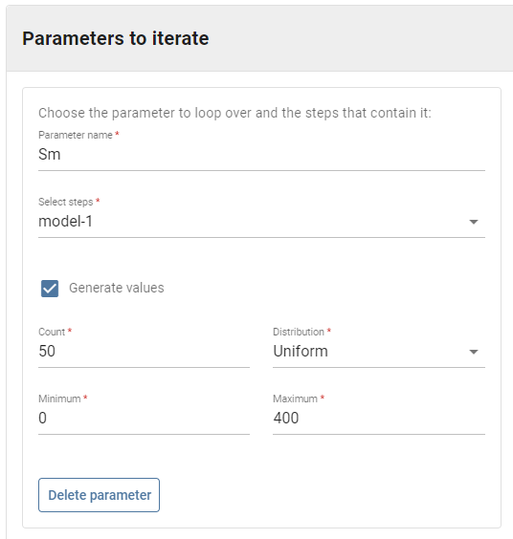
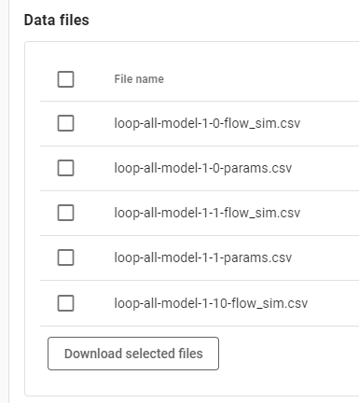
UQ&SA on DAFNI
Upload model and data to the DAFNI platform
Run model in DAFNI workflow
Sample parameter space by looping over workflow
Visualise outputs

Slide 10


UQ&SA on DAFNI
Upload model and data to the DAFNI platform
Run model in DAFNI workflow
Sample parameter space by looping over workflow
Model outputs can be accessed and analysed in a jupyter notebook
Visualise outputs

Slide 11
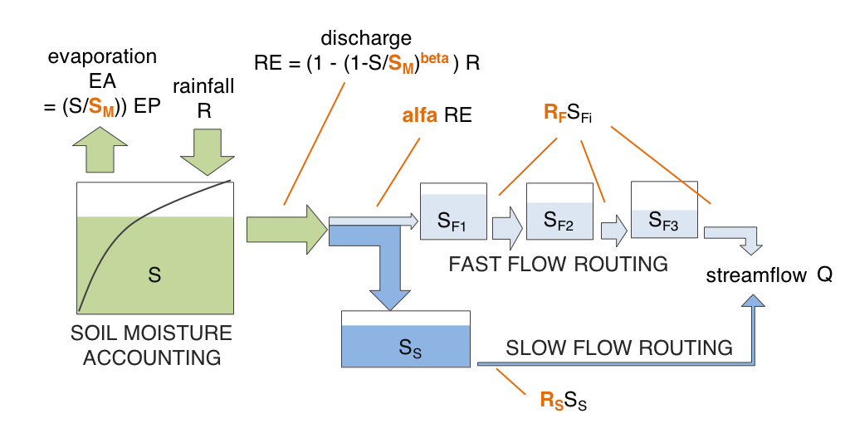
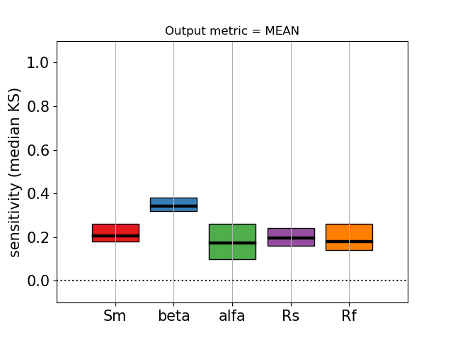
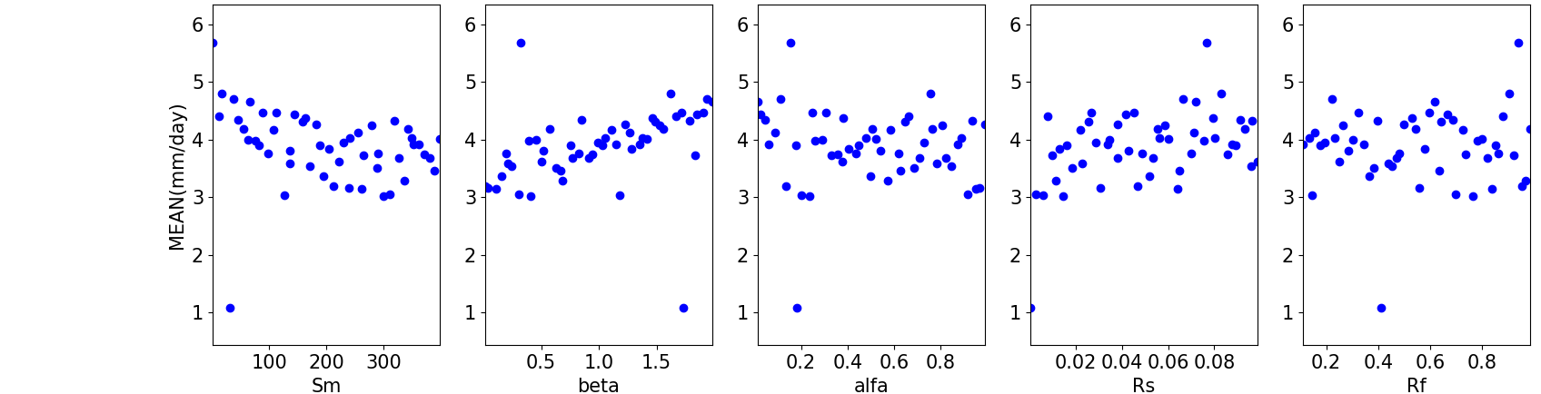
UQ&SA application to a hydrological model
Walk through available as DAFNI workflow
Water supply systems
mean flow
Notes:
Methodology can be applied to models from all sectors, we have a hydrological model example which is (almost !!) available as a DAFNI workflow

Slide 12







UQ&SA application to a wind power model
This simple model has 5 parameters which control the transformation of wind speed into wind power.
α
Windspeed
Height
Year
Alpha
Power
curve
Timestep
10m or 100m
1940-2023
0.05 - 0.23
19 power curves
Daily
6 hour Midnight Hourly
Output: Mean wind power (generated in chosen year)
Notes:
Traditionally this kind of model is used for wind farm resource assessments, so before we build a new wind farm we need to know that there will be sufficient wind to generate the power we need, and not just that there will be sufficient wind this year, but we want to know that there will be sufficient wind across long time periods despite year-to-year variability
So this is usually assessed using a model like the one we’ve used here, inputting a timeseries of wind speed data and evaluating whether the variability in wind power is suitable
BUT, to run this model, the modeller makes a number of uncertain decisions and we wanted to investigate or I suppose check really, how much influence these decisions have and what the dominant controls are on the model output
SO, we conducted a SA incorporating all of these uncertain inputs so we varied the …..

Slide 13
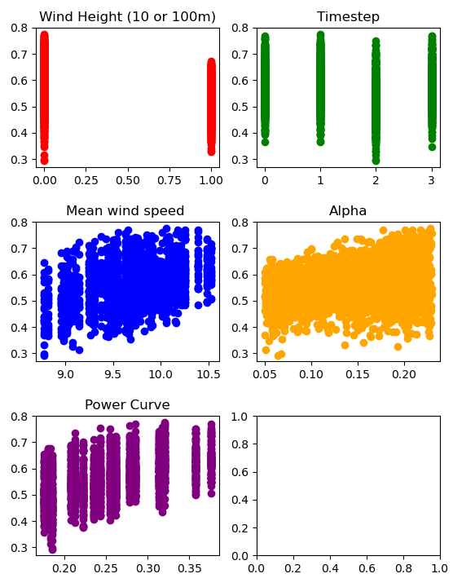
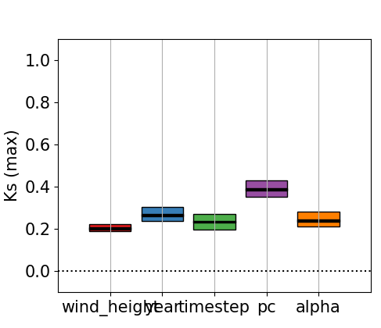
UQ&SA application to a wind power model
10m
100m
Hourly 6h daily midnight
Mean wind power
Wind height Year Timestep PC Alpha
To reduce uncertainty in model outputs we should focus on selecting the appropriate power curve
Shape descriptor (power at 7m/s)
Notes:
Dominant control on model output = power curve, if we want to use this model to investigate the year-to-year variability then we really need to make sure that this has been chosen correctly

Slide 14
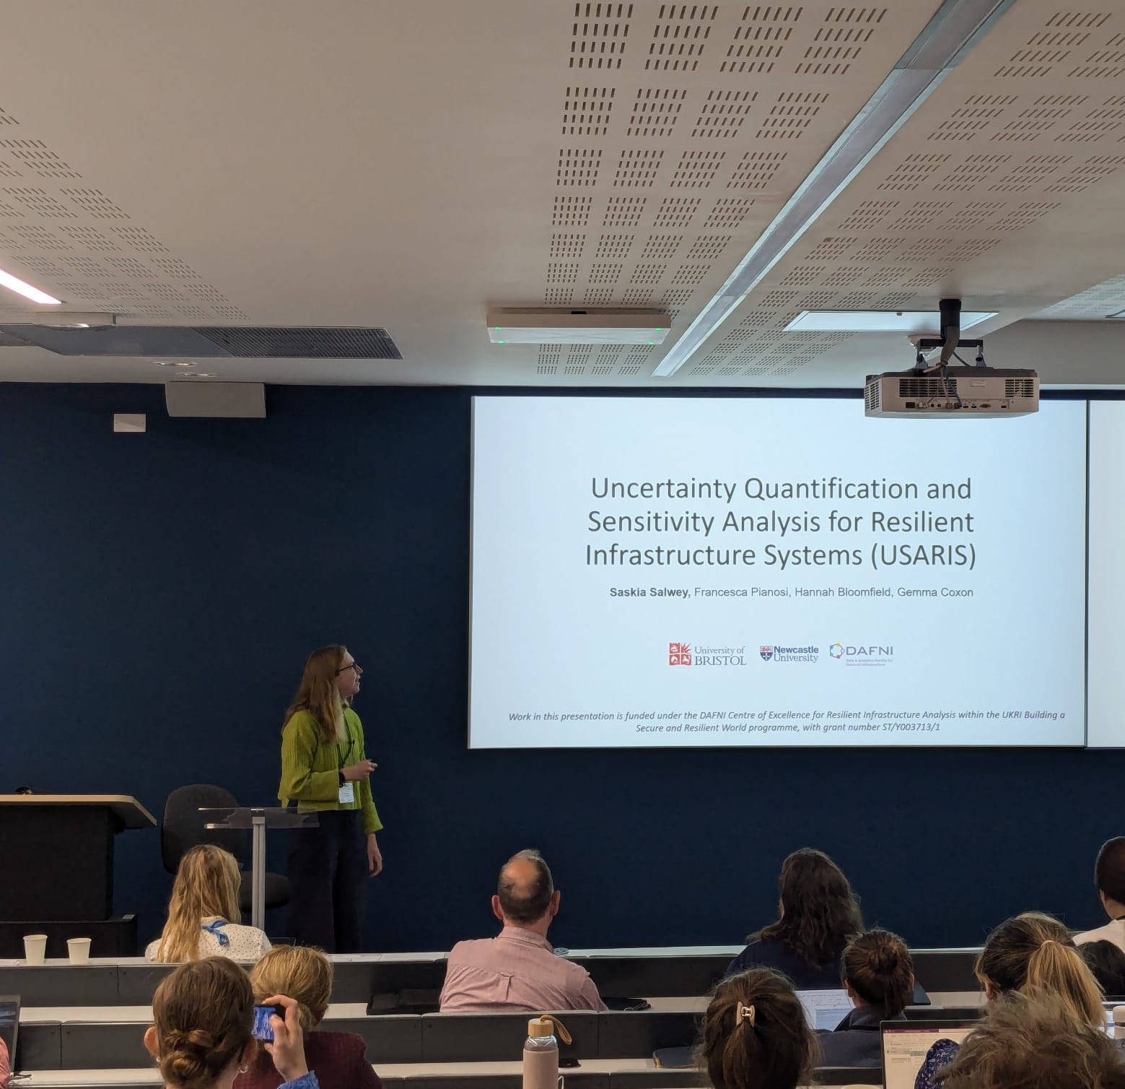

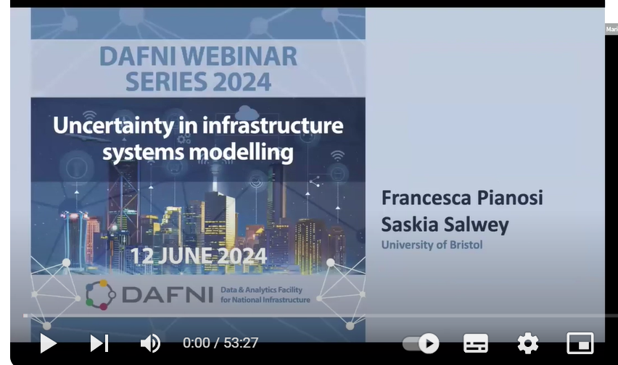
Dissemination and community engagement
Project aims and results so far have been presented at several conferences - Risk and Resilience Day 2024, Climate Impacts Conference 2024
Our DAFNI seminar is available on YouTube!
We are currently planning a workshop with the Environment Agency on uncertainty in water modelling

Slide 15


Challenges, Benefits and Impacts
Key challenge: computational complexity
Looping functionality: working with DAFNI team to increase cap on max number of iterations
Benefits and impacts:
Workflows allow for easy sharing of methods and visualisation of results
Facilitates collaborations - e.g. linking up to Pywr-WREW project (University of Newcastle + Environment Agency)
Our methods and results are very transferable!
Hopefully our findings will promote the selection of more resilient infrastructure designs and best modelling practises

