Slide 1
Climate Shocks and Income Inequality: Some first results
Nicholas Vasilakos
University of East Anglia

Slide 2




What we do

Slide 3
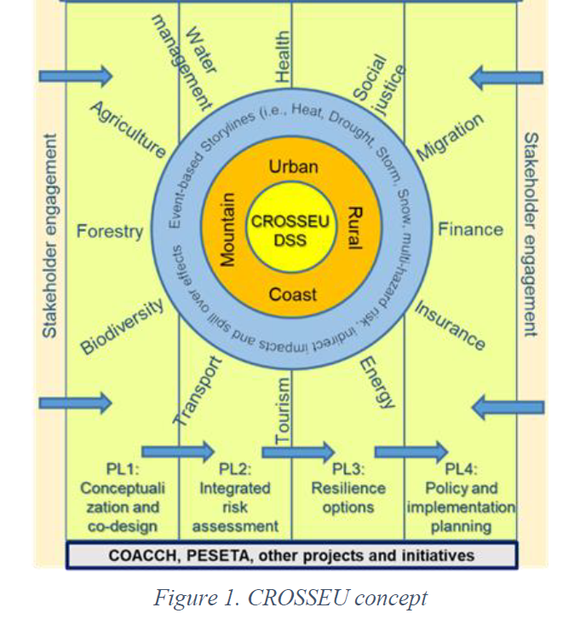
What we do
🌍 What does CROSSEU do?
Quantifies economic losses and distributional impacts (income inequality) from past and future extreme weather events.
Integrates climate science, economics, and social policy.
Provides tools for better risk mitigation and adaptation planning at EU and national levels.
🔬 Scientific Packages (WPs):
WP1: Macroeconomic modelling (Econometrics/CGE, Global)
WP2: Sectoral and regional analysis (Case studies)
WP4: Governance analysis and policy recommendations

Slide 4
Our case studies
Case Study 1: The impact of the unprecedentedly hot decade (2010–2019) on the health sectors in the United Kingdom and Czech Republic.
Case Study 2: The impact of the 2018-2022 multi-year drought on agriculture and food security in Central and South-Eastern Europe (SEE).
Case study 3: Storm damages in South Western Denmark and Northern Germany.
Case study 4: Valuation of social benefits of floods and flash floods adaptation and mitigation in Northeastern Italy.
Case study 5: Snow-related hazard risks in the European Alps and Carpathians under different climate sce-narios and impacts on the tourism sector and mountain communities.
Case-study 6: Shifting climate seasonality and water availability: risks for socio-ecological systems in the Lower Danube (LD).
Case-study 7: Impacts on energy demand and energy security in systems with high shares of renewable energy from heatwaves, drought and storms concurrent climate hazards on energy systems in Europe.
Case-study 8: Transboundary effects on agriculture and labour productivity due to climate impacts in the rest of the world.

Slide 5
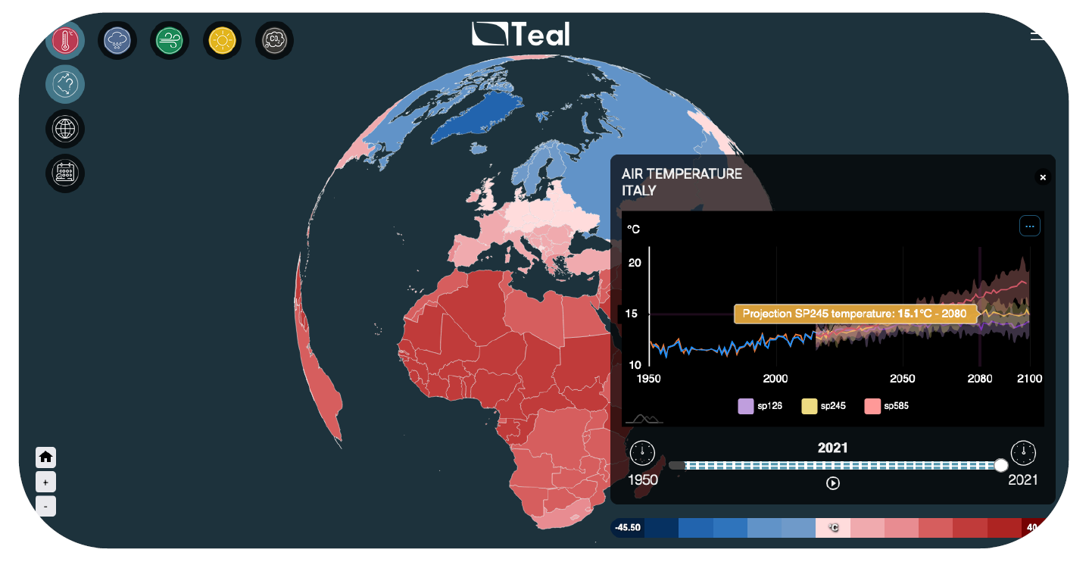

Slide 6
Climate Change & Society: Focus on Income Inequality (preliminary findings)
Drawing on findings from Vasilakos, Zhang, Jenkins, Forstenaeusler (2025)

Slide 7
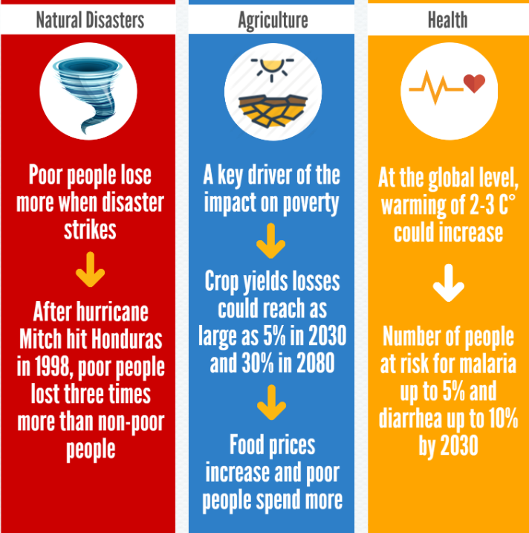
Motivation
This research links extreme weather to worsening income inequality
Findings from Vasilakos et al. (2025) use data from 145 countries and show that lower-income populations are consistently hit harder by extreme events.
When disasters strike, informal workers, low-wage earners, and those in rural or precarious housing suffer the most, amplifying pre-existing inequalities.
Our results show that a 1 standard deviation increase in the frequency × intensity of extreme weather is associated with a disproportionately negative impact on the bottom 30% of the income distribution.
Lower-income groups often work in climate-sensitive sectors (e.g. agriculture, construction), lack insurance or savings, and live in areas more exposed to physical risk.
A feedback loop: As inequality rises, adaptive capacity falls, further entrenching vulnerability. This dynamic fuels social unrest, migration pressures, and long-run productivity losses.

Slide 8
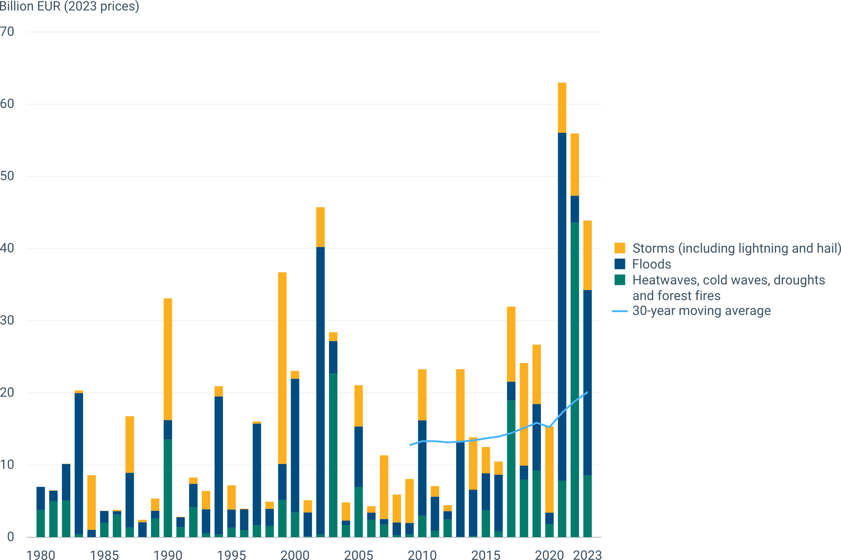

Annual economic losses caused by weather-and climate-related extreme events (all EU)

Slide 9
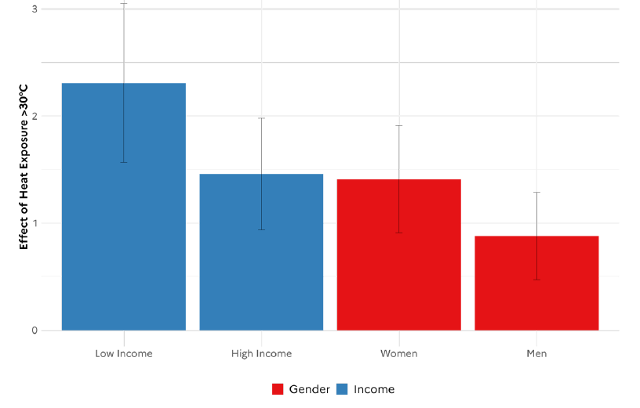

The climate-income-gender inequality nexus: unequal effects of heat exposure on mental health in the US

Slide 10
Methodology
Our paper investigates how different types of extreme weather events affect income inequality across the entire income distribution, using panel data globally.
By combining reanalysis climate data (ERA5), harmonised inequality metrics (PIP), and economic performance indicators, we estimate the extent to which climate risks drive regressivity in income outcomes, and how this varies by sector, region, and policy environment.
Climate variables included (so far): heatwaves, cold waves, icing days, hot days, and heavy precipitation
Poverty and Inequality Platform (PIP), World Bank:
Comprehensive global poverty and inequality data.
Covers ~2,400 surveys across 160+ countries up to 2024.
Standardised World Income Inequality Database (SWIID):
Extensive cross-country and longitudinal coverage.
Harmonised Income Study (LIS), ensuring high reliability.

Slide 11
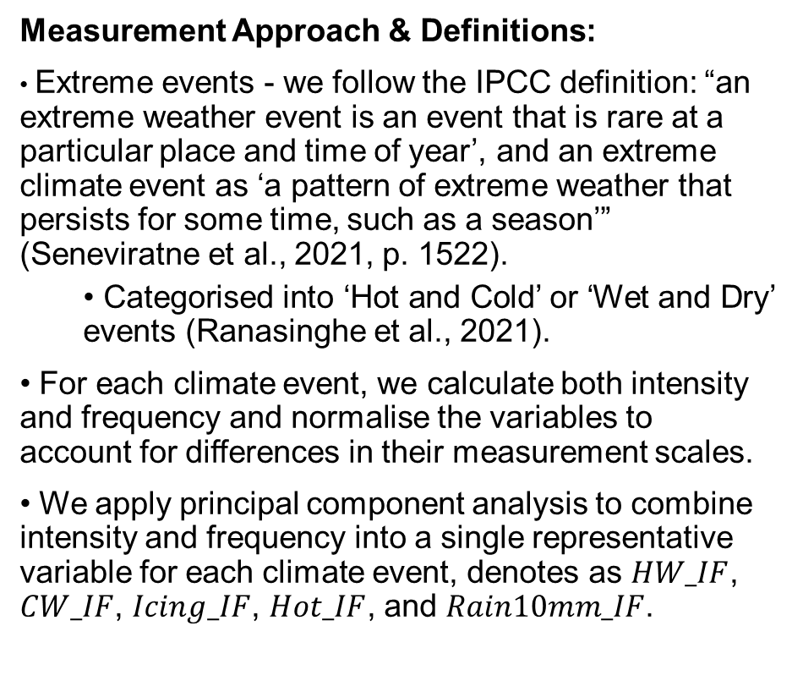
Methodology – Climate variables
Measurement Approach & Definitions:
Extreme events - we follow the IPCC definition: “an extreme weather event is an event that is rare at a particular place and time of year’, and an extreme climate event as ‘a pattern of extreme weather that persists for some time, such as a season’” (Seneviratne et al., 2021, p. 1522).
Categorised into ‘Hot and Cold’ or ‘Wet and Dry’ events (Ranasinghe et al., 2021).
For each climate event, we calculate both intensity and frequency and normalise the variables to account for differences in their measurement scales.
We apply principal component analysis to combine intensity and frequency into a single representative variable for each climate event, denotes as $HW_IF$, $CW_IF$, $Icing_IF$, $Hot_IF$, and $Rain10mm_IF$.
Index | Condition
Hot-days | Daily maximum temperature > 35°C
Heatwave | Excess Heat Factor is positive
Coldwave | Excess Cold Factor is negative
Icing days | Daily maximum temperature < 0°C
Rain 10mm | 10mm rainfall over agricultural land

Slide 12
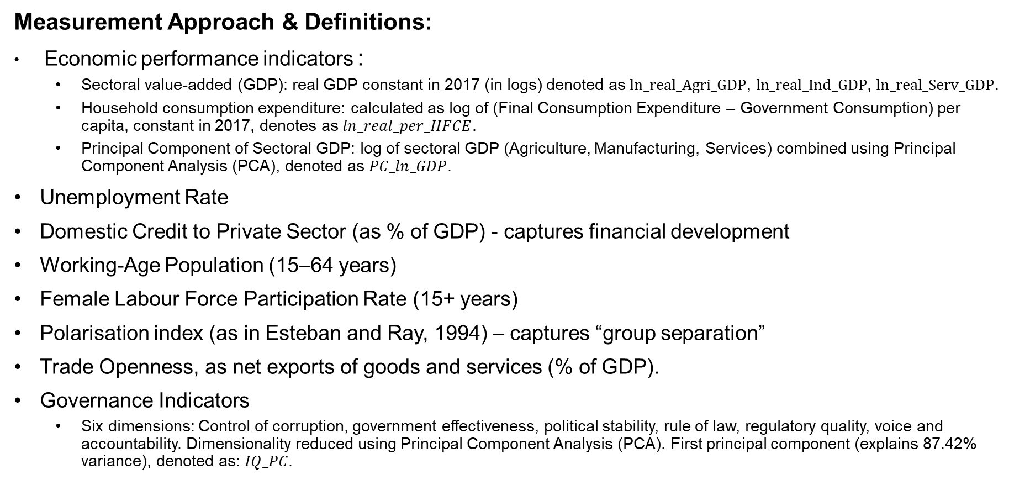
Methodology – Economic variables
Measurement Approach & Definitions:
Economic performance indicators :
Sectoral value-added (GDP): real GDP constant in 2017 (in logs) denoted as $ln_real_Agri_GDP$, $ln_real_Ind_GDP$, $ln_real_Serv_GDP$.
Household consumption expenditure: calculated as log of (Final Consumption Expenditure – Government Consumption) per capita, constant in 2017, denotes as $ln_real_per_HFCE$.
Principal Component of Sectoral GDP: log of sectoral GDP (Agriculture, Manufacturing, Services) combined using Principal Component Analysis (PCA), denoted as $PC_ln_GDP$.
Unemployment Rate
Domestic Credit to Private Sector (as % of GDP) - captures financial development
Working-Age Population (15–64 years)
Female Labour Force Participation Rate (15+ years)
Polarisation index (as in Esteban and Ray, 1994) – captures “group separation”
Trade Openness, as net exports of goods and services (% of GDP).
Governance Indicators
Six dimensions: Control of corruption, government effectiveness, political stability, rule of law, regulatory quality, voice and accountability. Dimensionality reduced using Principal Component Analysis (PCA). First principal component (explains 87.42% variance), denoted as: $IQ_PC$.

Slide 13
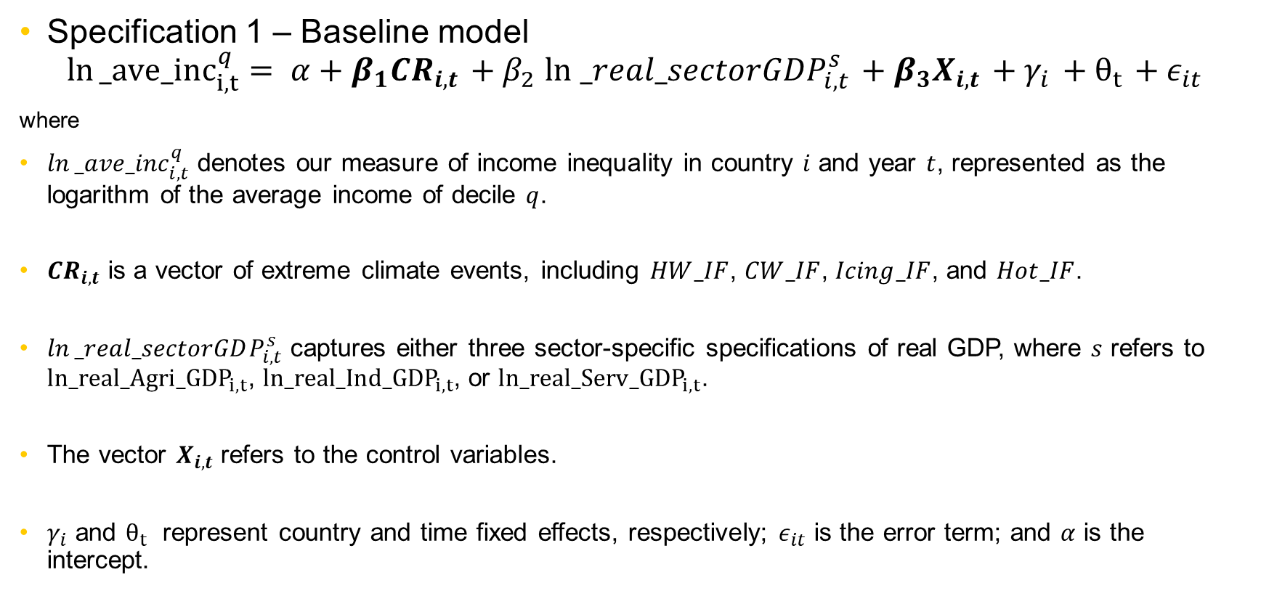
Methodology – Economic variables
Specification 1 – Baseline model
$$\ln{_ave_{inc}_{i,t}^{q}}= α+β_{1}CR_{i,t}+β_{2}\ln{_real_sectorGDP_{i,t}^{s}}+β_{3}X_{i,t}+γ_{i}+θ_{t}+ε_{it}$$
where
$\ln{_ave_{inc}_{i,t}^{q}}$​ denotes our measure of income inequality in country $i$ and year $t$, represented as the logarithm of the average income of decile $q$.
$CR_{i,t}$ is a vector of extreme climate events, including $HW_IF$, $CW_IF$, $Icing_IF$, and $Hot_IF$.
$\ln{_real_sectorGDP_{i,t}^{s}}$​ captures either three sector-specific specifications of real GDP, where $s$ refers to $ln_real_Agri_{GDP}_{i,t}$, $ln_real_Ind_{GDP}_{i,t}$, or $ln_real_Serv_{GDP}_{i,t}$.
The vector $X_{i,t}$ refers to the control variables.
$γ_{i}$ and $θ_{t}$ ​ represent country and time fixed effects, respectively; $ε_{it}$ ​is the error term; and $α$ is the intercept.

Slide 14
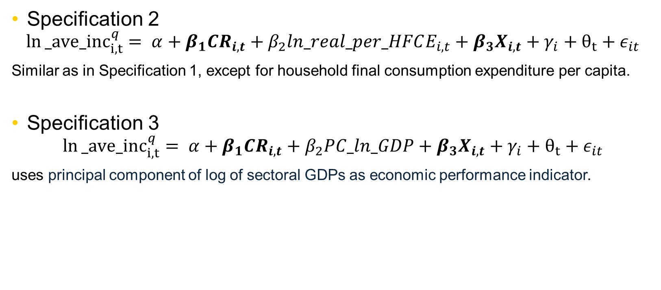
Methodology – Economic variables
Specification 2
$$\ln{_ave_{inc}_{i,t}^{q}}= α+β_{1}CR_{i,t}+β_{2}ln_real_per_HFCE_{i,t}+β_{3}X_{i,t}+γ_{i}+θ_{t}+ε_{it}$$
Similar as in Specification 1, except for household final consumption expenditure per capita.
Specification 3
$$\ln{_ave_{inc}_{i,t}^{q}}= α+β_{1}CR_{i,t}+β_{2}PC_ln_GDP+β_{3}X_{i,t}+γ_{i}+θ_{t}+ε_{it}$$
uses principal component of log of sectoral GDPs as economic performance indicator.

Slide 15
Results -- Full distribution (Agricultural sector)
 | (1) | (2) | (3) | (4) | (5) | (6) | (7) | (8) | (9) | (10)
 | Agri | Agri | Agri | Agri | Agri | Agri | Agri | Agri | Agri | Agri
VARIABLES | ln_ave_inc1 | ln_ave_inc2 | ln_ave_inc3 | ln_ave_inc4 | ln_ave_inc5 | ln_ave_inc6 | ln_ave_inc7 | ln_ave_inc8 | ln_ave_inc9 | ln_ave_inc10
HW_IF | -0.016*** | -0.013*** | -0.013*** | -0.013*** | -0.013*** | -0.013*** | -0.013*** | -0.013*** | -0.013*** | -0.011***
 | (0.005) | (0.004) | (0.003) | (0.003) | (0.003) | (0.003) | (0.003) | (0.003) | (0.003) | (0.004)
CW_IF | -0.012** | -0.010** | -0.009** | -0.008** | -0.009** | -0.009** | -0.009** | -0.009** | -0.009** | -0.009**
 | (0.006) | (0.004) | (0.004) | (0.004) | (0.004) | (0.004) | (0.004) | (0.004) | (0.004) | (0.004)
Icing_IF | -0.022** | -0.016** | -0.011 | -0.006 | -0.005 | -0.006 | -0.006 | -0.007 | -0.007 | -0.010
 | (0.010) | (0.007) | (0.007) | (0.007) | (0.007) | (0.007) | (0.007) | (0.007) | (0.007) | (0.007)
Hotdays_IF | -0.022*** | -0.015*** | -0.012** | -0.011** | -0.011** | -0.011** | -0.012** | -0.010* | -0.011** | -0.011*
 | (0.008) | (0.006) |  | (0.005) | (0.005) | (0.005) | (0.005) | (0.005) | (0.005) | (0.006)
ln_real_Agri_GDP | 0.027*** | 0.024*** | 0.021*** | 0.019*** | 0.018*** | 0.019*** | 0.019*** | 0.019*** | 0.019*** | 0.009
 | (0.009) | (0.007) | (0.006) | (0.006) | (0.006) | (0.006) | (0.006) | (0.006) | (0.006) | (0.007)
ln_Pop_1564 | -0.489*** | -0.644*** | -0.681*** | -0.690*** | -0.680*** | -0.677*** | -0.666*** | -0.662*** | -0.662*** | -0.716***
 | (0.068) | (0.049) | (0.047) | (0.046) | (0.047) | (0.047) | (0.047) | (0.047) | (0.046) | (0.050)
Unemp_rate | -1.840*** | -1.408*** | -1.325*** | -1.267*** | -1.269*** | -1.297*** | -1.301*** | -1.282*** | -1.249*** | -1.394***
 | (0.189) | (0.138) | (0.131) | (0.130) | (0.131) | (0.131) | (0.131) | (0.131) | (0.130) | (0.139)
Female_rate | -0.234 | -0.189 | -0.173 | -0.180 | -0.180 | -0.154 | -0.128 | -0.124 | -0.143 | -0.247**
 | (0.161) | (0.117) | (0.112) | (0.111) | (0.111) | (0.112) | (0.112) | (0.112) | (0.111) | (0.119)
Trade_Openess | 0.197** | 0.201*** | 0.194*** | 0.198*** | 0.210*** | 0.202*** | 0.204*** | 0.205*** | 0.208*** | 0.199***
 | (0.089) | (0.065) | (0.062) | (0.061) | (0.061) | (0.062) | (0.062) | (0.062) | (0.061) | (0.066)
DCPS | 0.057** | 0.078*** | 0.082*** | 0.081*** | 0.079*** | 0.076*** | 0.078*** | 0.081*** | 0.085*** | 0.105***
 | (0.026) | (0.019) | (0.018) | (0.018) | (0.018) | (0.018) | (0.018) | (0.018) | (0.018) | (0.019)
IQ_PC | 0.077*** | 0.077*** | 0.085*** | 0.089*** | 0.091*** | 0.090*** | 0.090*** | 0.090*** | 0.089*** | 0.071***
 | (0.013) | (0.009) | (0.009) | (0.009) | (0.009) | (0.009) | (0.009) | (0.009) | (0.009) | (0.010)
polarisation | -5.414*** | -3.628*** | -2.789*** | -2.273*** | -1.834*** | -1.393*** | -0.959*** | -0.501*** | 0.040 | 1.353***
 | (0.165) | (0.120) | (0.114) | (0.113) | (0.114) | (0.114) | (0.114) | (0.114) | (0.113) | (0.121)
Constant | 13.908*** | 16.320*** | 16.909*** | 17.090*** | 16.966*** | 16.913*** | 16.744*** | 16.709*** | 16.803*** | 18.188***
 | (1.089) | (0.790) | (0.753) | (0.749) | (0.750) | (0.754) | (0.754) | (0.753) | (0.749) | (0.801)
Observations | 1,300 | 1,300 | 1,300 | 1,300 | 1,300 | 1,300 | 1,300 | 1,300 | 1,300 | 1,300
R-squared | 0.682 | 0.721 | 0.698 | 0.672 | 0.646 | 0.621 | 0.596 | 0.570 | 0.543 | 0.498
Number of country_id | 145 | 145 | 145 | 145 | 145 | 145 | 145 | 145 | 145 | 145
Fixed Effects | YES | YES | YES | YES | YES | YES | YES | YES | YES | YES

Slide 16
 | (1) | (2) | (3) | (4) | (5) | (6) | (7) | (8) | (9) | (10)
VARIABLES | ln_ave_inc1 | ln_ave_inc2 | ln_ave_inc3 | ln_ave_inc4 | ln_ave_inc5 | ln_ave_inc6 | ln_ave_inc7 | ln_ave_inc8 | ln_ave_inc9 | ln_ave_inc10
Results respect to log of industrial GDP
HW_IF | -0.017*** | -0.013*** | -0.013*** | -0.013*** | -0.013*** | -0.013*** | -0.014*** | -0.013*** | -0.013*** | -0.011***
 | (0.005) | (0.003) | (0.003) | (0.003) | (0.003) | (0.003) | (0.003) | (0.003) | (0.003) | (0.004)
CW_IF | -0.012** | -0.010** | -0.009** | -0.008** | -0.008** | -0.008** | -0.008** | -0.008** | -0.009** | -0.009**
 | (0.006) | (0.004) | (0.004) | (0.004) | (0.004) | (0.004) | (0.004) | (0.004) | (0.004) | (0.004)
Icing_IF | -0.021** | -0.015** | -0.010 | -0.005 | -0.004 | -0.005 | -0.005 | -0.006 | -0.006 | -0.009
 | (0.010) | (0.007) | (0.007) | (0.007) | (0.007) | (0.007) | (0.007) | (0.007) | (0.007) | (0.007)
Hotdays_IF | -0.023*** | -0.015*** | -0.012** | -0.011** | -0.012** | -0.012** | -0.012** | -0.011** | -0.012** | -0.012**
 | (0.008) | (0.006) | (0.005) | (0.005) | (0.005) | (0.005) | (0.005) | (0.005) | (0.005) | (0.006)
ln_real_Ind_GDP | 0.057*** | 0.053*** | 0.049*** | 0.047*** | 0.047*** | 0.047*** | 0.047*** | 0.047*** | 0.048*** | 0.039***
 | (0.009) | (0.006) | (0.006) | (0.006) | (0.006) | (0.006) | (0.006) | (0.006) | (0.006) | (0.006)
Results respect to log of service GDP
HW_IF | -0.016*** | -0.013*** | -0.013*** | -0.013*** | -0.013*** | -0.013*** | -0.013*** | -0.013*** | -0.013*** | -0.010***
 | (0.005) | (0.003) | (0.003) | (0.003) | (0.003) | (0.003) | (0.003) | (0.003) | (0.003) | (0.004)
CW_IF | -0.012** | -0.010** | -0.009** | -0.008** | -0.009** | -0.009** | -0.009** | -0.009** | -0.009** | -0.009**
 | (0.006) | (0.004) | (0.004) | (0.004) | (0.004) | (0.004) | (0.004) | (0.004) | (0.004) | (0.004)
Icing_IF | -0.021** | -0.015** | -0.010 | -0.005 | -0.004 | -0.005 | -0.005 | -0.006 | -0.006 | -0.009
 | (0.010) | (0.007) | (0.007) | (0.007) | (0.007) | (0.007) | (0.007) | (0.007) | (0.007) | (0.007)
Hotdays_IF | -0.023*** | -0.015*** | -0.012** | -0.011** | -0.012** | -0.012** | -0.012** | -0.011** | -0.012** | -0.012**
 | (0.008) | (0.006) | (0.005) | (0.005) | (0.005) | (0.005) | (0.005) | (0.005) | (0.005) | (0.006)
ln_real_Serv_GDP | 0.050*** | 0.049*** | 0.045*** | 0.043*** | 0.043*** | 0.043*** | 0.043*** | 0.043*** | 0.043*** | 0.035***
 | (0.009) | (0.006) | (0.006) | (0.006) | (0.006) | (0.006) | (0.006) | (0.006) | (0.006) | (0.007)

Slide 17
 | (1) | (2) | (3) | (4) | (5) | (6) | (7) | (8) | (9) | (10)
VARIABLES | ln_ave_inc1 | ln_ave_inc2 | ln_ave_inc3 | ln_ave_inc4 | ln_ave_inc5 | ln_ave_inc6 | ln_ave_inc7 | ln_ave_inc8 | ln_ave_inc9 | ln_ave_inc10
Results respect to log of real household final consumption expenditure per capita
HW_IF | -0.016*** | -0.012*** | -0.012*** | -0.012*** | -0.012*** | -0.012*** | -0.012*** | -0.012*** | -0.012*** | -0.009***
 | (0.005) | (0.003) | (0.003) | (0.003) | (0.003) | (0.003) | (0.003) | (0.003) | (0.003) | (0.004)
CW_IF | -0.015** | -0.012*** | -0.011*** | -0.010** | -0.010** | -0.011*** | -0.010** | -0.011*** | -0.011*** | -0.011**
 | (0.006) | (0.004) | (0.004) | (0.004) | (0.004) | (0.004) | (0.004) | (0.004) | (0.004) | (0.004)
Icing_IF | -0.022** | -0.016** | -0.011 | -0.006 | -0.005 | -0.006 | -0.006 | -0.007 | -0.007 | -0.010
 | (0.010) | (0.007) | (0.007) | (0.007) | (0.007) | (0.007) | (0.007) | (0.007) | (0.007) | (0.007)
Hotdays_IF | -0.025*** | -0.017*** | -0.015*** | -0.014*** | -0.015*** | -0.014*** | -0.015*** | -0.013** | -0.015*** | -0.016***
 | (0.008) | (0.006) | (0.005) | (0.005) | (0.005) | (0.005) | (0.005) | (0.005) | (0.005) | (0.006)
ln_real_per_HFCE | 0.046*** | 0.043*** | 0.040*** | 0.038*** | 0.037*** | 0.038*** | 0.038*** | 0.038*** | 0.038*** | 0.028***
 | (0.009) | (0.007) | (0.006) | (0.006) | (0.006) | (0.006) | (0.006) | (0.006) | (0.006) | (0.007)
Results respect to principal component of log of sectoral GDPs
HW_IF | -0.016*** | -0.013*** | -0.013*** | -0.013*** | -0.013*** | -0.013*** | -0.013*** | -0.013*** | -0.013*** | -0.010***
 | (0.005) | (0.003) | (0.003) | (0.003) | (0.003) | (0.003) | (0.003) | (0.003) | (0.003) | (0.004)
CW_IF | -0.012** | -0.010** | -0.009** | -0.008** | -0.009** | -0.009** | -0.008** | -0.009** | -0.009** | -0.009**
 | (0.006) | (0.004) | (0.004) | (0.004) | (0.004) | (0.004) | (0.004) | (0.004) | (0.004) | (0.004)
Icing_IF | -0.021** | -0.016** | -0.010 | -0.005 | -0.004 | -0.005 | -0.006 | -0.006 | -0.007 | -0.009
 | (0.010) | (0.007) | (0.007) | (0.007) | (0.007) | (0.007) | (0.007) | (0.007) | (0.007) | (0.007)
Hotdays_IF | -0.023*** | -0.015*** | -0.012** | -0.011** | -0.012** | -0.011** | -0.012** | -0.011* | -0.012** | -0.012**
 | (0.008) | (0.006) | (0.005) | (0.005) | (0.005) | (0.005) | (0.005) | (0.005) | (0.005) | (0.006)
PC_ln_GDP | 0.065*** | 0.061*** | 0.057*** | 0.054*** | 0.053*** | 0.053*** | 0.053*** | 0.054*** | 0.054*** | 0.040***
 | (0.013) | (0.009) | (0.009) | (0.009) | (0.009) | (0.009) | (0.009) | (0.009) | (0.009) | (0.009)

Slide 18
Results - Full distribution (focus on heavy precipitation Rain 10mm)
 | (1) | (2) | (3) | (4) | (5) | (6) | (7) | (8) | (9) | (10)
VARIABLES | ln_ave_inc1 | ln_ave_inc2 | ln_ave_inc3 | ln_ave_inc4 | ln_ave_inc5 | ln_ave_inc6 | ln_ave_inc7 | ln_ave_inc8 | ln_ave_inc9 | ln_ave_inc10
R10mm_IF | -0.001 | -0.001** | -0.001** | -0.001** | -0.001** | -0.001** | -0.001** | -0.001** | -0.001** | -0.001**
 | (0.001) | (0.000) | (0.000) | (0.000) | (0.000) | (0.000) | (0.000) | (0.000) | (0.000) | (0.000)
ln_real_Agri_GDP | 0.028*** | 0.025*** | 0.021*** | 0.019*** | 0.018*** | 0.019*** | 0.019*** | 0.020*** | 0.020*** | 0.009
 | (0.009) | (0.007) | (0.006) | (0.006) | (0.006) | (0.006) | (0.006) | (0.006) | (0.006) | (0.007)
R10mm_IF | -0.001 | -0.001** | -0.001** | -0.001*** | -0.001** | -0.001** | -0.001** | -0.001** | -0.001** | -0.001**
 | (0.001) | (0.000) | (0.000) | (0.000) | (0.000) | (0.000) | (0.000) | (0.000) | (0.000) | (0.000)
ln_real_Ind_GDP | 0.057*** | 0.053*** | 0.050*** | 0.047*** | 0.047*** | 0.047*** | 0.047*** | 0.048*** | 0.048*** | 0.038***
 | (0.009) | (0.006) | (0.006) | (0.006) | (0.006) | (0.006) | (0.006) | (0.006) | (0.006) | (0.006)
R10mm_IF | -0.001 | -0.001** | -0.001** | -0.001*** | -0.001** | -0.001** | -0.001** | -0.001** | -0.001** | -0.001**
 | (0.001) | (0.000) | (0.000) | (0.000) | (0.000) | (0.000) | (0.000) | (0.000) | (0.000) | (0.000)
ln_real_Serv_GDP | 0.051*** | 0.049*** | 0.046*** | 0.044*** | 0.043*** | 0.043*** | 0.044*** | 0.044*** | 0.044*** | 0.035***
 | (0.009) | (0.006) | (0.006) | (0.006) | (0.006) | (0.006) | (0.006) | (0.006) | (0.006) | (0.007)

Slide 19
Results – Arid, Tropical, Tropical/Temperate climate zone
 | (1) | (2) | (3) | (4) | (5) | (6) | (7) | (8) | (9) | (10)
VARIABLES | ln_ave_inc1 | ln_ave_inc2 | ln_ave_inc3 | ln_ave_inc4 | ln_ave_inc5 | ln_ave_inc6 | ln_ave_inc7 | ln_ave_inc8 | ln_ave_inc9 | ln_ave_inc10
Results respect to log of agricultural GDP
HW_IF | -0.010 | -0.009* | -0.009* | -0.010** | -0.010** | -0.010** | -0.011** | -0.011** | -0.010** | -0.002
 | (0.008) | (0.005) | (0.005) | (0.005) | (0.005) | (0.005) | (0.005) | (0.005) | (0.005) | (0.005)
Hotdays_IF | -0.017* | -0.013** | -0.011* | -0.010* | -0.011* | -0.011* | -0.011** | -0.010* | -0.011* | -0.009
 | (0.010) | (0.006) | (0.006) | (0.006) | (0.006) | (0.006) | (0.006) | (0.006) | (0.006) | (0.006)
ln_real_Agri_GDP | 0.098*** | 0.059*** | 0.045*** | 0.040*** | 0.036** | 0.034** | 0.036** | 0.037** | 0.038*** | 0.036**
 | (0.026) | (0.016) | (0.015) | (0.015) | (0.015) | (0.015) | (0.015) | (0.015) | (0.015) | (0.016)
Results respect to log of industrial GDP
HW_IF | -0.007 | -0.007 | -0.007 | -0.008* | -0.008* | -0.008* | -0.009* | -0.008* | -0.008* | 0.001
 | (0.008) | (0.005) | (0.005) | (0.005) | (0.005) | (0.005) | (0.005) | (0.005) | (0.005) | (0.005)
Hotdays_IF | -0.021** | -0.016*** | -0.013** | -0.012** | -0.013** | -0.013** | -0.014** | -0.012** | -0.013** | -0.011*
 | (0.009) | (0.006) | (0.005) | (0.005) | (0.005) | (0.005) | (0.005) | (0.005) | (0.005) | (0.006)
ln_real_Ind_GDP | 0.157*** | 0.119*** | 0.103*** | 0.096*** | 0.093*** | 0.092*** | 0.093*** | 0.095*** | 0.097*** | 0.089***
 | (0.022) | (0.014) | (0.013) | (0.013) | (0.013) | (0.013) | (0.013) | (0.013) | (0.013) | (0.014)
Results respect to log of service GDP
HW_IF | -0.008 | -0.007 | -0.008 | -0.008* | -0.008* | -0.009* | -0.009* | -0.009* | -0.008* | -0.000
 | (0.008) | (0.005) | (0.005) | (0.005) | (0.005) | (0.005) | (0.005) | (0.005) | (0.005) | (0.005)
Hotdays_IF | -0.019** | -0.015** | -0.012** | -0.011** | -0.012** | -0.012** | -0.013** | -0.011** | -0.012** | -0.010*
 | (0.009) | (0.006) | (0.005) | (0.005) | (0.005) | (0.006) | (0.006) | (0.006) | (0.005) | (0.006)
ln_real_Serv_GDP | 0.142*** | 0.103*** | 0.086*** | 0.078*** | 0.074*** | 0.074*** | 0.076*** | 0.077*** | 0.079*** | 0.071***
 | (0.024) | (0.016) | (0.014) | (0.014) | (0.014) | (0.014) | (0.014) | (0.014) | (0.014) | (0.015)

Slide 20
Results – Temperate and varied climate zone
 | (1) | (2) | (3) | (4) | (5) | (6) | (7) | (8) | (9) | (10)
VARIABLES | ln_ave_inc1 | ln_ave_inc2 | ln_ave_inc3 | ln_ave_inc4 | ln_ave_inc5 | ln_ave_inc6 | ln_ave_inc7 | ln_ave_inc8 | ln_ave_inc9 | ln_ave_inc10
Results respect to log of agricultural GDP
HW_IF | -0.028*** | -0.023*** | -0.020*** | -0.020*** | -0.019*** | -0.020*** | -0.019*** | -0.020*** | -0.021*** | -0.021***
 | (0.008) | (0.007) | (0.007) | (0.007) | (0.007) | (0.007) | (0.007) | (0.007) | (0.007) | (0.007)
ln_real_Agri_GDP | 0.006 | 0.001 | 0.000 | 0.000 | -0.000 | -0.000 | -0.001 | 0.000 | 0.001 | 0.005
 | (0.012) | (0.010) | (0.010) | (0.010) | (0.010) | (0.010) | (0.010) | (0.010) | (0.010) | (0.011)
Results respect to log of industrial GDP
HW_IF | -0.028*** | -0.023*** | -0.021*** | -0.020*** | -0.020*** | -0.020*** | -0.020*** | -0.020*** | -0.021*** | -0.021***
 | (0.008) | (0.007) | (0.007) | (0.007) | (0.007) | (0.007) | (0.007) | (0.007) | (0.007) | (0.007)
ln_real_Ind_GDP | 0.030** | 0.028*** | 0.028*** | 0.029*** | 0.028*** | 0.028*** | 0.028*** | 0.028*** | 0.030*** | 0.033***
 | (0.012) | (0.010) | (0.010) | (0.010) | (0.010) | (0.010) | (0.010) | (0.010) | (0.010) | (0.010)
Results respect to log of service GDP
HW_IF | -0.028*** | -0.023*** | -0.020*** | -0.020*** | -0.019*** | -0.020*** | -0.019*** | -0.020*** | -0.021*** | -0.021***
 | (0.008) | (0.007) | (0.007) | (0.007) | (0.007) | (0.007) | (0.007) | (0.007) | (0.007) | (0.007)
ln_real_Serv_GDP | 0.029** | 0.028*** | 0.028*** | 0.029*** | 0.029*** | 0.029*** | 0.028*** | 0.029*** | 0.030*** | 0.034***
 | (0.012) | (0.010) | (0.010) | (0.010) | (0.010) | (0.010) | (0.010) | (0.010) | (0.010) | (0.010)

Slide 21
Conclusions
All climate shocks exhibited regressive effects: lower-income groups suffer more
Heatwaves and Coldwaves are consistently associated with rising income inequality, disproportionately affecting lower deciles.
Icing days show stronger effects on the poorest deciles, likely through disruption of agriculture and mobility.
Heavy Rainfall (10 mm+) has weak to strong statistically significant negative effects on the income groups.
Sectoral GDP matters: differences in impacts between sectors
Interaction terms show that lower-income deciles experience amplified inequality effects from climate events.
The magnitude of inequality effects varies across climate zones.
These results highlight the complexity of climate impacts (and the importance of integrating climate justice into climate policy – at the European and global level).

Slide 22


