Slide 1






Researcher Data Access Pilot Programme
September 2025

Slide 2


1. Overview

Slide 3













Data access is not optimal in the UK
Economic
Growth
Government
Productivity
Data
  Barriers
Data use &
analysis
Insights &
innovations
Empowering
Citizens
  Quality
  Infrastructure
  For researchers:
  Legal
  Market incentives
  Data discoverability
  Cross-discipline sharing
  Data sharing agreements

Slide 4





We piloted ways to improve data access for researchers
Objective
Pilots
Outputs
To pilot ways of addressing data sharing barriers in the research ecosystem
Safe People Registry
(HDR UK)
Better use now
FAIR Data Accelerator
(UK SKA Regional Centre & UCL)
DINI
(DAFNI)
Lessons for the future
£5m from UKRI’s Digital Research Infrastructure Programme
BOOST-EDS
(NERC)

Slide 5





DSIT coordinated activity to support pilot delivery
Cross-programme coordination
Outputs
Activity
Approach
Progress tracking
Bi-monthly governance boards
Better use now:
successful pilot delivery
Monitoring & evaluation
Custom evaluation plans
Pilot join-up
Deep dive workshops
Communications
Webinars, newsletters
Lessons for the future: gathering information on
‘what works well’

Slide 6
2. Pilots

Slide 7

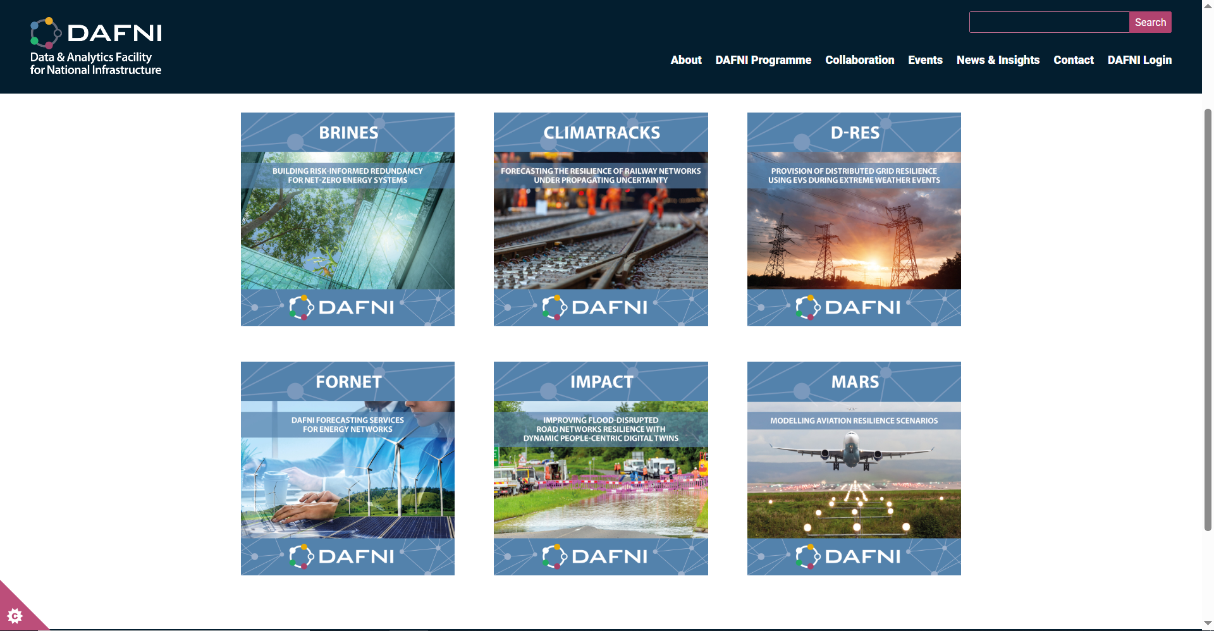
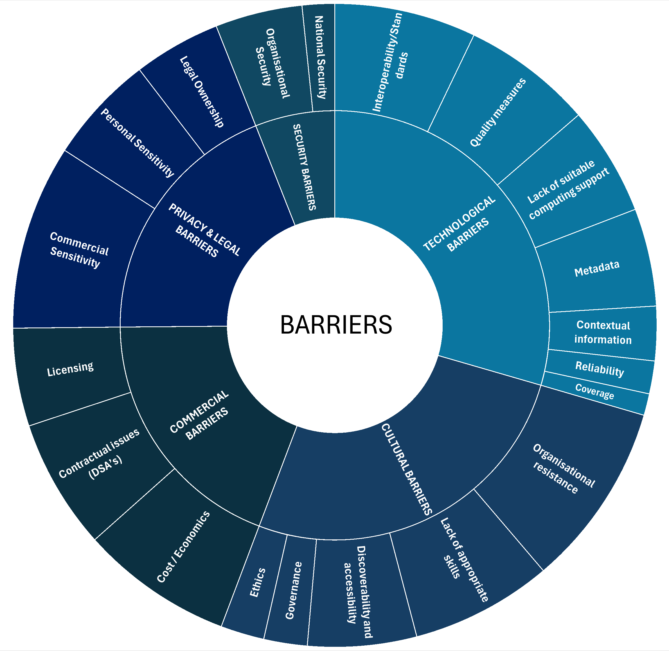


DINI
Study on the barriers to sharing
national infrastructure data
Technical specs to improve DAFNI’s links to JASMIN & external datasets
Data Infrastructure for National Infrastructure
(DAFNI)
Energy sector
ontology review
Objective: providing insights & better capabilities to improve national infrastructure data analysis​
Vision for a future Data Infrastructure for National Infrastructure

Slide 8






DINI: Headlines
Working w. data holders can mitigate the sharing incentive problem
Professional support needs
to be prioritised
Complexity hinders
collaboration
Supplying data is costly & complex for data holders. Secondments into their organisations; a third party broker; or investing in one-off ‘reference datasets’ w. standard access conditions can all speed up access.
Managing data (properly) is resource intensive. Investment in a specific ‘data stewardship’ profession, or new communities of practice in management, sharing & publication, can help maintain assets.
An interoperability framework could map different sector standards to a common framing, enabling (i) reuse of data by, & (ii) collaborations between, other sectors & industries who are not specialists in the original field.

Slide 9
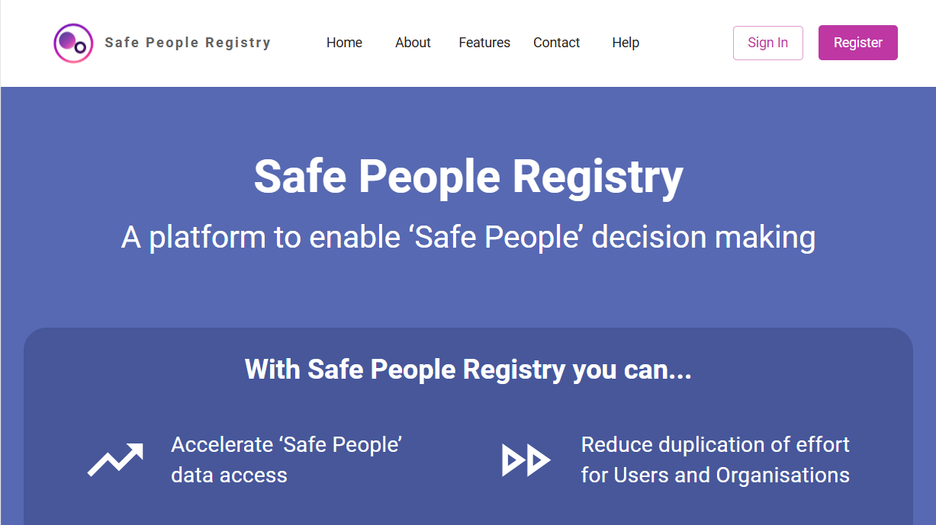
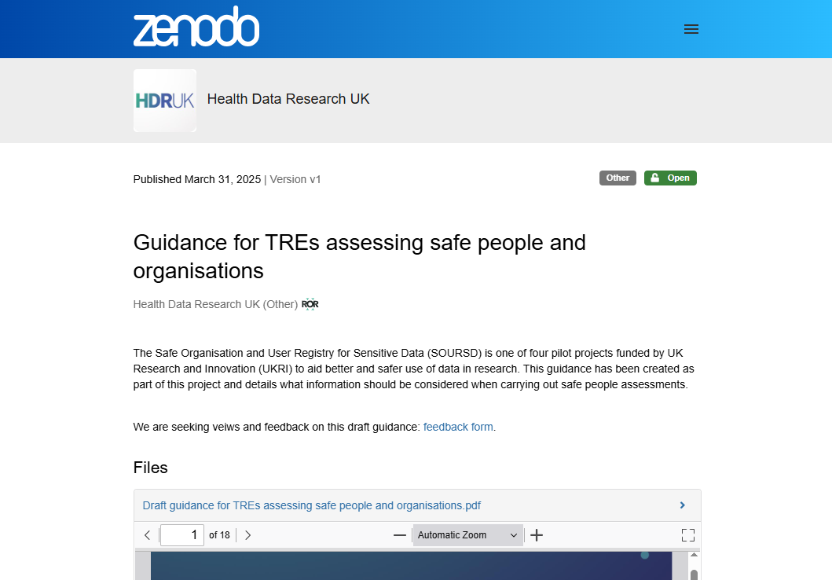
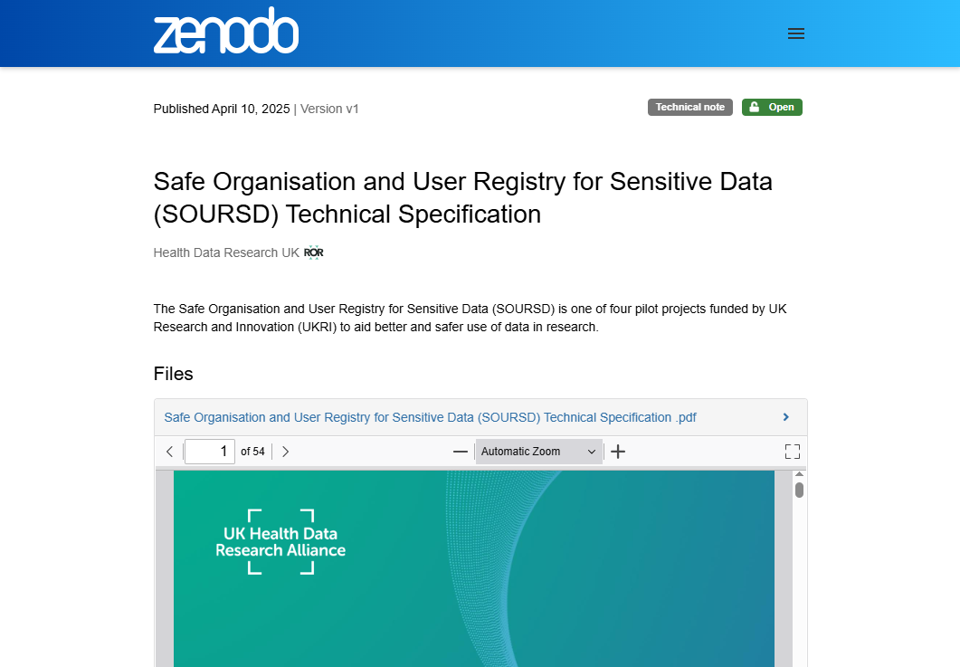
Safe People Registry
Safe People Registry
(Health Data Research UK)
Prototype of a ‘researcher registry’
Objective: streamlining how researchers access sensitive data in secure environments ​
Guidance on what a
‘safe’ researcher looks like

Slide 10






Safe People Registry: Headlines
Tools reduce risk…
… but legal complexities / fears make them less effective
The public have a stake
Data custodians and users have specific roles in the data sharing process – tools and systems can help them execute duties responsibly (and contribute to de-risking the process)
The original aim (a nationally standard way to approve access) fell, as each individual TRE has unique legal issues to navigate. Fears about being sued also slowed development of a way to record infringements.
It’s the general public’s data that’s in TREs. Information about this project & product was therefore made accessible to the general reader (use of plain English; + demonstrators & explainer videos).

Slide 11

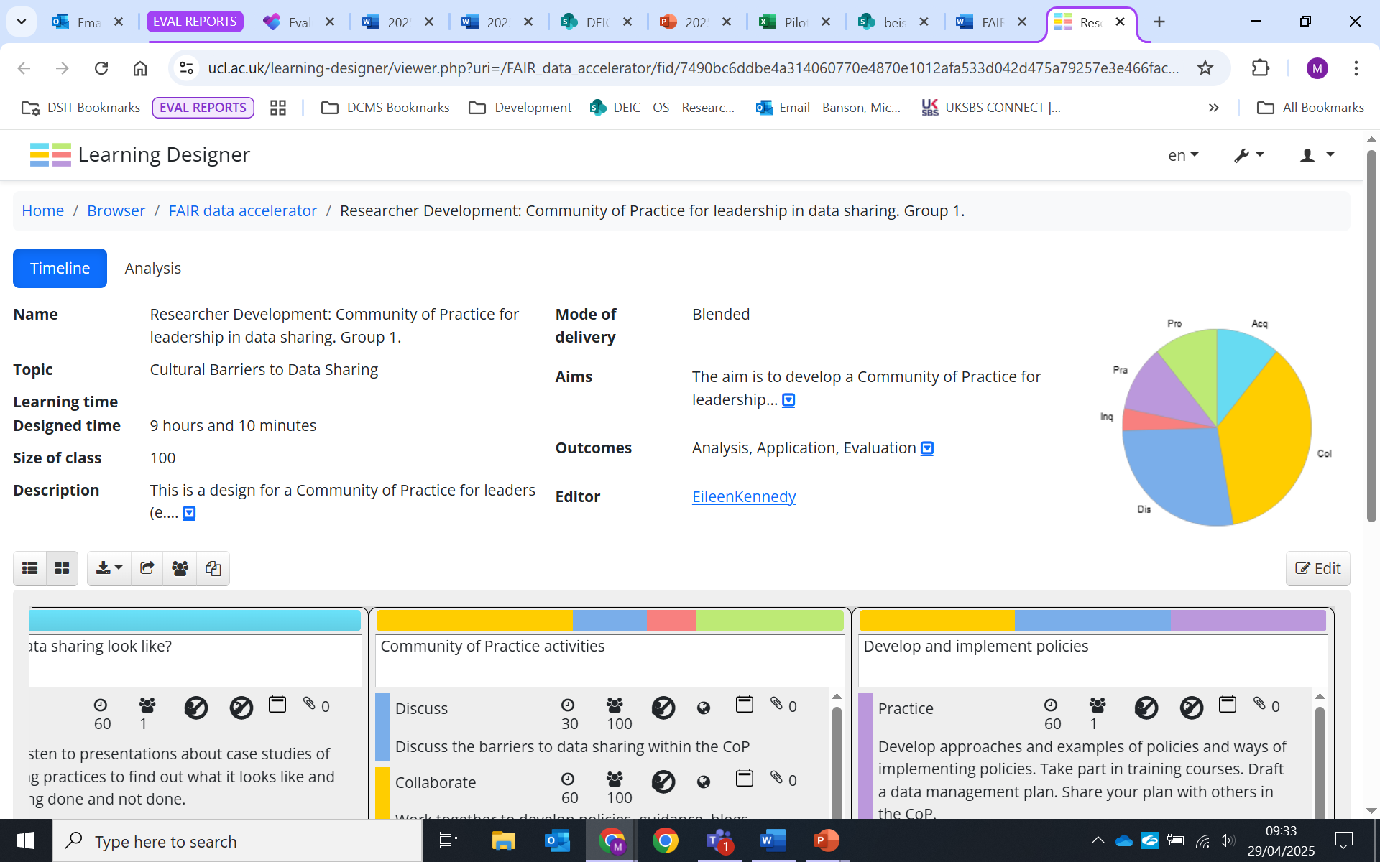
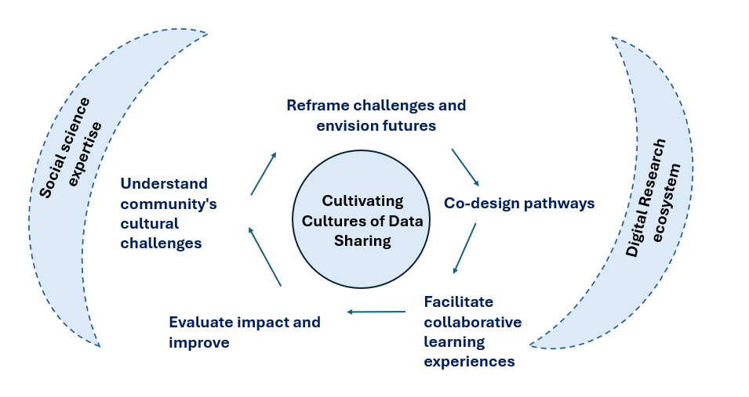
FAIR Data Accelerator
Fear of judgment, loss of control
Sharing
deprioritized
Social science concepts applied to cultural & social data access barriers
Epistemic uncertainties
Cultural reluctance
FAIR Data Accelerator
(UCL & SKA Regional Centre)
Objective: tackling social and cultural barriers to data sharing & access
Applied Learning Programme & learning designs

Slide 12






FAIR Data Accelerator: Headlines
Data access won’t improve
without social change
There is no leader grasping this agenda (but lots could be done)
The problem will evolve
(so sustained support is vital)
Cultural norms (enforced by disengaged leadership, lack of incentive) and fears (of judgement for data quality or losing control of ‘my’ asset) must both be tackled to enable optimal data access
A central actor could fix this through (i) quick wins (guidance, repositories, tagging methods) & (ii) substantial actions (forums; funding of communities, training, challenges, frameworks) – unclear who
Possibilities for data will keep evolving – creating cultures has to be resourced so it can be done on an ongoing basis to respond to that (and help new communities start in the ‘right way’)

Slide 13

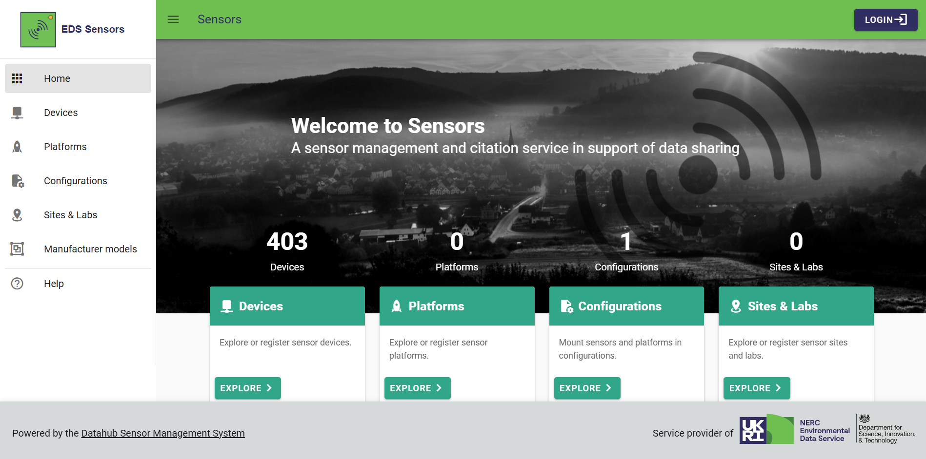
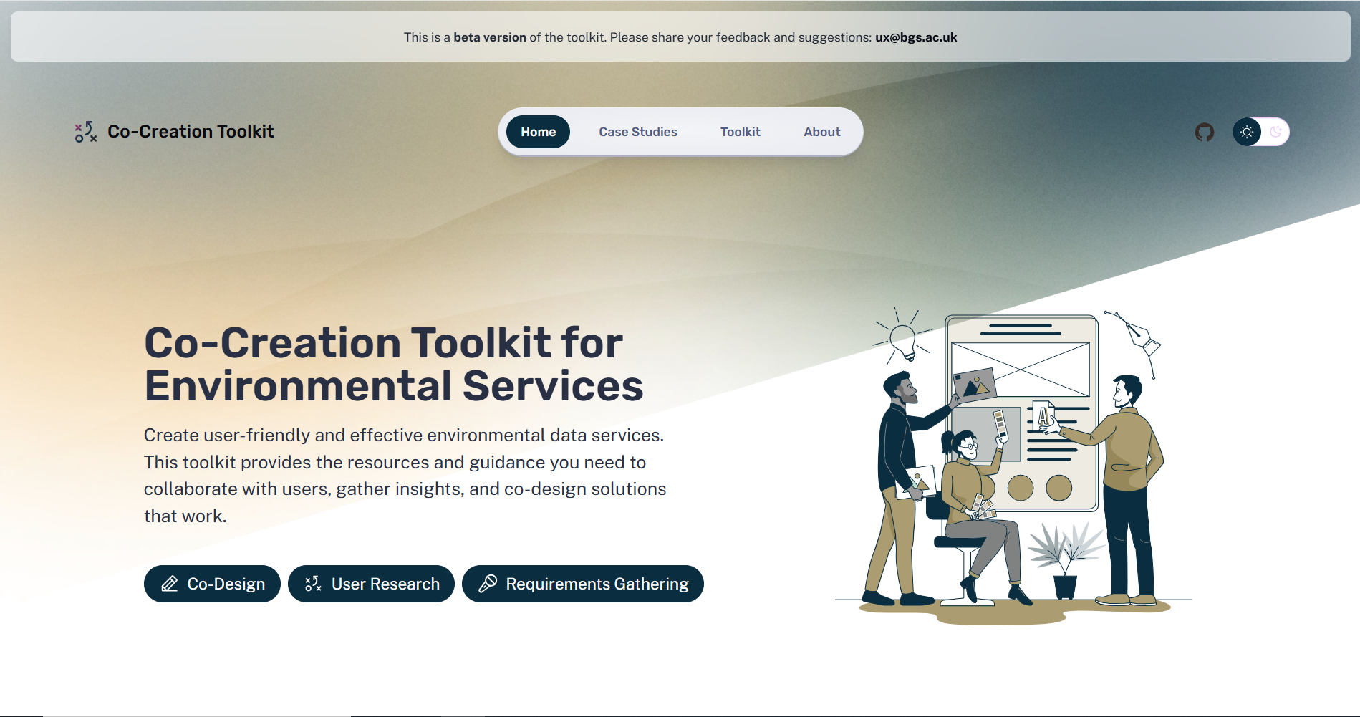


BOOST-EDS
‘Persistent Identifier’ service to
label digital objects
Exploring piloting geospatial software in TREs
BOOST Environmental Data Service
(Natural Environment Research Council)
Modular genomics workflow framework
Toolkit supporting co-creation of
user-focused data services
Objective: improving how data is used across the EDS: the UK’s largest collection of environmental science data
Review to improve interoperation between platforms

Slide 14





BOOST-EDS: Headlines
Technology can solve the
sharing incentive problem
Infrastructure is
about people
Multidisciplinary research is in demand, but difficult to deliver
Digital citations (including authorship) can be attached to data. They can be tracked, so whenever data is reused (i) authors get credit, and (ii) funders can measure data’s use, impact & derived value in the long-term.
Good data infrastructure enables access. But it doesn’t operate properly without knowledge sharing, including (i) networks of specialists (e.g.: TRE experts) and (ii) training to help users use the technology.
Research disciplines are increasingly specialised, including their data use. Shared vocabularies to bridge gaps need to be in place, to tackle x-cutting issues (e.g.: climate change) that draw on multiple disciplines’ data.

Slide 15
3. Conclusions

Slide 16



Data access & sharing can be broken down to 3 themes
Culture &
co-ordination
Data
characteristics
Frameworks &
resources
Systematic practices and perceptions that underpin data coordination practices
Structural characteristics of the data being accessed and shared
Legal, financial, infrastructure & skill factors underpinning data coordination
for example:
for example:
for example:
Organisational guidelines
Incentives
Trust (public, stakeholder)
Sensitivity
Quality (Findability, Accessibility, Interoperability, Reusability)
Legal regulations
Technical infrastructure & investment
Data-related skills & knowledge

Slide 17


DSIT & the pilots discussed the programme format
A relatively small amount of funding can build momentum for broader change, by creating tangible examples of ‘what works’ (but challenges persist in turning pilots into operational services)
Strengths
Challenges
Improvements now: programme saw the beginnings of FAIR data sharing, and delivery of real tangible outputs
Convening: range of projects offered the opportunity to identify common challenges & issues; and created the foundations of a community with shared interests
Foundation for future work: data quality and interoperability issues persist, but these pilots are creating the technical and community infrastructure to tackle them
Data access barriers: legal complications and a lack of shared data standards made delivering the pilots difficult at times
Financial: the pilots had a relatively small budget that needed to be spent quickly, which could be challenging to manage
  (but became a good stress of what was possible)
Next steps: considering how to use these short-term projects to make longer-term, or permanent, progress / changes

Slide 18
DSIT reflected on the programme’s findings as a whole
Frameworks & resources
Open governance mechanisms can have both a social impact (building trust, buy-in to the importance of FAIR data practices) & technical impact (more efficient access processes)
It’s important to consider ‘the whole system’ in improving data access: all elements are mutually dependent
Culture & co-ordination
Good data access & use depends on connecting people, often across diverse areas & different skillsets (e.g.: public / private sectors, different research disciplines, experts / non-experts)
Data characteristics
Clear communications, aided by development of common vocabularies (technical & non-technical) to describe data and its application can enable better research outputs, better sharing cultures, and better investment decisions

