Slide 1
11 September 2025
Assessing the resilience of infrastructure in the UK: the 2025 Adaptation Progress Report
Rachael Steller and Karina Rodriguez Villafuerte, Climate Change Committee

Slide 2
Contents
Background: role of CCC in adaptation planning cycle
Adaptation Progress Report 2025
  Key data findings for infrastructure
Update on the Fourth Climate Change Risk Assessment (CCRA4) and ways to get involved
  Technical report
  Well-Adapted UK Report

Slide 3
Advising and assessing climate risk
Evidence cycle for informing adaptation in the UK
Climate Change Committee advice on CCRA
(CCRA4 Evidence Report due in May 2026)
UK Climate Change Risk Assessment (CCRA)
(UK-wide, every five years)
2012, 2017, 2022, 2027
National Adaptation Programmes (NAP) (England/Scotland/Wales/Northern Ireland - every five years)
2013, 2018, 2023…
UK climate projections (Met Office)
Climate impacts and adaptation research
Adaptation Reporting Power (ARP)
Regional and sectoral adaptation plans
Climate Change Committee progress reports
(Next Scotland Progress Report Q3 2026)
Government policies

Slide 4
Adaptation progress report 2025: cross economy assessment

Slide 5
Measuring progress on adaptation
Key areas of adaptation for a well-adapted UK
Land, nature, and food
Infrastructure
Built environment and communities
Health and wellbeing
Economy
Nature
Water supply
Towns and cities
Health
Business
Working land and seas
Energy
Buildings
Finance
Food security
Telecoms and ICT
Community preparedness and response
Transport

Slide 6
Measuring progress on adaptation
How we monitor preparedness for climate change
Plentiful supply of water for people
Sufficient water for public supply
Sufficient water for private supply
Reduce demand
Improve system performance
Increase supply
Interdependencies identified and managed
Required outcomes
Data and monitoring
Funding and investment
Engagement and education
Governance
Enablers
Legislation and regulation
Standards
Financial instruments
Information and reporting
Policies
Hazard
Exposure
Vulnerability
Contextual factors

Slide 7
Measuring progress on adaptation
Scoring criteria for what ‘good’ adaptation looks like
Scores and criteria
Score | Delivery and implementation | Policies and plans
Good | Performance across most indicators is at a high-level (either in relation to an industry or government commitment or target, or based on judgement from the Adaptation Committee), with performance either being maintained or improving over time. | Credible plans which are comprehensive and appropriately ambitious, with enablers (including funding, monitoring and evaluation) and timelines in place.
Partial | Performance across most indicators has not yet reached a high-level. However, most indicators are moving in the right direction. There may be some indicators which are being maintained at a high level, or some indicators where progress is moving in the wrong direction. | Some adjustment to plans may be needed to deliver outcomes and to improve ambition. Whilst the plans cover funding and enablers (including monitoring and evaluation), there are some uncertainties on how these will be delivered.
Limited | Performance across most indicators has not yet reached a high-level and progress is mixed, or performance across most indicators has reached a high-level but indicators are moving in the wrong direction. | Plans need further work to improve ambition and to deliver outcomes. There are considerable uncertainties on how enablers and funding will be delivered and there is minimal evidence of monitoring and evaluation.
Insufficient | Performance across most indicators has not yet reached a high-level and progress is stagnant or moving in the wrong direction | Plans are either missing, do not cover key areas, do not have appropriate ambition or lack funding and new proposals are needed. Negligible evidence of monitoring and evaluation plans are in place.
Unable to evaluate | Limited or no available data. | There is insufficient evidence to assess, or it is too early to tell.

Slide 8
Summary of progress on adapting to climate change
The UK’s preparations for climate change remain inadequate
Delivery and implementation
Policies and plans
Source: CCC analysis

Slide 9
Assessment of adaptation progress for infrastructure
Infrastructure adaptation planning is still failing to lead to demonstrable delivery of adaptation
Infrastructure outcome scores
Thematic area | Outcome | Delivery and implementation score | Policies and plans score
Water supply | Reduce demand | Insufficient | Partial
 | Improve system performance | Insufficient | Partial
 | Increase supply | Partial | Partial
 | Interdependencies identified and managed | Limited | Limited
Energy | Reduced vulnerability of energy assets to extreme weather | Limited | Partial
 | Climate-resilient supply | Limited | Limited
 | Interdependencies identified and managed | Partial | Insufficient
Telecommunications and ICT | Vulnerability of assets reduced | Unable to evaluate | Limited
 | System level resilience | Unable to evaluate | Limited
 | Interdependencies identified and managed | Insufficient | Insufficient
Transport | Asset and system level reliability of rail network | Limited | Good
 | Asset and system level reliability of strategic road network | Limited | Good
 | Asset and system level reliability of local roads | Limited | Insufficient
 | Asset and system level reliability of airport operations | Limited | Partial
 | Asset and system level reliability of port operations | Insufficient | Limited
 | Interdependencies identified and managed | Limited | Limited

Slide 10
Adaptation progress report 2025: examples of data underpinning energy findings

Slide 11
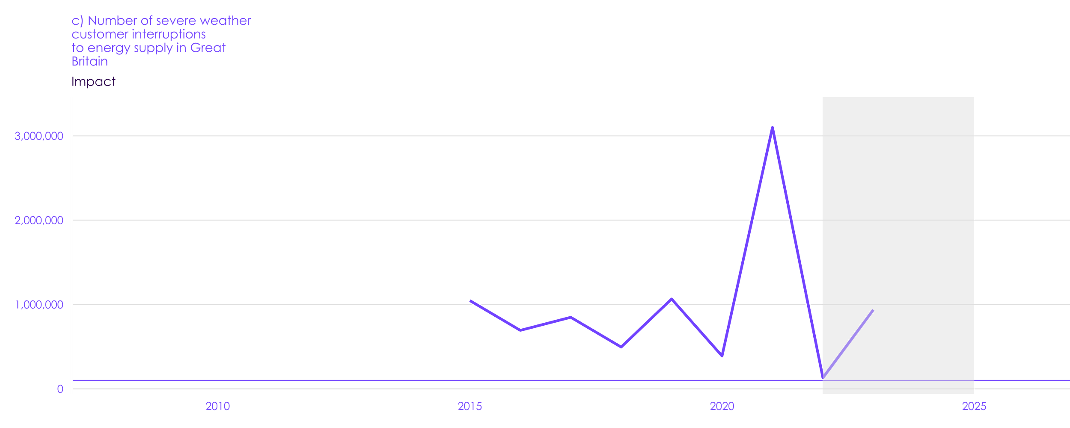
Key indicators for energy
Customer interruptions due to severe weather vary year-on-year based on weather events
Historical data
Source: Ofgem

Slide 12
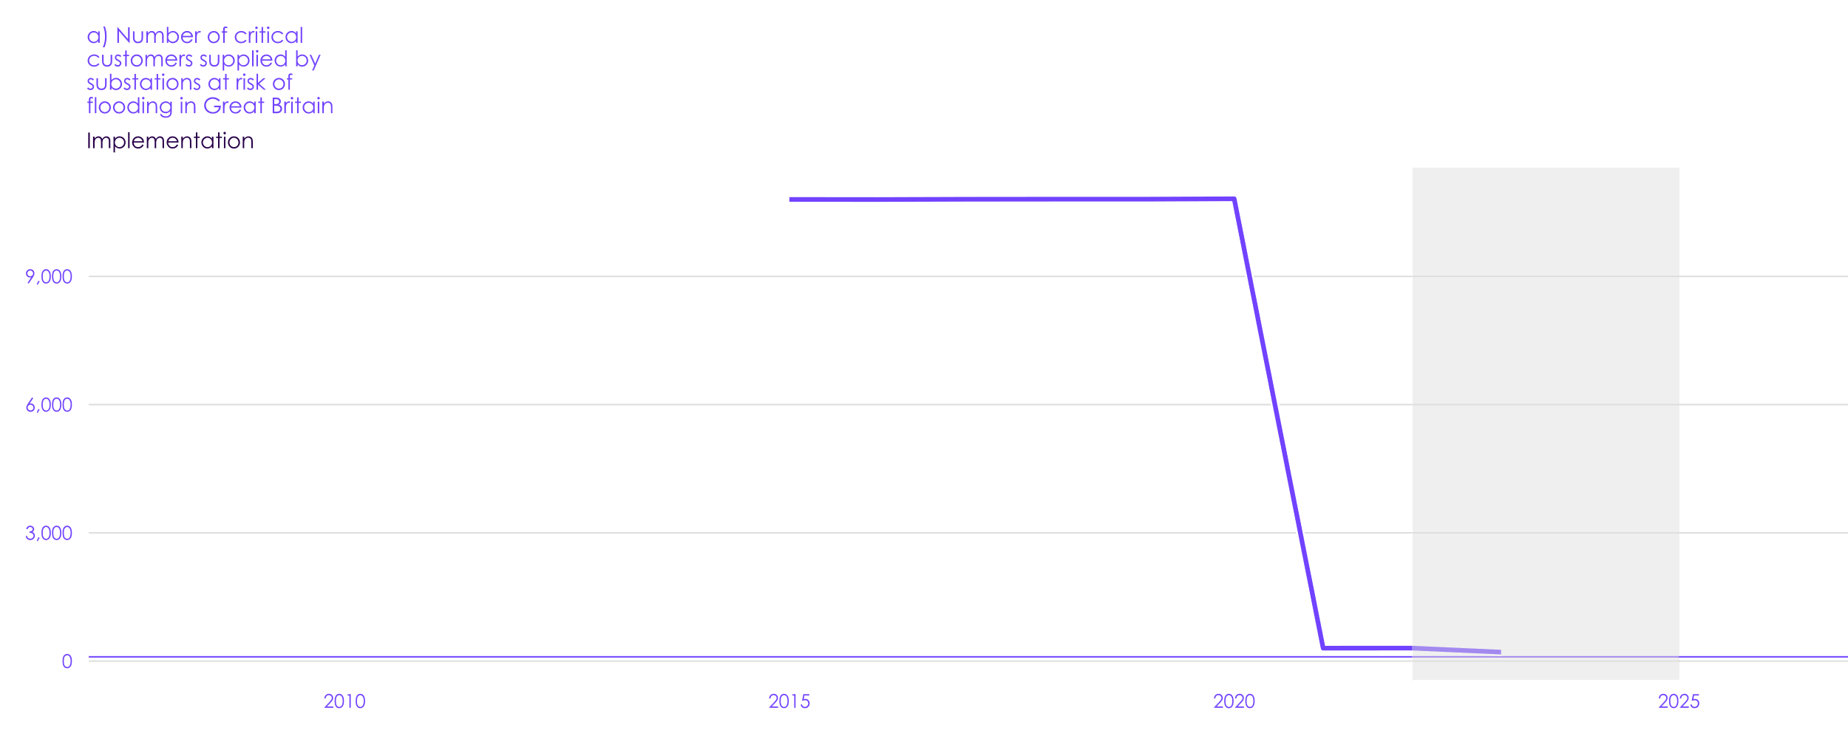
Key indicators for energy
Less critical customers supplied by substations at risk of flooding addresses interdependency risks
Historical data
Source: Ofgem
Notes: Critical customers are: “connected customers that provide a vital service to the community, where the loss of supply to these sites is likely to lead to mass evacuation”.

Slide 13
Fourth Climate Change Risk Assessment (CCRA4)

Slide 14
CCC outputs for CCRA4
Independent Assessment and statutory advice
Technical Report
  Review the published evidence to:
  Identify climate risks and opportunities to the UK
  Assess the urgency of taking additional action to manage each risk
Well-Adapted UK report
  Synthesise published evidence and conduct innovative research to:
  Discuss target levels of climate resilience
  Set out what actions are needed to build climate resilience
Statutory Advice Report
  Provide independent advice to:
  Recommend policy actions needed in the next set of national adaptation plans
What are the risks that need to be managed?
What actions are needed to manage these risks?
What should governments do to ensure these actions are delivered?
CCC’s Independent Assessment to Government
CCRA4 - IA
CCC’s statutory advice to Government

Slide 15

Next steps
Further opportunities to engage on CCRA4-IA
  Technical Report:
    The Met Office-led consortium are progressing with analysis and drafting.
    An interim version of the Technical Report will be published for Community Review in November 2025.
  Well-Adapted UK report:
    We are looking for potential indicators to track adaptation progress.
    Please share your ideas via this Mentimeter survey: menti.com, code: 8330 6697
    Reach out to rachael.steller@theccc.org.uk and karina.rodriguezvillafuerte@theccc.org.uk

Slide 16
1st Floor, 10 South Colonnade
Canary Wharf
London, E14 4PU www.theccc.org.uk

