Slide 1

National Water Resources Modelling: From research to delivery
Jonny Wilson

Slide 2
Content
Background
National System Simulation Modelling Project
National Water Resources Modelling tools and their uses
Future plans – WR modelling & DAFNI

Slide 3
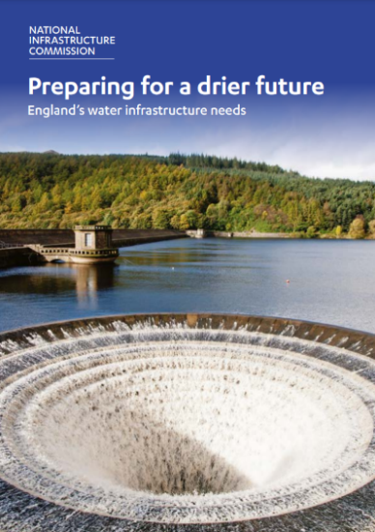



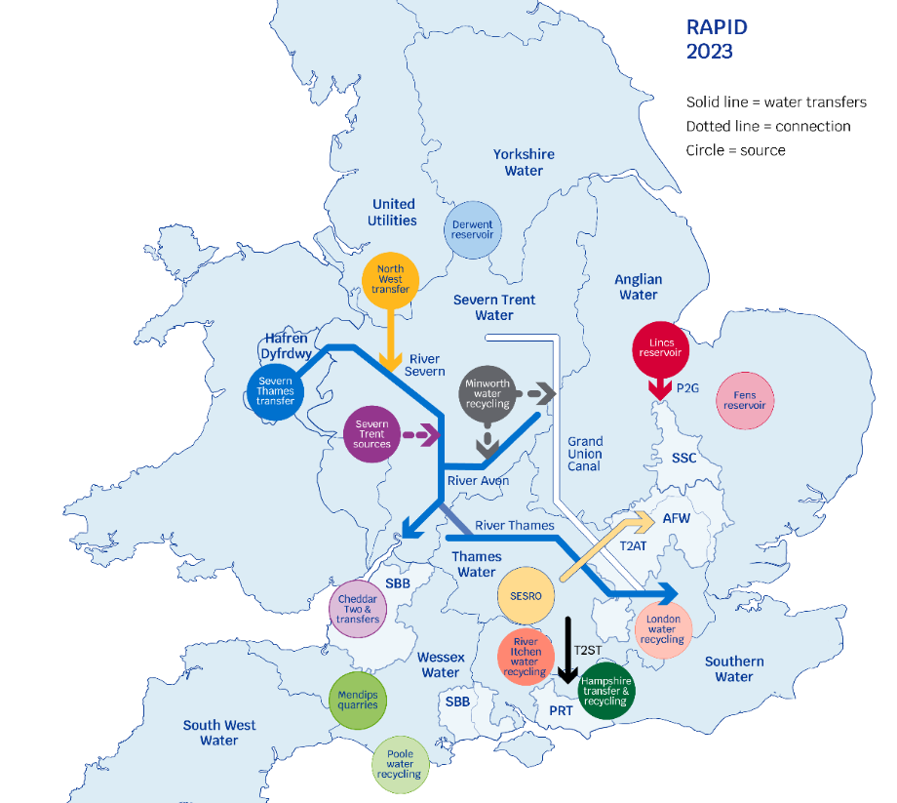
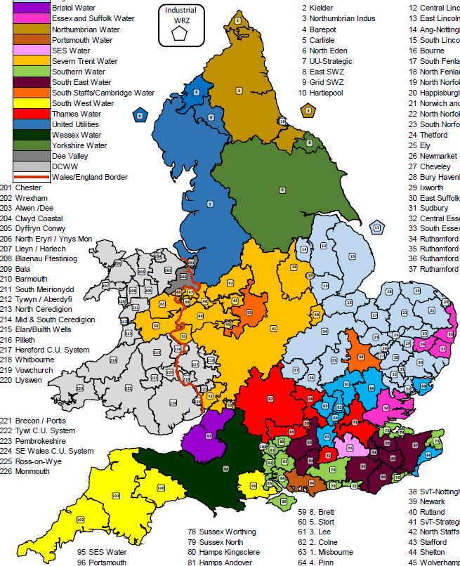
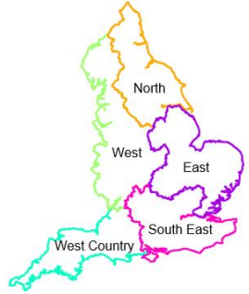
Background – water needs and strategic approach
Policy reacts to an evolving water resource challenge
NIC (2018)
Preparing for a drier future
Ofwat (2019)
PR19 Final Determinations
EA (2020)
National Framework for WR
HMT (2020)
National Infrastructure Strategy
WR planning and industry reacts to challenge
WRMP19
RAPID/NAU & SROs
WRMP24

Slide 4

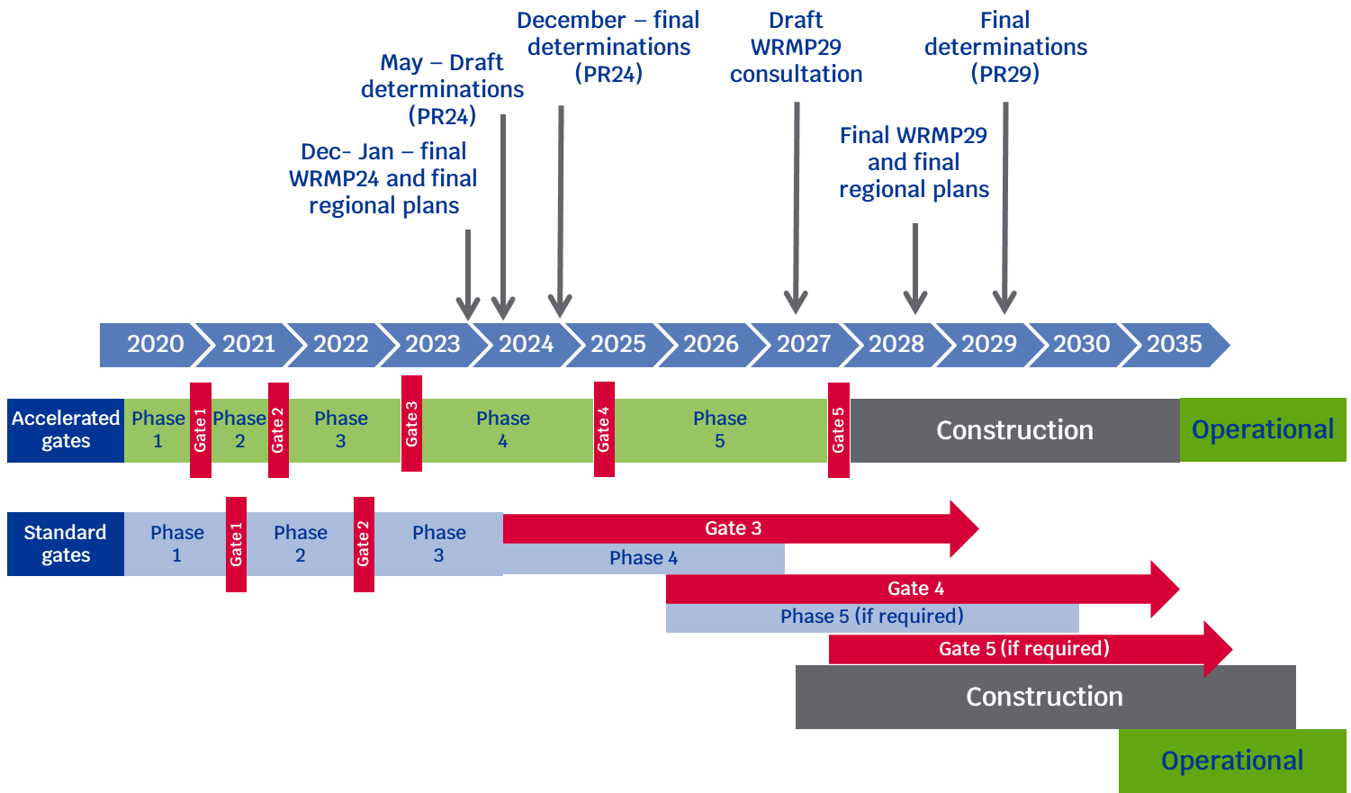
RAPID, NAU & the Strategic Resource Options
RAPID: Regulators Alliance for Progressing Infrastructure Development
£469m fund for the continued development of strategic resource options (SROs);
Oversight from regulators to overcome policy and planning risks and barriers
Ofwat, Environment Agency & Natural England, Drinking Water Inspectorate;
A gated process to allocate funding across 18 options, with SRO submissions and WRMPs needing to demonstrate SRO is feasible and best value to progress through each gate.

Slide 5
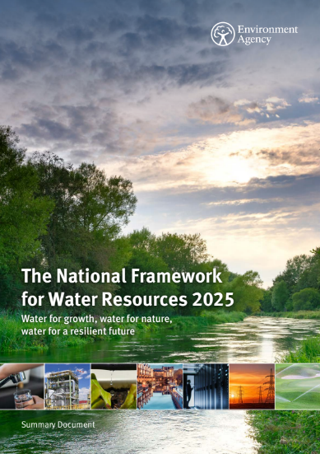
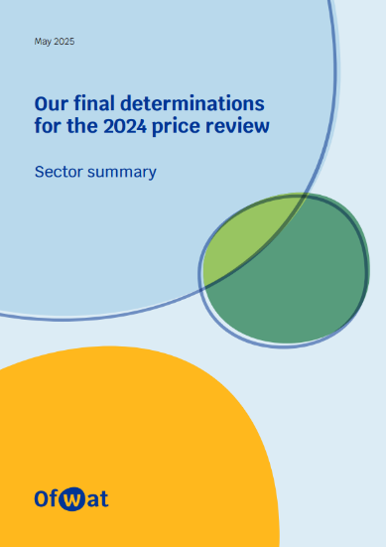
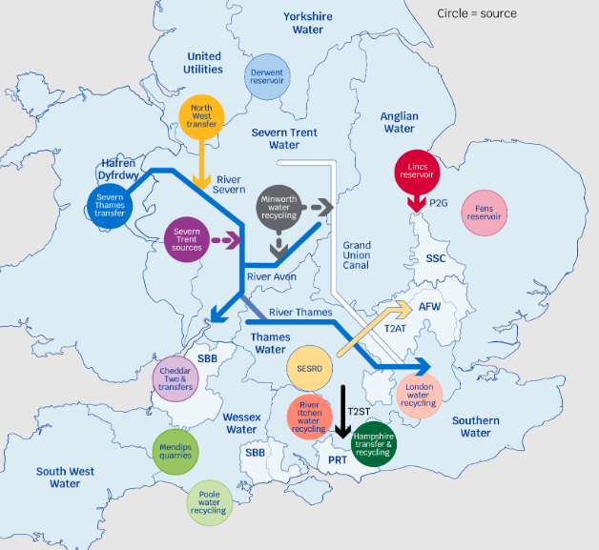
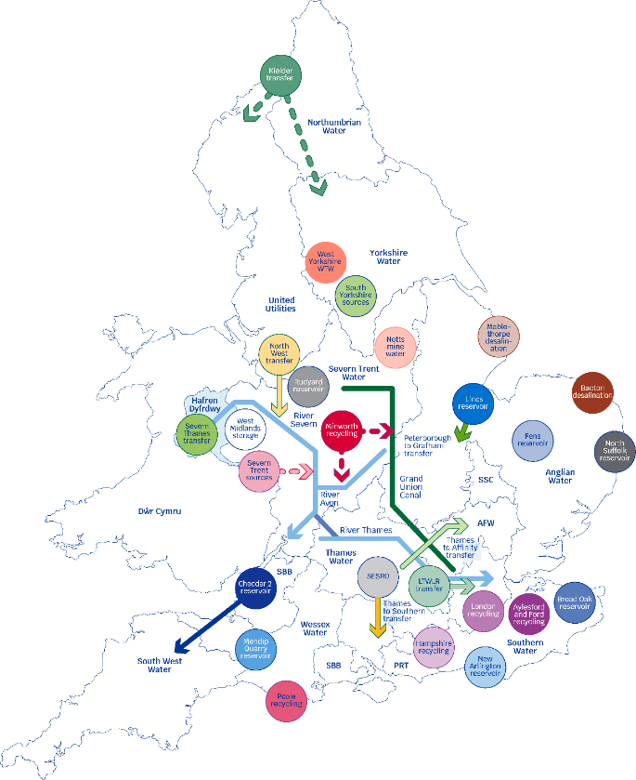
Evolving picture of water needs and solutions
Policy and planning react to an evolving water resource challenge
PR19 SROs
PR24 SROs
EA (2025)
National Framework for WR
Ofwat (2025)
PR24 Final Determinations
Refresh of the National Framework in June 2025 shows that an additional 4,940 Ml/d of water is needed to address future pressures on public water supply by 2050
Increase of ~1,500 Ml/d since first NF published in 2020
PR24 includes 17 New significant infrastructure projects
11 of the options are new SROs to be developed under the RAPID gated process.
£2.4billion of funding allowed at PR24 for developing SROs
RAPID now oversees a ~£50billion programme of 28 major new infrastructure schemes.
Notes:
Previous NF 3,435 Ml/d by 2050 new NF 4,940 by 2055.

Slide 6
Trilemma
Charges to water users
Subsidies through taxation
Affordability
Security of Supply
Impacts of climate change and droughts
Growing demand
Leakage
Environmental impacts
Deterioration of the freshwater environment
Carbon emissions

Slide 7









The National System Simulation Modelling (NSSM) project
Team
Regulators
Academia
Technical
Tom Russell
Gemma Coxon
Yanchen Zheng
Doug Hunt
Paul Hickey
Elliot Tinton
Haydn Johnson
Fiona Lobley
Jonathan Dennis
Jim Hall
Anna Murgatroyd
Rachel Pugh
Alison Peard
Jonathan Wilson
David Pritchard
Richard Rowan-Robinson
Saman Hashemi
☺ With governance and technical support from the regional groups and water companies, SRO teams and industry experts ☺
Aims
1. Technical: Independently assess Strategic Resource Options and WRMP options
Test the resilience of SROs against nationally-coherent droughts and climate change impacts to provide a regulator check on the most resilient set of SROs
Sense check emerging regional plans through national system stress-testing of WRMP scenarios.
Use outputs to support decision making around the selection of supply options
2. Long Term: Develop cross-regulatory integrated modelling approach
Quantitative evidence to support joined-up regulatory decisions and advice.
Approach
Different way of looking at the problem: top-down vs bottom-up approach to modelling
National modelling does not replace the detailed company, solution and regional models. It is a tool to look more holistically at the resilience and planning problem;
Working collaboratively and transparently with water companies and solution teams to achieve appropriate system and solution representation, and to influence new ideas and solutions.
Notes:
We have brought WREW in house – can run everything on DAFNI (Data & Analytics Facility for National Infrastructure)

Slide 8
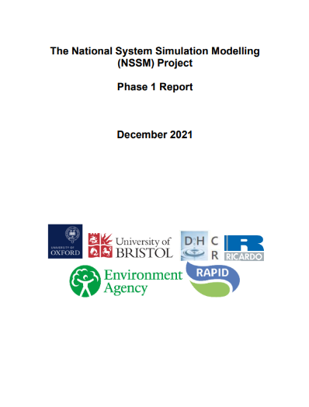
The National System Simulation Modelling (NSSM) project - Phases
Phase 1
Proof of concept, working with solution teams and WCs to represent SROs and independently test the resilience of individual solutions
Phase 2
Testing the drought resilience of SROs in combination and exploring possible scenarios of demand, climate change and environmental destination
Phase 3
(current)
Independently test the full range of WRMP24 scenarios to explore the range of uncertainty and assess if there are any sensitivities associated with large scale, severe, long duration droughts.
Help inform thinking around low/no regrets SROs
Timing and configuration of solutions later in the planning horizon where uncertainty is greater
Notes:
We have brought WREW in house – can run everything on DAFNI (Data & Analytics Facility for National Infrastructure)

Slide 9



EA/RAPID national WR modelling tools
1
2
System Simulation modelling
‘Aggregate’ modelling
1a
National WR Supply-Demand model
1b
National WR Supply-Demand model for options comparison
Low-resolution (WRZ scale, yearly timestep) ‘model’ built on data from WRMP19 tables
Provides high-level quantitative evidence on future water needs under different scenarios of water availability, policy and demand
National System Simulation Model (NSSM) –
Most similar to water company modelling but at the national scale
The model is way of stress testing the system and a risk analysis tool for reliably exploring uncertainty
Allows for rapid identification of the most cost-efficient set of options for meeting water demand under different scenarios
Used to test benefit of improving connectivity via new transfers

Slide 10
What do National WR Models tell us?
Aggregate WR modelling
Define the planning problem/challenge by quantifying how much water is needed nationally under a range of plausible future scenarios of water needs and pressures.
Identifying new options for meeting water needs – are there new large/national scale options that could help meet water needs more efficiently than options currently considered in WRMPs?
National System Simulation Modelling
Sense checking WRMPs - Independent assurance on the options selected by Water Companies in their water resources management plans.
Do the SROs provide the benefits (drought resilience) presented in WRMPs?
Does the performance of SROs change when tested against national scale droughts, or other types of drought not sampled by water company methods?
Are the best combination of options are chosen in WRMPs?

Slide 11
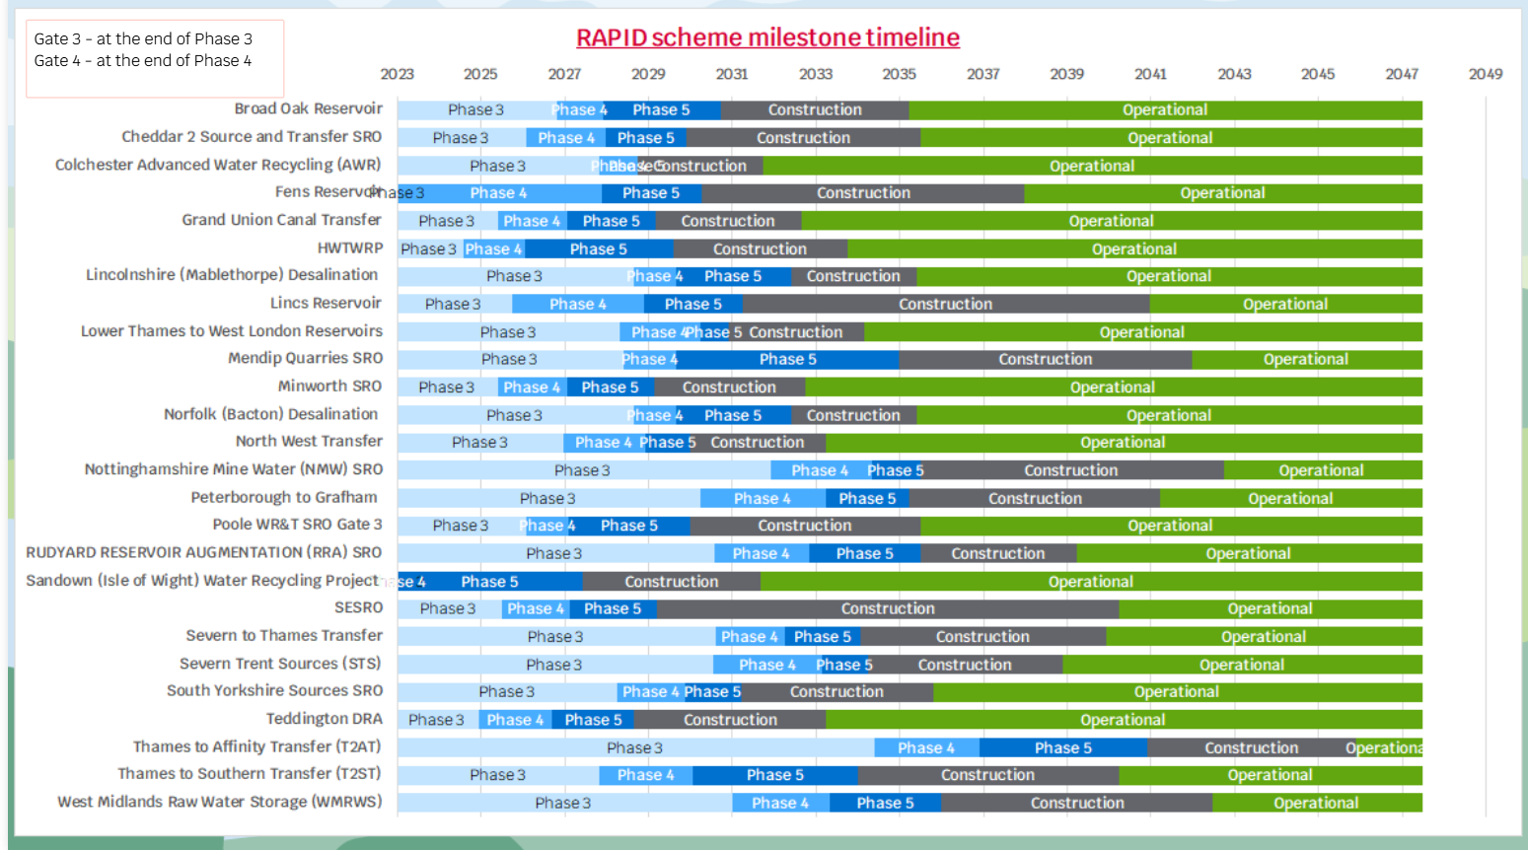
What do National WR Models tell us?
Aggregate WR modelling & National System Simulation Modelling
Explore the consequences of delays to delivery of SROs the current SRO milestones and timeline is quite ambitious and regulators need to understand the implications of delays to schemes.
Which delays carry the greatest impact/risk?
Where are there insufficient options to mitigate delays and could new national options help?

Slide 12
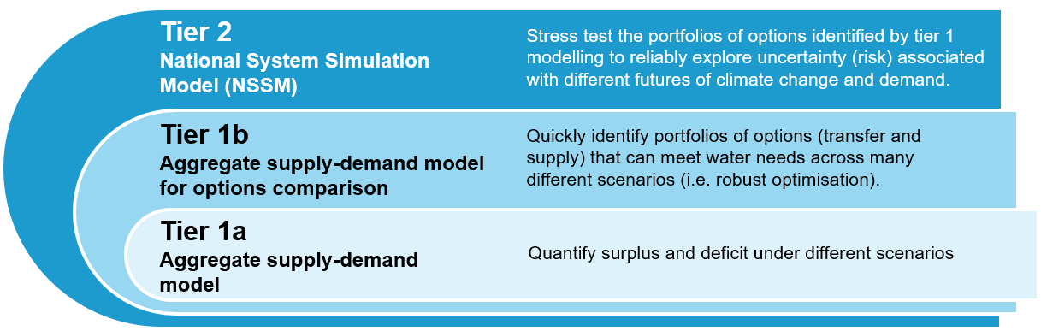
Future Plans – WR modelling & DAFNI
Tiered modelling strategy to join up aggregate modelling & NSSM, and leverage the strengths of each approach.

Slide 13
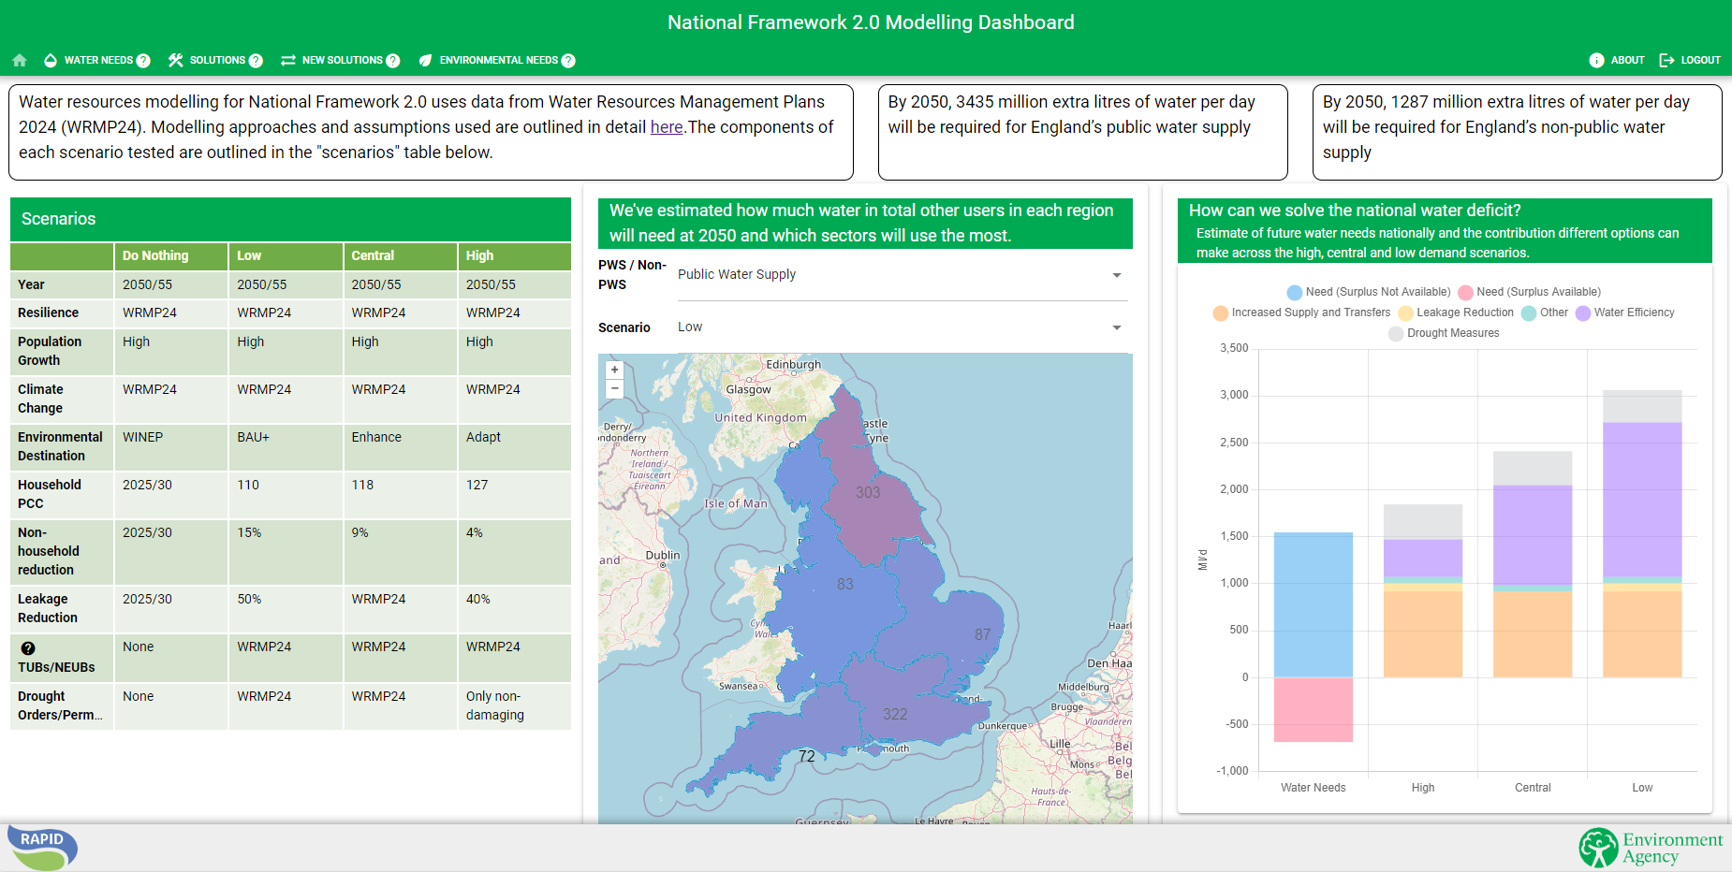
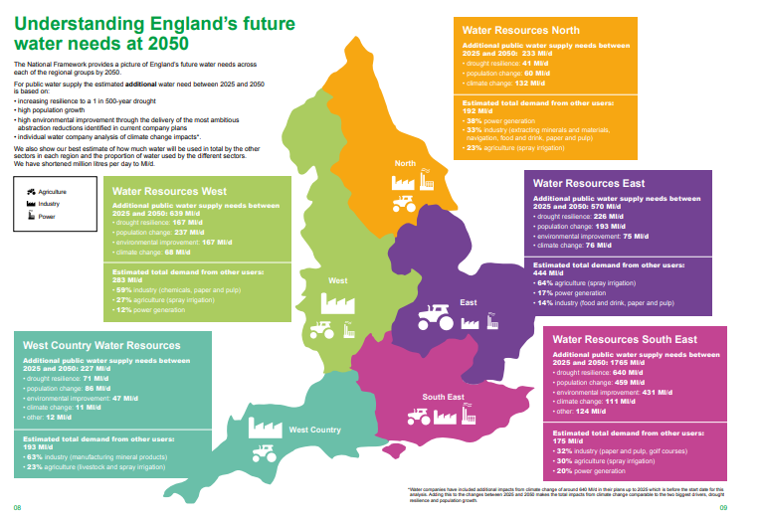
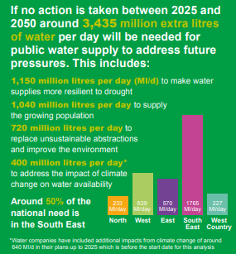
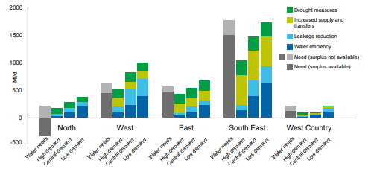
Future Plans – WR modelling & DAFNI
Stakeholder engagement through interactive visualisation
NF1.0
Standalone figures and reports
Lack of transparency uncertainty management
Limited and inefficient data sharing and access
Limited user experience/engagement with data
NF2.0
More complex problems & subsequent ambitious modelling requires a change in approach to engagement including improved transparency, accessibility & user experience
Interactive visualisation dashboard!
Ability to interact and visualise with data and scenarios
Ability to download input and output data/figures/maps
Ability to explore a range of scenarios

Slide 14
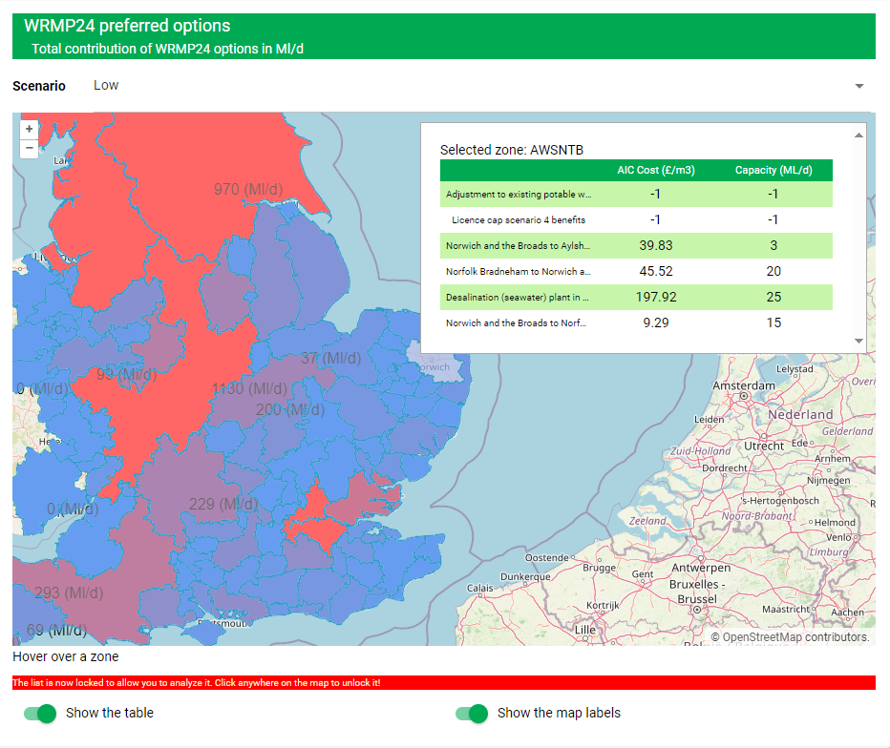
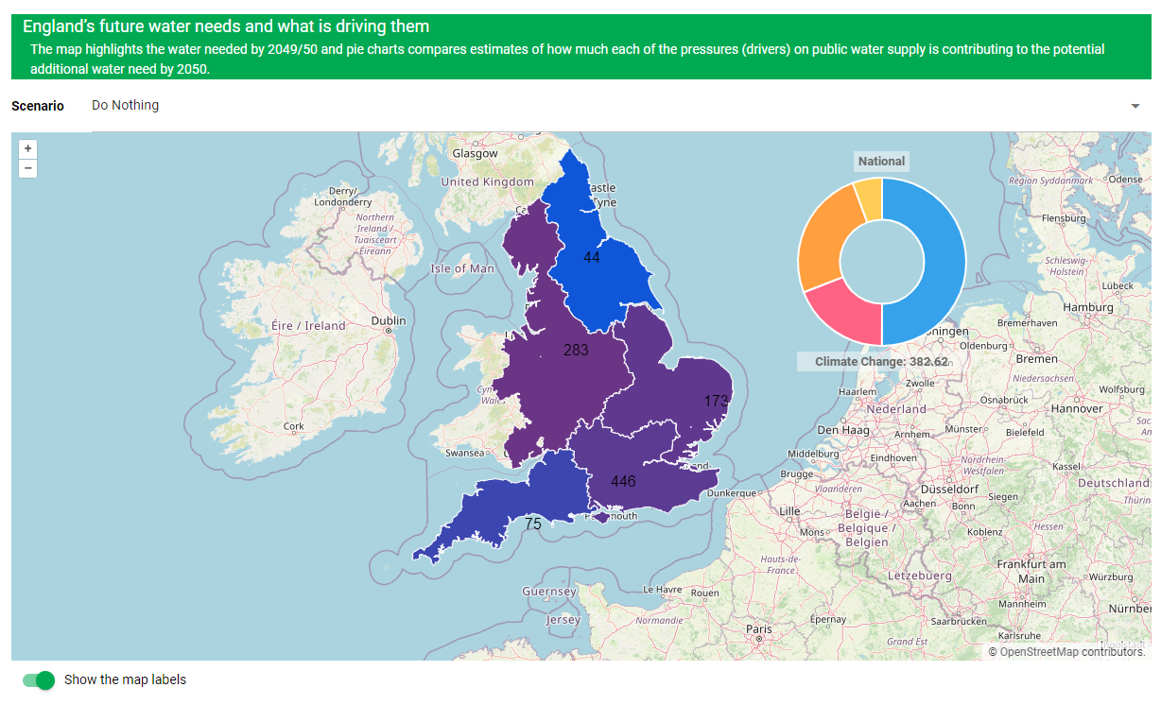
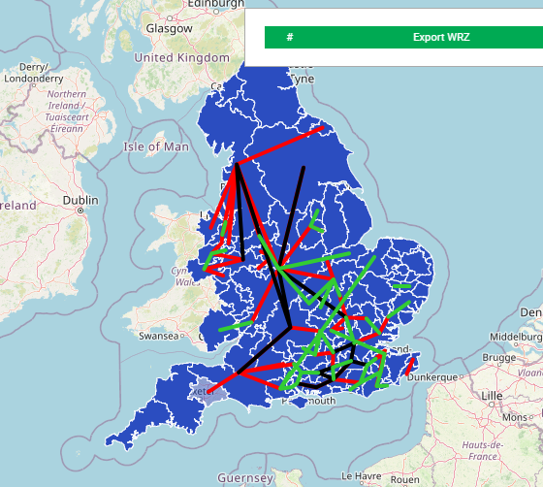
Future Plans – WR modelling & DAFNI
Stakeholder engagement through interactive visualisation
Summary landing page
Solution explorer
Summary landing & information page
Summary of modelling outputs
Models & assumptions
“Explorer pages” including:
Water needs explorer – visualises and compares future water needs at different scales under different future scenarios
Solution explorer – visualises how WRMP24 supply and demand options can meet the range of future water needs
New transfer explorer – visualises potential new transfer options, assess trade-off between options(cost/yield) and comparison to WRMP24 portfolios
Environmental needs explorer – visualises and compares future environmental needs
Water needs explorer
New solution explorer

Slide 15
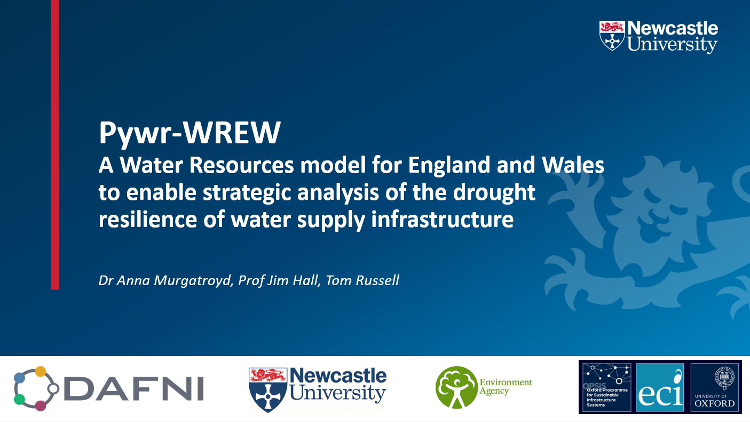

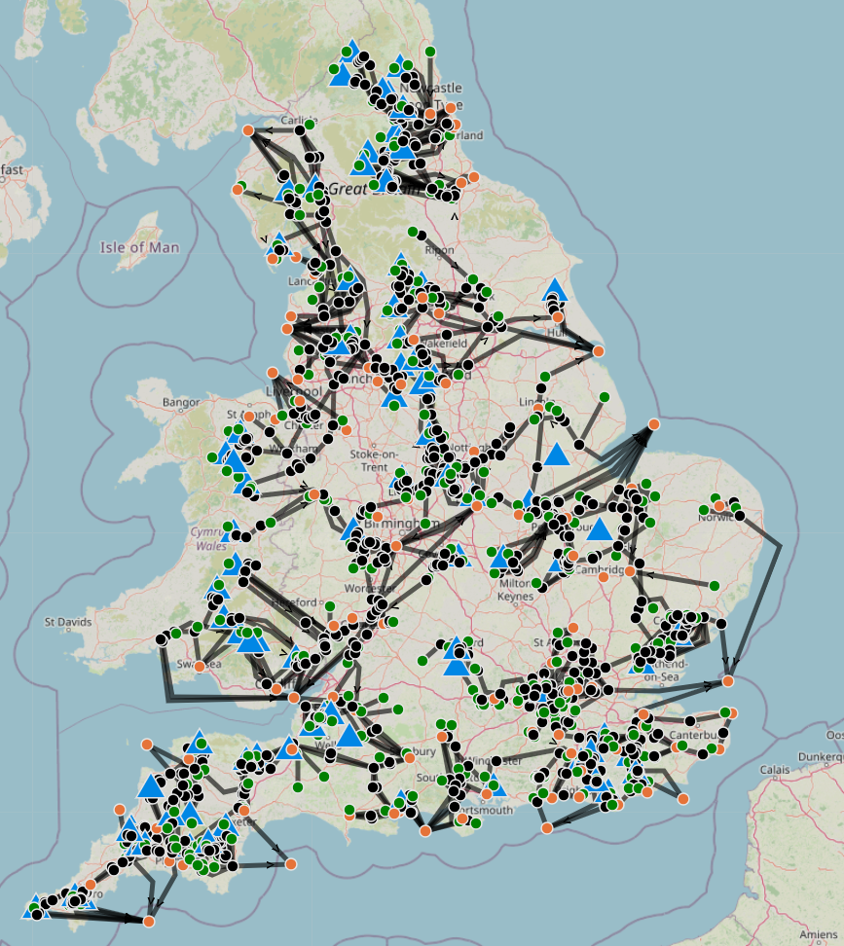

Future Plans – WR modelling & DAFNI
Pywr-WREW
Open-source: Pywr’s source code is available on GitHub. Given that the framework is devised entirely in the widely-used Python programming language, users can easily detect and fix bugs, as well as implement new features.
Free to use: Pywr has been designed to be free end-to-end. This means that models can be formulated and solved using open-source optimisation solvers (e.g., GLPK), avoiding expensive license fees.
Strong support base: Pywr’s userbase spans the globe, which provides a strong support base for users. Since Pywr is currently the only open-source water resources modelling framework, its documentation and features are continuously growing.

Slide 16
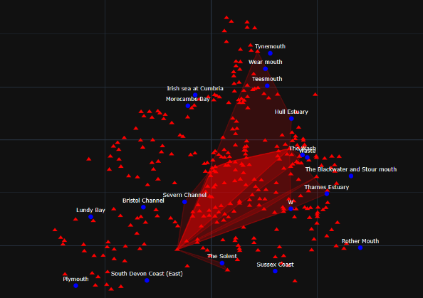

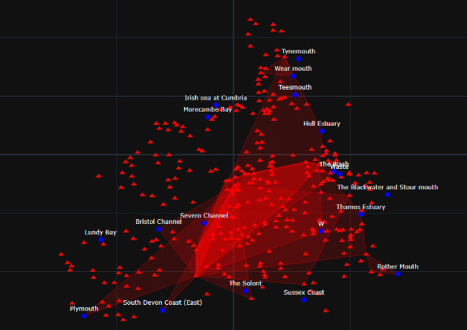
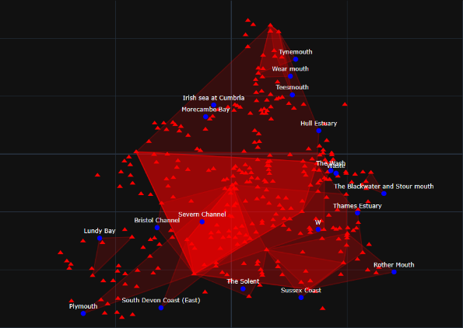
Future Plans – WR modelling & DAFNI
Collaboration with other DAFNI users/modellers
Dr. Michael Foster
Dr Neil Walkinshaw
Dr Farhad Allian
Prof. Robert Hierons
Richard Sommers
Increasing confounding effect between model elements
CITCoM – Causal Inference for Testing Computational Models
The NSSM is a complex computational model, and it is therefore difficult to assess whether output is to be expected – e.g. is non-convergence of optimisation significant/meaningful?
Researchers at Uni Sheffield have developed a framework for testing computational models via the application of statistical analysis approaches know as causal inference
Allow us to draw justifiable conclusions about model behaviour
Possible to test “what if” questions about simulations that have not yet been executed.

Slide 17

Future Plans – WR modelling & DAFNI
IWC report – key themes and recommendations relevant to National WR modelling include:
Integrated regulation & Systems planning
Expansion of the RAPID programme
“The RAPID framework to speed up delivery of major projects could be expanded to increase coverage and effectiveness.”
“The scope of RAPID should be expanded to include wastewater projects and strategically important projects that do not meet current size and complexity thresholds”
“A new integrated body would better equip regulators to manage current trade-offs in the system. By integrating economic functions with water environment and water industry regulation within a single body… the regulator would be able to take a holistic view of the development of water company plans”
“The new regulator would bring together Ofwat, the DWI and the water regulatory functions from the EA and NE.”
Focus on long-term water needs
“There is an urgent need to strengthen long-term strategic direction for water supply…including consolidating the modelling and assumptions underpinning long-term and interim targets.”
“Systems planners should ensure that water supply is sufficient to meet the current and future needs of the region and is robust to future water system stress”
“Systems planners would review plans and select the preferred options based on criteria set by the government. Systems planners would have ‘constrained discretion’ to make trade-off decisions”
“The systems planner would support all sectors in developing feasible options”
“The national coordinator should take on responsibility for ensuring the consistency in scenarios, assumptions, and metrics for water industry planning… introducing a consistent standard method for forecasting various assumptions including population growth and climate change.”
National consistency of methods
Notes:
Additional recommendations:
“A comprehensive systems planning framework should be introduced for England and Wales, with responsibility for integrated and holistic water systems planning”
“The systems planner… should produce strategic and cross-sectoral plans based on regional and national objectives”
“The systems planner should be responsible for planning, funding, setting water body objectives, and monitoring delivery of plans”
“Systems planners should ensure that water supply is sufficient to meet the current and future needs of the region and is robust to future water system stress”
“A national water systems planning coordinating function would sit above the regional water systems planners.. to ensure regional plans add up to national targets”
“The national coordinator would also ensure consistency of approach and effective use of digital tools.”

Slide 18
Thank You

Slide 19
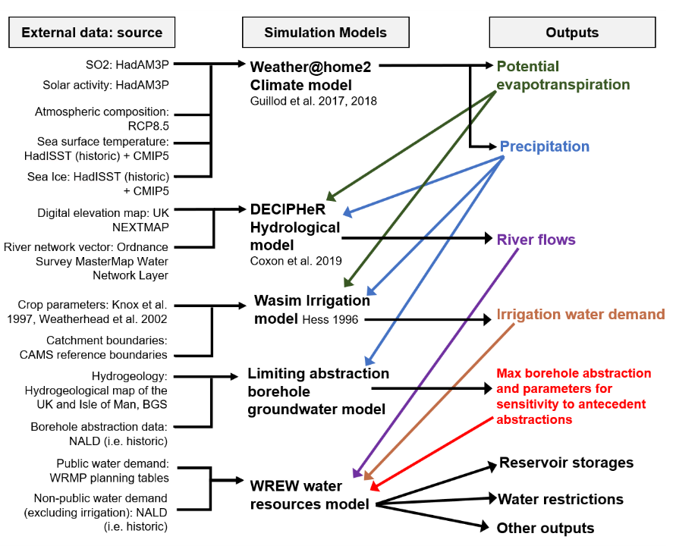
NSSM – data & workflow
Climate data
Historic period (1974-2014)
Weather@home2:
Baseline (1975-2005) 100 x 30 –year
Near future (2020-2050) 100 x 30-year
Far future (2070-2100) 100 x 30-year
River flows
DECIPHeR hydrological modelling (University of Bristol)
Groundwater
Empirical model based on relationship between observed groundwater abstractions (from NALD) & rainfall
Water demand
NPWS: National Abstractors Database (NALD)
PWS: WRMP19 – DYAA distribution input
Irrigation demand
Wasim
Validation
WREW validated for the WaterUK project - using water company flows
Validation improvements during this project
Water Company / Solution Team Collaboration
Solution representation
Reservoir control curves & drought triggers
Abstraction rules

