Slide 1

Making good choices
DAFNI conference – bridging the gap between academia and industry
Dr Juliet Mian, Director and Arup Fellow
September 2025

Slide 2
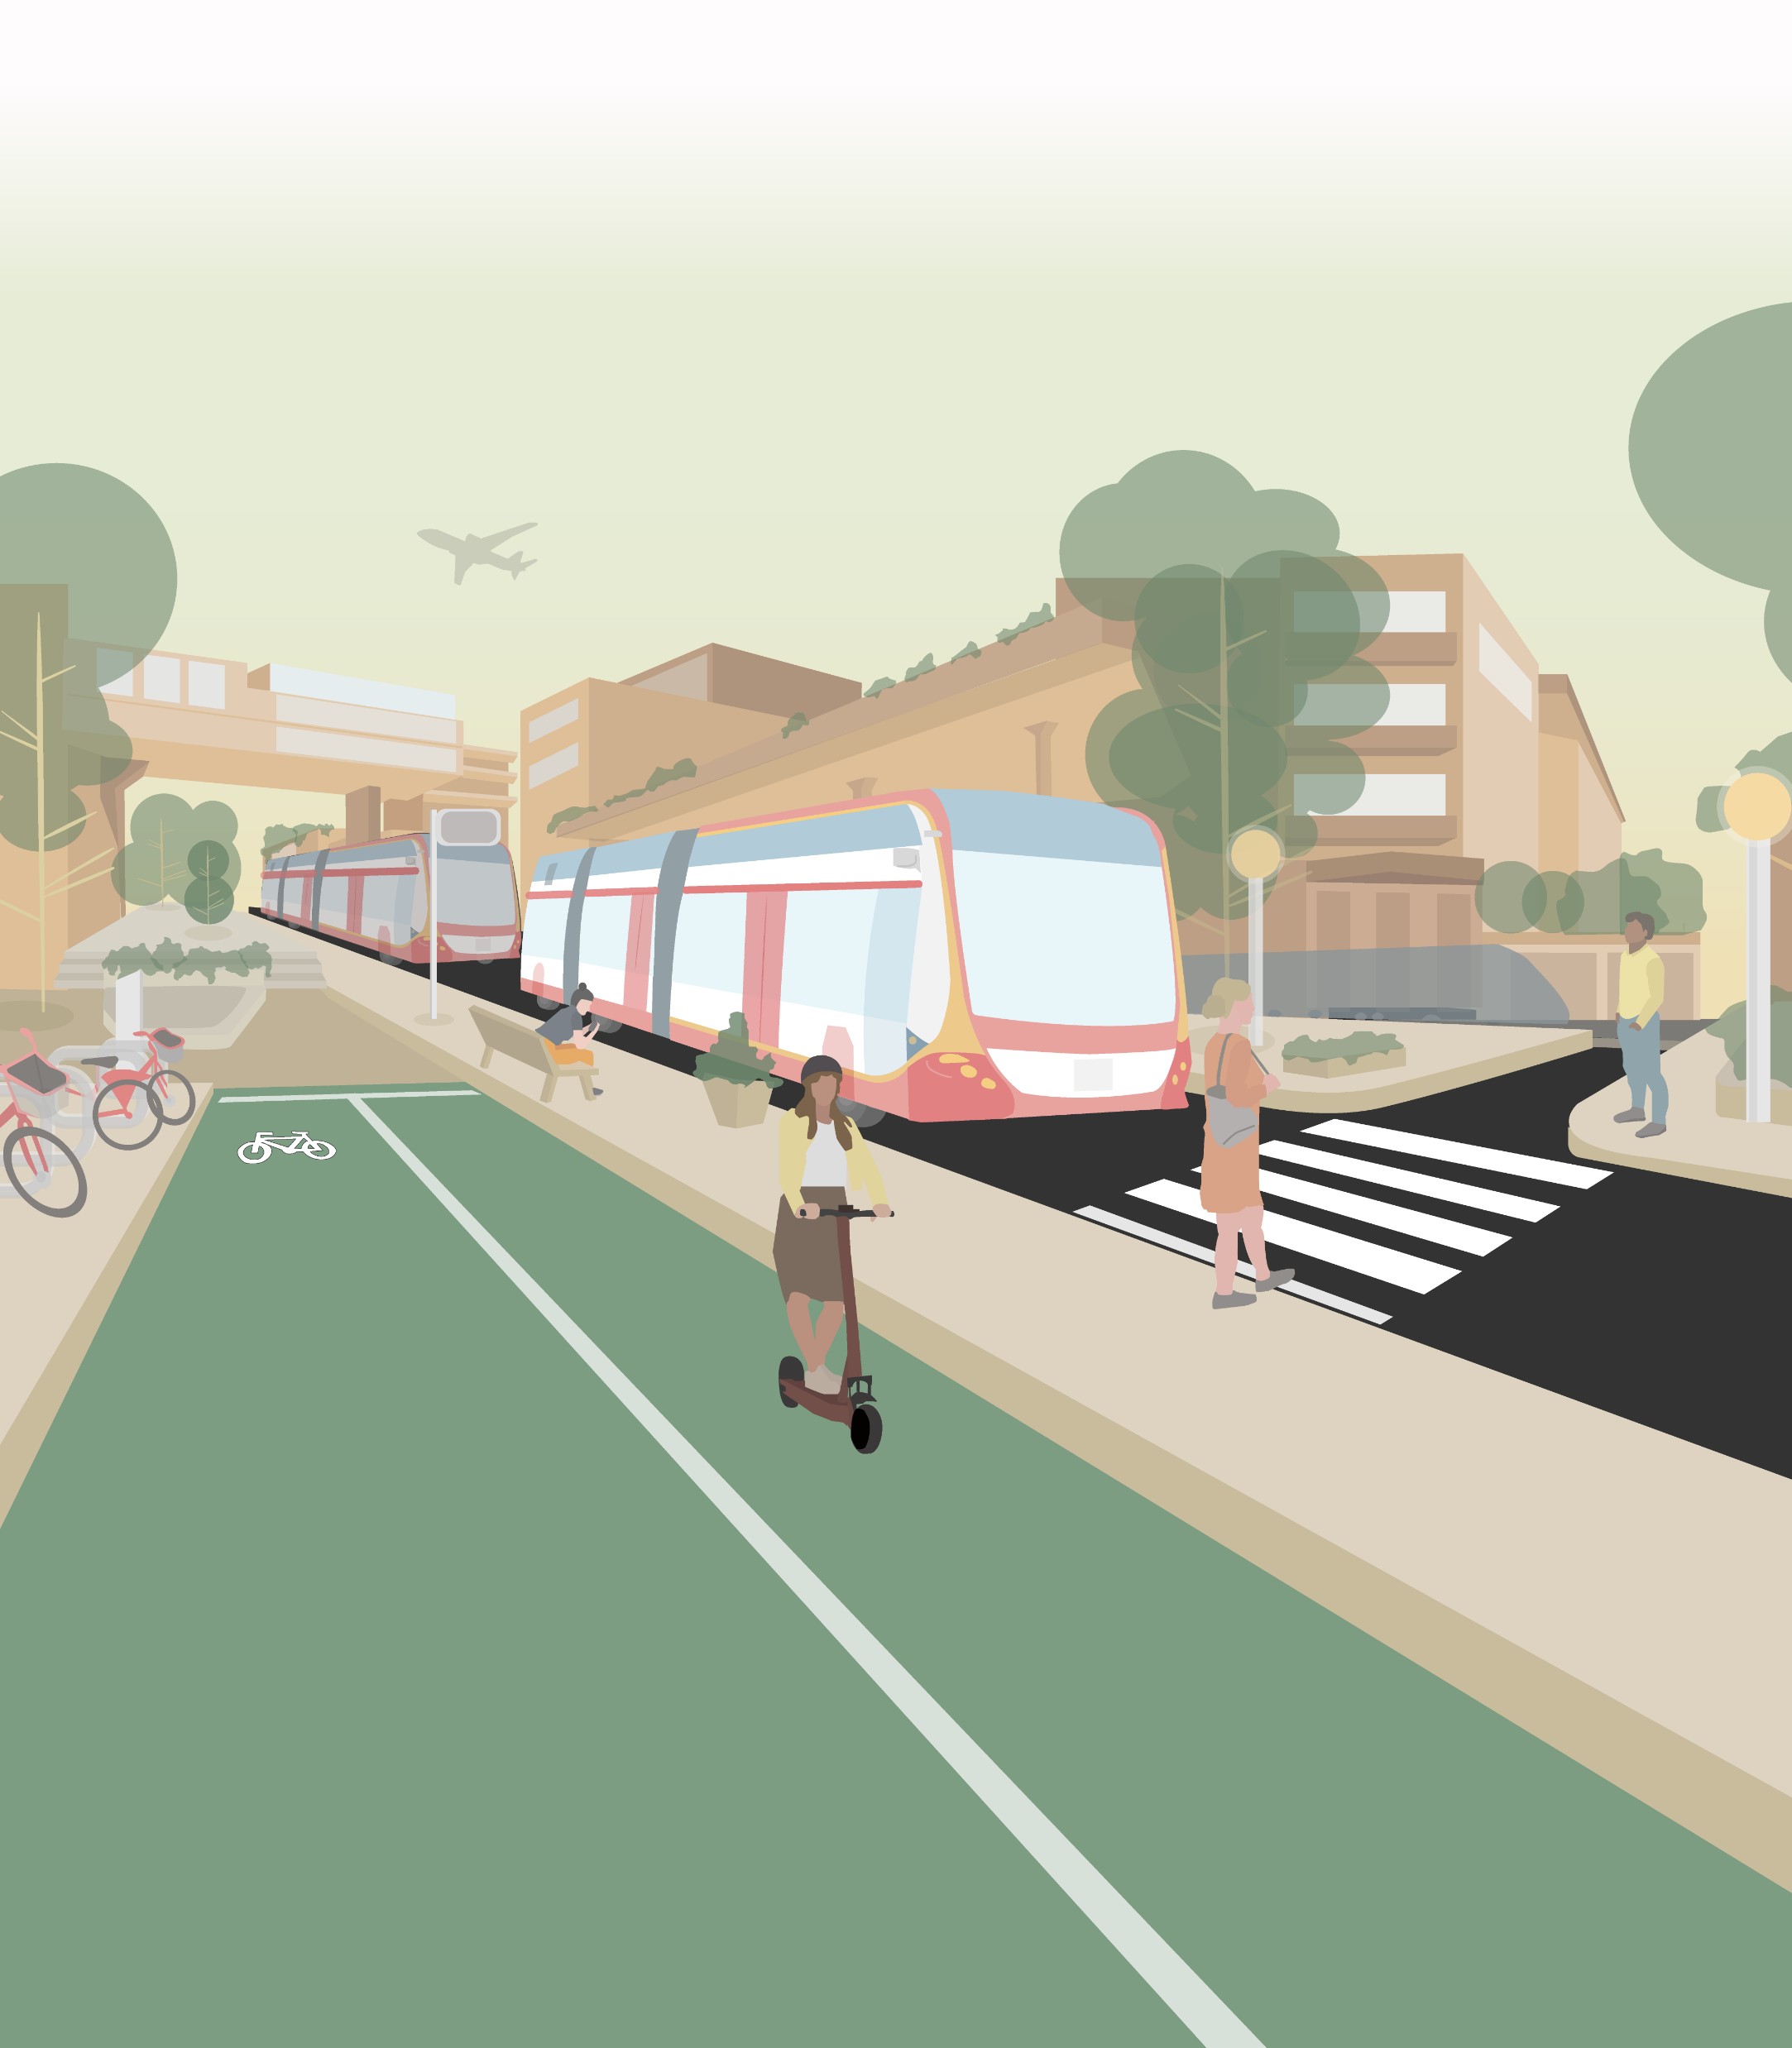
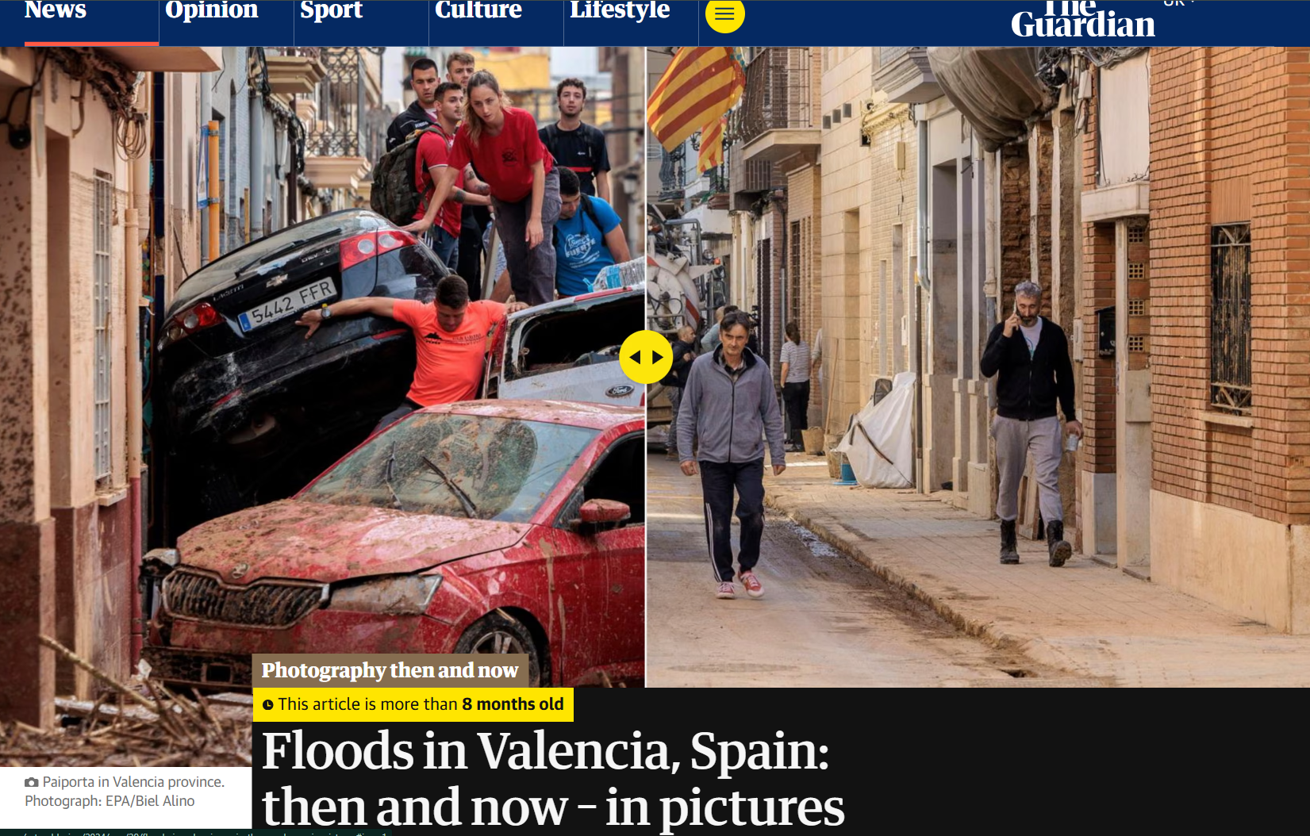
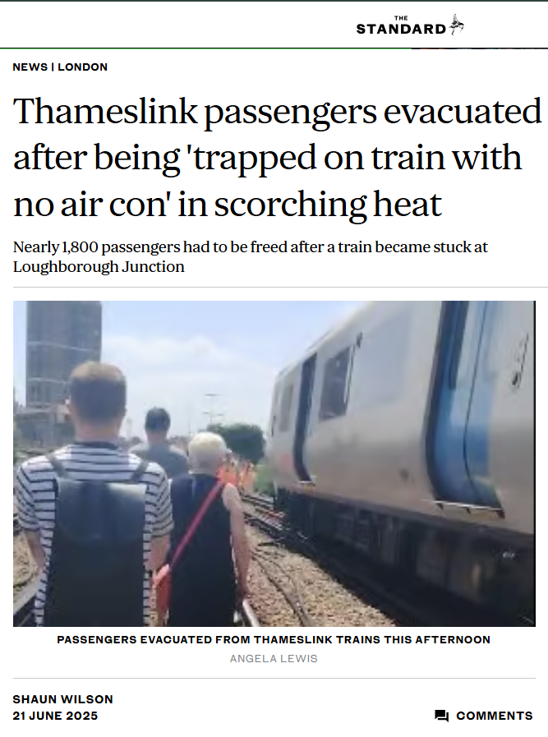

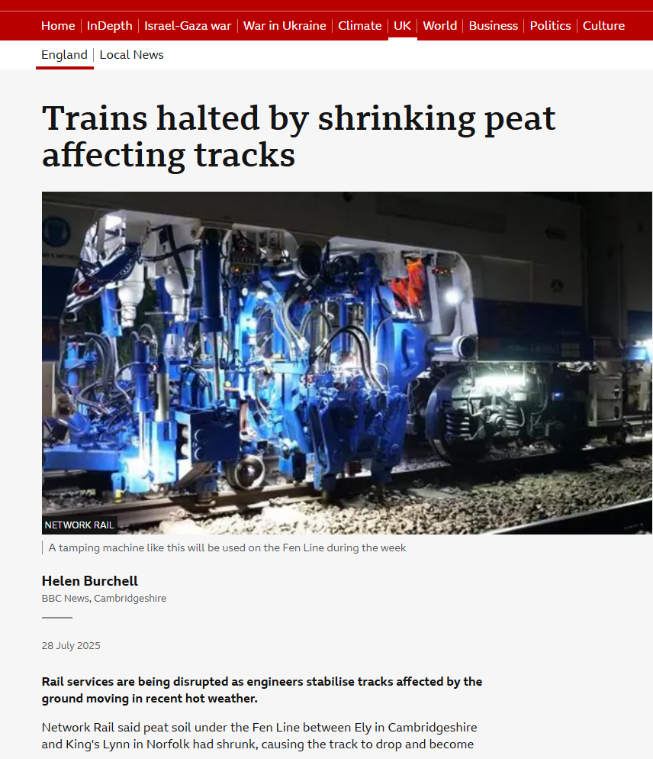
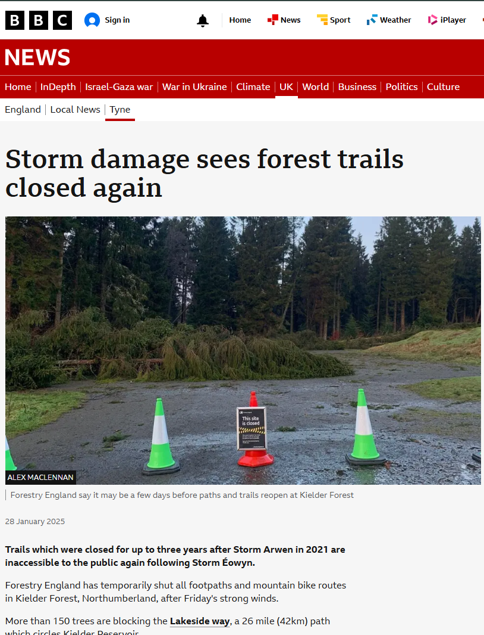
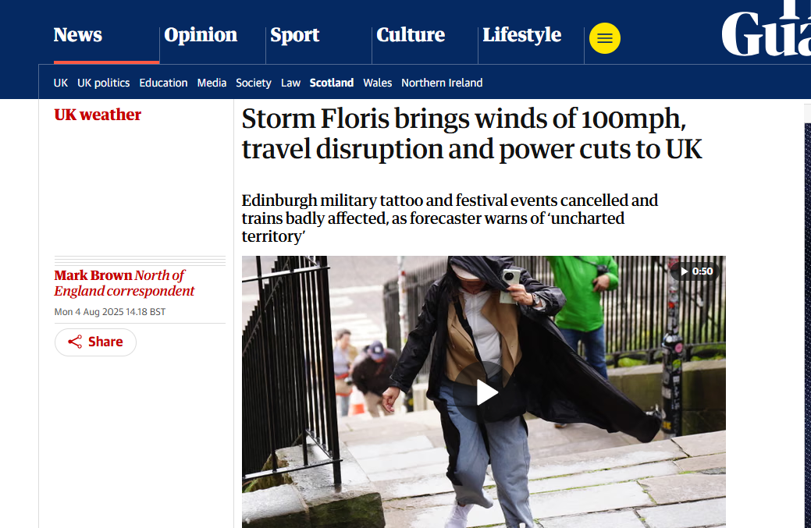
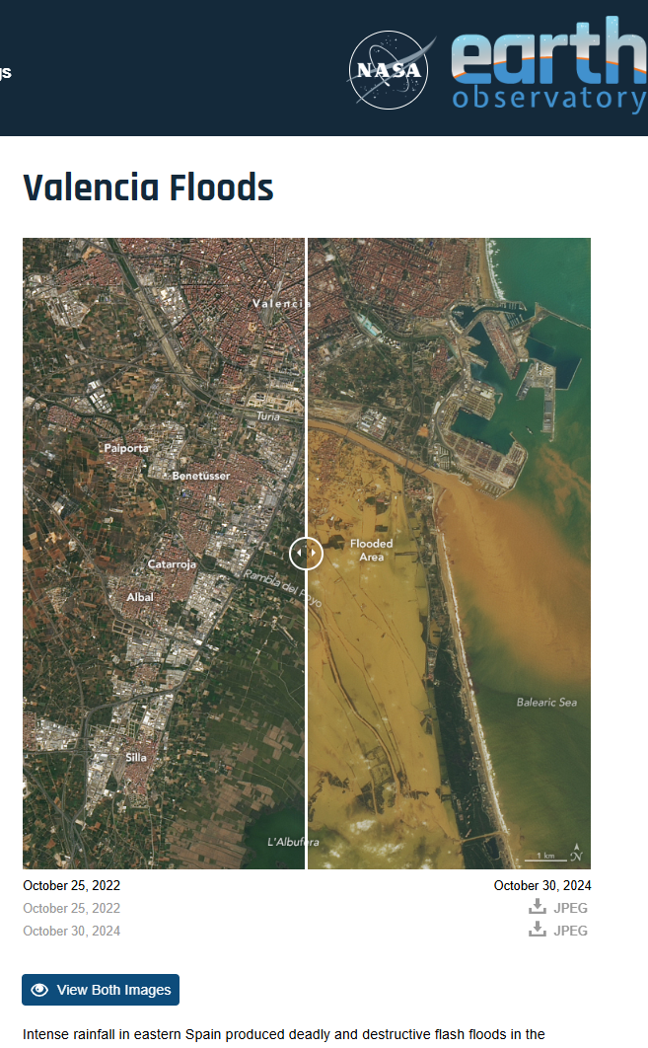
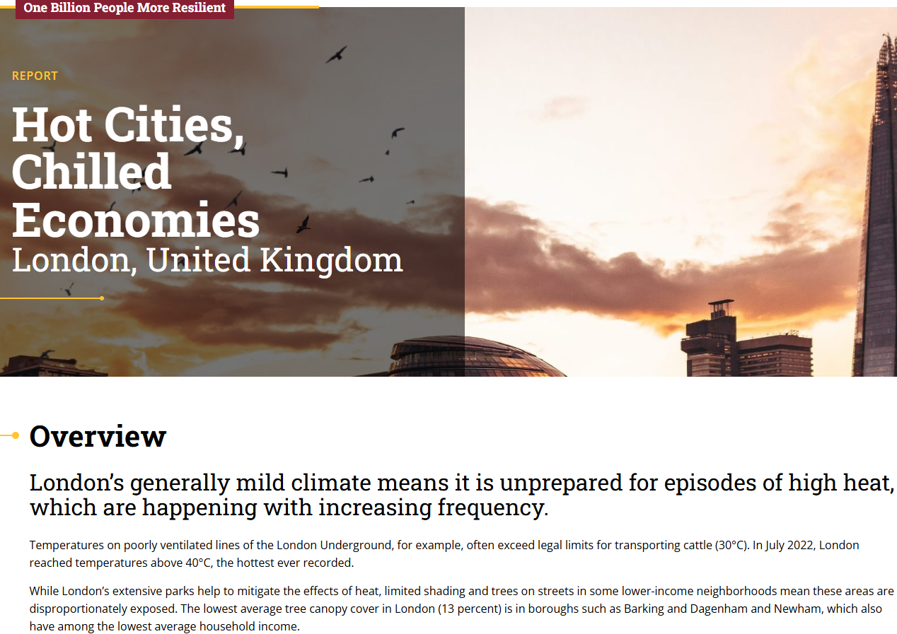

    We help our clients to ​integrate climate risks into climate informed decisions ​that help to build resilience and create value from their investments.
    This contributes to safe, resilient and regenerative places, where communities will thrive.
Notes:
A bit about me and what I do

Slide 3

The Resilience Journey for road, rail and energy networks
4
01
Understand multi-hazard risks at a high level: data collection, hazard assessment, risk assessment
Quantify risks and identify risk drivers: hazard modeling, exposure modeling, vulnerability modeling, quantitative risks analysis
02
3
03
Strategize to mitigate risks: development of mitigation (physical and operational) options and resource requirements, cost-benefit analysis, multi-decision framework analysis, prioritize investments
04
Implement solutions: design retrofit, resilience-base design, operational planning, adaptive capacity/organizational resilience
2
1

Slide 4
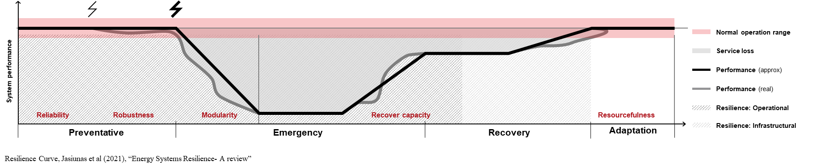
Notes:
Discuss baseline.

Slide 5
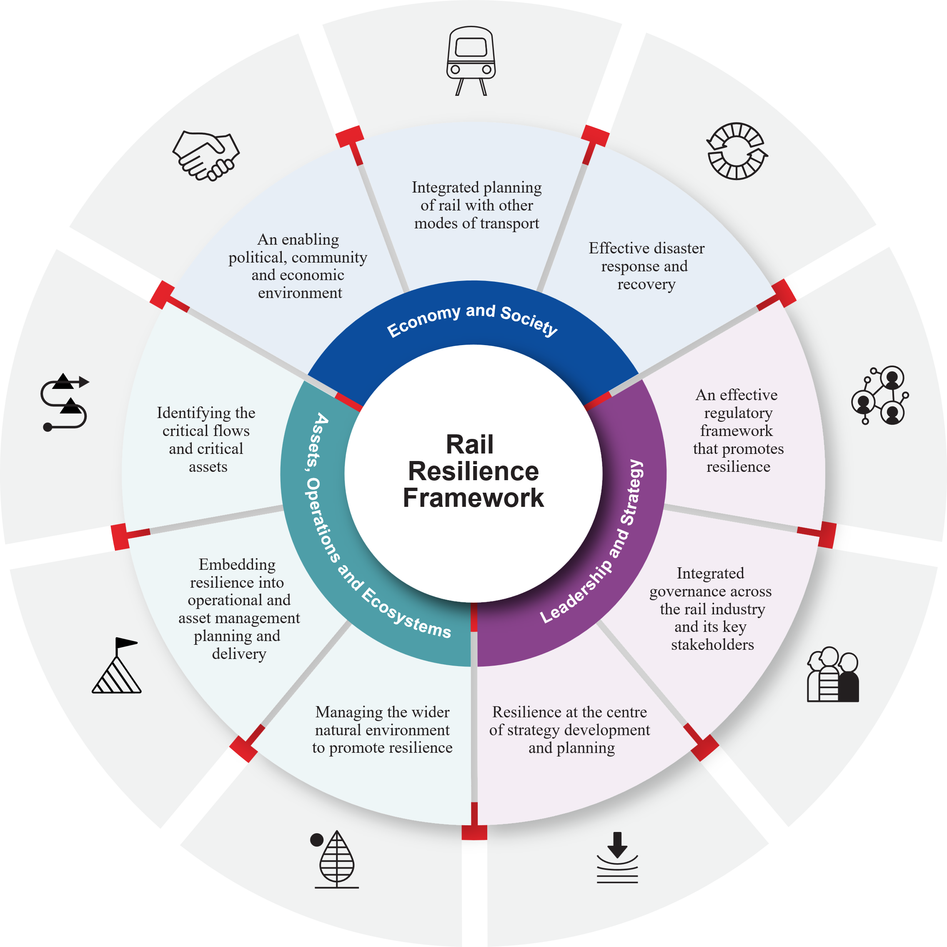
Taking a whole-system response
Work across multiple dimensions to achieve resilience
Identify which goals need attention and by who
Make tangible and systemic progress towards resilience

Slide 6
1. The big picture – what choices are we making, and why?

Slide 7
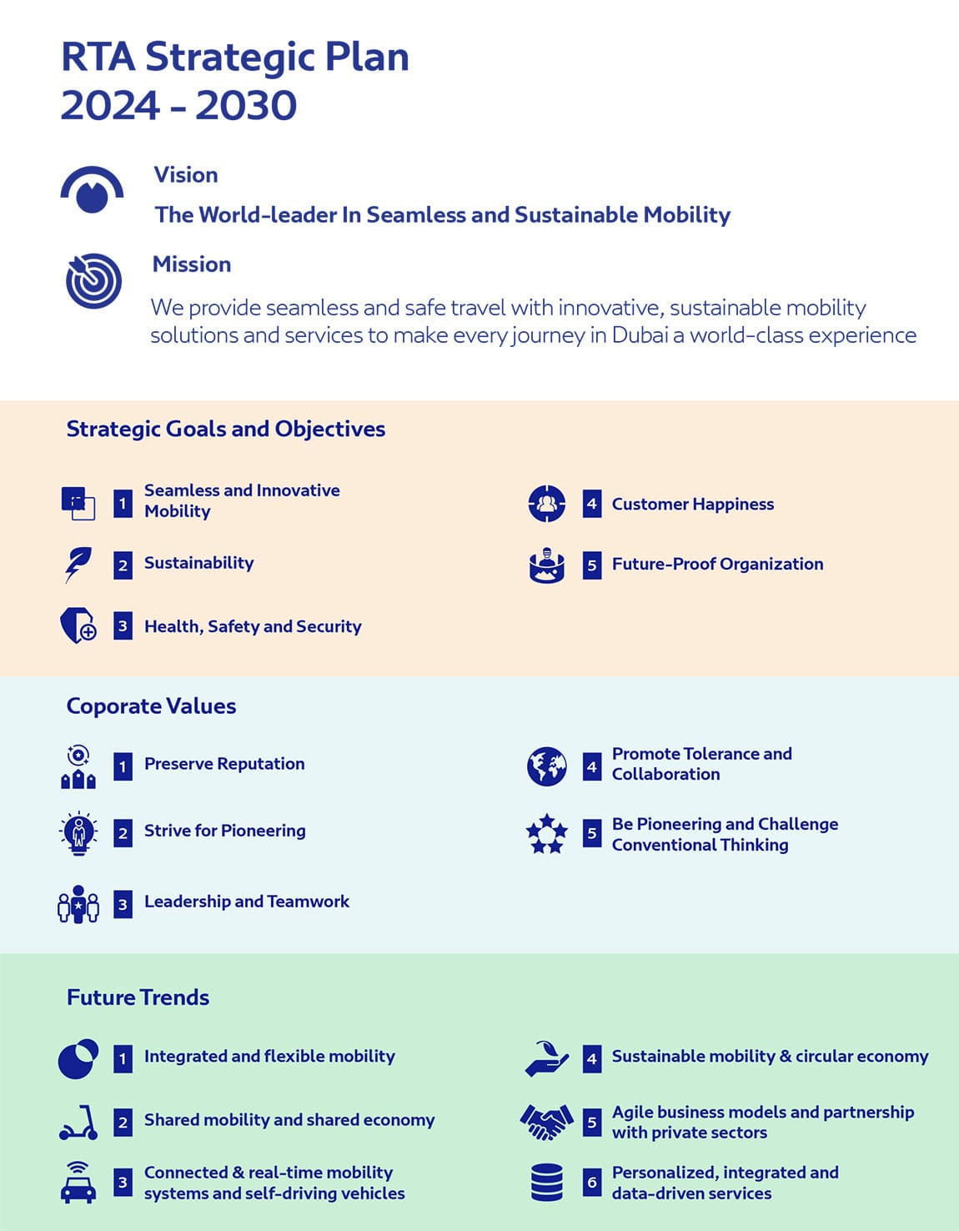
Theory of change
Root causes
Problem
Resources (inputs)
Activities
Outputs
Outcomes
Impacts

Slide 8
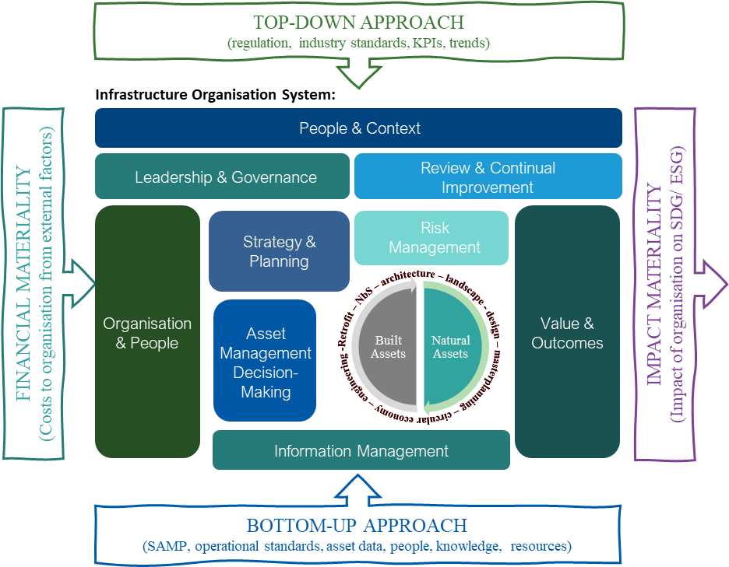

Slide 9
An organisation’s resilience journey
Asset portfolios
Site Development
Portfolio Management
Main Services & Tasks
Support with:
Project assessment and understanding requirements
Data collection and analysis
Provide second opinion and challenge current design if necessary
Supporting decision making (focus on achieving project goals, decarbonization targets and sustainability requirements)
Collaboration and communication
Quality assurance and compliance
Risk reduction and expert guidance
Peer reviews
Investigations & research
Decision to proceed
Decision to take recommendations
Final design
Prioritization
Internal validation with sites
Site resilience solutions action
High Level risk assessment
Deeper dives
Quantitative or resilience-based design
High Level risk assessment
(all hazards)
Quantitative (deeper dives for higher risks only
Develop site-specific measures
Site selection → Due diligence → New construction
Portfolio assessment → Cluster assessments → Corrective measures

Slide 10
2. The long and lasting impact of infrastructure choices

Slide 11
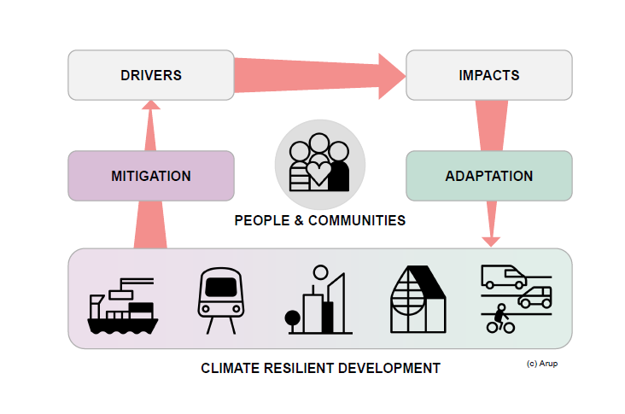
Safe, resilient and sustainable

Slide 12
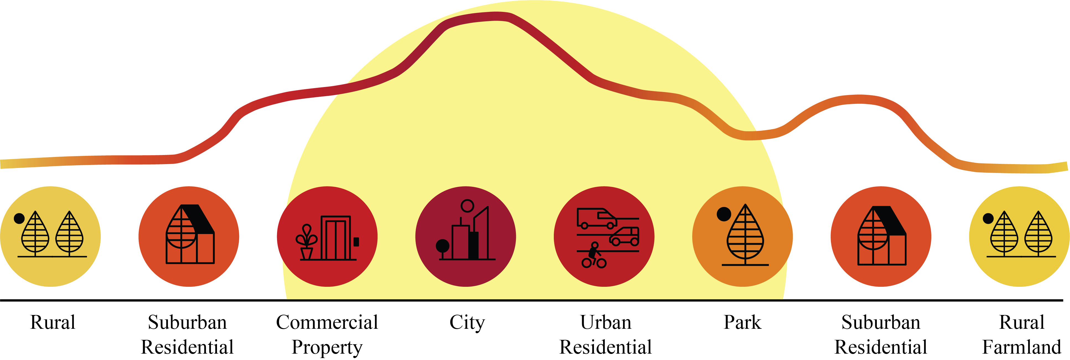
Urban Heat Island (UHI) effect
Warmer temperatures urban areas experience compared to rural surroundings
x3
UHI
expected increase in number of cities exposed to heat above 35°C by 2050
Notes:
UHI intensity measures the annual mean difference in daytime and nighttime surface temperatures between urban land cover and non-urban land cover within the city, in degrees Celsius (°C) for 2016.
https://datadrivenlab.org/urban/issue-profiles/climate-change/
The UHI phenomenon which indicates higher temperatures in cities than their surrounding rural/suburban areas is a crucial problem [8]. “The Urban Heat Island (UHI) effect describes the warmer temperatures urban areas experience compared to their rural surroundings”
It is projected that UHI effects will be aggravated in the coming decades, along with urbanization, especially in Asian and African cities [10]. The HWs and UHIs can potentially interact, and under most situations threats to human societies are magnified [1].
Did you know?
The number of cities exposed to temperatures of 35 degrees C and above is expected to triple by 2050 (Source: C40).

Slide 13


In 2022, global food prices reached an
all-time high, driven in part by disruptions in transport networks caused by extreme weather events. Delays in supply chain systems led to shortages, driving
up food prices and impacting economies worldwide.

Slide 14
3. Framing the choices that we make

Slide 15
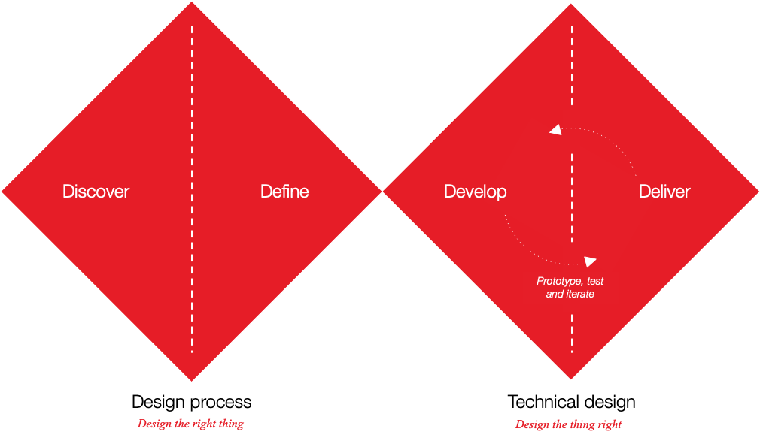
Zoom out before zooming in
Adapted from UK Design Council Double Diamond
Notes:
Or diverge, then converge
We are looking for solutions, but first we are looking for understanding

Slide 16
The need for resilience
Energy system example - disrupting factors
Climate change & Extreme events
Climate change
Extreme weather events
Natural hazards
Geopolitical uncertainty
Technological
Electrical grid outage
Intermittency of renewables
Digitalization
New, disruptive technologies
Increasing interconnectedness of systems
Transformation
Energy market transformation
Regulatory Compliance
Decarbonization & Net Zero strategies
Electrification
Adversarial
War
Cyber-attacks
Acts of terror
Energy price instability
Human factors
Growing population
Changing demand & consumer behaviors
Human error
Notes:
The disruptors affecting energy system resilience are varied:
Supply and delivery of energy across our built environment is evolving.
Over-provision and substantial redundancy is being replaced by finetuned, dynamic and highly interactive approach
Extreme weather events are increasing in intensity and frequency. These can overload electrical infrastructure and energy systems.
Transition to low carbon energy systems can create both threats and opportunities for energy systems.
Boundaries between energy, mobility, water and digitalisation are increasingly blurred => changes in some parts of the system can have drastic effects on other parts

Slide 17
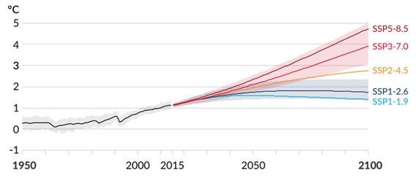
Climate Change Analysis
Climate Change Models
Projected global average surface temperature change in each of the five SSP scenarios.

Slide 18
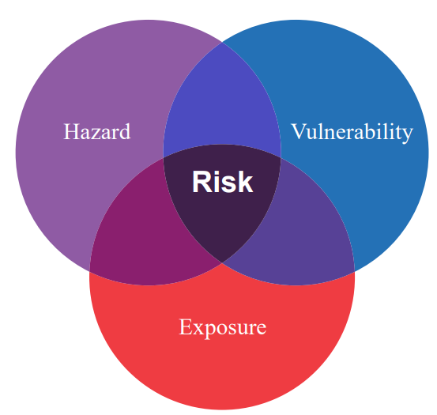
Climate risk analysis
How damageable are the exposed assets and how susceptible are building occupants?
How likely is a hazard event to occur, and what is the intensity?
What are the characteristics, functions, and replacement values of exposed assets or the number of building occupants?

Slide 19
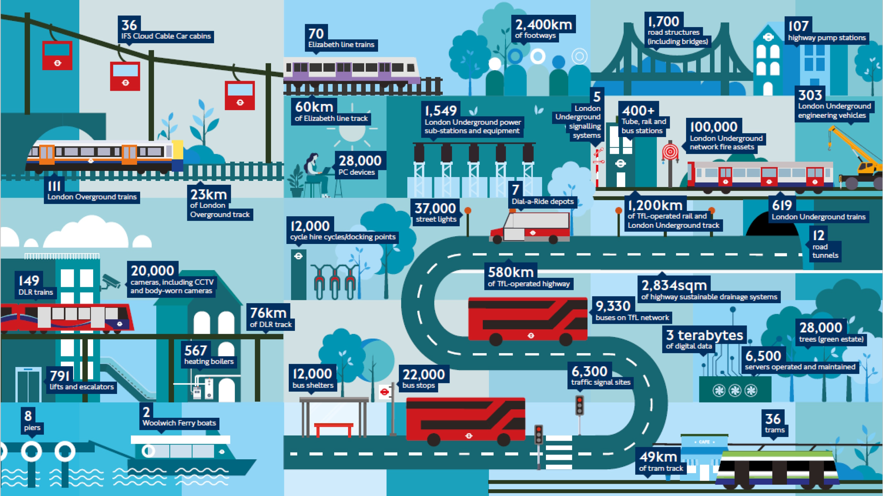
Notes:
The infographic is taken from the Asset Management Strategy Update document, which is used for Transport for London's (TfL) Programmes and Investment Committee and was held on 26 June 2024.

Slide 20
Investing in resilience is no longer optional, it’s essential
Achieving resilience begins with understanding that every place has its own story, shaped by geography, culture, and unique set of challenges. Making infrastructure networks more resilient requires tailored solutions that address these local contexts, while ensuring long-term functionality.​
Resilient road networks reduce the risk of disruption, protect and connect communities, and help secure sustainable economic growth. Acting now saves money in the long term and helps enable adaptable, future ready infrastructure.

Slide 21

4. What’s stopping us?
We are navigating an environment of extreme uncertainty. Despite this, certain realities are clear: assets, operations, and people will inevitably be affected by climate change. Organisations must make strategic decisions on allocating limited resources, addressing immediate shocks, and preparing for long-term stresses and disruptions.
Every $1 spent on preventive road maintenance saves $6
to $10 in future repair costs [American Association of State Highway and Transportation Officials (AASHTO)]

Slide 22
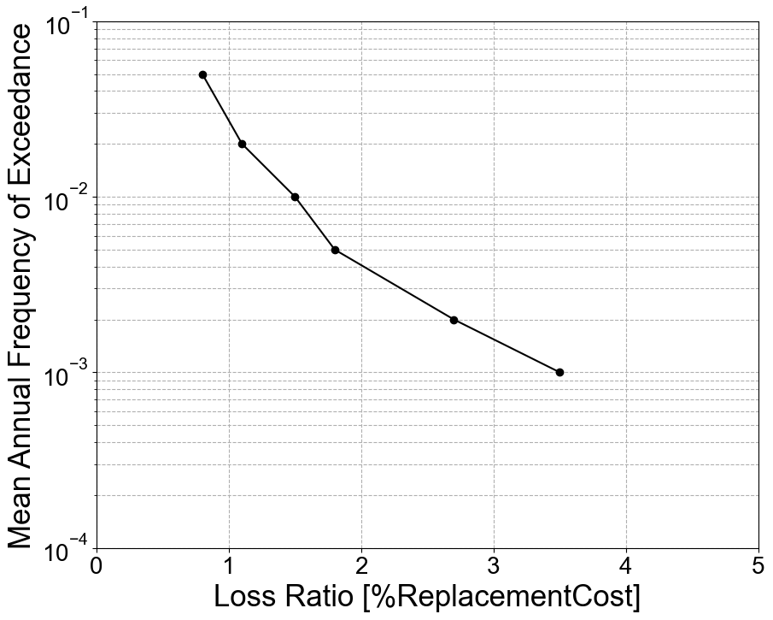

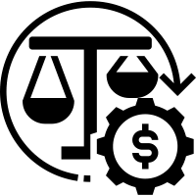
Selection of adaptation measures using CBA
Calculate risk considering the as-built assumption
List possible adaptation measures
Reassess the risk considering the implementation of the adaptation measure to understand the risk reduction associated to each adaptation measure
Adaptation measure #1
Adaptation measure #2
Adaptation measure #3
Expected Annual Loss
Perform a cost-benefit analysis to understand the most effective solution

Slide 23
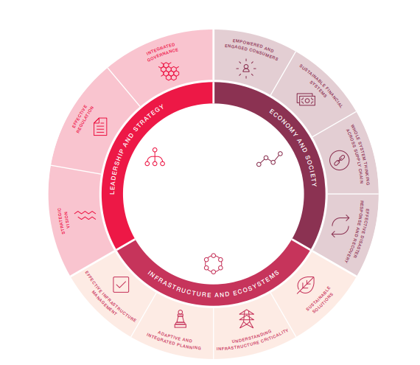
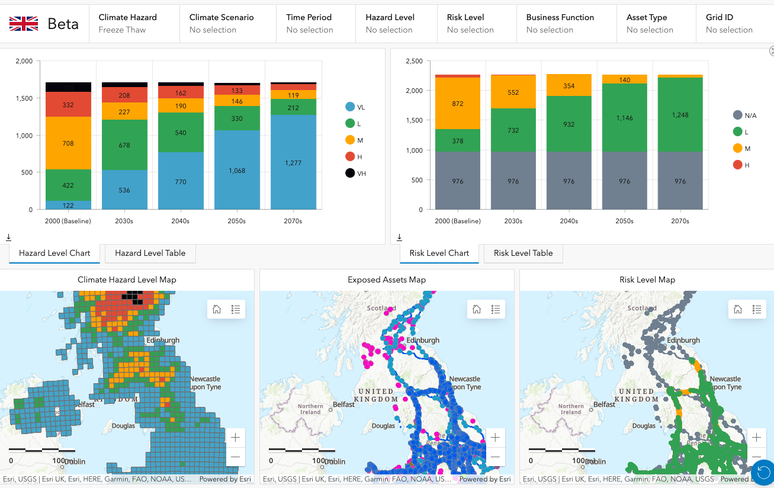
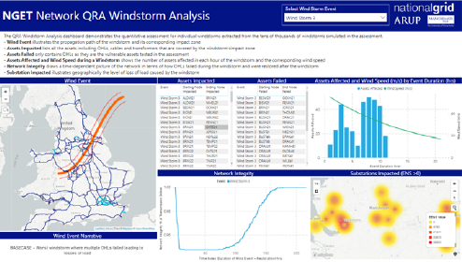
A tiered approach to assessment
Energy systems need several levels of detail for resilience planning and implementation
Holistic understanding
Creating the right tools for the job
Prioritisation and proportionality of investment
These are all prior to adaptation
Tier 1
Screening models or indices. Widest engagement, holistic view for opportunities and roadmap.
Tier 2
Semi-quantitative risk assessment. Decision support and investment prioritisation.
Tier 3
Quantitative system modelling. Actionable insights for specific shocks/stresses.

Slide 24

5. The outcomes we want to see

Slide 25
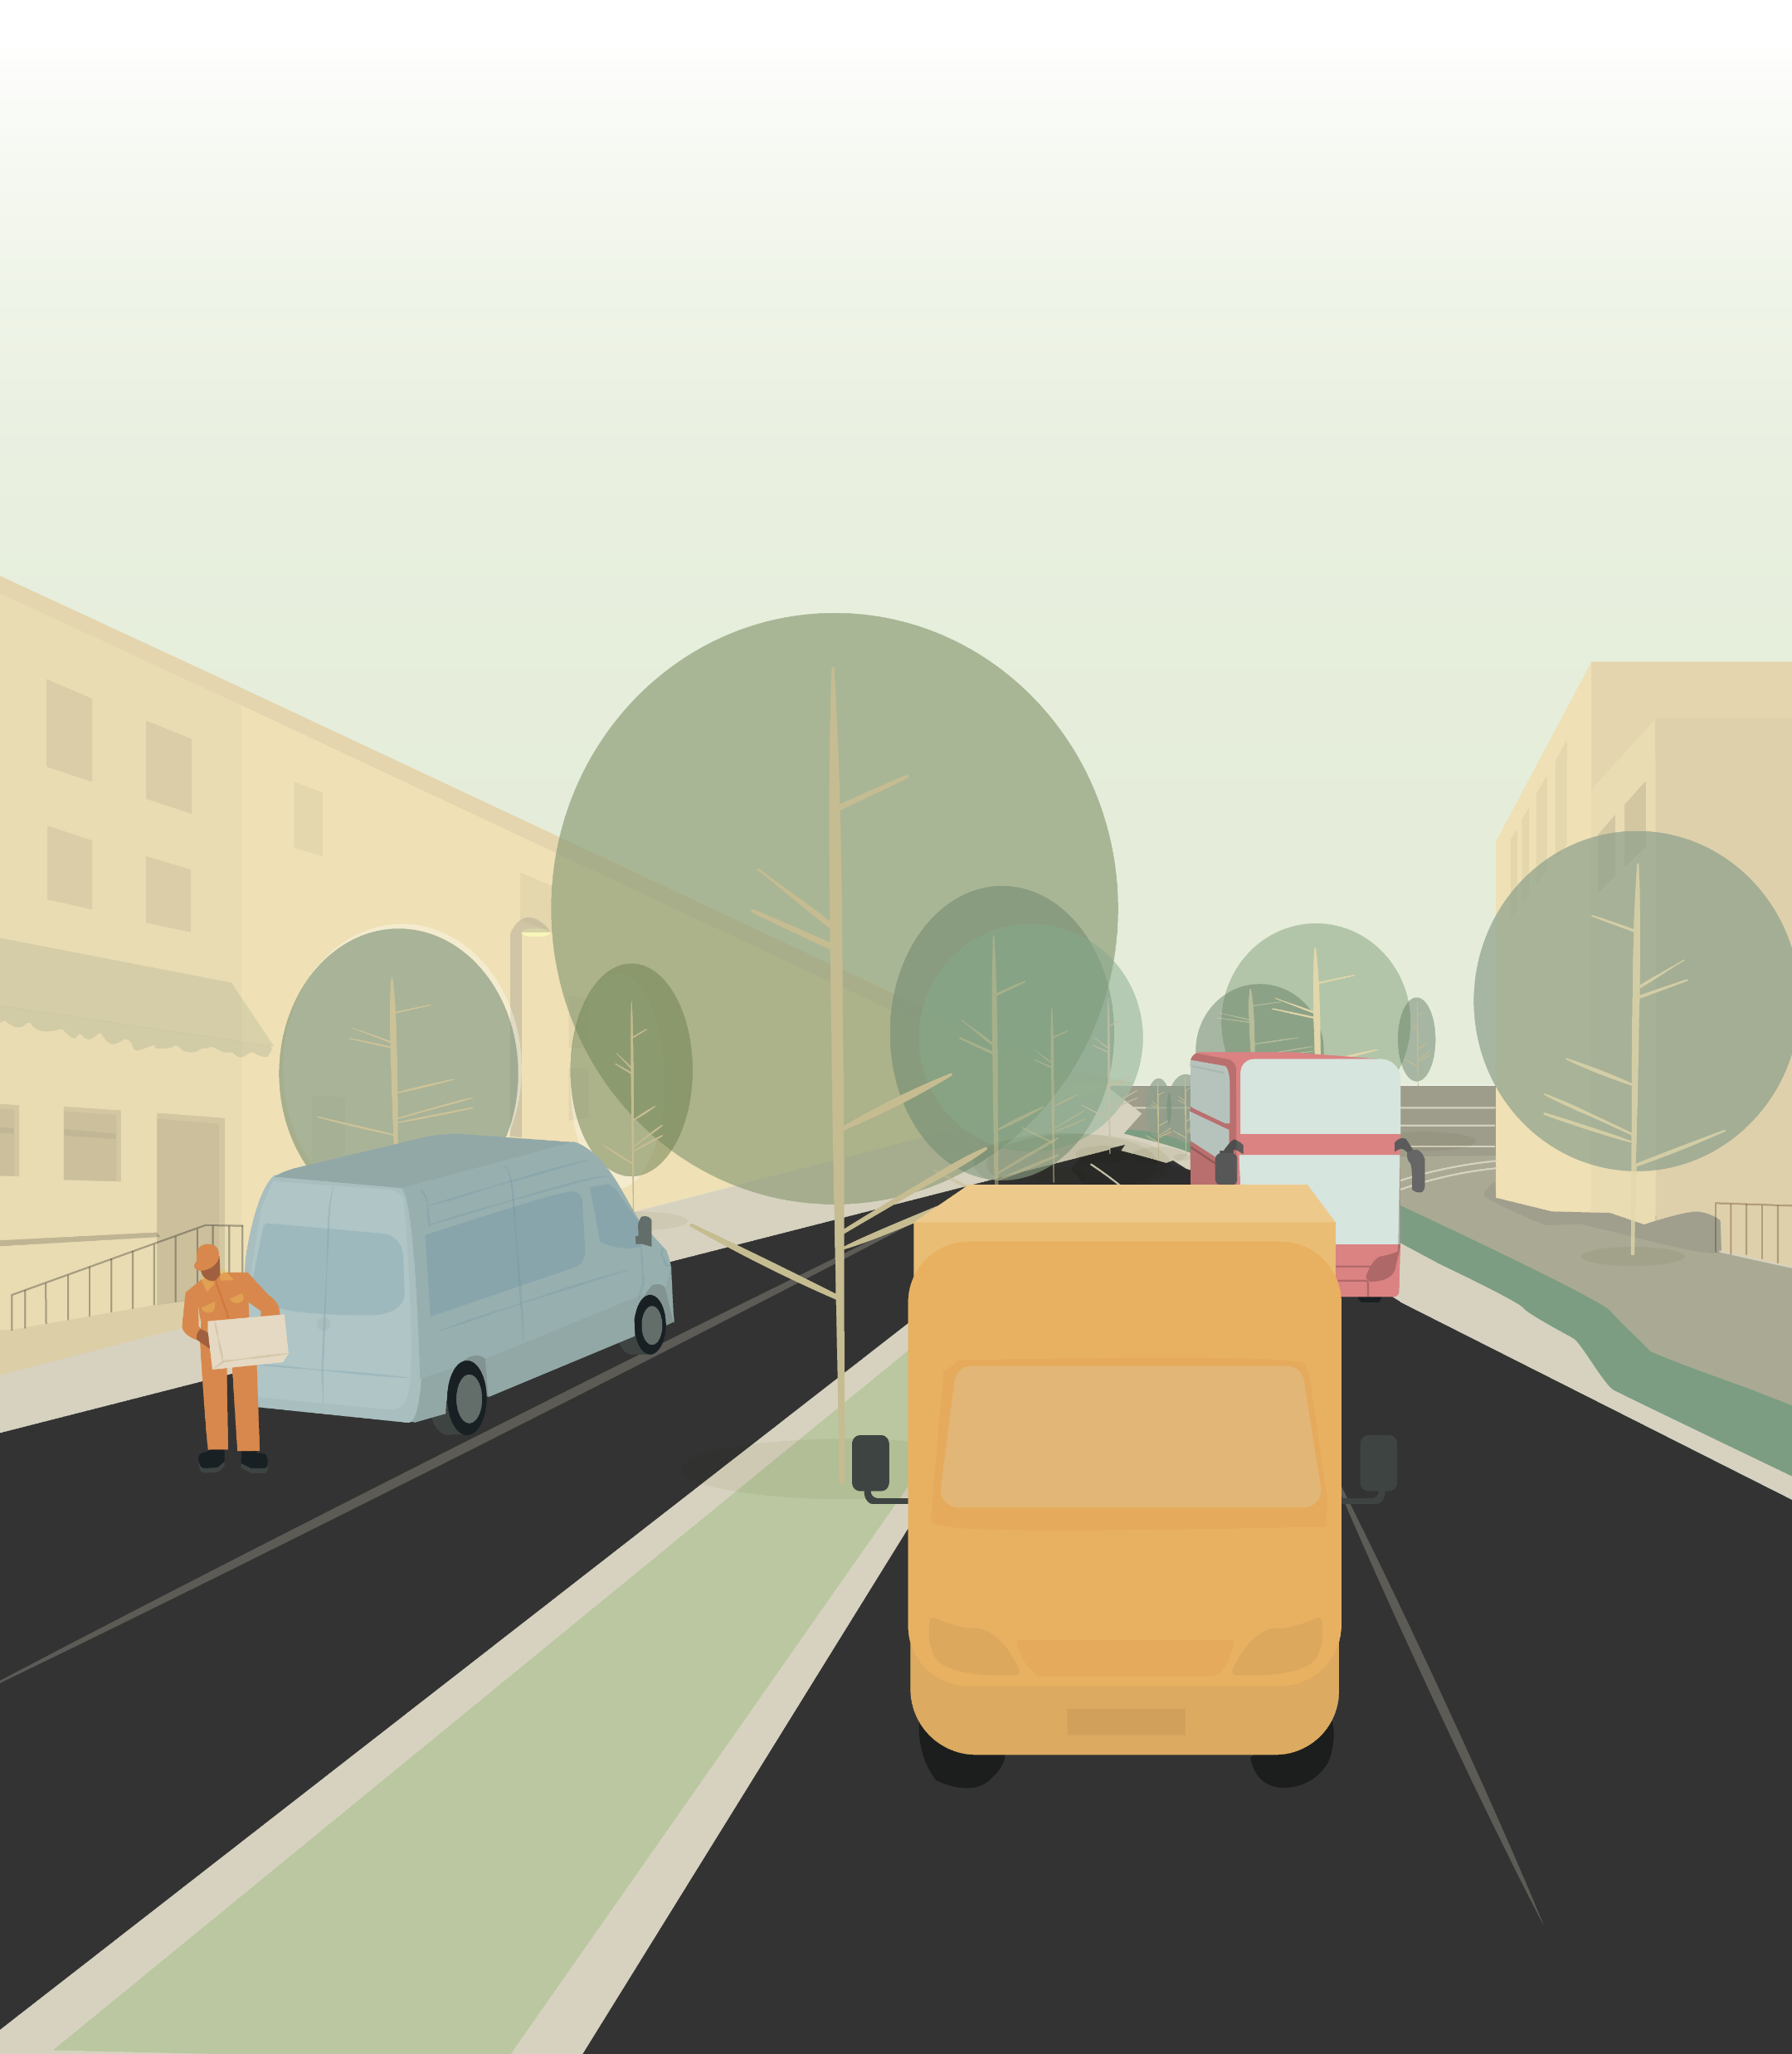
Safe and connected communities
Imagine infrastructure networks that keep communities safe and connected, even as demand increases, infrastructure ages, storms become more extreme
and temperatures rise. This is what resilience looks
like when we adapt together. ​​
Our infrastructure systems are the backbone of our communities, local businesses, and essential services.
Notes:
Stories

