Slide 1

“Do it once and share it many times”
Data sharing working group, DAFNI Conference, 11 Sep 2025
Sarah Hayes, chair data sharing working group, independent consultant
sarah@digitaltwinnercouk.onmicrosoft.com

Slide 2


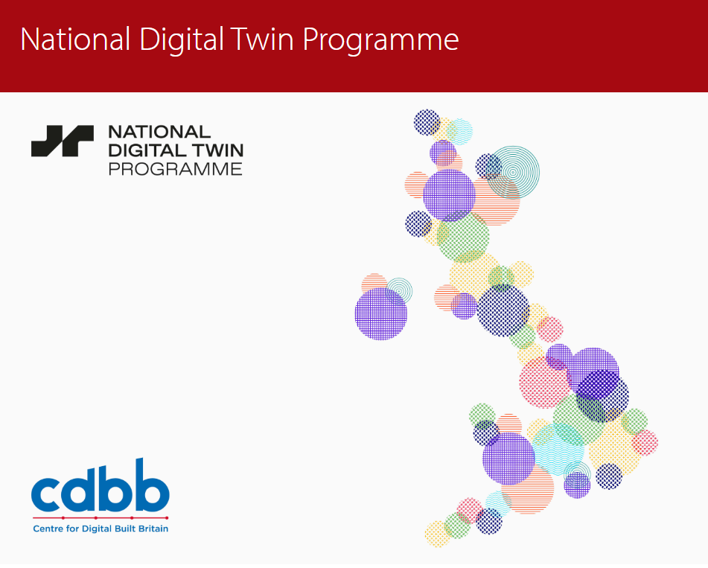

My journey 2017-2022

Slide 3

Climate resilience demonstrator 2021-23

Slide 4




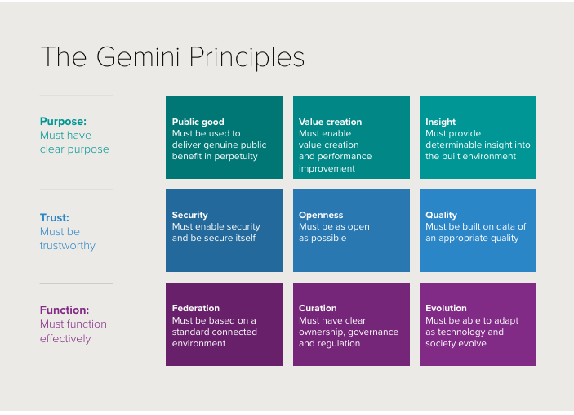



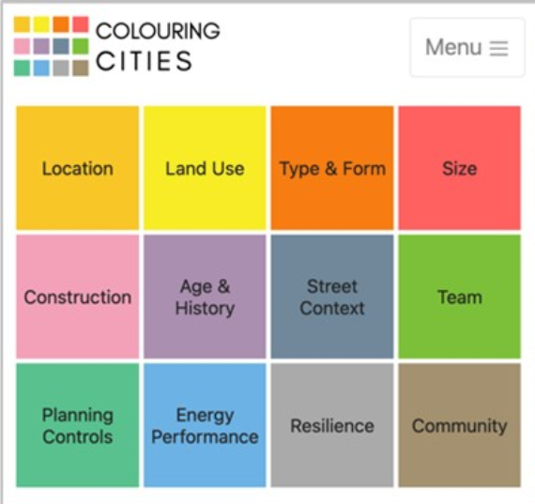

Multiple data sharing initiatives in 2023

Slide 5



Growing coordination problem
Disconnected data sharing initiatives
Connected use cases
Interoperability is harder to achieve

Slide 6

Data sharing working group
Set up in 2022 as a voluntary group
The purpose of DSWG is to bring people together to discuss and develop data sharing best practice in a collaborative way that builds upon existing work and avoids duplication
Recognise challenges to sharing data
Our motto is “Do it once and share it many times”
Cross sector: across government, industry and academia
Open and collaborative with other groups eg Digital Twin Hub Working Groups
Sharing best practice and how to describe things

Slide 7
What is data sharing infrastructure?

Slide 8
Components of
Data Sharing
Infrastructure
Use &
value
Business
case
Security
& trust
Governance
Data inter-
operability
Legal
Source: Digital Twin Hub
Data Sharing Working Group
CC-BY-SA 4.0

Slide 9
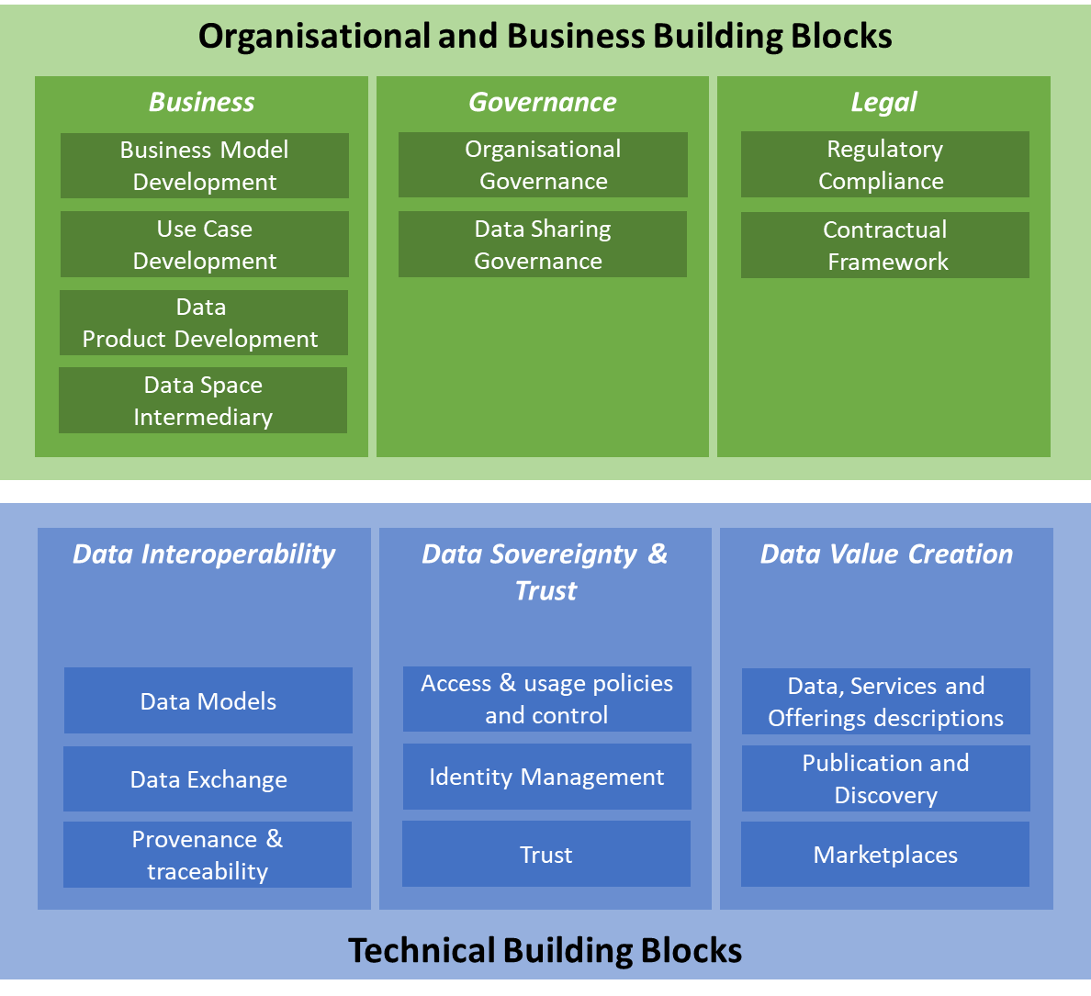
EU Data Spaces Programme
Dutch report: “Sustainable Revenue Models for Data Sharing Initiatives” April 2025, JADS and Tilberg University

Slide 10
Many different Data sharing initiatives
“This suggests other countries have more data space activity than they realize. The challenge isn’t starting from zero. It’s identifying and connecting existing efforts.” IDSA
A
B
C
D
E
Source: Digital Twin Hub
Data Sharing Working Group
CC-BY-SA 4.0

Slide 11
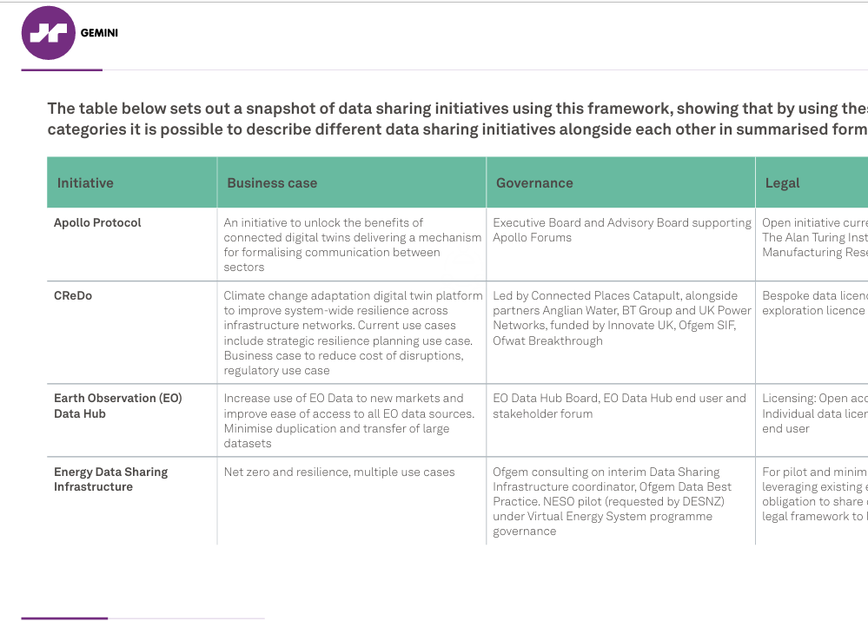
Multiple data sharing initiatives
Understand differences and similarities
Build on existing work
Key is to understand which part of DSI you are building and communicate that well
Dutch lessons learnt

Slide 12
Data sharing infrastructure
Use &
value
Business
case
Use &
value
Business
case
Use &
value
Business
case
Use &
value
Business
case
Use &
value
Business
case
Security
& trust
Security
& trust
Governance
Governance
Security
& trust
Security
& trust
Governance
Governance
Security
& trust
Governance
Data inter-
operability
Legal
Data inter-
operability
Legal
Data inter-
operability
Legal
Data inter-
operability
Legal
Data inter-
operability
Legal
Source: Digital Twin Hub
Data Sharing Working Group
CC-BY-SA 4.0

Slide 13

What are we doing in DSWG?
Recent sessions:
Energy data sharing infrastructure
DAFNI DINI
Stream
NUAR
Planned sessions:
Data valuation
Industrial strategy
Smart data
Data marketplaces

Slide 14

Industrial strategy commitments
“By 2035, we aim to establish the UK as a global leader in data-driven innovation and content creation, with a robust, secure, and interoperable data-sharing infrastructure that supports sustainable economic growth”
“Invest in UK Data Sharing Infrastructure Initiatives from April 2026. Learning from international practices, including the Common European Data Spaces, these will promote effective and more coordinated approaches to governance, legal considerations, regulations, data interoperability, security, and trust.”
Need for governance and a British culture of collaboration

Slide 15

actions
Join the DSWG
Share what you do in a reusable way!
Do it once and share it many times

Slide 16
Do it once and share it many times
Data Sharing Working Group

