Slide 1

Welcome

Slide 2

Sandpit Funding Opportunity
House keeping
Zoom
Please stay muted in the main room
We welcome video on – it’s nice to see faces!
We have a Q&A timeslot at 12.40, please either use:
  Use the raise hand function
  Use the Zoom chat
Recording
The webinar will be recorded
We will share the slides and recording on our website. https://www.dafni.ac.uk

Slide 3
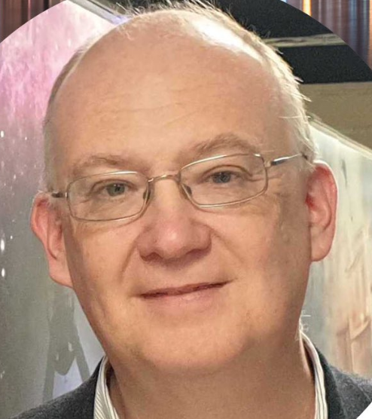
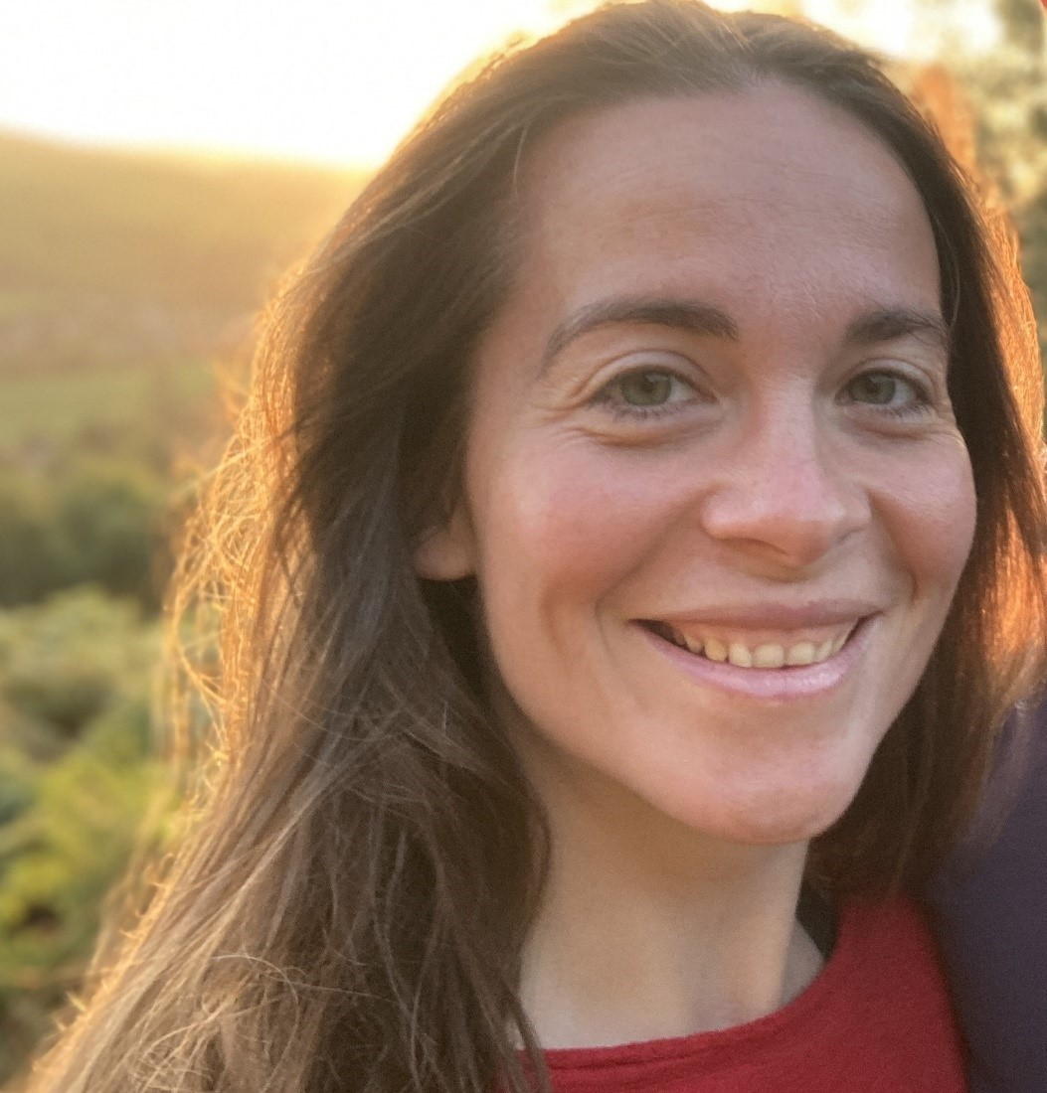
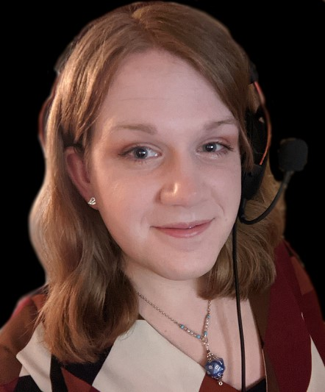
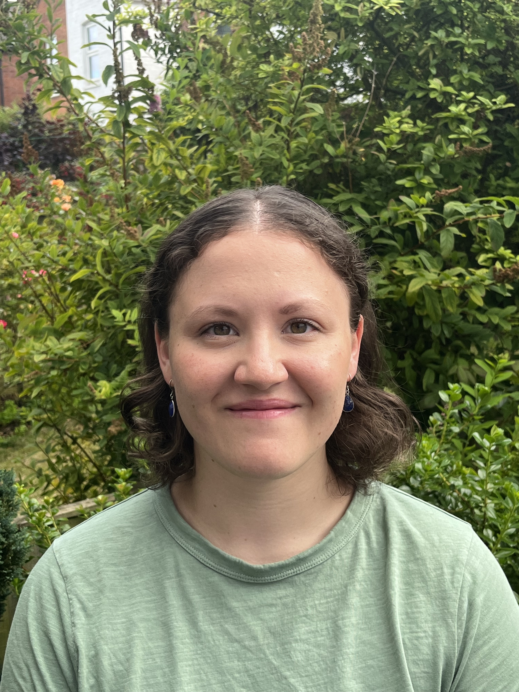
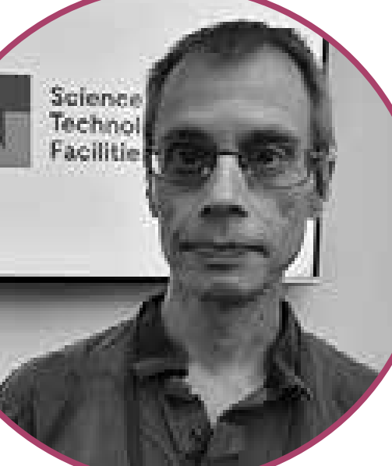
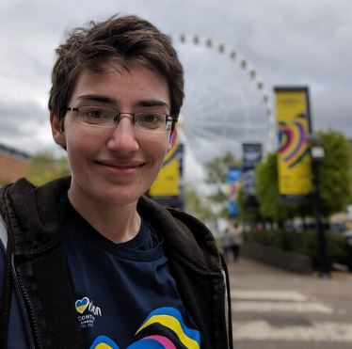
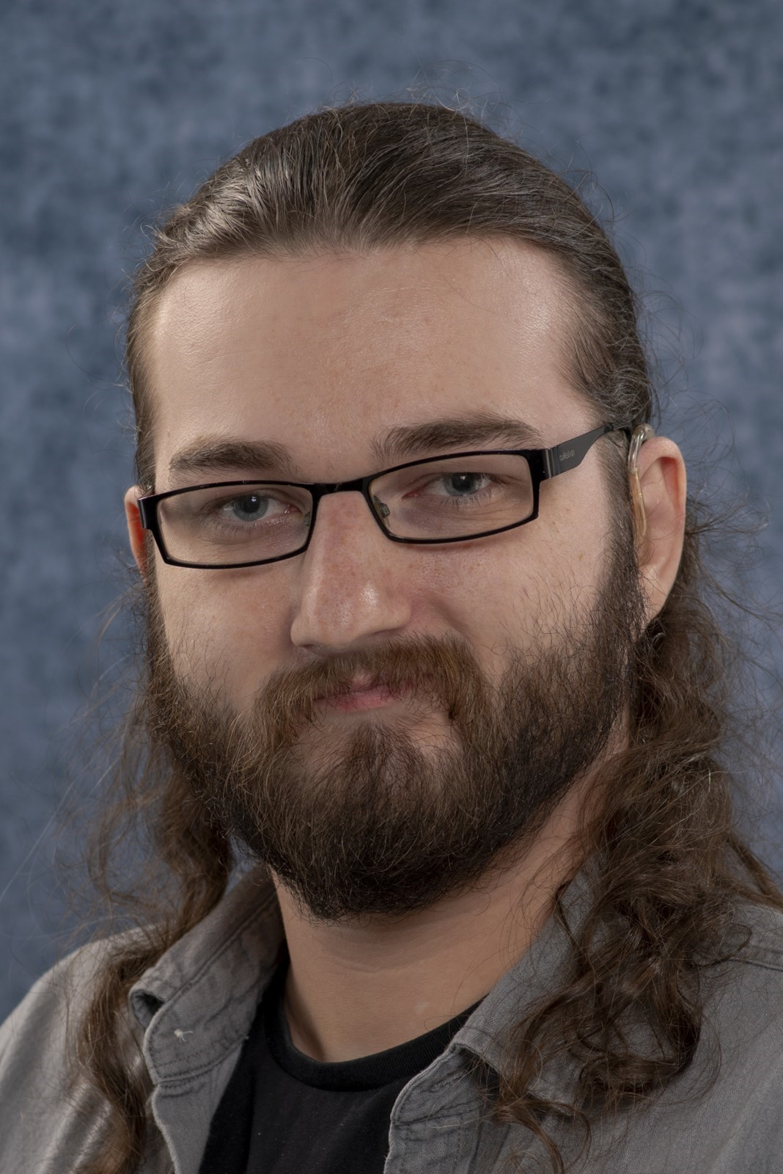
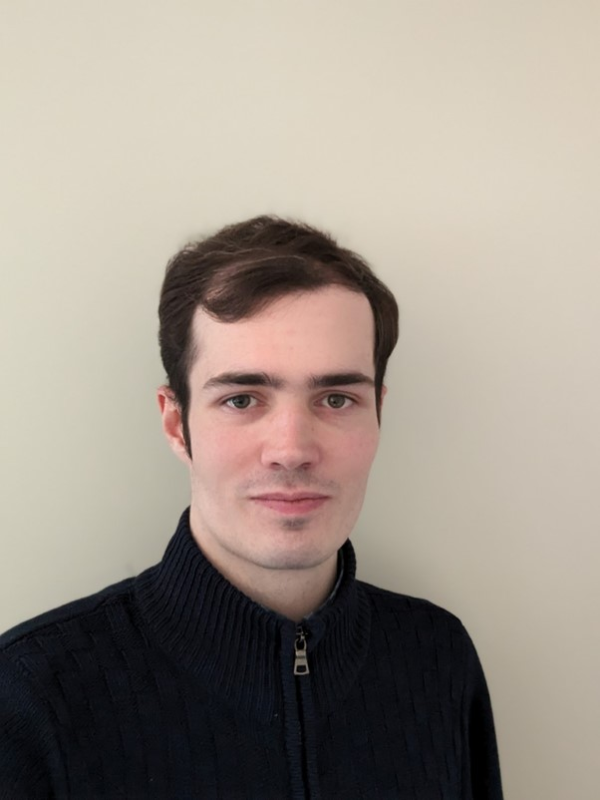
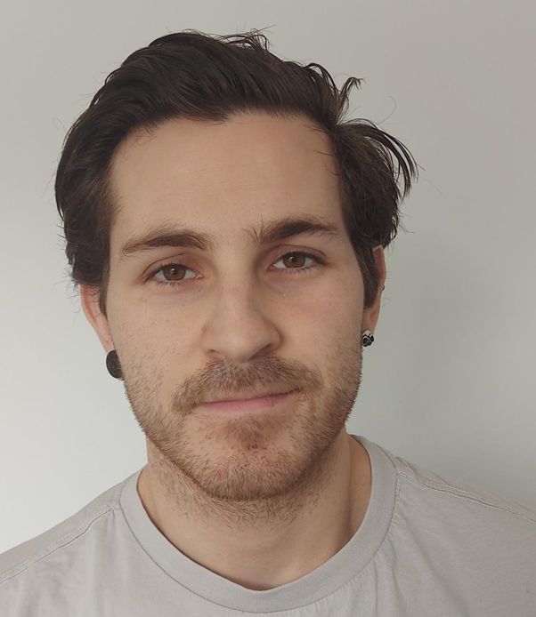
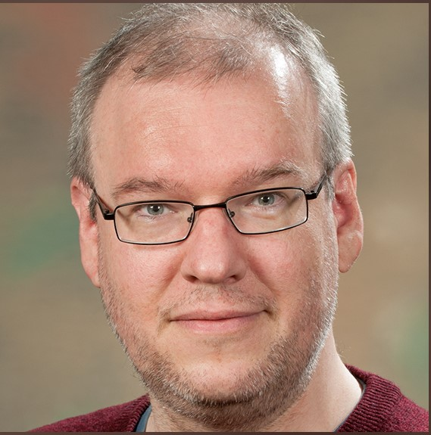
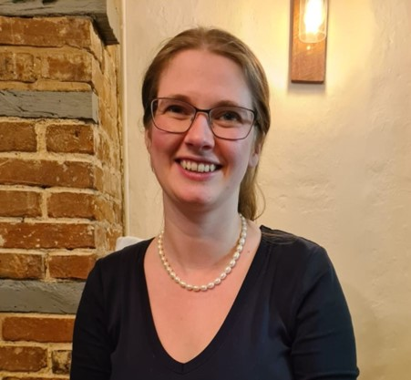
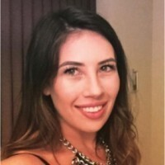
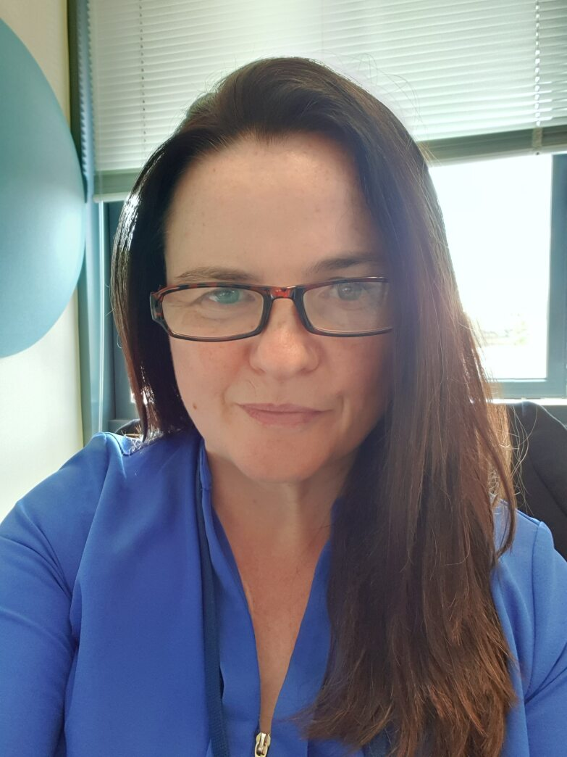
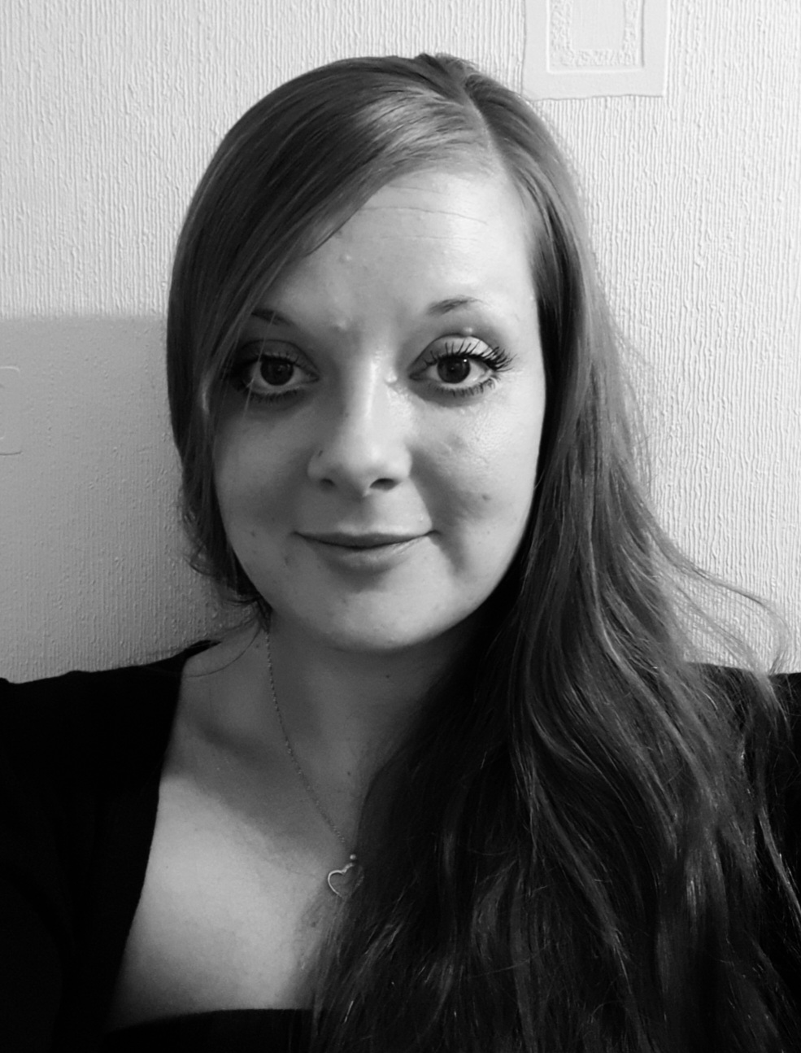
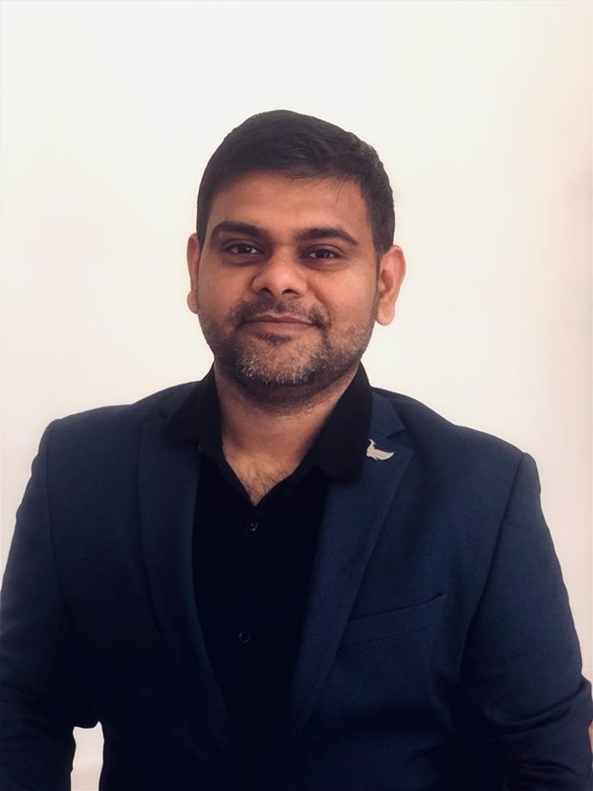

The DAFNI Team
Dr Brian Matthews
DAFNI Programme Lead
Dr Bethan Perkins
DAFNI Team Lead
Rose Dickinson
Senior Software Engineer / Technical Lead
Caroline Haigh
Research Software Engineer
Jack Haydock
Software Developer.
Joel Davies
Scientific Computing
Graduate
Sarah Byrne
Software Engineer
Dr Jens Jensen
Data Scientist
Lewis Sampson
Research Software Engineer
Kyle Stevenson
User Liaison
Esther Turner
Senior Research
Software Engineer
Katie Cartmell
DAFNI
Partnership Manager
Marion Samler
Business
Development Manager
Lyndsey Harding
Administrator
Archit Mantry
Project Co-Ordinator
Catherine Dhanjal
Media Manager
Info@dafni.ac.uk

Slide 4
Sandpit Funding Opportunity
Agenda:
12.05 | Welcome and Introduction
12.10 | Background
12.20 | Overview of the funding Programmes
12.30 | Sandpit Overview
12.35 | Format and Timeline of the process
12.40 | Q&A

Slide 5
Sandpit Funding Opportunity
Background on the aims of the sandpit
Extension of the Centre of Excellence
Continuing the work under ‘Building a Secure and Resilient World’ theme for UKRI
New investigation on behalf of the Department of Science, Innovation and Technology (DSIT).
Looking to fund feasibility studies in Infrastructure resilience specifically looking at;
  Impact and mitigations to improve the resilience using computational modelling on the DAFNI platform
  Highlighting the challenges and solutions that arise in identifying and accessing the data
  In the areas of Transport and Energy

Slide 6


Slide 7

Building a Secure and Resilient world
UKRI Strategic Theme
This funding aims to strengthen social and economic resilience, and enhance national security across virtual and physical spaces, by improving awareness of risks and threats; preparedness, decision making and response; and allowing change to be understood as a force for good

Slide 8

Building a Secure & Resilient World
UKRI Strategic Programme – Transforming tomorrow together
Identified five strategic themes to enable working across disciplines and leveraging new and existing investment and activity. BSRW is one them out of five.
Themes' aims
  strengthen social and economic resilience
  enhance national security across virtual and physical space
  ensure the UK can absorb adversity, deal with change and respond to emerging threats and opportunities
Five sub themes
  Global order in a time of change
  Technologies for resilient security and defence
  Resilient and secure supply chains
  Behavioural and cultural resilience
  Strengthening resilience in natural and built environment
Image © STFC John Dawson
Notes:
PLEASE DELETE/REPLACE PHOTO CREDIT IF CHANGING THE IMAGE.
8

Slide 9
The DAFNI Centre of Excellence for Resilient Infrastructure Analysis:
Strengthening resilience in the natural and built environment in response to short-term and long-term threats via computational modelling
Short term shocks – e.g. flooding, heat events, emergency response
Long term shocks – e.g. effects and adaptations to climate change, demographic change

Slide 10
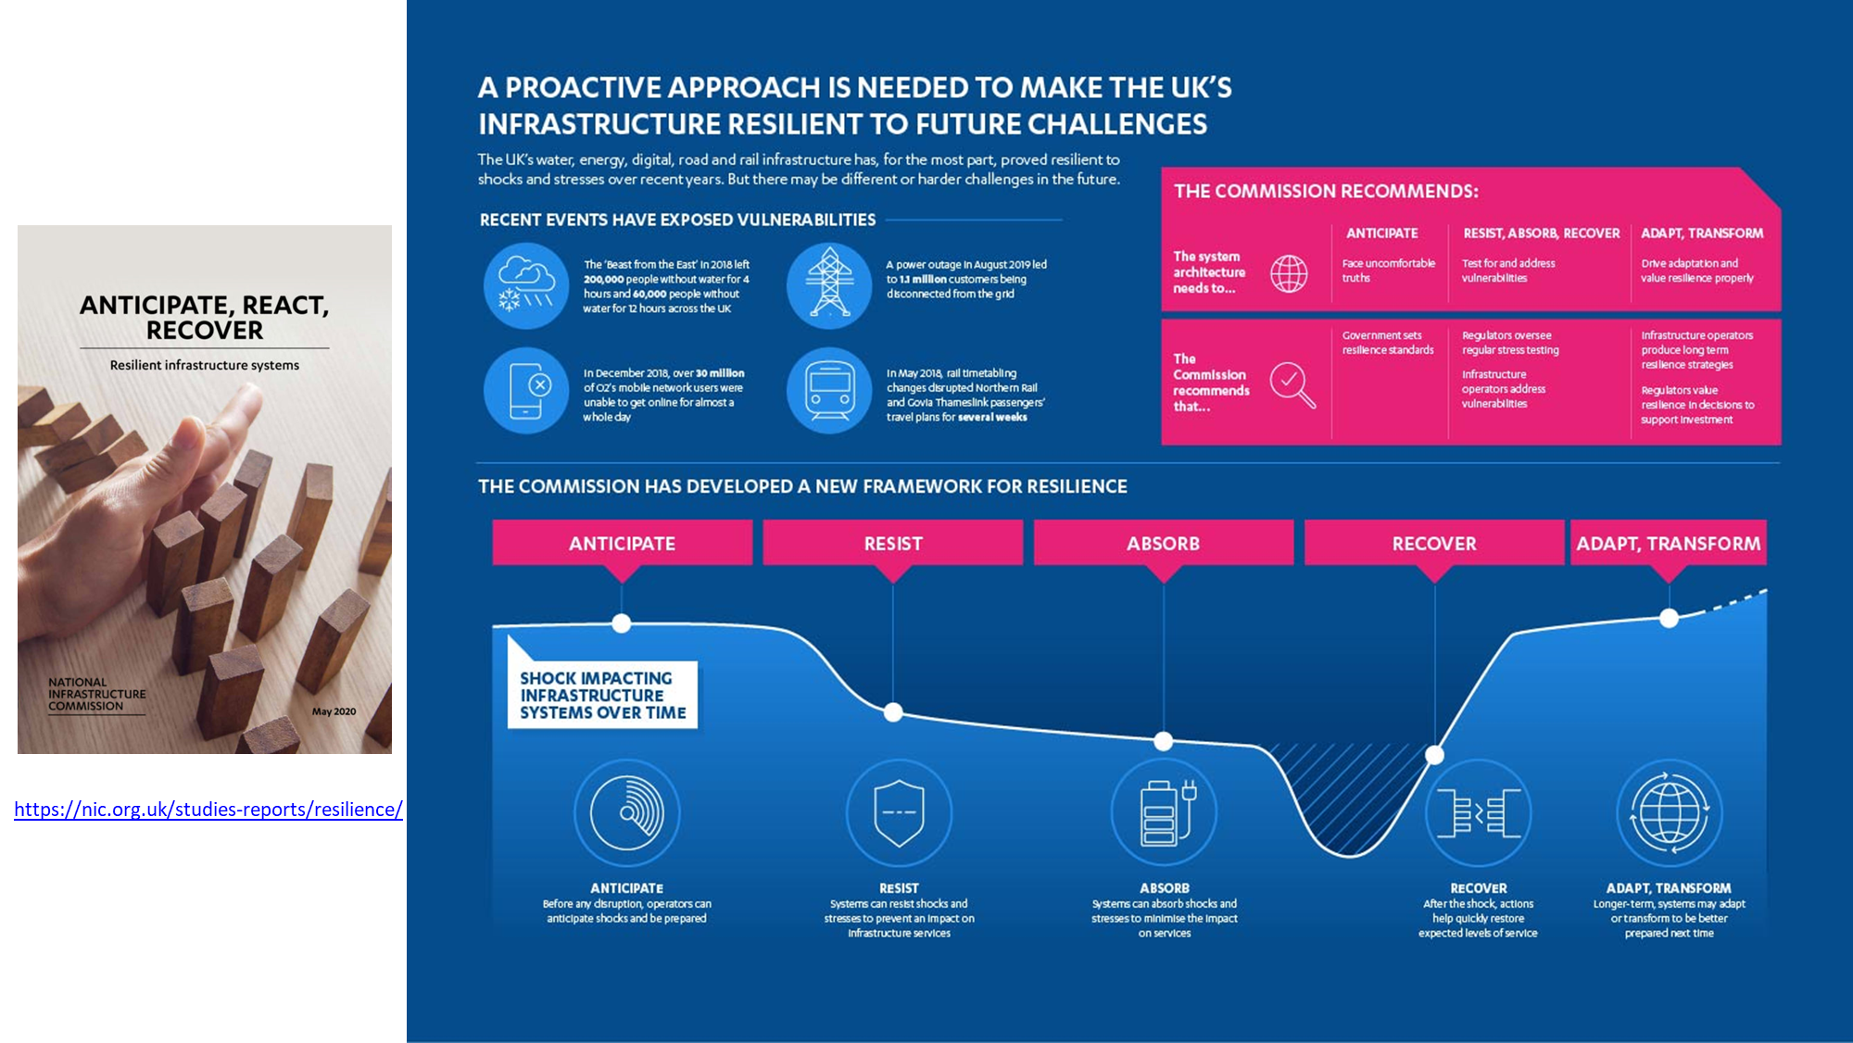

Slide 11
A Research Programme
Three funding streams:
1. Supporting Key Models
Providing key resources to explore resilience
2. Developing a Resilience Framework
Providing tools to describe and measure resilience
3. Exploring Resilience Scenarios
Providing research demonstrators of resilience in practise
A total fund of £1.4M was available overall for projects, for up to 18 months.

Slide 12
A Programme of Research
Developing a Resilience Framework
USARIS: Uncertainty quantification and sensitivity analysis for resilient infrastructure systems
  Dr Francesca Pianosi, University of Bristol
Supporting Key Models
Pywr-WREW​: A Water Resources model for England and Wales built in Python water resources simulation ​system​
  Dr Anna Murgatroyd, University of Oxford
FIRM: An agent-based model of flood infrastructure resilience – FIRM
  Prof. Richard Dawson, University of Newcastle
SCQUAIR: Small Changes and Computer-Generated Spatial Interaction Modelling with QUANT
  Dr Richard Milton, University College, London
Exploring Resilience Scenarios
STORMS: Strategies and Tools for Resilience of Buried Infrastructure to Meteorological Shocks
  Dr Xilin Xia​, University of Birmingham
RIWS: Resilience Scenarios for Integrated Water Systems
  Dr Ana Mijic, Imperial College London
SOFRAMODE​: Sewer overflow flood risk analysis model DAFNI enabled
  Dr Vassilis Glenis​, University of Newcastle
NIRD: systemic resilience of interdependent infrastructure networks at the national scale
  Dr Raghav Pant University of Oxford

Slide 13

Research Data Cloud Pilot
Department of Science, Innovation and Technology are undertaking a pilot initiative to understand the need for a UK Research Data Cloud
DAFNI is beginning an activity: DAFNI-Data Infrastructure for National Infrastructure (DINI), focused on exploring the barriers and opportunities for data sharing in national infrastructure
Pilot objectives:
  Situation analysis on data availability and integration
  Data publication and sharing guidelines
  Pilot enabling data access services
  Demonstrate benefits in scenarios
Image © STFC John Dawson
Notes:
PLEASE DELETE/REPLACE PHOTO CREDIT IF CHANGING THE IMAGE.
13

Slide 14
Sandpit project funding opportunity
Some funds outstanding from the BSRW programme
  Plus some additional funds available from the DSIT Research Data Cloud programme
Gaps in coverage of the research programme
  Water infrastructure well covered
  Flooding well covered
  Other infrastructure domains and threats less well so
So set up some additional smaller projects
  Focus on resilience of transport and energy infrastructure to a range of shocks.
  Focus on resilience scenarios
  Add an emphasis on barriers and opportunities of data sharing and integration
A lightweight assessment process for these smaller projects
  Use a Sandpit proposal development and evaluation process.

Slide 16
Sandpit Funding Opportunity
Sandpit Overview
Outline of the funding
Requirements for Transport and Energy Sandpits
What to expect at the Sandpit
Overview of all Sandpit activities
Timeline/Dates
Application and Assessment Processes
External Panel Members
Projects should..

Slide 17

Sandpit Funding Opportunity
DAFNI Programme Sandpits
This funding is to address grand-challenge problems for infrastructure resilience and challenges to data sharing, with a focus on Transport and Energy sectors.
A total fund of £240,000 is available across the two sandpit events, funded at 80% full economic cost (FEC), between 6-to-12-month projects.
In line with Research Data Cloud Pilot, and the Centre of Excellence objectives and DAFNI collaborative platform, we are interested in promoting access and integration of diverse data sources and overcoming the barriers associated with using data (such as data sharing agreements and making data FAIR).
Seeking to support feasibility studies, extending the CoE research, Infrastructure resilience, looking specifically at the impact and mitigations to improve the resilience using computational modelling on the DAFNI platform, whilst highlighting the challenges and solutions that arise in identifying and accessing the data to solve the infrastructure resilience questions in the areas of Transport and Energy.

Slide 18
Requirements
Requirements for Transport
Modelling of transport systems to identify pinch points which cause transport systems failures and explore mitigation strategies.
Digital twin of a transport system or operational systems to consider impact of failures and potential approaches to mitigation.
Simulating the impact of natural and human derived shocks onto transport systems and explore adaptation and mitigation strategies
Projects should include a deliverable highlighting their use of data in the scenario, particularly discussing:
    the availability, use and integration of diverse data sources
    the organisational and technical barriers to accessing and using those data sources

Slide 19
Requirements
Requirements for Energy
Modelling future energy security in response to global shocks in energy supply and analysing the transition risks as the economy adapts to the net zero carbon target.
Digital twin of an energy system to consider impact of failures resulting from unexpected events and potential approaches to mitigation.
Renewable Energy Sources: Diversifying to zero carbon energy sources – modelling of Energy demand and impact of climate on net zero energy sources
Projects should include a deliverable highlighting their use of data in the scenario, particularly discussing:
    the availability, use and integration of diverse data sources
    the organisational and technical barriers to accessing and using those data sources

Slide 20
At the Sandpit
Overview of the funding opportunity
Lightning Talks from each applicant
Partnership formation
- Ideally form teams working on ideas developed within breakout sessions
- Idea: Developed from initial Expression of interest forms submitted by attendees. Several ideas may be combined to make up a final proposal
- Team: One proposal with a lead PI.
DAFNI Programme will facilitate in the breakout rooms
Funding is limited, we encourage everyone to be receptive to merging and tweaking ideas.

Slide 21

How it works
Stage 1 | Applicants will complete the expression of interest survey. The DAFNI Programme panel will review applications against the initial criteria. Successful applicants will be invited to the ‘Session 1 Sandpit Event’.
Stage 2 | Individuals/teams will present their pitch in a ‘lightning talk’ format. After lightning talks are complete, a discussion will be held to confirm if any ideas can be combined, and teams agreed.
Stage 3 | The PI from each team will be required to confirm their team to the DAFNI Programme team
Stage 4 | Teams will prepare their presentation pitch and outline proposal for the Expert Panel
Stage 5 | Projects will pitch to the Expert Panel
Stage 6 | Expert Panel award funding
Stage 7 | DAFNI Programme will contact all applicants on the outcome.

Slide 22

Sandpit Timeline
Transport
Applications Close | 19th January 2024
Successful Applicants sent invite | 29th January 2024
Sandpit Session 1 - Lightning Talks | 5th February 2024
PI to email DAFNI Programme to confirm their team | 6th February 2024
Teams to contact DAFNI tech team within the week | 6th February 2024—9th February 2024
Sandpit Session 2— Presentations | 12th February 2024
Funding Decision | 15th February 2024
Energy
Applications Close | 19th January 2024
Successful Applicants sent invite | 29th January 2024
Sandpit Session 1—Lightning Talks | 27th February 2024
PI to email DAFNI Programme to confirm their team | 28th February 2024
Teams to contact DAFNI tech team within the week | 28th February 2024—4th March 2024
Sandpit Session 2— Presentations | 5th March 2024
Funding Decision | 11th March 2024

Slide 23
Application and Assessment Process
DAFNI Programme Criteria – Reviewing Expression of Interests
Availability to attend the Sandpits
Background and expertise
Brief description of your proposal (context, challenge the project addresses, aims and objectives and potential applications & benefits
External Panel Criteria
Scientific technical excellence
Originality and potential contribution to knowledge, with a focus of the aims of the Building a Secure and Resilience World programme and DSIT Research Data Cloud Programme
Research design and methods, including feasibility of work-plan and suitability and sustainability of research within the DAFNI platform
Value for money

Slide 24
Panel
External Panel Members
Transport
George Economides | Head of Digital Twins, Department of Transport
Melina Kakouratou | External Risks Engineer, Transport for London
William Powrie | Professor of Geotechnical Engineering, University of Southampton
Energy
Robin Preece | Senior Lecturer in Future Power Systems, The University of Manchester
Catherine Jones | Energy Data Centre Lead, UKERC Energy Data Centre
Beth Warnock | Senior Power Systems Engineer, Energy Systems Catapult

Slide 25
Sandpit Funding Opportunity
Projects should...
If you have any technical queries about your project and how it would work on DAFNI, please contact info@dafni.ac.uk
Projects from the Transport sandpit will be expected to start on the 1st of April 2024 and finish before the 31st of March 2025.
Projects from the Energy sandpit will be expected to start 1st of May 2024 and finish before the 31st of March 2025
Successful sandpit projects will be invited to speak at our DAFNI Annual Conference (10th of September 2024)
We have upcoming technical training, please see dates here
If you have any queries, please contact katie.cartmell@stfc.ac.uk, DAFNI Partnership Manager

Slide 26


Sandpit Funding Opportunity
Q&A session

